Slide 1
Routing in Fat Trees Engineering Simplicity in IP Fabric
Melchior Aelmans melchior@juniper.net

Slide 2
IP Fabrics: The Big Picture
Standardized Form-Factor of Network Capacity
Next-Gen Evolution Drivers
Next Gen Underlay Routing Protocol Requirements
RIFT Basic Concept
RIFT Advantages
Standards Status
Product Status

Slide 3
The BIG Picture
Next Gen IP Fabric Evolution Drivers

Slide 4
IP Fabrics: The Big Picture
The Global Data Center Market Size is Expected to Reach Revenues of around $174 Billion by 2023
growing at a CAGR of about 4% 2018–2023
Topologies & Technologies are Unifying Towards a “IP Fabric Substrate” in Proximity to Producers and Consumers of Content
Fortune 1000 Generate and Host Content and are Building Own IP Fabrics to Consume Larger and Larger Amounts of “Local” Networking Capacity
Building IP Fabrics Today is Largely High OPEX Artisanal Activity
Most Fortune 1000 Need a ”Standardized Form Factor” for Bandwidth Just Like Storage
We Lack a Standardized ZTP Underlay Technology to Make IP Forwarding in Fabrics as Simple as Ethernet Switching

Slide 5
WHAT and WHY ?
Hyper-scalers are Extrapolating the Things to Come
Vast Amount of Bandwidth Close to Producer & Consumer Are Provisioned
IP Fabrics in DC (Server Farms)
Metro (Caches and Access)
Disaggregated Chassis Architectures in Backbone with Regular Fabrics Holding Leaves Together
Those Topologies are Uniform, Local and Regular
At the End, Economics of Interconnecting of Crossbars Done in 1950 in Bell Labs are Still Valid
WAN-Style Traffic Engineering & Protection is Being Replaced by Wide Fan-Out & Distributed Systems Redundancy (Rather Than Chassis & FRR)
Simpler is Cheaper in Opex _and_ Capex
Hyper-Scalers are Building Customized High-Opex Solutions to Manage those Fabrics
IP Fabric is Becoming the New “RAM Chip” to Consume Bandwidth
No’one Configures SSD Wear-Leveling, RAM Banks and CAS/RAS Manually in Every Laptop
IP Fabrics HW is Largely Commodity Already
L3 Forwarding is the New L2
IP Fabrics Must and Will “OPEX Commoditize”
Customers are Hosting Their Content & Critical Business Processes
Hybrid Cloud for Many Reasons, One of Them to Keep Real-Estate from Hyper-scalers
Need to Build Own Fabrics
Hard to Sustain Proprietary OPEX Efforts
RIFT/TechClub '19

Slide 6
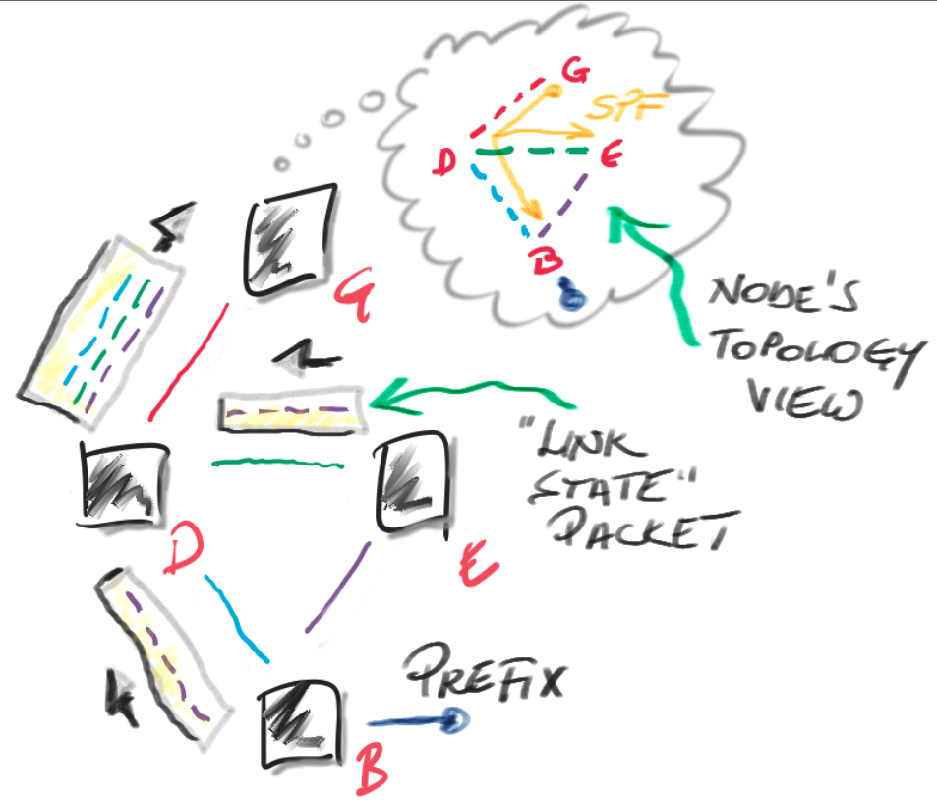
Link State and SPF = Distributed Computation
Topology Elements
Nodes
Links
Prefixes
Each Node Originates Packets with Its Elements
Packets are ”Flooded”
”Newest” Version Wins
Each Node “Sees” Whole Topology
Each Node “Computes” Reachability to Everywhere
Conversion is Very Fast
Every Link Failure Shakes Whole Network (modulo Areas)
Flooding Generates Excessive Load for Large Average Connectivity
Periodic Refreshes (not Strictly Necessary)

Slide 7
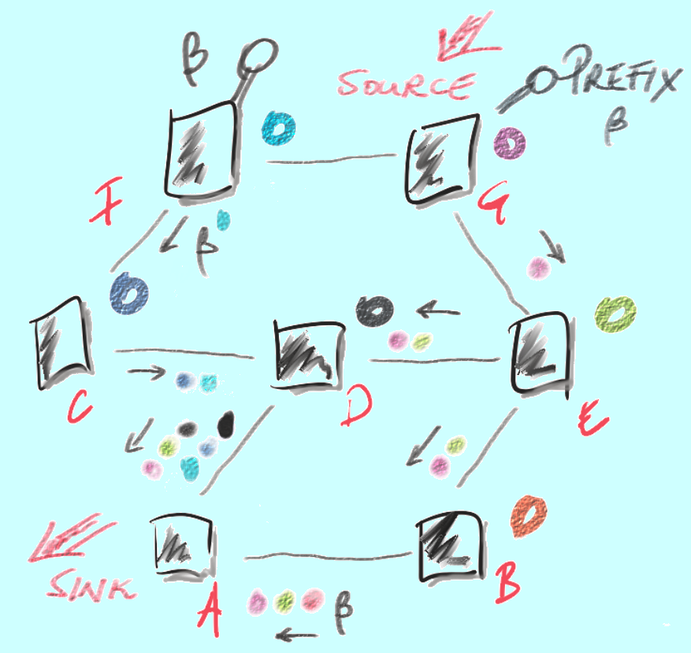
Distance/Path Vector = Diffused Computation
Prefixes “Gather” Metric When Passed Along Links
Each Sink Computes “Best” Result And Passes It on ( Add-Path Changed That )
A Sink Keeps All Copies, Otherwise It Would Have to Trigger “Re-Diffusion”
Loop Prevention is Easy on Strictly Uniformly Increasing Metric
Ideal for “Policy” Rather Than “Reachability”
Scales When Properly Implemented to Much Higher # of Routes Than Link-State

Slide 8
Current State of Affairs
Several of Large DC Fabrics Use E-BGP with Band-Aids as De-Facto IGP (RFC7938)
Numbering Schemes to Control “Path Hunting”
”Looping Paths” (allow-Own-as Under AS Private Numbering)
“Relaxed Multi-Path ECMP” Since ECMP over Different AS in EBGP Does Not Work Normally
Add Paths to Support Multi-Homing, N-ECMP, Prevent Oscillations
Efforts to Get Around 65K ASes and Limited Private AS Space
Proprietary Provisioning and Configuration Solutions, LLDP Extensions
“Violations” of FSM Like Restart Timers and Minimum-Route-Advertisement Timers
Emerging Work for “Peer Auto-Discovery” and “SPF” Diametrically Opposite to BGP Design Principles
Reliance on “Update Groups” ~ Peer Groups to Prevent Withdrawal and Path Hunting After Server Link Failures
Others Run IGP (ISIS)
Generally a “Better” Approach to Faster Convergence
Current Attempts to Deal with Some “Spot Problems” like Flooding Reduction
Yet Others Run BGP over IGP (Traditional Routing Architecture)
Less Than More Successful Attempts @ Prefix Summarization, Micro- and Black-Holing, Blast Radius Containment
Server Multi-Homing not Possible Using IP Due to Equal Cost and Scaling Constraints, Hence MC-LAG’ed Solutions or EVPN
In Summary: High OPEX Solutions Not Necessarily Viable for Customers Who Cannot or Do Not Want to Build Sophisticated Talent Pool to Deal with Their “Unicorn” Fabrics
RIFT/TechClub '19

Slide 9
Next Gen IP Fabric Underlay Routing Protocol Requirements

Slide 10
Next Gen Underlay Protocol Requirements
Problem / Attempted Solution | BGP modified for DC (all kind of “mods”) | ISIS modified for DC (RFC7356 + “mods”) | RIFT Native DC
Peer Discovery/Automatic Forming of Trees/Preventing Cabling Violations | ⚠️ | ⚠️ | ✓
No Need for Internal Addressing, Minimal Amount of Routes/Information on ToRs, Stretches True Routing to the Multi-Homed Host | ✘ | ✘ | ✓
High Degree of ECMP (BGP needs lots knobs, memory, own-AS-path violations) and ideally NEC and LFA | ⚠️ | ✓ | ✓
Non Equal Cost Multi-Path, ECMP Independent Anycast, MC-LAG Replacement | ✘ | ✘ | ✓
Traffic Engineering by Next-Hops, Prefix Modifications | ✓ | ✘ | ✓
See All Links in Topology to Support PCE/SR | ⚠️ | ✓ | ✓
Carry Opaque Configuration Data (Key-Value) Efficiently | ✘ | ⚠️ | ✓
Take a Node out of Production Quickly and Without Disruption | ✘ | ✓ | ✓
Automatic Disaggregation on Failures to Prevent Black-Holing and Back-Hauling | ✘ | ✘ | ✓
Minimal Blast Radius on Failures (On Failure Smallest Possible Part of the Network “Shakes”) | ✘ | ✘ | ✓
Fastest Possible Convergence on Failures | ✘ | ✓ | ✓
State of the Art Security Including Originator Validation and Replay Prevention | ✘ | ✘ | ✓
Simplest Initial Implementation | ✓ | ✘ | ✓✘

Slide 11
RIFT Basic Concept

Slide 12
RIFT Concept

Slide 13
RIFT Advantages

Slide 14
Automatic De-Aggregation
South Representation with Adjacencies of Red Beta is Reflected by the Green Layer to Alpha
Alpha Red Spine Computes P1 Reachability (Tree that Indicates Next-Hops)
alpha Sees that Beta has no Adjacencies to any of the available Next-Hops to P1
Alpha Disaggregates P1
Left Green Nodes do NOT Propagate Disaggregation Further
When Beta Obtains a Viable Next-Hop to P1, Alpha Automatically Reaggregates

Slide 15
Northbound Bandwidth Balancing
Zeta Computes Bandwidth Sum to NextHop and Next Level Up
Through A Cumulative 60 Units
Through B Cumulative 70 Units
Default Route Uses That in Some Form to Unequal Load Balance
Perfectly Safe Since RIFT is Loop-Free

Slide 16
Operational Advantages
Open IETF Standard
Can Build Hybrid Vendor Fabrics
Protocol is Well Reviewed and Understood by World-Class Experts
True ZTP
No Configuration Necessary
V4 over V6 Forwarding
Mis-cabling Handled
Can Operate on Asymmetric Bandwidth Fabrics and Handle “Fat Link” Failures By Adjusting Automatically
Can Support and Scale to an Architecture with Multi-Home Servers
No Need for Service Migration on ToR Upgrades
Can Talk Directly to Hyper-Visors/Kubernetes GW
BFD is “Built In”
Can Be Used for Fast Rehash or Early Loss Detection
Runs on UDP
Trivial Kernel Support on All Platforms
Allows for Max. Speed Flooding
Easy to “Multi-Instantiate” for Different Purposes
Minimal Blast-Radius
Failures/Bring-Up on Fabric Only Affects the Smallest Viable Radius
RIFT Flooding is ~30% of Normal Flat IGP
Built-In Flood Reduction Reduces Flood Traffic to <20% of Flat IGP
Loop-Free
Can Utilize All Viable Paths Through Fabric
Can Support True Anycast
Model Based
Much Less Possibility for Parser and Formatter Bugs Plaguing Today’s Networking Protocols
Specification is Written for Maximum parallelization
With Enough Cores IP Switches Should Be Able to Converge @ Speeds Making FRR Unnecessary (Assuming Fast Rehash)
KV Store Allows to Replace Out-Of-Band Applications
IP/MAC Binding Can Be Flooded to Top-of-Fabric
Sophisticated, Newest Routing Security
Full Fabric Visibility at the Top

Slide 17
Standardization Progress

Slide 18
Standardization Progress
RIFT Standards Track IETF Working Group in Revision -12
Security Area Directorate Early Revision Done and Addressed
IESG Revisions Being Addressed
Co-Authors from Cisco, Yandex, Mellanox, HP & Implementing Individuals
https://tools.ietf.org/html/draft-ietf-rift-rift-12
Applicability Draft
Co-Authored with operators, e.g. Orange and Yandex
Under Gen-ART review
https://tools.ietf.org/html/draft-ietf-rift-applicability-03

Slide 19
Product Status

Slide 20
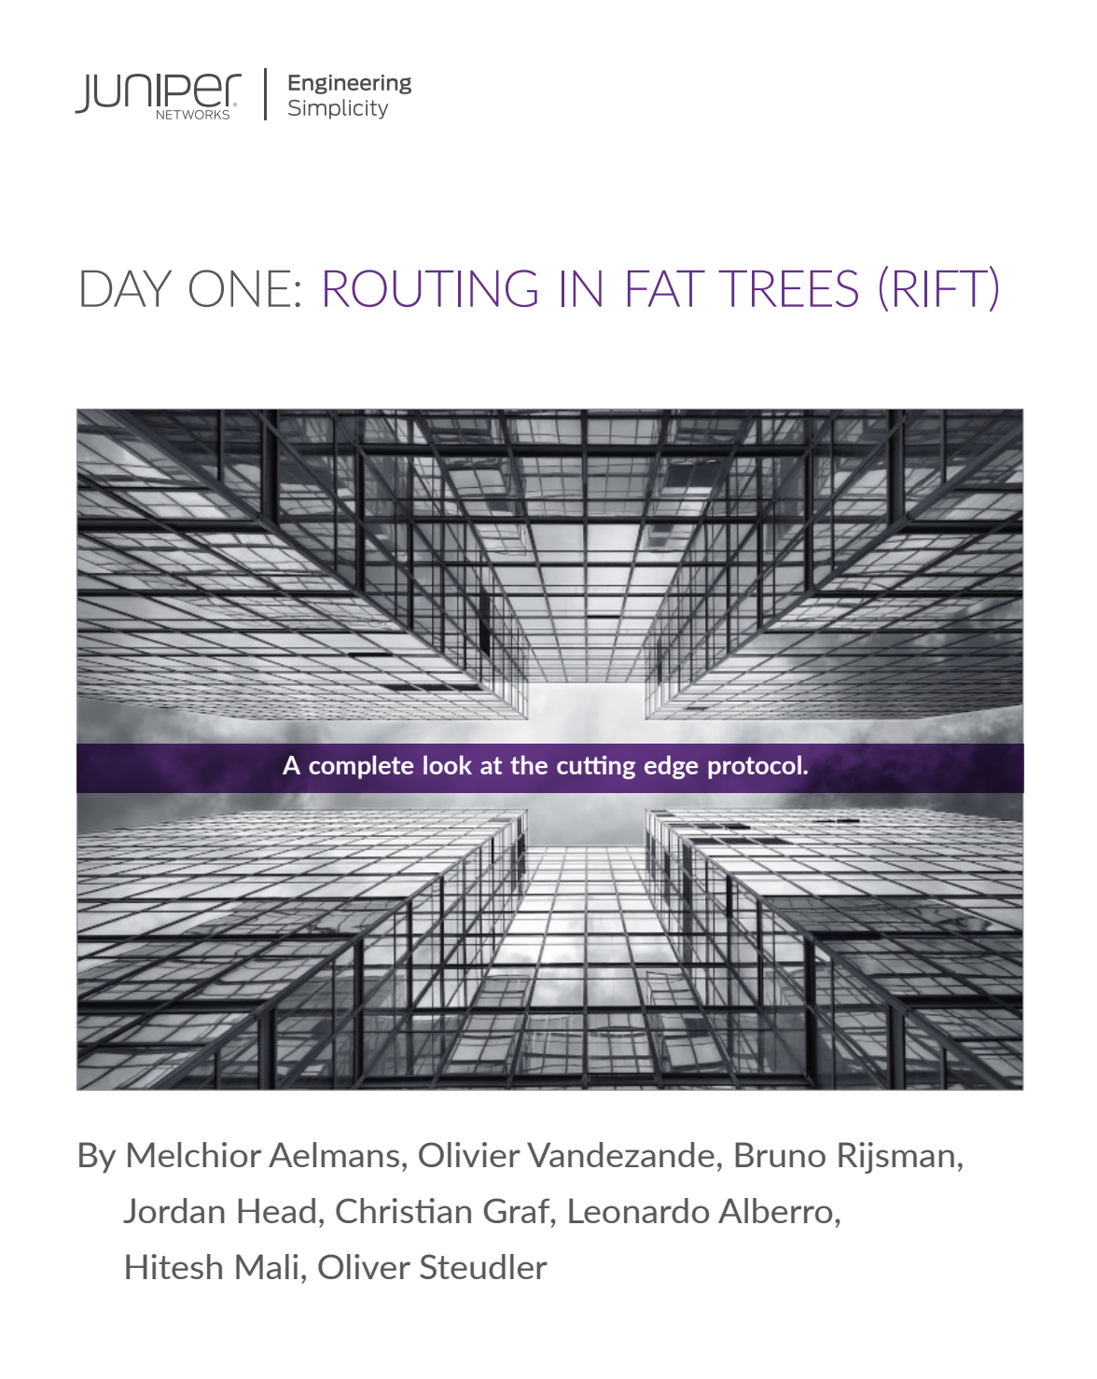
Productization
Implementations
Juniper Networks
FCS in 19.4R1 64-bit Junos
Package Installing over 19.4R1 or Newer
QFX (All Variants), vMX, MX
cRPD & EVO in progress
https://www.juniper.net/us/en/dm/free-rift-trial/
Python Open-source by Bruno Rijsman
https://github.com/brunorijsman/rift-python
Documentation
Day One Book: Routing in Fat Trees (RIFT)
covering Juniper and open-source implementation
RIFT Wireshark dissector
Download free: http://jnpr.nl/rift

Slide 21
RIFT: Engineering Simplicity in IP Fabric d Questions?
Melchior Aelmans melchior@juniper.net

