Slide 1
The Python gNMI client
© 2020, karneliuk.com

Slide 2
What are we going to discuss today?
How does network programmability look like today?
What is the gNMI and where is that used nowadays?
How can pygnmi help with network automation?
© 2020, karneliuk.com

Slide 3
How does network programmability look like today?
© 2020, karneliuk.com

Slide 4
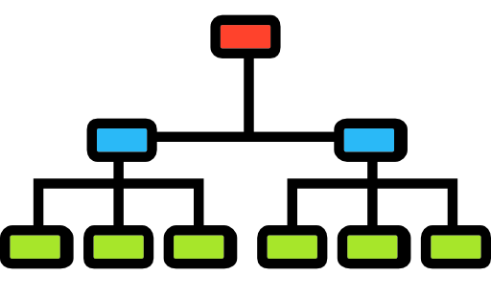
How does network programmability look like today?
Text-driven vs Model-driven automation:
Text-driven
Model-driven
What: manipulation of the configuration files followed by optional restart of the services/daemons
Where: (a) Legacy network equipment and (b) Linux and Linux-based operating system
Why: (a) Model-driven configuration is not supported (intentionally or not) and (b) desire to eliminate the configuration discrepancies
What: interaction with the target endpoint as a collection of key-value pairs based on YANG modules or JSDs
Where: Modern-ish network operating systems or any application via API (REST, gRPC, etc)
Why: (a) Same experience and approach for network and application management and (b) unified information for configuration and data collection
© 2020, karneliuk.com

Slide 5
How does network programmability look like today?
YANG
XML
JSON
Protobuf
NETCONF
RESTCONF
GNMI
© 2020, karneliuk.com

Slide 6
What is the gNMI and where is that used nowadays?
© 2020, karneliuk.com

Slide 7
What is the gNMI and where is that used nowadays?
What is what: gRPC and gNMI
gRPC
gNMI
What: unified RPC framework
What exactly: defines the interaction with transport protocol, possible ways of communication, message handling, etc
What: gRPC-based Specification
What exactly: defines names and types of RPCs and format of the messages based on gRPC transport
© 2020, karneliuk.com

Slide 8
What is the gNMI and where is that used nowadays?
gRPC/gNMI: brief history of time
Initial scope
Current scope
Telemetry
Telemetry
Device management (gNMI)
Device operation (gNOI)
© 2020, karneliuk.com

Slide 9
What is the gNMI and where is that used nowadays?
gNMI operation types (and comparison to NETCONF/RESTCONF):
Operation | gNMI | NETCONF | RESTCONF
Collect information about the YANG modules supported by the endpoint | Capabilities | get-schema | GET to a specific endpoint
Collect the configuration or operational data | Get | get, get-config | GET
Modify the configuration | Set | edit-config, delete-config | POST, PUT, PATCH, DELETE
Collect the operational data on a push-basis | Subscribe | create-subscription, notification | -
© 2020, karneliuk.com

Slide 10
How can pygnmi help with network automation?
© 2020, karneliuk.com

Slide 11
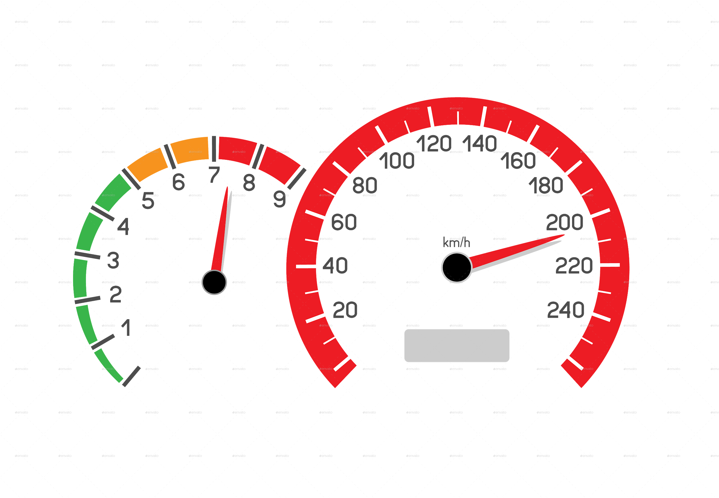
How can pygnmi help with network automation?
What do we expect from Python library for network automation?
Simplicity
Simple usage, automation for networkers
Performance
Speedy operation
© 2020, karneliuk.com

Slide 12
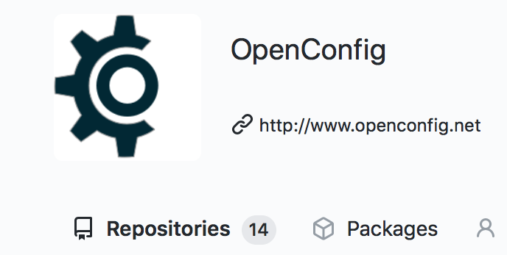
How can pygnmi help with network automation?
What exists in open source world for gNMI?
Official openconf/gnmi bindings
Pros:
All possible features
Cons:
Very complex
Need to understand Protobuf well
gNMIc
Pros:
All possible features
Cons:
Not Python
CLI tool
https://github.com/openconfig/gnmi
https://gnmic.kmrd.dev
© 2020, karneliuk.com

Slide 13
How can pygnmi help with network automation?
What is pygnmi?
INPUT
Native Python formats
e.g.
['openconfig-interfaces:interfaces/interfaces=[1/1/c1/1]'
or
('openconfig-interfaces:interfaces/interfaces=[1/1/c1/1]',
{config: {"name": "1/1/c1/1""})}
OUTPUT
Native Python formats
e.g.
{'notification':
[
{'timestamp': 0},
...
]
}
https://github.com/akarneliuk/pygnmi/
© 2020, karneliuk.com

Slide 14
How can pygnmi help with network automation?
What does pygnmi support?
Ready
Calls:
Capabilities
Get
Set
Subscribe (JSON, Protobuf)
Channels:
Insecure
Secure with certificate
Plans
Channels:
Secure without certificate (e.g. skip certificate validation)
Functionality:
CLI
https://github.com/akarneliuk/pygnmi/
© 2020, karneliuk.com

Slide 15
How can pygnmi help with network automation?
Why is pygnmi that beneficial for you?
Simplicity
Easy to use
Integration with Nornir
Use your favorite automation framework
Python dictionary
No need to convert/parse data
High-quality backend
Relies on the official Google library
© 2020, karneliuk.com

Slide 16
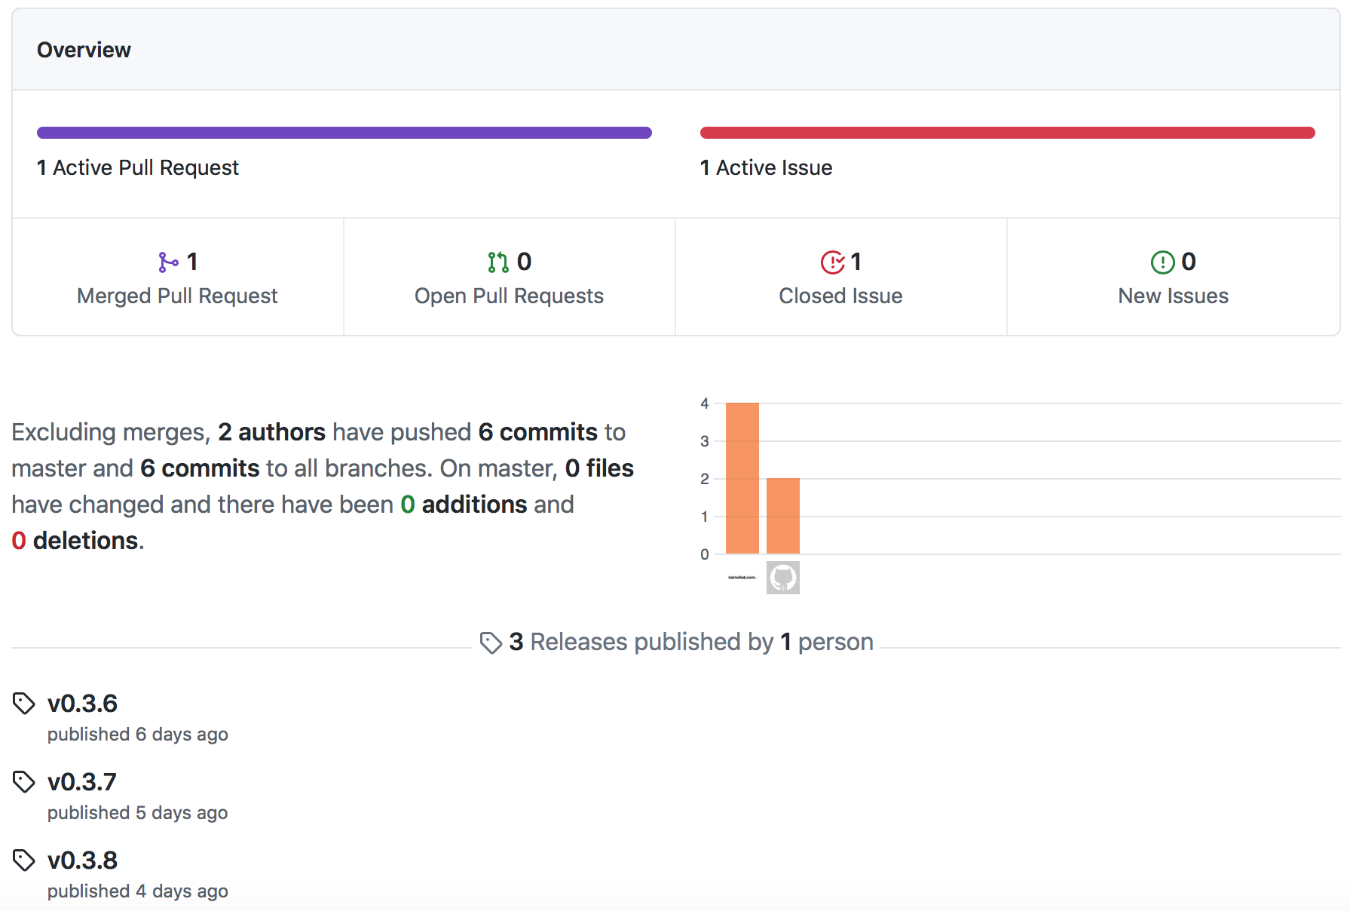
How can pygnmi help with network automation?
1st issue, 1st pull request:
© 2020, karneliuk.com

Slide 17
How can pygnmi help with network automation?
Installation of pygnmi:
Pygnmi is available at pypi.org → Just it install it using pip.
Prerequisites: Python 3.7 - 3.9
# Install pygnmi library
$ pip install pygnmi
# Check pygnmi version
$ python3.7 -c 'import pygnmi; print(pygnmi.__version__)'
0.3.8
https://pypi.org/project/pygnmi/
© 2020, karneliuk.com

Slide 18
How can pygnmi help with network automation?
gNMI Capabilities RPC with pygnmi:
Code example
#!/usr/bin/env python
# Modules
from pygnmi.client import gNMIclient
# Variables
host = ('fd17:625c:f037:2::100',6030)
# Body
if __name__ == '__main__':
with gNMIclient(target=host, username='aaa', password='aaa', insecure=True) as gc:
response = gc.capabilities()
print(response)
© 2020, karneliuk.com

Slide 19
How can pygnmi help with network automation?
gNMI Get RPC with pygnmi:
Code example
#!/usr/bin/env python
# Modules
from pygnmi.client import gNMIclient
# Variables
host = ('fd17:625c:f037:2::100',6030)
path = ['openconfig-network-instance:network-instances/network-instance[name=default]/interfaces/interface[name=Ethernet1]', 'openconfig-interfaces:interfaces/interface[name=Ethernet1]']
datatype = 'all'
# Body
if __name__ == '__main__':
with gNMIclient(target=host, username='aaa', password='aaa', insecure=True) as gc:
response = gc.get(path=path, datatype=datatype)
print(response)
© 2020, karneliuk.com

Slide 20
How can pygnmi help with network automation?
gNMI Set RPC with pygnmi(1):
Code example
## Update call
update_message = []
vv1 = 'openconfig-interfaces:interfaces/interface[name=Loopback10]'
vv2 = {
"name": "Loopback10",
"config": {
"name": "Loopback10",
"enabled": True,
"type": "iana-if-type:softwareLoopback",
"description": "pygnmi-lo-10"
}
}
update_message.append((vv1, vv2))
## Delete call
delete_paths = ['openconfig-network-instance:network-instances/network-instance[name=default]/interfaces/interface[name=Loopback30]', 'openconfig-interfaces:interfaces/interface[name=Loopback30]']
© 2020, karneliuk.com

Slide 21
How can pygnmi help with network automation?
gNMI Set RPC with pygnmi(2):
Code example
#!/usr/bin/env python
# Modules
from pygnmi.client import gNMIclient
# Variables
host = ('fd17:625c:f037:2::100',6030)
# Body
if __name__ == '__main__':
with gNMIclient(target=host, username='aaa', password='aaa', insecure=True) as gc:
response = gc.set(update=update_message, replace=None, delete=delete_paths)
print(response)
© 2020, karneliuk.com

Slide 22
How can pygnmi help with network automation?
gNMI Subscribe RPC with pygnmi (1):
Code example
## Subscription request
subscribe = {
'subscription': [
{
'path': 'openconfig-interfaces:interfaces/interface[name=Ethernet1]',
'mode': 'sample',
'sample_interval': 10000000000,
'heartbeat_interval': 30000000000
},
{
'path': 'openconfig-interfaces:interfaces/interface[name=Management1]',
'mode': 'sample',
'sample_interval': 10000000000,
'heartbeat_interval': 30000000000
}
],
'use_aliases': False,
'mode': 'stream',
'encoding': 'proto'
}
© 2020, karneliuk.com

Slide 23
How can pygnmi help with network automation?
gNMI Subscribe RPC with pygnmi (2):
Code example
#!/usr/bin/env python
# Modules
from pygnmi.client import gNMIclient, telemetryParser
# Variables
host = ('fd17:625c:f037:2::100',6030)
# Body
if __name__ == '__main__':
with gNMIclient(target=host, username='aaa', password='aaa', insecure=True) as gc:
response = gc.subscribe(subscribe=subscribe)
for telemetry_entry in response:
print(telemetryParser(telemetry_entry))
© 2020, karneliuk.com

Slide 24
How can pygnmi help with network automation?
Join us to learn much more about network automaton:
https://training.karneliuk.com
© 2020, karneliuk.com

Slide 25
Thank you very much for your attention!
You can reach us on:
Web: https://karneliuk.com/
Mail: training@karneliuk.com
Phone: +44 7752 159339
© 2020, karneliuk.com

Slide 26
About karneliuk.com
Training services
Consulting services
Our happy customers
Regular trainings:
Network automation live online
Network automation self-paced
Corporate trainings:
Network automation tailored to company network vendors (e.g. Nokia, Arista, Cisco, Cumulus, etc)
Individual sessions:
Ad-hoc consultancy for a specific technologies
Network automation:
Advisory on automation tools
Development of automation tools and integration in your network
Network technologies:
Audit and analysis of your network
Design and testing (Nokia, Arista, Cisco, Cumulus) for service providers and data centres
Documentation (design, configuration, slide decks)
Integration and optimisation
Our expertise
© 2020, karneliuk.com

Slide 27
BACK UP
© 2020, karneliuk.com

Slide 28
How can pygnmi help with network automation?
Useful links:
GitHub: https://github.com/akarneliuk/pygnmi
PyPI: https://pypi.org/project/pygnmi/
Video tutorial: https://www.youtube.com/watch?v=NooE_uHIgys&list=PLsTgo2tBPnTwmeP9zsd8B_tZR-kbguvla
Blog: https://karneliuk.com
© 2020, karneliuk.com

Slide 29
How can pygnmi help with network automation?
Demo topology:
eth0:
IPv4: 192.168.1.66/24
IPv6: FD00:192:168:1::66/64
OOB management:
IPv4: 169.254.255.10/24
IPv6: FC00:169:254:255::A/64
OOB management:
IPv4: 169.254.255.11/24
IPv6: FC00:169:254:255::B/64
Loopback 0:
IPv4: 10.0.255.1/32
system:
IPv4: 10.0.255.2/32
Ethernet1:
IPv4: 10.0.0.0/31
IPv6: fc00:10::/64
1/1/c1/1:
IPv4: 10.0.0.1/31
IPv6: fc00:10::1/64
EOS1
SR1
© 2020, karneliuk.com

Slide 30
How can pygnmi help with network automation?
[LIVE DEMO] Using pygnmi to manage Nokia/Arista network
Time to get hands dirty!
© 2020, karneliuk.com

