Slide 1
Transforming Network Automation at the Edge (a use Cases)

Slide 2
About Me
Long standing IT professional, working for more the 15 years in the Out of Band, Data Center management and networking space
Living:
Limerick, Ireland
Hobbies:
Running, Photography
Notes:
Ritesh asks Rene
Can you tell us more about ZPE systems? Where are you based, what do you guys do, and who are your customers?
Q: Where are you based?
A: Fremont, California
Q: What does ZPE Systems do?
A: We help businesses unleash their networks using our patented hardware & software, which allow for rapid deployments, high flexibility, and in-depth control, even at very remote offices or sites.
Q: Who are our customers?
A: Our customers include some of the most recognizable brands, and are in many industries, from retail and e-commerce, to finance, utilities services, healthcare, and more

Slide 3
Most common customer
requirements @ the Edge
Faster deployments and the ability to scale quickly.
Enterprise-grade security
Collapsing of Hardware/Reduction of Hardware complexity
Always on connectivity, more connection options !!
Increasing Security footprint on the Edge
Reducing management requirement
Notes:
For the smart edge, customers are now requiring:

Slide 4
Customer Use Case
SD-Branch & Security (SASE)
One of the world's leading oil and gas service providers was looking for a solution to consolidate the network stack at their remote locations and drilling rig/command centers all over the globe.
Their existing solution was cumbersome to manage and offered limited scalability – each appliance had it’s own management software and associated CAPEX and OPEX costs.
Requirements:
Simple to manage SD-Branch / SASE solution with high availability and connectivity failover embedded for each drilling rig/command center location. ​ Old Solution:
Each drill rig / location had a network stack consisting of a hardware firewall and hardware switch on top of the drill rig’s connected devices.
Notes:
Ritesh asks Rene
Can you tell us about successes or experiences you have seen in the marketplace?

Slide 5
Extremely hard to reach remote sites
Global deployment with different skill sets in each location
Multiple devices in a HA configuration
Better connectivity/bandwidth is required for each site, currently using only VSAT
Due to newer business applications, changed the security profile
Support for Cloud and Split tunnel
Hardware and software management was an issue
Integration of hardware into automation is an issue, boot-strapping
Challenges
Notes:
For the smart edge, customers are now requiring:

Slide 6
Vendor Specific Solution vs Vender Agnostic Solution
Connectivity through VSAT plus LTE/5G to increase bandwidth
SD-WAN solution, with different VPN overlay options
Hardware appliances vs NFV options
Security based on SD-WAN solution or EDGE deployment of corp. Firewall solution
One automation solution for all components or multiple tools
OOB for hardware components or depend on HA capabilities
Options
Notes:
For the smart edge, customers are now requiring:

Slide 7
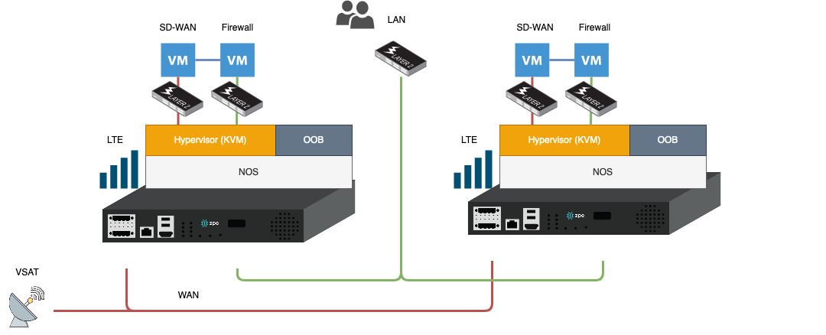
Final Implementation:
Notes:
For the smart edge, customers are now requiring:

Slide 8
SD-WAN solution specialising in Low Bandwidth high Latency environment
Hardware Consolidation, from 8RU to 2RU
Integrated OOB function, including Sensors and RPDU support, providing remote access
Full Integration with existing Automation Tool
Single vendor support for hardware
Connectivity through VSAT plus LTE/5G to increase bandwidth
Security based on SD-WAN solution
Decision Time
Notes:
For the smart edge, customers are now requiring:

Slide 9
Appliances get shipped to pre-staging facility
ZTP pushes a basic configuration
Network configuration, incl. LTE
Enroll the system to Automation Tool
Pre-provisions the NFV images due to size
Appliances get shipped to finial location
Onsite works connect the units
Unit reports back to HQ
Final configuration is pushed through Automation Tool which includes a fully automated process to boot strap SD-WAN and Firewall application
Final tests
Smiling Users
Deployment
Notes:
For the smart edge, customers are now requiring:

Slide 10
Q & A
Notes:
For the smart edge, customers are now requiring:

