Slide 1
Team Cymru
Community Services
Brian Davenport

Slide 2
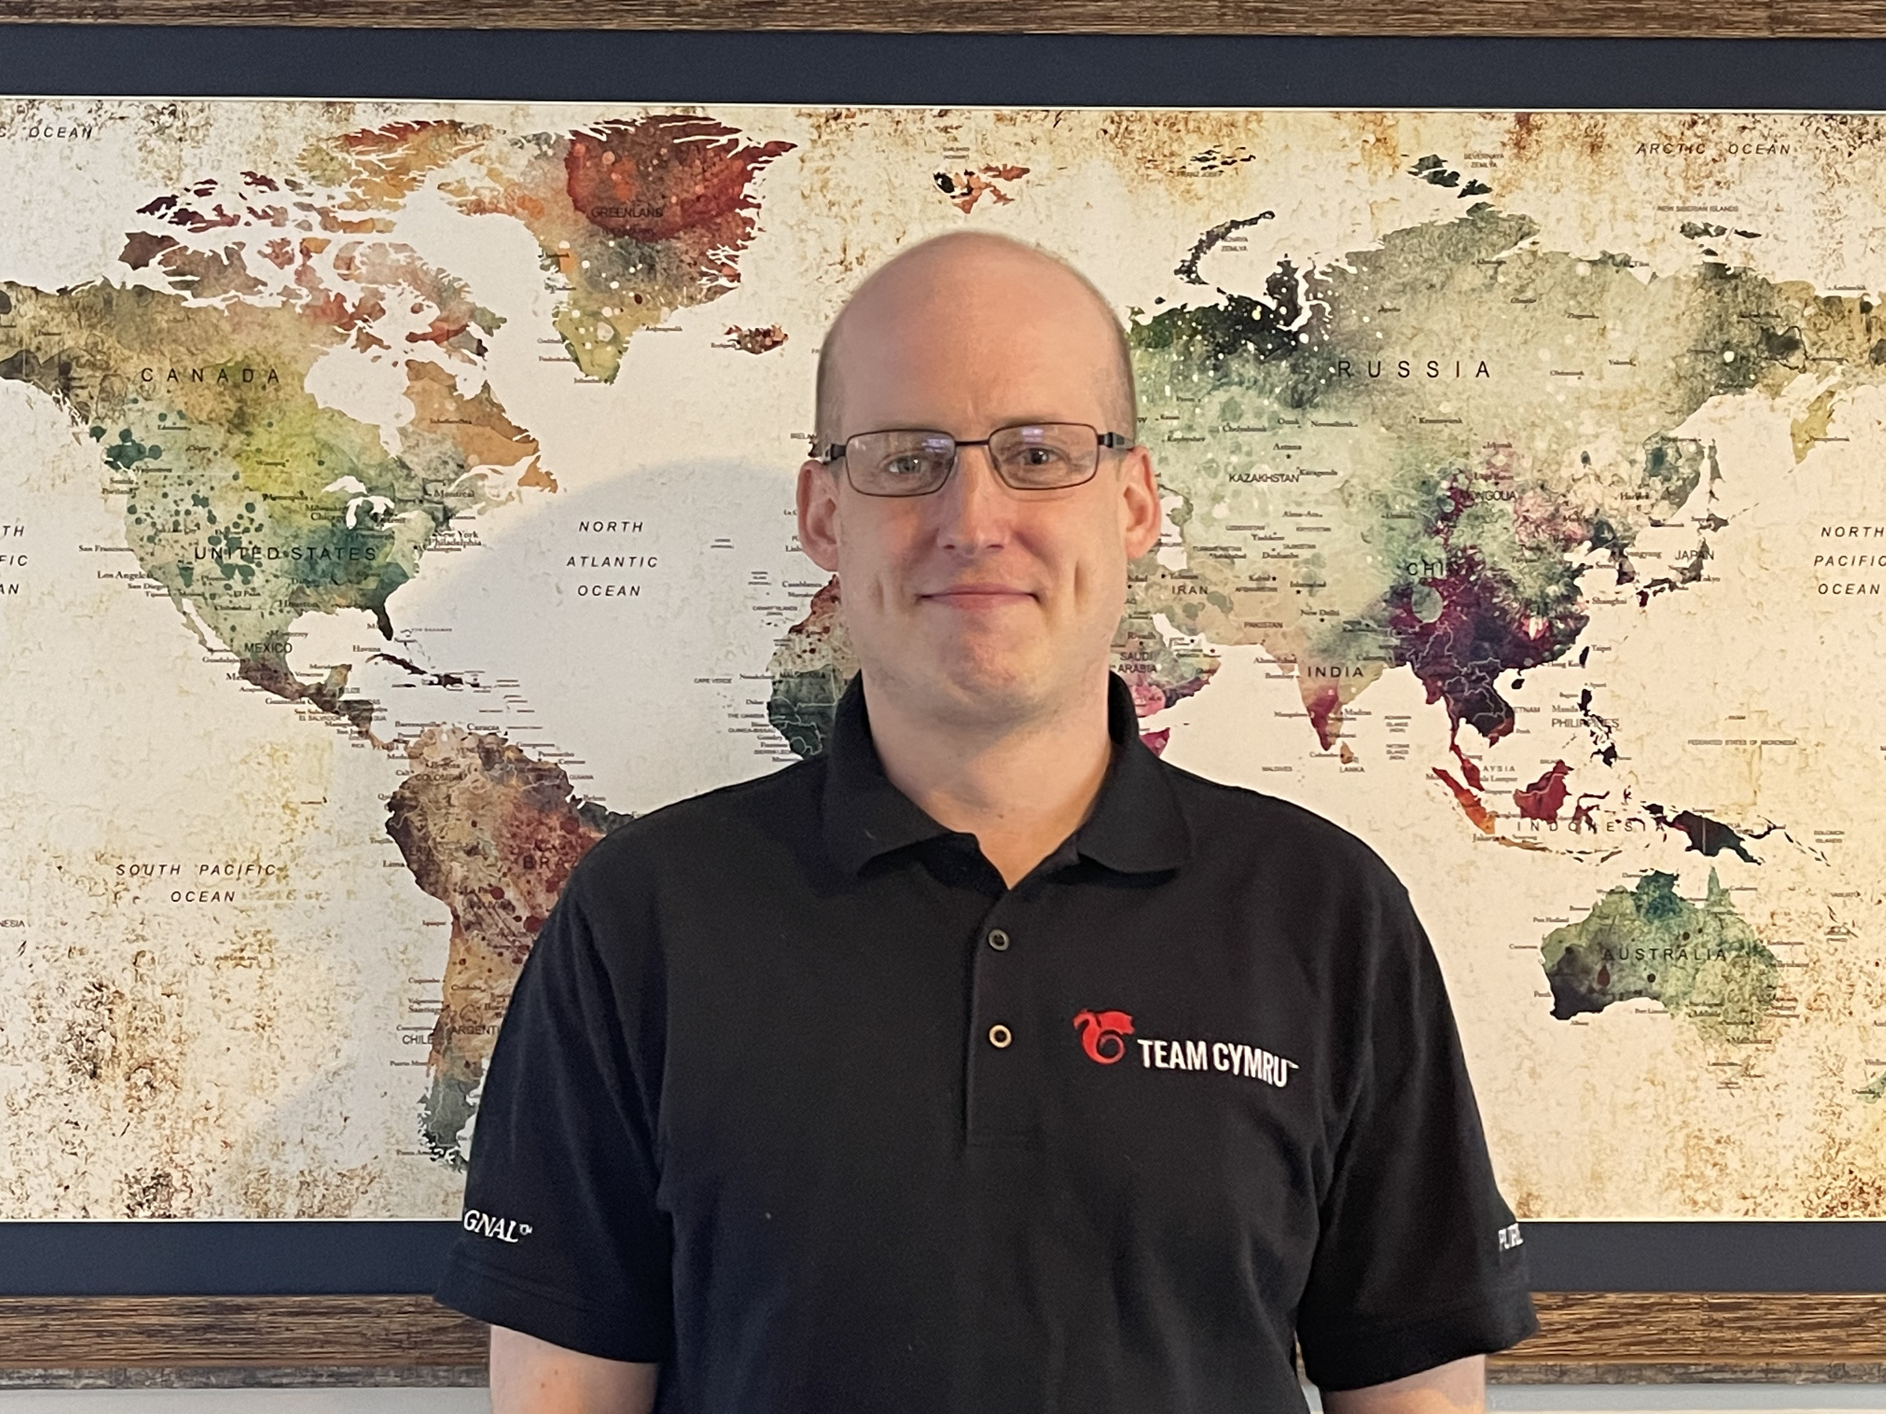
Presenter: Brian Davenport
Solutions Engineer with Team Cymru, supporting community services.
Training, Configuration, Demo’s whatever you need!
Contact Info :
Email: bdavenport@cymru.com
LinkedIn: https://www.linkedin.com/in/briandavenport1/
Calendar: https://calendly.com/bdavenport-3

Slide 3
Team Cymru (pronounced come-ree)
Founded in 2005
Mission:
To save and improve human lives.
Free services to ISPs, hosting providers and CSIRTs
Unmatched eco-system of data sharing and collaboration partnerships worldwide
Work with 130+ CSIRT teams in 86+ countries
Relied on by many security vendors, Fortune 100 companies, and public sector teams.

Slide 4
Community Services
Restricted Events
Underground Economy
Regional Internet Security Events (RISE)
Free Tools / Services
CSIRT Assistance
137 CSIRT Teams
52% of IPV4
75% of IPV6
NimbusTM
BOGON Reference
Malware Hash Registry
Unwanted Traffic Removal Service
Dragon News Bytes (threat news feed)
Notes:
I have a short document I will leave with you detailing the data sharing ecosystem and the types of data that is shared with us from partners around the world.
For the past 12 years, we have been running our own exclusive events. People must apply for admittance, as we verify the identities of everyone involved. Attendance is limited and TLP-Amber and Red case studies are discussed among other things.
We conduct 4 events per year – a major conference, typically in Europe call The Underground Economy conference, and 3 regional events called Regional Internet Security Events or RISE
These events are opportunities for us throughout the year to get the public and private sector analysts and investigators together to network and dig into some common problems. Sometimes they even get together do intelligence gathering blitzes as a group to help the community with such things as finding missing persons.
These gatherings bring together the top minds in the cyber industry with cyber law enforcement.
There is no cost to attend.
Let me know if you’d like to apply for admittance.
Beyond events our no-cost Community Services have a global impact… For example…
We enable CSIRTs worldwide to block compromised devices.
Through this CSIRT assistance program, we help protect, over ½ of all IPV4 and 3/4s of all IPV6
Our Dragon News Bytes is a popular threat news feed that goes out to over 6500 cyber executives and practitioners each day.

Slide 5
NimbusTM
Cloud based collector, built on Elastic / Kibana.
Free to use for ISPs, hosting providers and CSIRTs.
Correlates flow data with reputation feeds.
Sign Up Today: https://team-cymru.com/community-services/nimbus-threat-monitor/
Notes:
I have a short document I will leave with you detailing the data sharing ecosystem and the types of data that is shared with us from partners around the world.
For the past 12 years, we have been running our own exclusive events. People must apply for admittance, as we verify the identities of everyone involved. Attendance is limited and TLP-Amber and Red case studies are discussed among other things.
We conduct 4 events per year – a major conference, typically in Europe call The Underground Economy conference, and 3 regional events called Regional Internet Security Events or RISE
These events are opportunities for us throughout the year to get the public and private sector analysts and investigators together to network and dig into some common problems. Sometimes they even get together do intelligence gathering blitzes as a group to help the community with such things as finding missing persons.
These gatherings bring together the top minds in the cyber industry with cyber law enforcement.
There is no cost to attend.
Let me know if you’d like to apply for admittance.
Beyond events our no-cost Community Services have a global impact… For example…
We enable CSIRTs worldwide to block compromised devices.
Through this CSIRT assistance program, we help protect, over ½ of all IPV4 and 3/4s of all IPV6
Our Dragon News Bytes is a popular threat news feed that goes out to over 6500 cyber executives and practitioners each day.

Slide 6
Flow Data – How it works…
Destination IP | Source IP | Destination Port | Source port | Source Interface | Protocol | Bytes
8.8.8.8 | 1.1.1.1 | 80 | 65000 | 1 | TCP | 100
Notes:
I have a short document I will leave with you detailing the data sharing ecosystem and the types of data that is shared with us from partners around the world.
For the past 12 years, we have been running our own exclusive events. People must apply for admittance, as we verify the identities of everyone involved. Attendance is limited and TLP-Amber and Red case studies are discussed among other things.
We conduct 4 events per year – a major conference, typically in Europe call The Underground Economy conference, and 3 regional events called Regional Internet Security Events or RISE
These events are opportunities for us throughout the year to get the public and private sector analysts and investigators together to network and dig into some common problems. Sometimes they even get together do intelligence gathering blitzes as a group to help the community with such things as finding missing persons.
These gatherings bring together the top minds in the cyber industry with cyber law enforcement.
There is no cost to attend.
Let me know if you’d like to apply for admittance.
Beyond events our no-cost Community Services have a global impact… For example…
We enable CSIRTs worldwide to block compromised devices.
Through this CSIRT assistance program, we help protect, over ½ of all IPV4 and 3/4s of all IPV6
Our Dragon News Bytes is a popular threat news feed that goes out to over 6500 cyber executives and practitioners each day.

Slide 7
Destination IP | Source IP | Destination Port | Source port | Source Interface | Protocol | Bytes
8.8.8.8 | 1.1.1.1 | 80 | 65000 | 1 | TCP
Destination IP | Source IP | Destination Port | Source port | Source Interface | Protocol | Bytes
8.8.8.8 | 1.1.1.1 | 80 | 65000 | 1 | TCP
Destination IP | Source IP | Destination Port | Source port | Source Interface | Protocol | Bytes
8.8.8.8 | 1.1.1.1 | 80 | 65000 | 1 | TCP | 100
4.4.4.4 | 2.2.2.2 | 80 | 64500 | 1 | TCP | 50
100
100
200
300
400
500
600
700
100
200
300
400
500
600
Notes:
I have a short document I will leave with you detailing the data sharing ecosystem and the types of data that is shared with us from partners around the world.
For the past 12 years, we have been running our own exclusive events. People must apply for admittance, as we verify the identities of everyone involved. Attendance is limited and TLP-Amber and Red case studies are discussed among other things.
We conduct 4 events per year – a major conference, typically in Europe call The Underground Economy conference, and 3 regional events called Regional Internet Security Events or RISE
These events are opportunities for us throughout the year to get the public and private sector analysts and investigators together to network and dig into some common problems. Sometimes they even get together do intelligence gathering blitzes as a group to help the community with such things as finding missing persons.
These gatherings bring together the top minds in the cyber industry with cyber law enforcement.
There is no cost to attend.
Let me know if you’d like to apply for admittance.
Beyond events our no-cost Community Services have a global impact… For example…
We enable CSIRTs worldwide to block compromised devices.
Through this CSIRT assistance program, we help protect, over ½ of all IPV4 and 3/4s of all IPV6
Our Dragon News Bytes is a popular threat news feed that goes out to over 6500 cyber executives and practitioners each day.

Slide 8
NimbusTM
Destination IP | Source IP | Destination Port | Source port | Source Interface | Protocol | Bytes
8.8.8.8
1.1.1.1
80
65000
1
TCP
600
4.4.4.4
2.2.2.2
80
64500
1
TCP
50
Notes:
I have a short document I will leave with you detailing the data sharing ecosystem and the types of data that is shared with us from partners around the world.
For the past 12 years, we have been running our own exclusive events. People must apply for admittance, as we verify the identities of everyone involved. Attendance is limited and TLP-Amber and Red case studies are discussed among other things.
We conduct 4 events per year – a major conference, typically in Europe call The Underground Economy conference, and 3 regional events called Regional Internet Security Events or RISE
These events are opportunities for us throughout the year to get the public and private sector analysts and investigators together to network and dig into some common problems. Sometimes they even get together do intelligence gathering blitzes as a group to help the community with such things as finding missing persons.
These gatherings bring together the top minds in the cyber industry with cyber law enforcement.
There is no cost to attend.
Let me know if you’d like to apply for admittance.
Beyond events our no-cost Community Services have a global impact… For example…
We enable CSIRTs worldwide to block compromised devices.
Through this CSIRT assistance program, we help protect, over ½ of all IPV4 and 3/4s of all IPV6
Our Dragon News Bytes is a popular threat news feed that goes out to over 6500 cyber executives and practitioners each day.

Slide 9
NimbusTM Data Enrichment
Destination IP | Source IP | Destination Port | Source port | Source Interface | Protocol | Bytes
8.8.8.8 | 1.1.1.1 | 80 | 65000 | 1 | TCP | 100
Destination IP | Destination ASN | Source IP | Source ASN | Destination Port | Source port | Source Interface | Protocol | Bytes | Alert IP | Alert_ASN | Alert Signature | Confidence
8.8.8.8 | GOOGLE, US (151169) | 1.1.1.1 | BrianCo (65536) | 80 | 65000 | 1 | TCP | 100 | 1.1.1.1 | BrianC0 (65536) | Brian Malware | 100
Notes:
I have a short document I will leave with you detailing the data sharing ecosystem and the types of data that is shared with us from partners around the world.
For the past 12 years, we have been running our own exclusive events. People must apply for admittance, as we verify the identities of everyone involved. Attendance is limited and TLP-Amber and Red case studies are discussed among other things.
We conduct 4 events per year – a major conference, typically in Europe call The Underground Economy conference, and 3 regional events called Regional Internet Security Events or RISE
These events are opportunities for us throughout the year to get the public and private sector analysts and investigators together to network and dig into some common problems. Sometimes they even get together do intelligence gathering blitzes as a group to help the community with such things as finding missing persons.
These gatherings bring together the top minds in the cyber industry with cyber law enforcement.
There is no cost to attend.
Let me know if you’d like to apply for admittance.
Beyond events our no-cost Community Services have a global impact… For example…
We enable CSIRTs worldwide to block compromised devices.
Through this CSIRT assistance program, we help protect, over ½ of all IPV4 and 3/4s of all IPV6
Our Dragon News Bytes is a popular threat news feed that goes out to over 6500 cyber executives and practitioners each day.

Slide 10
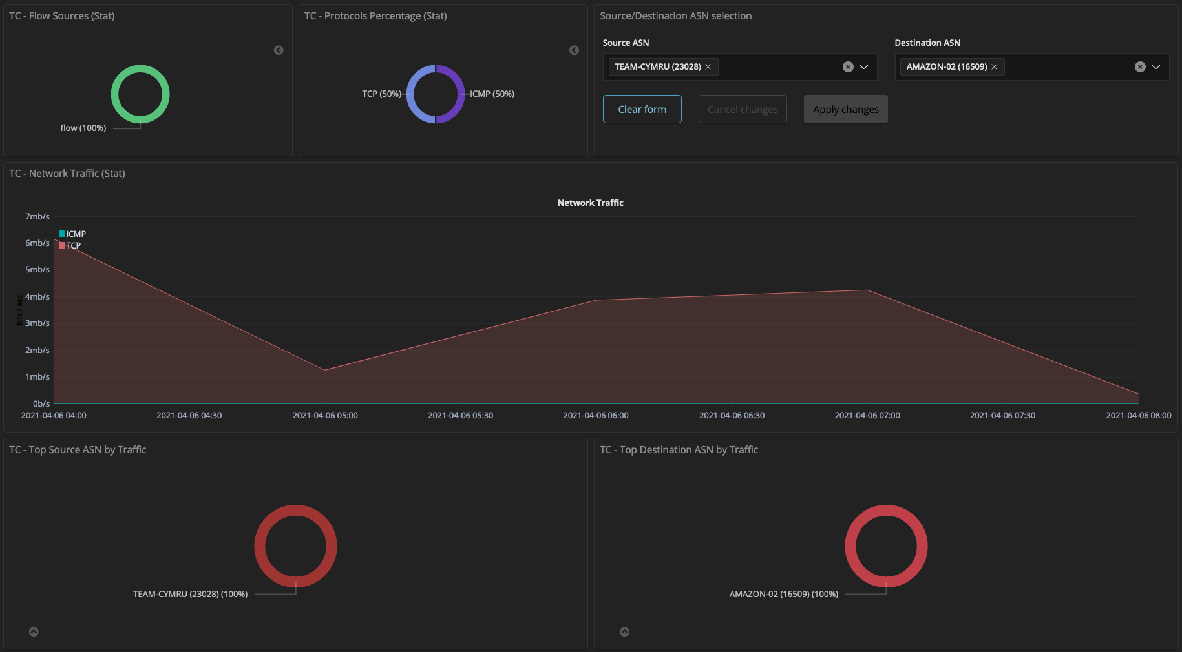
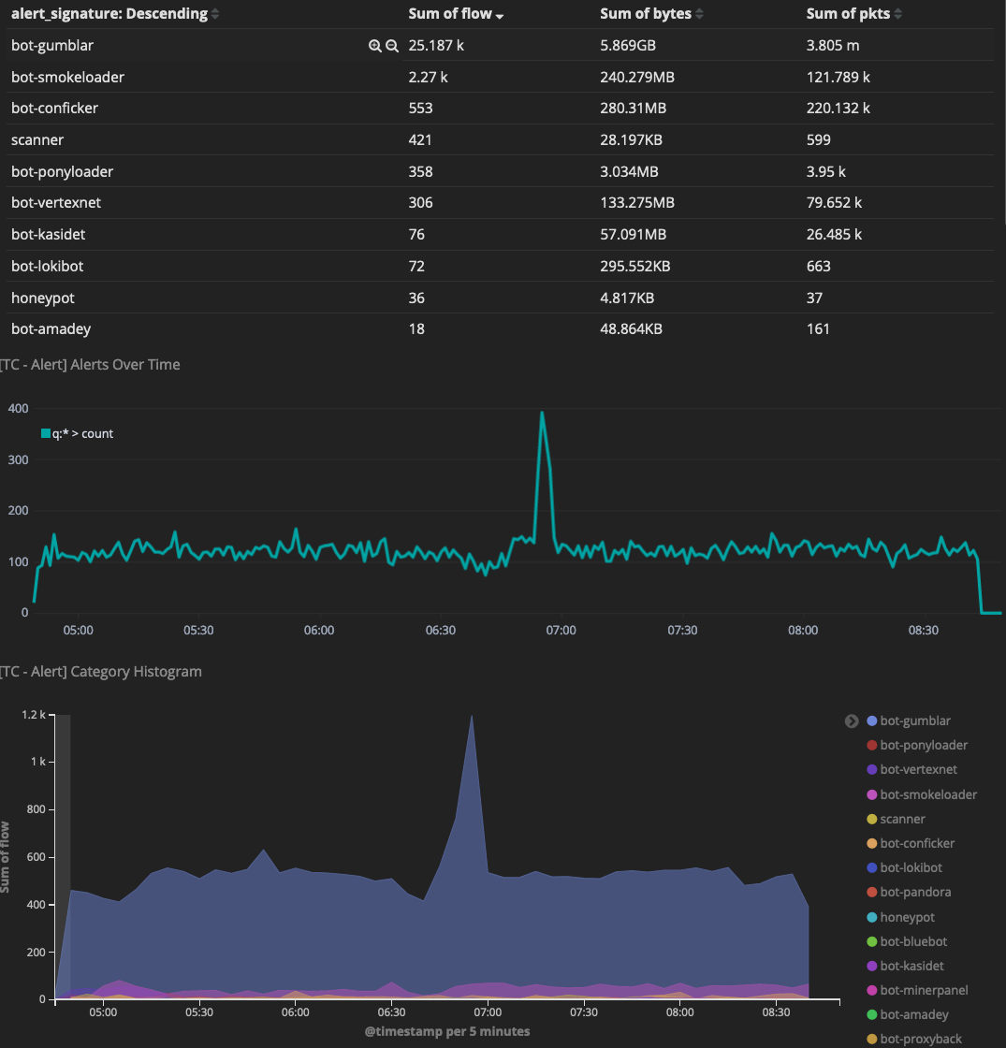
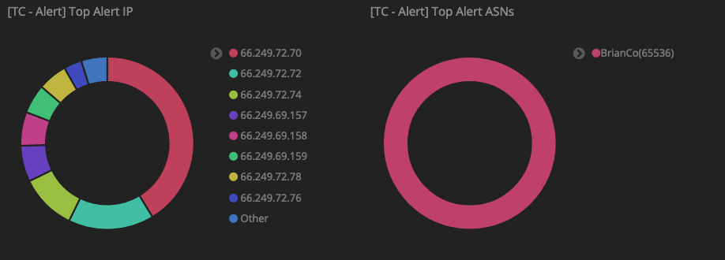
Alert ASN allows for easy identification of Compromised Assets
Identify Botnet families and trend activity over time
Gather Statistics for Peering / Transit Analysis
Notes:
I have a short document I will leave with you detailing the data sharing ecosystem and the types of data that is shared with us from partners around the world.
For the past 12 years, we have been running our own exclusive events. People must apply for admittance, as we verify the identities of everyone involved. Attendance is limited and TLP-Amber and Red case studies are discussed among other things.
We conduct 4 events per year – a major conference, typically in Europe call The Underground Economy conference, and 3 regional events called Regional Internet Security Events or RISE
These events are opportunities for us throughout the year to get the public and private sector analysts and investigators together to network and dig into some common problems. Sometimes they even get together do intelligence gathering blitzes as a group to help the community with such things as finding missing persons.
These gatherings bring together the top minds in the cyber industry with cyber law enforcement.
There is no cost to attend.
Let me know if you’d like to apply for admittance.
Beyond events our no-cost Community Services have a global impact… For example…
We enable CSIRTs worldwide to block compromised devices.
Through this CSIRT assistance program, we help protect, over ½ of all IPV4 and 3/4s of all IPV6
Our Dragon News Bytes is a popular threat news feed that goes out to over 6500 cyber executives and practitioners each day.

Slide 11
Where to gather data from?
Flow data exported to collector
No Flows Exported
Flow monitors are applied to the interfaces you want to observe traffic for
When applying flow monitors think about how traffic flows through your network to make sure you gather at funnel points.
Configuring IPv6 Monitoring sometimes requires additional configuration
NimbusTM
Peer 2
Peer 1
No Flow Monitor Applied
Flow Monitor Applied Here
Notes:
I have a short document I will leave with you detailing the data sharing ecosystem and the types of data that is shared with us from partners around the world.
For the past 12 years, we have been running our own exclusive events. People must apply for admittance, as we verify the identities of everyone involved. Attendance is limited and TLP-Amber and Red case studies are discussed among other things.
We conduct 4 events per year – a major conference, typically in Europe call The Underground Economy conference, and 3 regional events called Regional Internet Security Events or RISE
These events are opportunities for us throughout the year to get the public and private sector analysts and investigators together to network and dig into some common problems. Sometimes they even get together do intelligence gathering blitzes as a group to help the community with such things as finding missing persons.
These gatherings bring together the top minds in the cyber industry with cyber law enforcement.
There is no cost to attend.
Let me know if you’d like to apply for admittance.
Beyond events our no-cost Community Services have a global impact… For example…
We enable CSIRTs worldwide to block compromised devices.
Through this CSIRT assistance program, we help protect, over ½ of all IPV4 and 3/4s of all IPV6
Our Dragon News Bytes is a popular threat news feed that goes out to over 6500 cyber executives and practitioners each day.

Slide 12
Where to gather data from?
Flow monitors are applied to the interfaces you want to observe traffic for
When applying flow monitors think about how traffic flows through your network to make sure you gather at funnel points.
Configuring IPv6 Monitoring sometimes requires additional configuration.
Equally important to think about what network devices traffic flows through.
NimbusTM
Peer 3
Peer 2
Flow Monitors Applied
Flow Monitors Applied
Peer 4
Notes:
I have a short document I will leave with you detailing the data sharing ecosystem and the types of data that is shared with us from partners around the world.
For the past 12 years, we have been running our own exclusive events. People must apply for admittance, as we verify the identities of everyone involved. Attendance is limited and TLP-Amber and Red case studies are discussed among other things.
We conduct 4 events per year – a major conference, typically in Europe call The Underground Economy conference, and 3 regional events called Regional Internet Security Events or RISE
These events are opportunities for us throughout the year to get the public and private sector analysts and investigators together to network and dig into some common problems. Sometimes they even get together do intelligence gathering blitzes as a group to help the community with such things as finding missing persons.
These gatherings bring together the top minds in the cyber industry with cyber law enforcement.
There is no cost to attend.
Let me know if you’d like to apply for admittance.
Beyond events our no-cost Community Services have a global impact… For example…
We enable CSIRTs worldwide to block compromised devices.
Through this CSIRT assistance program, we help protect, over ½ of all IPV4 and 3/4s of all IPV6
Our Dragon News Bytes is a popular threat news feed that goes out to over 6500 cyber executives and practitioners each day.

Slide 13
UTRS
Unwanted Traffic Removal Service
Like RTBH, but:
upstream and global
Over 1,200 participating networks
Reduces unwanted traffic hitting you and others

Slide 14
UTRS
BGP based triggers, with two basic rules:
Accepts only IPv4 /32 advertisements for addresses within prefixes you originate
You agree to null route traffic to routes received from UTRS
2.0 new features
Add FlowSpec support
Add RPKI validation (Mitigation service friendly)
Add support for IPv6
Allow larger prefixes (up to IPv4 /25, IPv6 /49)
Notes:
We do enforce policies
Maximum times: 7 days
Maximum routes per peer

Slide 15
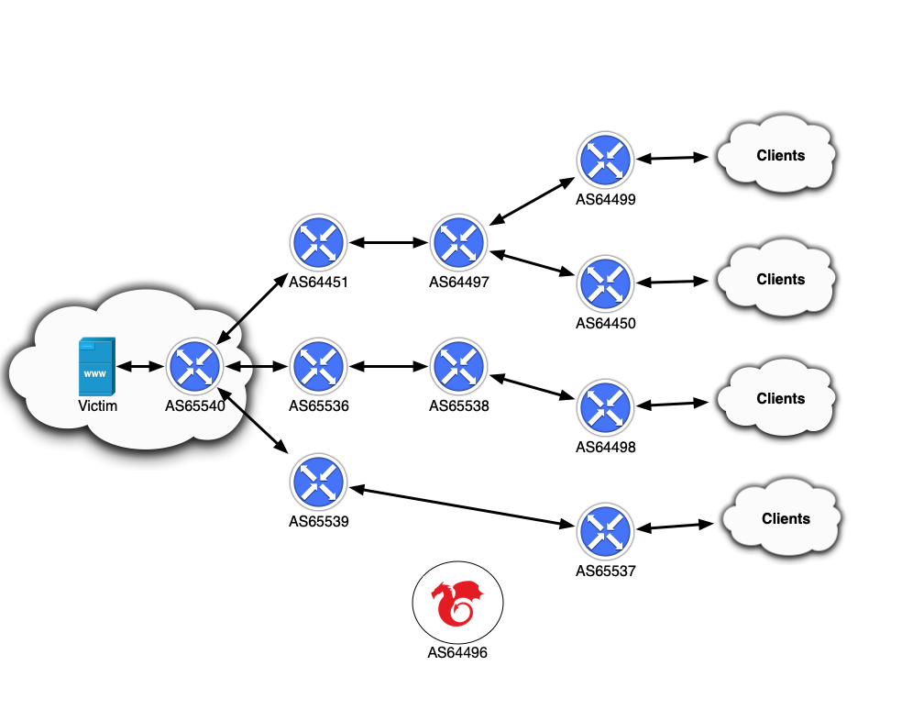
UTRS

Slide 16
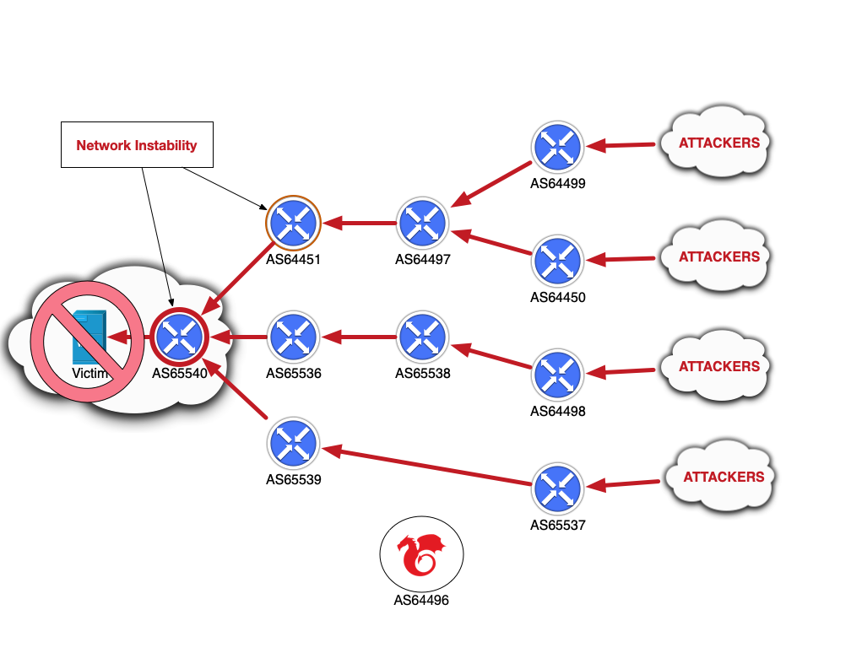
UTRS

Slide 17
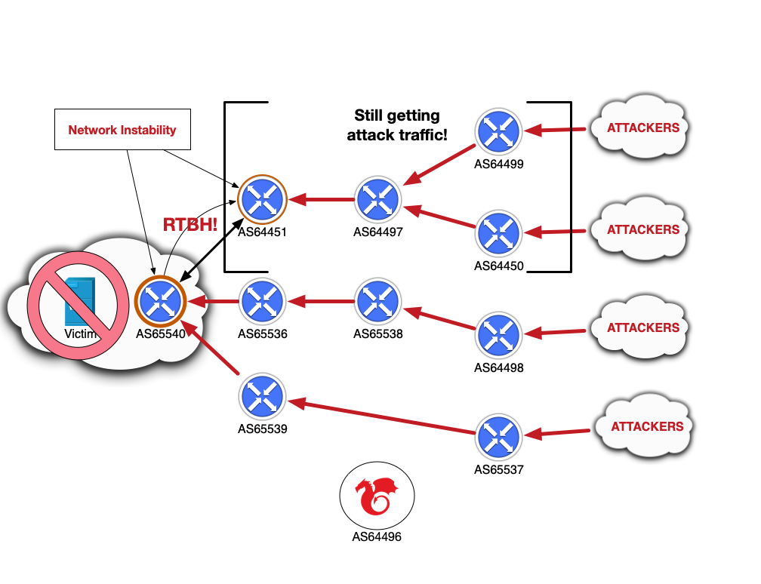
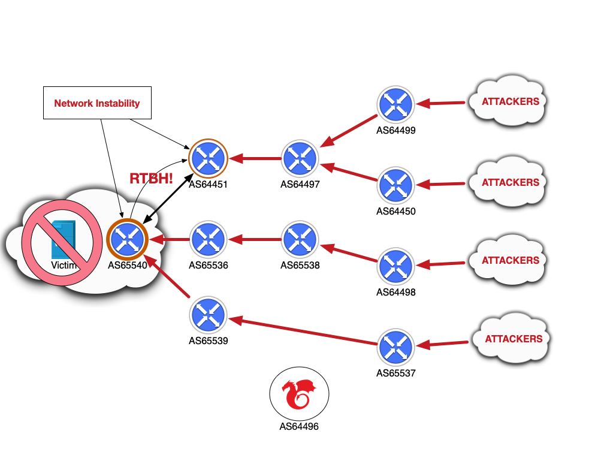
UTRS

Slide 18
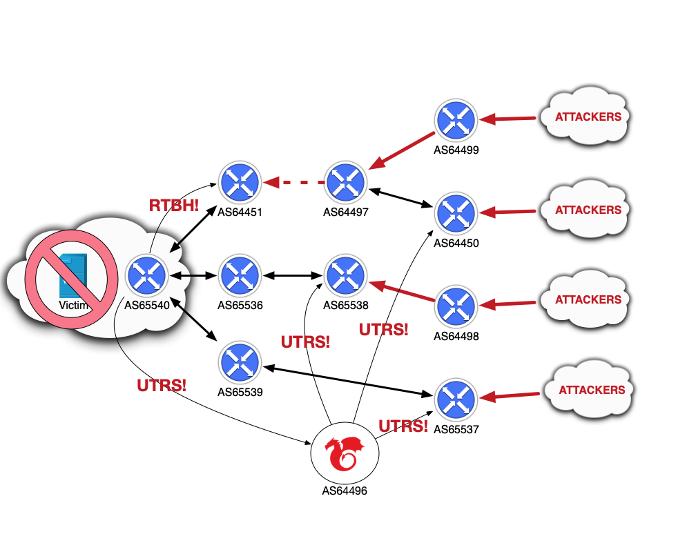
UTRS

Slide 19
CAP
CSIRT Assistance Program (CAP)
Free reputation data
Contains our filtered set of threat intelligence
Specific to “jurisdiction”
Available to Regional and National CSIRTs only

Slide 20
Other Services
IP to ASN Mapping:
https://team-cymru.com/community-services/ip-asn-mapping/
Malware Hash Registry:
https://team-cymru.com/community-services/mhr/
Dragon News Bytes:
https://team-cymru.com/community-services/dnb/

Slide 21
Thank you.

