Slide 1
Dark Halo
How a new class of cloud cyber attack is reshaping security
Aaron Turner
Founder & CEO - Siriux

Slide 2
Aaron Turner – My Background
Awarded “Top 5 InfoSec Executive Leaders of Last 30 Years” by SC Magazine
Worked on teams to establish Microsoft’s first cybersecurity capabilities in late 1990’s and early 2000’s, recognized several times by Bill Gates as cybersecurity leader
Developed technologies to keep critical infrastructure safe from cyberattacks like Stuxnet
Inventor, Entrepreneur, Author
Father of 3 grown daughters and passionate VW T1 Kombi restorationist
Always looking to gain an advantage over cyber attackers

Slide 3
Agenda
2020 - So many exploits… so little time
Complexity breeds… apathy?
Dark Halo Attacker M365 Activities
Big Picture

Slide 4
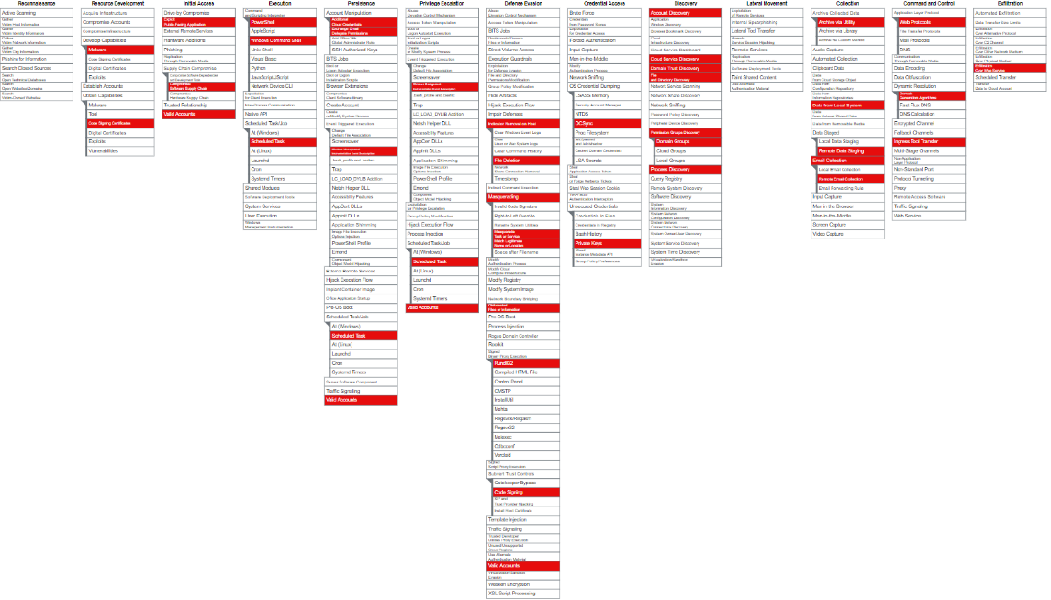
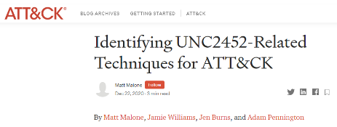
2020 – So many exploits… so little time
FireEye Tool Proliferation
SolarWinds Supply Chain Attack
M365 Privilege Abuse
VMWare W1 Exploit
Any APT Campaign
Duo MFA Bypass
https://medium.com/mitre-attack/identifying-unc2452-related-techniques-9f7b6c7f3714

Slide 5
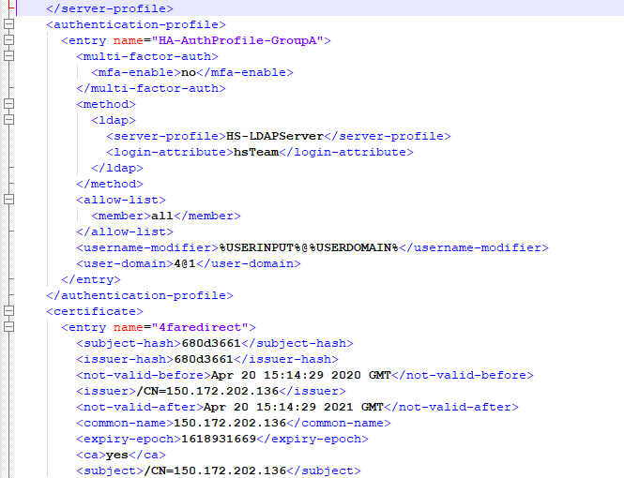
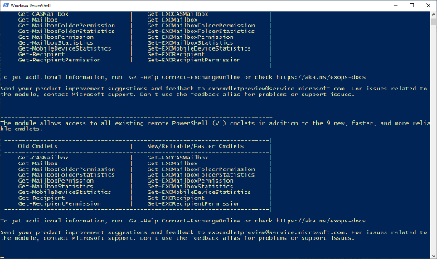
M365 Complexity – Tough to Get Straight Answers
Office 365 security research started in 2017
First consulting engagement in 2018 with a customer with over 50,000 users
Difficult to fully comprehend attack surface
8 weeks of R&D = maybe 25% coverage of security settings
VERY difficult to find appropriate documentation
M365 security configuration research in March 2020 discovered over 7,500 potential settings for each USER within M365

Slide 6
Dark Halo – First Global M365 Incident
Nation/state attackers have already used M365’s complexity to essentially hide in plain sight. In the US Treasury and other US customers’ M365 tenants, reconnaissance and data exfiltration activities were accomplished using poorly-documented M365 administrative interfaces.
In Siriux’s research, less than 1 in 10 organizations has invested in any sort of M365 monitoring to detect Dark-Halo-style attacks.

Slide 7
Dark Halo: Discovery/Recon
M365:
Get-AcceptedDomain
Get-CASMailbox
Get-Mailbox
Get-ManagementRoleAssignment
Get-OrganizationConfig
On-Prem Exchange:
Get-OwaVirtualDirectory
Get-WebServicesVirtualDirectory

Slide 8
Dark Halo: Exfiltration
Set-CASMailbox
CASMailbox: EwsEnabled
CASMailbox: ImapEnabled
CASMailbox: PopEnabled
CASMailbox: ECPEnabled
CASMailbox: MAPIEnabled
CASMailbox: ActiveSyncEnabled
Get-Mailbox: DelivertoMailboxAndForward
Get-Mailbox: ForwardingAddress
Get-Mailbox: AntispamBypassEnabled

Slide 9
Dark Halo: Activity Obfuscation
Get-Mailbox: AuditEnabled
Get-Mailbox: AuditLogAgeLimit
Get-AdminAuditLogConfig: AdminAuditLogEnabled
Get-AdminAuditLogConfig: LogLevel
Get-AdminAudiLogConfig: UnifiedAuditLogIngestionEnabled

Slide 10
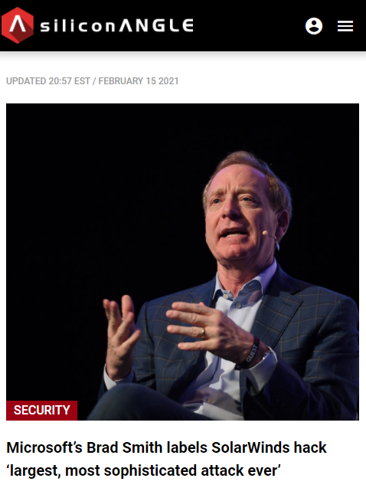
What we’ve learned
Siriux has helped dozens of organizations respond to nation/state attacks against their M365 tenants
The adversaries range from persistent and sophisticated to copycats
The Dark Halo style attacks of penetrating M365 tenants and persisting have proliferated
The default settings that Microsoft let most of their M365 clients inherit are not appropriate for proper identity and data protection

Slide 11
Big Picture: Not just a Microsoft Problem

Slide 12
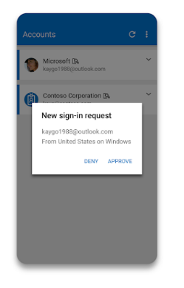
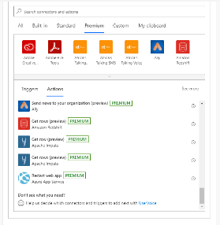
GATO: M365 Attacks Out of the Bag
Global Admin Account Takeover (GATO)
Browser exploit started the game (probably opportunistic?)
Targeted attack against vulnerable iPhone to capture Microsoft Authenticator keys
Cloned Authenticator + credentials = full control of tenant
Attackers used Exchange Online powershell commands to harvest information from targets’ email accounts
Information most likely used for financial market arbitrage
Wild West of Connectors & Apps
Without appropriate plugin hygiene and change management, massive exploit risk
M365 Power Automate used to clone Sharepoint/OneDrive repositories based upon content rules
Microsoft Teams configurations used to snoop on HR communications about layoffs

Slide 13
Detection Tools
Azure AD Artefact detection tools:
CrowdStrike
Mandiant
Looking at Azure AD artefacts is only part of the problem
Azure AD logging, federation credential and service principle forensics
Most of the data exfiltration and attacker obfuscation activity observed within Siriux customers and those organizations Microsoft has assisted have significant Exchange Online artefacts
Secrutiny has worked with Siriux to develop a scan that goes beyond the Mandiant and CrowdStrike tools
Exchange Online, SharePoint, Teams and Intune artefacts

Slide 14
Dark Halo Artefacts in Other SaaS Platforms?
Salesforce Consulting Engagement:
Logging disabled in August 2020
Unauthorized API data feed installed around same time
Workday Security Assessment:
Anomalous vendor registration activities in September 2020
“Authorized” (but unauthorized) vendor payments

Slide 15
M365 Security Tactics
Begin to assess the integrity of M365 settings:
Azure AD privileges relative to M365 controls
M365 Application settings across most-targeted apps:
Exchange Online
SharePoint Online
OneDrive
Teams
Privilege Management
Attack Surface Reduction
Service Hardening
Transitive Trust Management

Slide 16
M365 Security Strategies
Change detection on material M365 settings
Auditing & Logging:
Assess how to economically & efficiently capture M365 audit logs in a SIEM
Trick: how to do this without exponentially increasing your SIEM bill
Event filtering is key
Identity Provider Hygiene
Improve auditing and logging for MFA component integrity
Evaluate Identity Provider key rotation
Improve telemetry from SAML-driven apps for identity use & correlate to other indicators

Slide 17
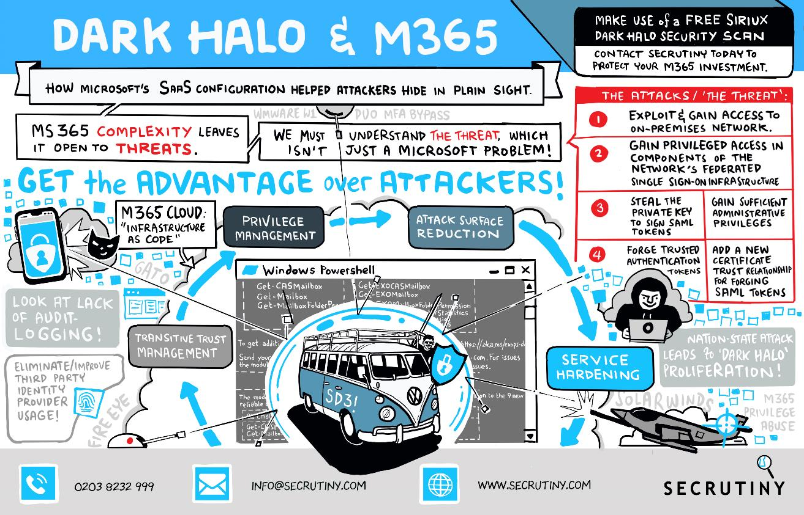

Slide 18
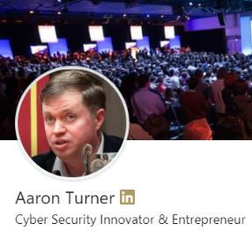
Questions?
Follow me on LinkedIn
HTTPS://LINKEDIN.COM/IN/AARONRTURNER

