Slide 1
From zero to unbundled
https://1310.io/

Slide 2
Who am I?
Simon Green
CTO @ Wirehive
Career SysAdmin turned business owner
Non-exec to a few start-ups
Been on the hosting side of the Internet
for about 20 years, started in college.
One day we decided to start an access ISP
https://1310.io/

Slide 3
What is 1310?
Hopefully you all get the name ;)
A small (5 people today) ISP using creative ways to provide internet around the Thames Valley.
In order of preference we build on:
Our own fibre
Openreach
Wholesale
https://1310.io/
Notes:
This presentation, of course, is about Openreach

Slide 4
How did this start?
Wirehive has resold connectivity from the big players on and off for a long time.
We had a customer near the office who needed a connectivity upgrade.
Thought to ourselves, how hard can this be?
https://1310.io/

Slide 5
Refresher on the UK market
Layer 1 Networks
(People who own the stuff in the ground)
Openreach
OFNL etc.
Virgin
Media, Gigaclear, etc
Wholesale Networks
BT Wholesale, TalkTalk Business Wholesale, etc
TalkTalk
Resellers
BT Retail
Most other
Highstreet ISPs
More Highstreet ISPs
Consumers
(Broad stroke examples)
https://1310.io/
Notes:
A quick refresher on the UK cabled broadband market
First 2 are full channel model
3rd is a nationwide direct
4th is regional direct examples
Virgin is the fully vertically integrated example
Personally, I believe we have a very capable and flexible telco market in the UK

Slide 6
Choose your layer
The further up that stack you choose to go, the more “difficult” your job will be and the more problems you’ll need to solve yourself.
But also the more control you’ll have over what you can do.
https://1310.io/

Slide 7
On Openreach
Openreach is a unique business in the UK.
OFCOM basically tell them:
“You can sell these products, for these prices, to these people”
https://1310.io/
Notes:
When OFCOM broke up BT they did a brilliant thing IMO. Openreach is a gold-mine now, you just need to figure out how to tap it.

Slide 8
Our Day 1 Principles
As low level as we know we can, and are able to, at any time
Scope tight, don’t over architect, don’t over fill
No “me too”, do it our own way
https://1310.io/
Notes:
We decided not to go the investment funded route. We inserted a bit of seed capital and took it gently.
We’re in the privileged position of being able to lean on Wirehive, my existing business, for a lot.

Slide 9
Step 1: Become an OR customer
Get someone to reply to an email or pick up the phone
Utter the correct magical word (“Establish”)
https://1310.io/
Notes:
Not actually like any business ever dealt with before.
Dealing with OR is as if you always had a right the whole time you just never muttered the correct incantation in the right direction

Slide 10
Step 2: Establish for a product
establish
/ɪˈstablɪʃ,ɛˈstablɪʃ/
verb
1. make someone at Openreach actually start doing a thing
https://1310.io/
Notes:
Magical phrase

Slide 11
Step 2: Establish for a product
Pass credit vetting
Provide growth projections
Pass basic product training
Place an initial order
https://1310.io/
Notes:
Pass some serious credit vetting, they may ask for deposits or prepayments. Usually £10k prepayment that must be spent in first year.
Provide growth projections
Most products need you to pass basic product training to prove your not going to flood their support with idiotic requests
Some products (like LLU) need you to place an initial order as part of establishment
LLU also requires some very steep insurance

Slide 12
What products?
Openreach offer a bewildering variety of products…
GEA FTTP
FTTPoD
Gfast
GEA FTTC
CPE Enablement
GEA Cablelink
FVA
Multicast
SOGEA
EAD
EBD
Cablelink
Broadcast Access
CCTV Access
Street Access
OSA
SFIA
Access Locate
MPF
SMPF
SOTAP
SLU
WLR3
ISDN2
ISDN30
MiiS
PIA
DFX
https://1310.io/
Notes:
Here is a quick skim selection, just to give you an idea.
All of these have detailed price lists down to crazy detail.
They even have price list items for specialist legal services
You can think of each product like it’s own mini business.
You need to enable for each product set seperately.
Most of the people working for Openreach don’t know what the other departments do
A lot of the departments don’t self identify in the way Openreach pitch them externally
There are some VERY niche departments
I found myself on the phone to someone in the DEPARTMENT who places and drives the orders for the WLR3 lines that will end up with GEA on top of them which are used to monitor EAD circuits

Slide 13
What products?
Openreach offer a bewildering variety of products…
GEA FTTP
FTTPoD
Gfast
GEA FTTC
CPE Enablement
GEA Cablelink
FVA
Multicast
SOGEA
EAD
EBD
Cablelink
Broadcast Access
CCTV Access
Street Access
OSA
SFIA
Access Locate
MPF
SMPF
SOTAP
SLU
WLR3
ISDN2
ISDN30
MiiS
PIA
DFX
https://1310.io/
Notes:
For our first project though, we need these ones

Slide 14
Access Locate
Think of this as “Co-Lo in the Telephone Exchange”
Variety of different configurations, most of them for “legacy” products
What the potential audience of this presentation wants is FCP
FCP=Flexible Co-mingling (old name)
Approximately 3-6 months lead time
https://1310.io/
Notes:
They send you a _horrific_ spreadsheet to fill in where you specify all your requirements.
The LLU build team is actually one of the most helpful groups I’ve found in OR, along with GEA Cablelink

Slide 15
Side note: BASOL and iDesk
If you get to this stage, you will be starting to think to yourself:
“How do I get through the door?”
The key to this is BASOL, a system accessed via iDesk.
BASOL is the frontend to ORs door security system.
Use this to issue access cards and control access.
https://1310.io/
Notes:
This system is horrible, though less horrible than it used to be
The team who run this are actually incredibly helpful, any issues just pick up the phone to them

Slide 16
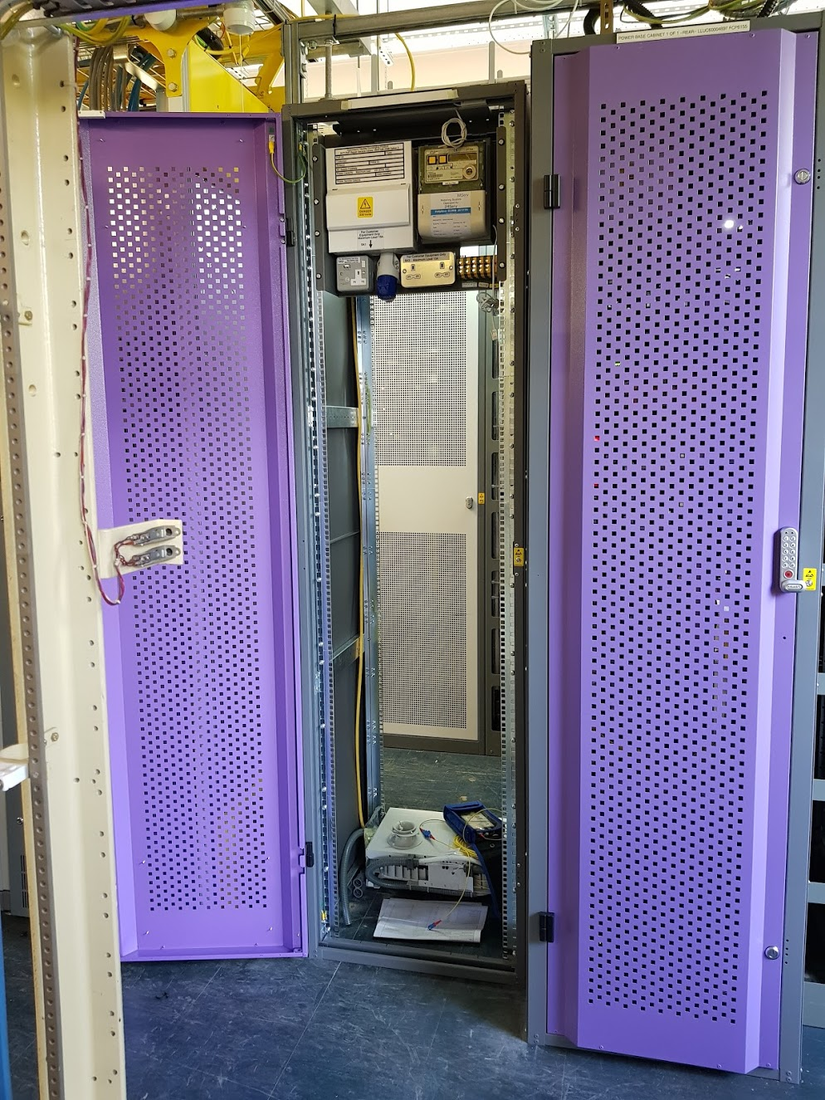
Access Locate
This gets you a purple cabinet!
It will be in the “MUA”
(Multi user area)
These are not nice places to be.
https://1310.io/
Notes:
The astute of you will notice the fibre tray in the bottom.
As soon as we got the LLUC number we placed our order

Slide 17
Ethernet
Gives you access to EAD: Ethernet Access Direct. The thing you’ve heard of.
Point-to-point fibre with a combination media converter and quality monitoring box on each end.
Pre-existing fibre runs all over the place connecting node-to-node.
Some between exchanges, some between points in the ground.
Fibre gets spliced from point A, along these routes, all the way to point B.
There’s nothing active on the fibre apart from the box at each end.
https://1310.io/
Notes:
They send you a _horrific_ spreadsheet to fill in where you specify all your requirements.
The LLU build team is actually one of the most helpful groups I’ve found in OR, along with GEA Cablelink

Slide 18
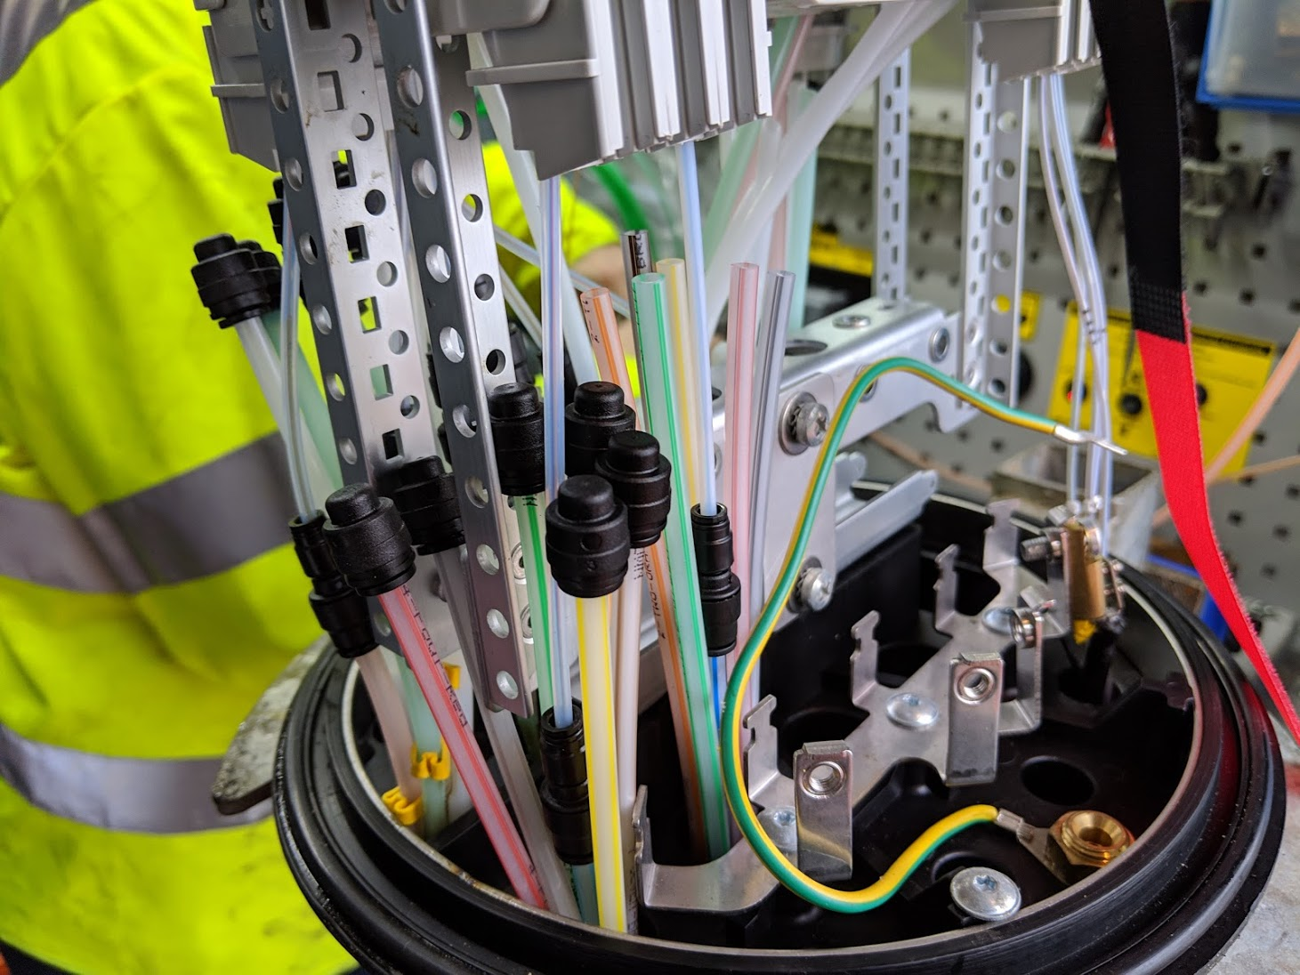
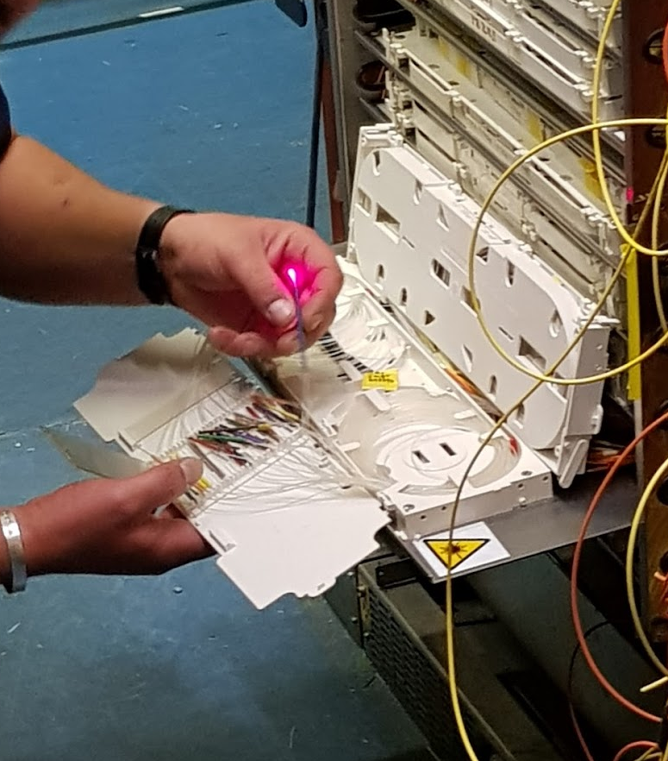
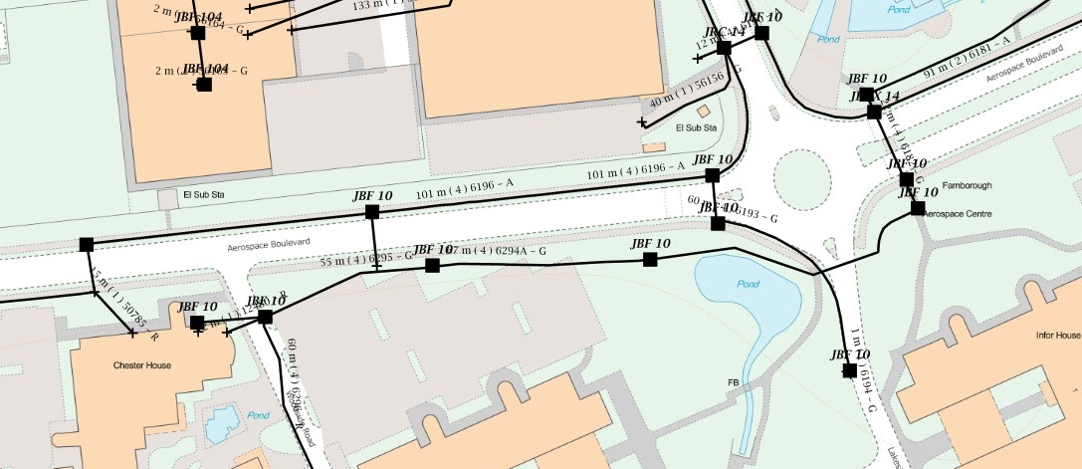
EAD
https://1310.io/
Notes:
Top left: EAD chassis, typical 1Gb end customer
Bottom left T node. Tubes at bottom, splice trays at top
Centre: Splice trays in Exchange – There are thousands in the frames connecting pre-run from place to place. Use these to join your floors, racks, and T nodes together. They don’t use patch leads, splice or go-home.
Right top: Tubes in t-node, for blowing to properties
Bottom right: The infrastructure map showing all the duct work, footway boxes, and nodes. Great tool for desk surveying.

Slide 19
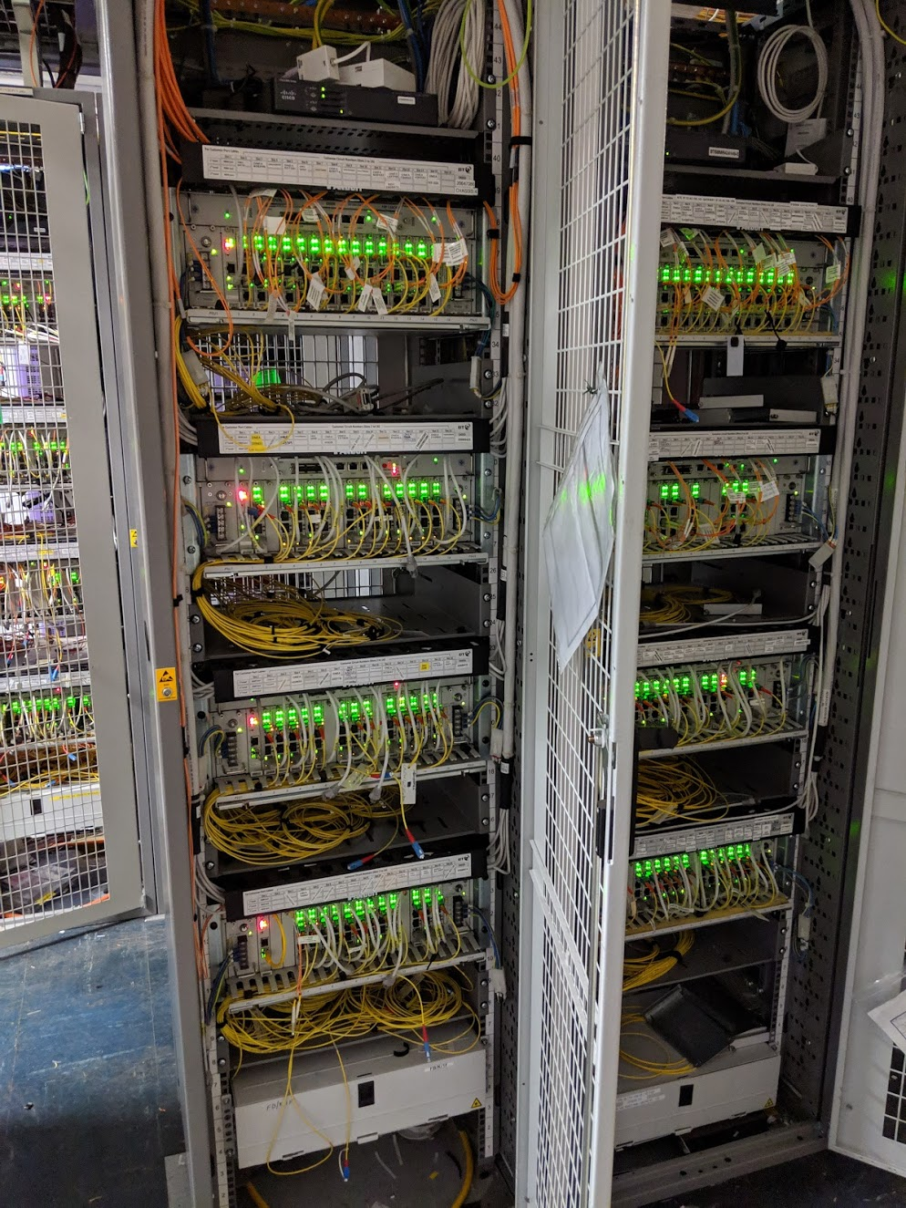
Success
EAD from customer to the exchange
Router in the exchange
EAD from exchange to local DC
Now we’re an ISP?!
https://1310.io/
Notes:
I’m not going to get in to the detail on DC end, transit, things like that.
That stuffs the easy BAU for you :)
Picture on the right shows the multi-U chassis used in high-density locations such as Exchange and DCs

Slide 20
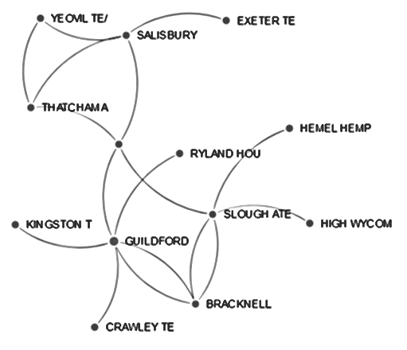
Backhaul Options - Openreach
EBD (Ethernet Backhaul Direct)
Most locations can be linked to 2 or more other locations
ER variant to hop through an intermediary exchange
Very rarely do they go where you expect
Regular EADs
OSA
https://1310.io/
Notes:
Backhaul is one of the biggest challenges with unbundling
We chose our first exchange to be within EAD LA reach of our DC for this reason
Exchanges aren’t like regular DCs

Slide 21
Backhaul Options - Others
Other network providers (the usual suspects: Zayo, SSE, etc)
Cablelink (Openreach for “cross connect”) is used to reach them
Internal
Type 1: Connects 2 CPs
Type 2: Connects a CP to an Openreach OFF
Type 3: Connects a CP to the external cable chamber
External
Pulls through a CPs cable from the Handover Box to the cable chamber
https://1310.io/
Notes:
Backhaul is one of the biggest challenges with unbundling
We chose our first exchange to be within EAD LA reach of our DC for this reason
Next exchange we used SSE
Exchanges aren’t like regular DCs

Slide 22
What next?
Once in there, we obviously started thinking about FTTC etc.
GEA FTTP
FTTPoD
Gfast
GEA FTTC
CPE Enablement
GEA Cablelink
FVA
Multicast
SOGEA
EAD
EBD
Cablelink
Broadcast Access
CCTV Access
Street Access
OSA
SFIA
Access Locate
MPF
SMPF
SOTAP
SLU
WLR3
ISDN2
ISDN30
MiiS
PIA
DFX
https://1310.io/
Notes:
These blue products come under the category of NGA
Next Generation Access covers all the FttX type products, basically anything after ADSL.
GEA is the interesting bit, Generic Ethernet Access.
Also, WLR3. At the point we did this SOGEA (the no-phone-line product) was not generally available.
WLR3 was by far the worst thing in here to establish for, however I’m not going in to it in this presentation because I can think of no good reason any of you would want it today

Slide 23
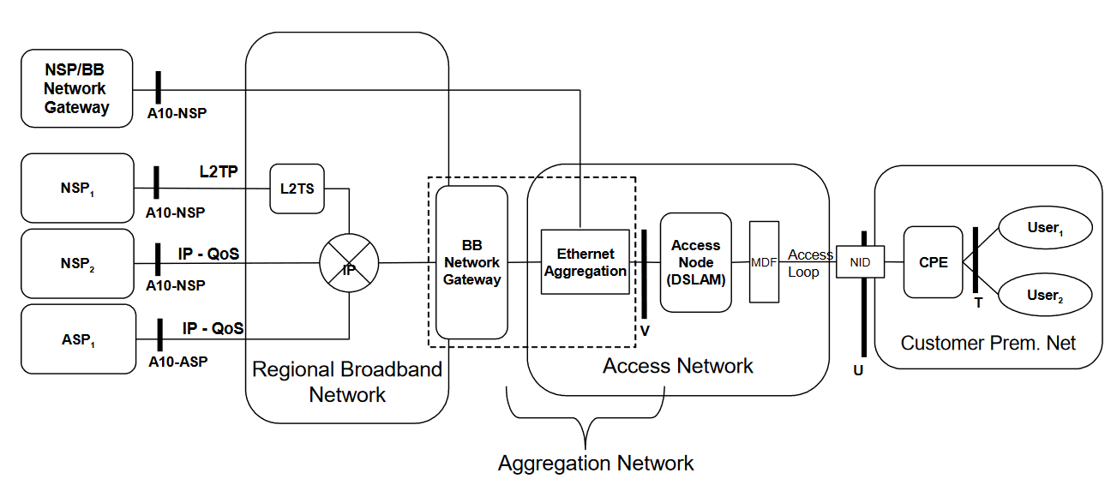
TR-101
Openreach GEA
https://1310.io/
Notes:
What Openreach have implemented is pretty much the reference design for TR-101, with very little variation.
From studying the spec doc in detail, and comparing to real life, I’ve got no complaints!
This diagram is from the TR-101 spec doc and you can see the part OR are delivering is the right hand side Access Network
If you’re interested in the design decisions and justifications, I highly recommend checking out the TR-101 doc from the Broadband Forum

Slide 24
GEA
L2S
FTTC Cab
Consumer
VDSL2
Consumer
Consumer
CP
L2S
OLT
Consumer
GEA Cableinks
Openreach Fibre
GPON
Consumer
Consumer
L2S
Gfast Cab
G.fast
Consumer
https://1310.io/
Notes:
A CP, such as 1310, orders GEA Cablelinks to connect to the L2Ss
The L2Ss are connected to the DSLAMs and so on in the cabinets you see out on the streets, or to OLTs for GPON
Those devices are then connected to the customers, be that by copper or fibre

Slide 25
GEA
L2S
FTTC Cab
Consumer
VDSL2
Consumer
Consumer
CP
L2S
OLT
Transparent* L2 Circuit
Consumer
GEA Cableinks
Openreach Fibre
GPON
Consumer
Consumer
L2S
Gfast Cab
G.fast
Consumer
*ish
https://1310.io/
Notes:
The final service provided is a transparent L2 circuit on a VLAN to you
This is a really important point, and one of the key differences vs doing it through a wholesale provider
You can do whatever you like over this circuit, it’s “yours” to use as you see fit.
If you consume these services through wholesale they will usually come to you in a PPP/L2TP tunnel per customer, which while very functional isn’t very flexible.

Slide 26
PPPoE and DHCP
If you choose to use PPPoE or DHCP then the DSLAM inserts some useful information in to the request.
Agent Remote ID – Either a value specified during order, or the port and VLAN data for the socket
Agent Circuit ID – The DSLAM, port, and the VLAN
Upstream and downstream line rates
https://1310.io/
Notes:
These are really useful fields for identifying who the circuit is going to.
Remote ID can be used to identify the customer against your records
Circuit ID can be used to help with diag, although while interesting not especially useful to us
The line rates can be used to build queues at your BNG to avoid the brutal DSLAM traffic shaping

Slide 27
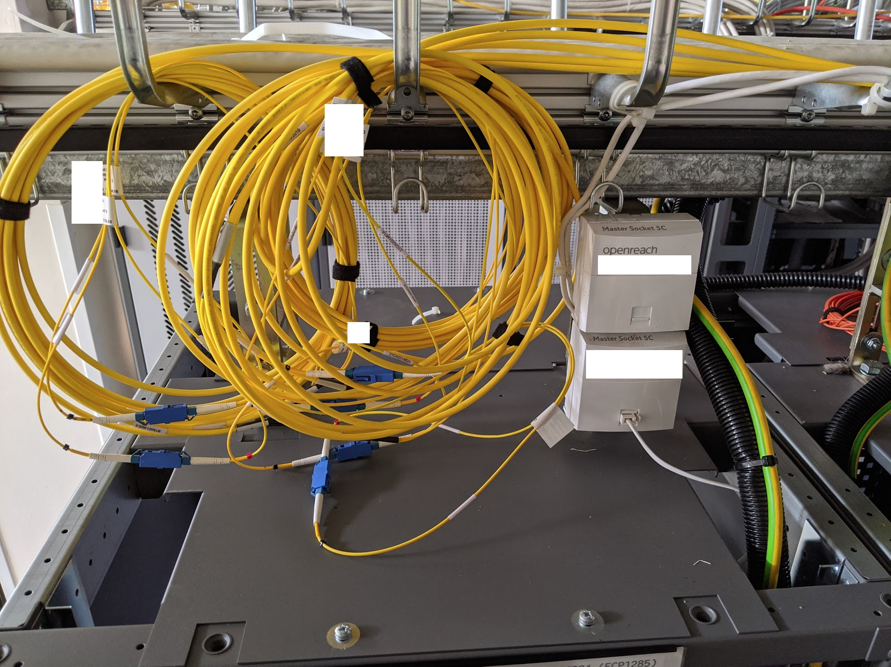
GEA Cablelink
https://1310.io/
Notes:
GEA Cablelink != Cablelink!
1Gb is one off £500
10Gb is one off £1000
These cablelinks are duplex LC delivered to your rack like this for you to deal with as you see fit.
Highly variable lead time, weeks to months.
When you order a GEA circuit, you specify the GEA Cablelink you want it to appear over.
Over this you get a inner VLAN per customer (the C-VLAN), optionally in an outer VLAN (the S-VLAN) and also optionally in ethertype 88A8 rather than 8100

Slide 28
Tools
Basic Dialogue services
Match addresses to keys
View available products at a location
View deep detail about those products
Explore existing line plant in a property
Maps
Infrastructure discovery
Duct & Poll Access
Service Test
All the fault finding tools for the monitorable products
EAD
WLR3
FTTC
FTTP
Data
Property level coverage data for the whole country
Exchange locations and details
EBD/OHD backhaul paths
Fibre LAD (where will this EAD likely go)
Route Maps for existing EADs
Ordering
Siebel for day-to-day
Spreadsheets for unusual
https://1310.io/
Notes:
Openreach provide you some reasonably good tools to help you out

Slide 29
Openreach Pros & Cons
Pros
Predictable (for better or worse)
Pretty transparent on the products
All possibilities thought of
Remarkably good value
Once you get to the knowledge tipping point you can navigate well
Normal BAU things go smoothly
No wholesale layer!
Cons
Don’t do anything they don’t have to
Completely inflexible
Steep cost barrier to entry on some key products
Very steep learning curve
Inconsistent on sharing their plans
Weird things can go very wrong
Backhaul can be a challenge
Wholesalers spoil the value in Openreach
https://1310.io/
Notes:
After a few years of dealing with Openreach mostly solo I feel a bit like Neo after his first session in the chair in the matrix. I know kung fu.
There is not a lot I can’t tell you about how the OR products work, what you can expect, and if I don’t know it I certainly know where to find it.

Slide 30
What does it all cost?
We allow ~£10k to get in to an exchange (Highly approximate! YMMV)
Access Locate = £6k
Varies greatly based on ceased pop availability and requirements
Local kit = ~£1.5k
GEA Cablelinks = £500/£1k each
Cablelink for backhaul = £760 each
https://1310.io/
Notes:
After a few years of dealing with Openreach mostly solo I feel a bit like Neo after his first session in the chair in the matrix. I know kung fu.
There is not a lot I can’t tell you about how the OR products work, what you can expect, and if I don’t know it I certainly know where to find it.

Slide 31
Tips
There is a lot of data in the Openreach portal, get it and store it.
Learn and use PowerBI and SQL, you’ll need it.
Ask about ceased pop reuse, it can save you a lot of money.
Everything has a price, and every price is publicised. Get familiar.
Expect your first few orders on any product to go wrong because you don’t know what you’re doing when you order it.
Order ADSL to your rack for out-of-band.
It’s unlikely anything you ask them is new, there will be a “right way”.
Build your own address book.
https://1310.io/
Notes:
After a few years of dealing with Openreach mostly solo I feel a bit like Neo after his first session in the chair in the matrix. I know kung fu.
There is not a lot I can’t tell you about how the OR products work, what you can expect, and if I don’t know it I certainly know where to find it.

Slide 32
The Future
OFCOM Wholesale Fixed Telecoms Market Review 2021-26
Comes into effect April ‘21
New geographic area classes
New Dark Fibre based on EAD costs
IEC remains as it is today
WBA to be deregulated
Have a read, things are changing.
https://1310.io/
Notes:
Wholesale Fixed Telecoms Market Review 2021-26
CLA = Central London Area, extensive rivalry
HNRA = High Network Reach Area, high degree of rival networks
GEA charge control is being de-regulated in area 2
IEC = inter exchange connectivity
WBA = wholesale broadband access – they consider that a solved problem now
WLA (Wholesale Line Access)
Area 1 (competitive), Area 2 (Some competition), Area 3 (No competition)
LL (Leased Line Access)
CLA, HNRA, Area 2, Area 3
Nowhere is classed as Area 1 right now
Area 1 is unregulated
Area 2 lifts some charge controls (including higher than 40/10)
Area 3 is broadly as-is, with the addition of a dark fibre product modelled on EAD 😮

Slide 33
Want to know more?
Join #openreach on AltNet.uk and ask for help!
Google “Openreach SINs”
Read TR-101 if you’re interested in GEA
Or ask me questions now :)
https://1310.io/
Notes:
This presentation has really only skimmed the service.
AltNet has just about 100 smaller ISP owners and network people in it right now. If you’re a small ISP then join up, we help each other out.
No sales, no marketing, no elitism
Browse the Openreach SINs (supplier information notices)
They tell you all about the products underneath, down to the technical detail

