Slide 1

BIDI: Building the BBC’s media CDN
Alistair Wooldrige
Senior product manager, OTG Media Distribution.
alistair.wooldrige@bbc.co.uk
2nd November 2020

Slide 2
Agenda
Introduction
BIDI growth so far
Future plans

Slide 3
Introduction

Slide 4
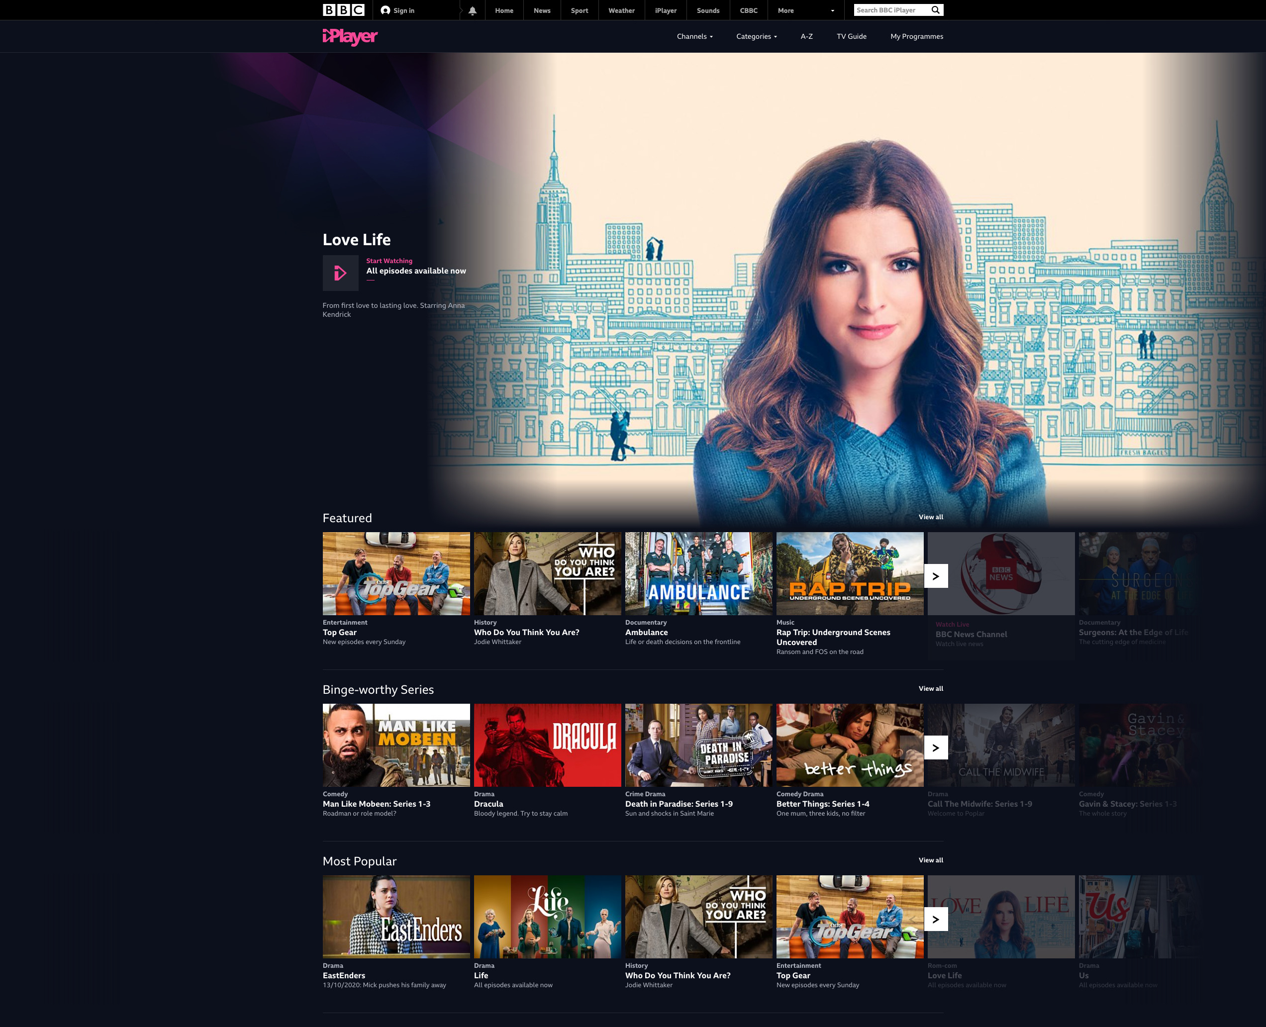




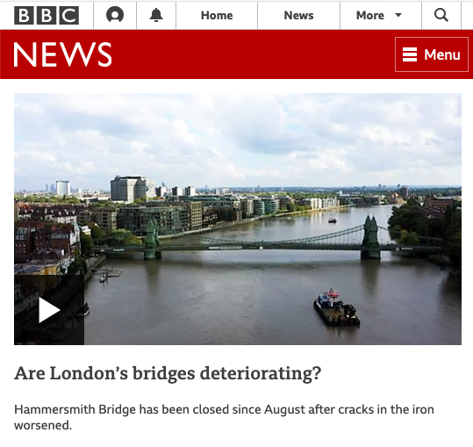


Introduction
Lots of media to distribute over IP

Slide 5




Introduction
Video clients
TV
66%
PC
10%
Tablet
15%
Mobile
9%

Slide 6
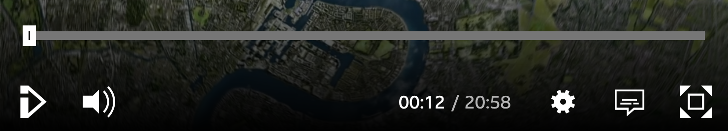
Introduction
Segmented media
1.m4s
2.m4s
3.m4s
4.m4s
5.m4s
6.m4s
315.m4s
Split into ~4 second segments.
Client downloads segments in advance, over HTTP.

Slide 7
Introduction
Segmented Media: Adaptive Bit Rate (ABR)
Encoder
12 Mbps
1080p
1.m4s
2.m4s
3.m4s
4.m4s
5.m4s
5 Mbps
720p
1.m4s
2.m4s
3.m4s
4.m4s
5.m4s
2.8 Mbps
540p
1.m4s
2.m4s
3.m4s
4.m4s
5.m4s

Slide 8
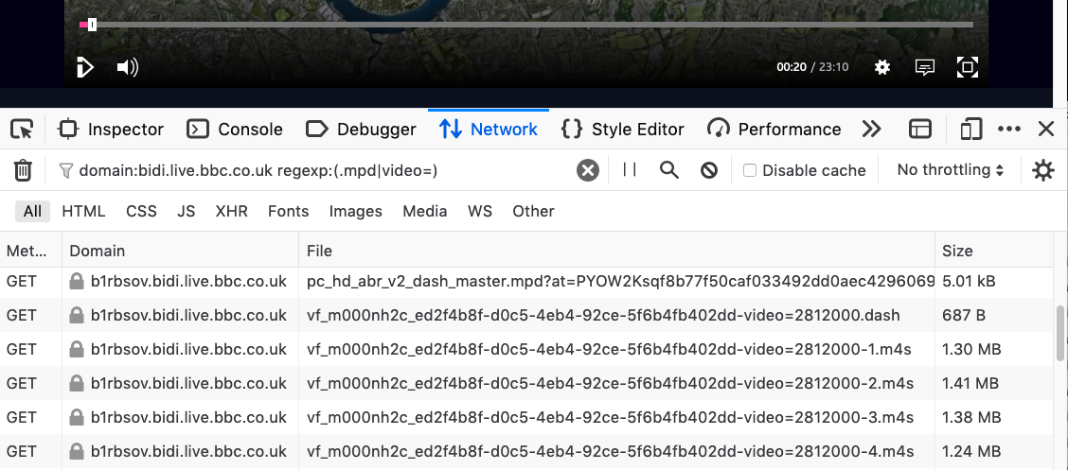
Introduction
Segmented Media: In action

Slide 9
Introduction
Pull through caching
BBC Media Selector
CDN A
On-premises origin cache
Asset origin
Which CDN?
CDN B
HTTP GET
HTTP GET
BIDI
HTTP GET

Slide 10
Introduction
Pull through caching
BBC Media Selector
CDN A
On-premises origin cache
Asset origin
Which CDN?
CDN B
HTTP GET
HTTP GET
BIDI
HTTP GET

Slide 11
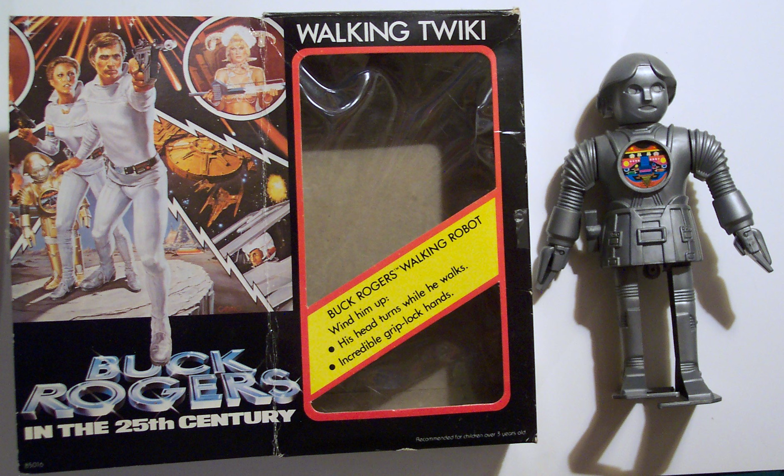

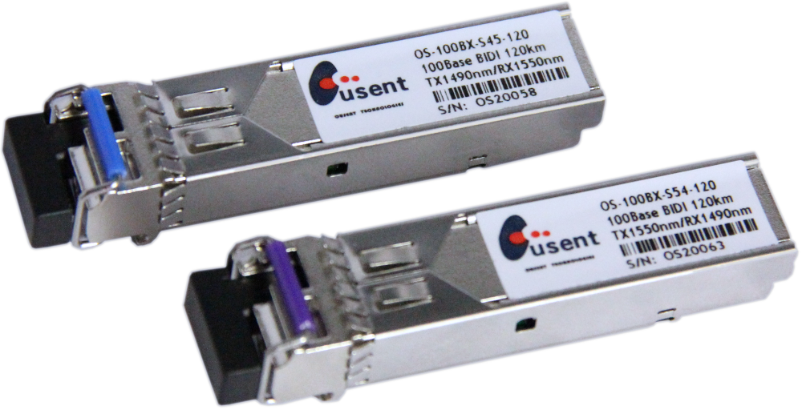
Introduction
Definition
BIDI:
BBC Internet Distribution Infrastructure
Image: https://www.flickr.com/photos/vintagehalloweencollector/421733590
Buck Rogers (maybe)
BiDi transceivers (no)

Slide 12

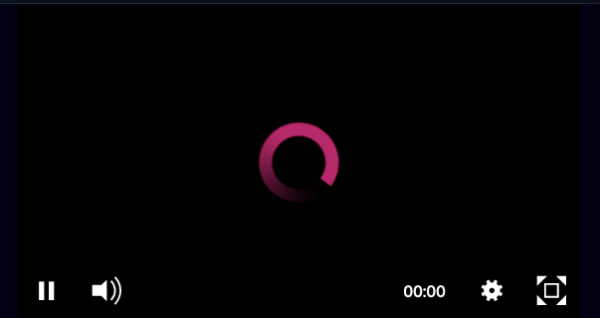
Introduction
Why build our own CDN?
1) IP distribution future
Consumption is transitioning from broadcast (digital terrestrial, satellite, cable) to over-the-top IP distribution.
2) Quality of Service
Optimise hardware and software for high quality of service. Reduce latency for remote UK audiences.

Slide 13

Introduction
Content served by bidi
BIDI serves UK public service only, focussing on the high volume video on demand content sets:
BBC UK CDN traffic breakdown in September 2020:
VoD (75%)
Non VoD (25%)
DASH (60%)
HLS (36%)
DASH: Dynamic Adaptive Streaming over HTTP. HLS: HTTP Live Streaming.

Slide 14
BIDI growth so far

Slide 15
BIDI growth so far
Timeline: R&D Project
2013
2015
2017
2019
2021
R&D project
Proof of concept built.
Small amount of production traffic.
Handover and joint trial.

Slide 16
BIDI growth so far
Timeline: Production build
2013
2015
2017
2019
2021
R&D project
Build
Handover complete.
Production build & rewrite.

Slide 17
BIDI growth so far
BIDI Battery
A BIDI battery is the smallest unit of deployment within a PoP. Built with commodity hardware.
Layer-3 switch, for aggregation and high availability.
2 to 4 caching cells
(commodity servers)
BIDI battery

Slide 18
BIDI growth so far
BIDI Battery: High availability
Servers advertise same VIP over BGP
203.0.113.0
VIP
203.0.113.2
(single)
ECMP
203.0.113.2
203.0.113.2
N+1 resilience

Slide 19
BIDI growth so far
BIDI Battery: Deployment options
A
B
ISP aggregation PoP
Peering
Peering
ISP aggregation PoP
BBC hosted
Clients

Slide 20


BIDI growth so far
BIDI Battery: route learning – which clients to serve
ISP router A
ISP router B
eBGP
eBGP
IP ranges that should be served by this battery
IP ranges
Central “bidibrain”
ISP aggregation PoP

Slide 21
BIDI growth so far
Getting clients to a BIDI battery
Matchmaker
Initial
Extract client IP.
Longest prefix match from IP ranges advertised to each battery.
Tie break with AS path length.
Media manifest request
HTTP redirect to optimal BIDI battery
Cloud hosted
Playback
Client switches to BIDI battery
All subsequent content requests
ISP aggregation PoP

Slide 22
BIDI growth so far
Timeline: Scale out
2013
2015
2017
2019
2021
R&D project
Build
Scale out

Slide 23
BIDI growth so far
BIDI caching cells (servers) in production

Slide 24


BIDI growth so far
BIDI estate size (November 2020)
102 | caching servers
26 | switches
24 | datacentres
3 | ISPs

Slide 25
BIDI growth so far
Peering locations
Public peering:
LINX LON1 + LON2.
IXManchester.
IXScotland (from Manchester).
LONAP.
Private peering:
Telehouse Docklands West, London.
Digital Realty Sovereign House, London.
Equinix MA1, Manchester.
Equinix LD7, Slough (coming soon).

Slide 26
BIDI growth so far
BIDI monthly traffic peak

Slide 27
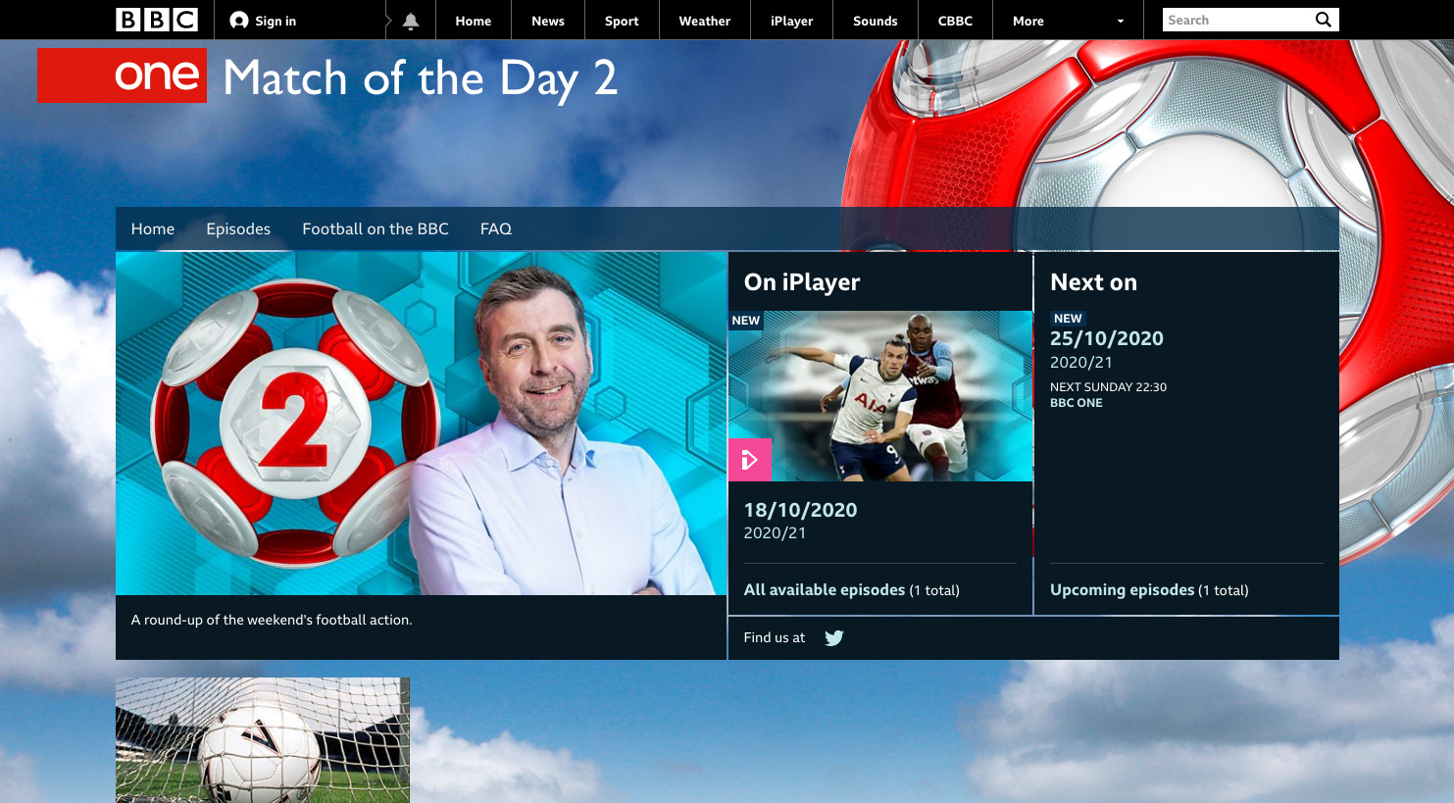
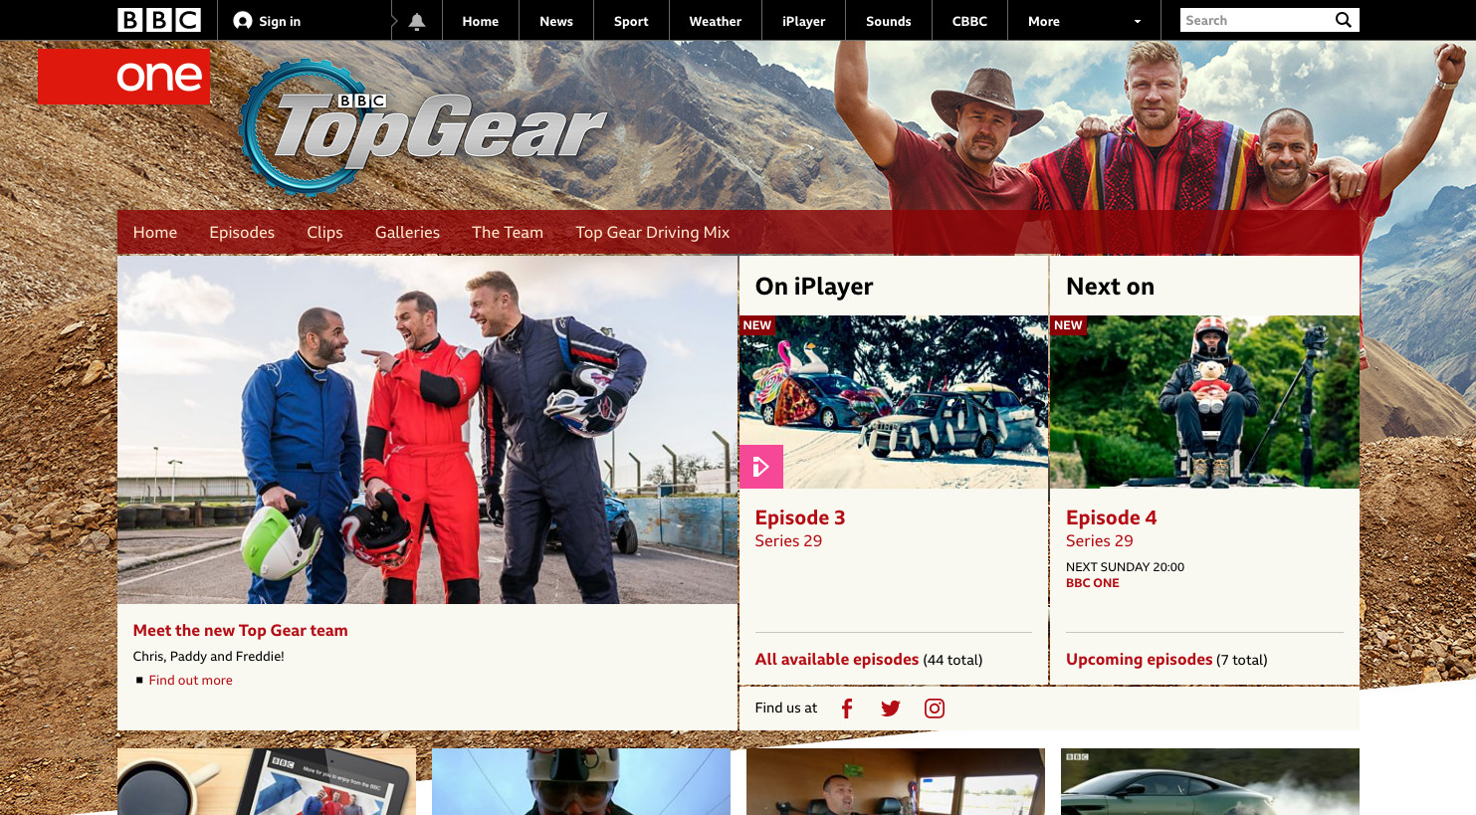
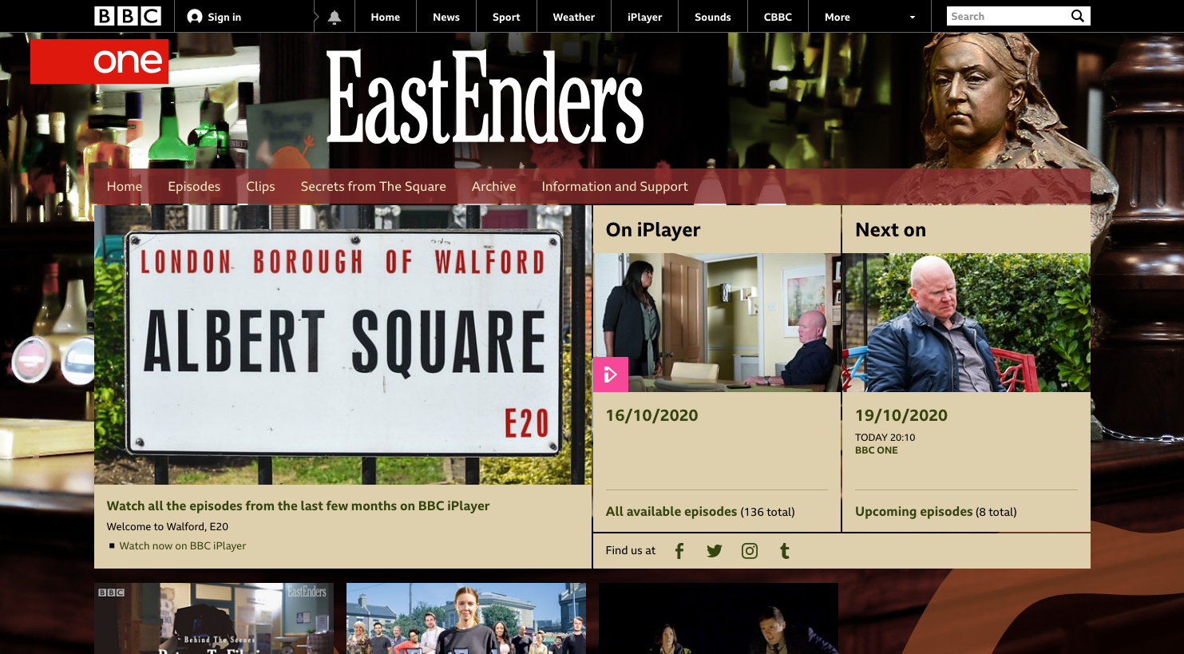
BIDI growth so far
BIDI monthly traffic peak

Slide 28
BIDI growth so far
BIDI monthly traffic peak
249,000 | concurrent streams
708,000 | TCP connections (ESTABLISHED)
96.7 % | offload
26 kW | server power draw
0.048 Wh | per episode (27m 15s)

Slide 29
BIDI growth so far
BIDI offload

Slide 30
BIDI growth so far
Vod 24 hour working set size

Slide 31
BIDI growth so far
Cache hardware evolution
 | 4 Gbps | 20 Gbps | >70 Gbps
Processor | 20 cores Dual socket 2.20 GHz / 190 W | 36 cores Dual socket 2.30 GHz / 280 W | 36 cores Dual socket 2.60 GHz / 300 W
RAM | 128 GiB | 256 GiB | 384 GiB
Storage | 1.3 TB SATA 6 x 480 GB SSDs 1 x HW RAID 1+0 | 19.2 TB SATA 10 x 1.92 TB SSDs 10 x HW RAID 0 | 80 TB NVMe 10 x 8 TB SSDs JBOD
Network | 20 Gbps 2 x 10 G NICs | 40 Gbps 2 x dual 10 G NICs | 100 Gbps 1 x 100 G NIC

Slide 32

BIDI growth so far
SSD performance – learning the hard way
Magic controller compression
Pesky RAID controllers
Performance cliff edges
Fast burnout
Write-back caching
High latencies / TRIM.
Disappearing acts.
Testing disks: Lessons from our odyssey selecting replacement SSDs:
https://www.bbc.co.uk/blogs/internet/entries/ce3eff16-228f-49a0-8d4e-d1a013e4895f
SSD

Slide 33
BIDI growth so far
Cache Software evolution
 | 4 Gbps | 20 Gbps | >70 Gbps
Web server | Varnish | httpd (front) nginx httpd (back) | OpenResty (nginx + LuaJIT)
BGP | ExaBGP | ExaBGP | BIRD
Services | Java | Node.js | Python

Slide 34
Future plans

Slide 35
Future plans
SmartShard
Popular programmes/streams
Served by all batteries, prioritising the edge.
Unpopular programmes/streams
Served by reduced number of core batteries.
Weighted rendezvous hashing distributes long tail.
Utilisation based spill-over
80 TB
20 TB
20 TB

Slide 36
Future plans
IPv6 and ISP portal
IPv6
Still to do:
IPv6 route ingest.
Dual stack addressing.
Actually doing it.
ISP portal
Web portal making BIDI information available for embedded ISPs:
Monitoring.
Emergency + scheduled traffic drains.
Route inspector.

Slide 37
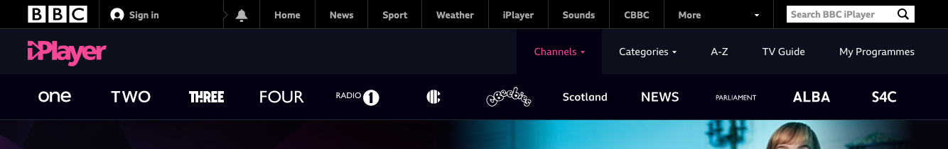
Future plans
Linear streams
Onboard linear streams
Next largest content set.
IP distribution expected to increase.
Less predictable traffic patterns and a high peak/mean ratio.

Slide 38
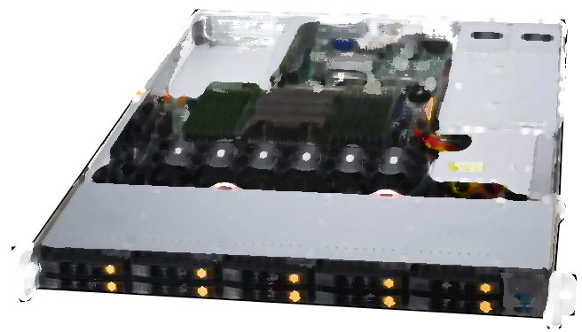
Future plans
MBIDI
Dual-port 100 GbE
Next generation caching cell, targeting deeper levels of the network:
Standalone operation.
Smaller unit size.
Increased power efficiency.
Single socket CPU
96 (logical) cores,
128 x PCIe 4 lanes.
91.8 TB cache storage
6 x 15.3 TB NVMe, PCIe 4.
Smaller 1U chassis

Slide 39

Future plans
New Slough PoP
New BIDI PoP at Equinix LD7, Slough:
Network infrastructure ready.
On-premises origin cache operational.
BIDI planned operational in March 2021.

