Slide 1
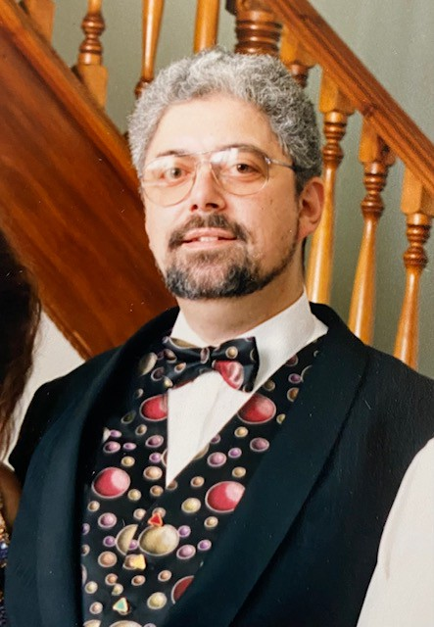
in memory: Cliff Stanford
UK Internet Pioneer
1954 - 2022
1 March, 2022

