Slide 1
Hollow Core Fiber: What is it, and why should you be interested?
Geoff Bennett, Infinera Corp.

Slide 2
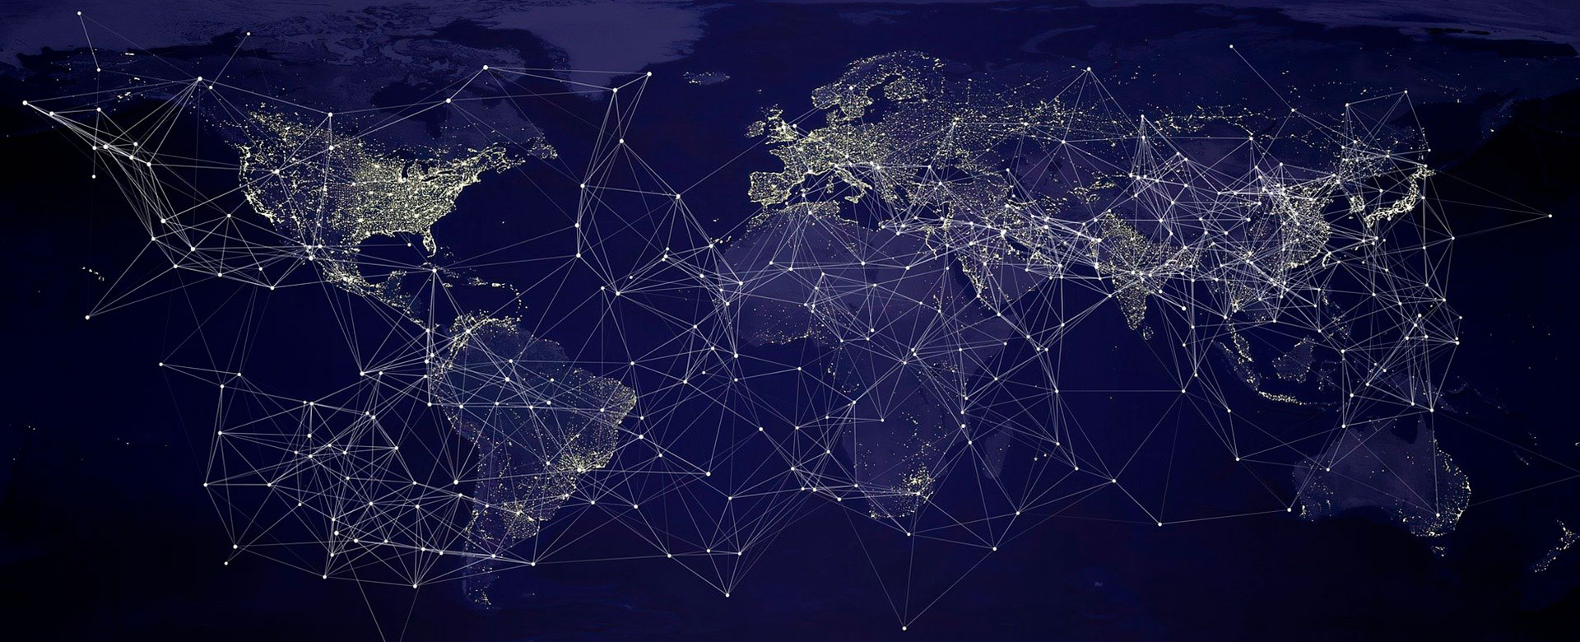
>5 Billion km
fiber deployed worldwide
>400 Million km produced annually
Four Decades of Progress
The Foundation of Global Communications
1 Mb/s → 800 Gb/s per transponder
800,000
times increase
Transported on
Optical Fiber
1 Mb/s → 80 Tb/s per fiber pair
80 Million
times increase

Slide 3
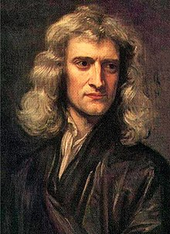
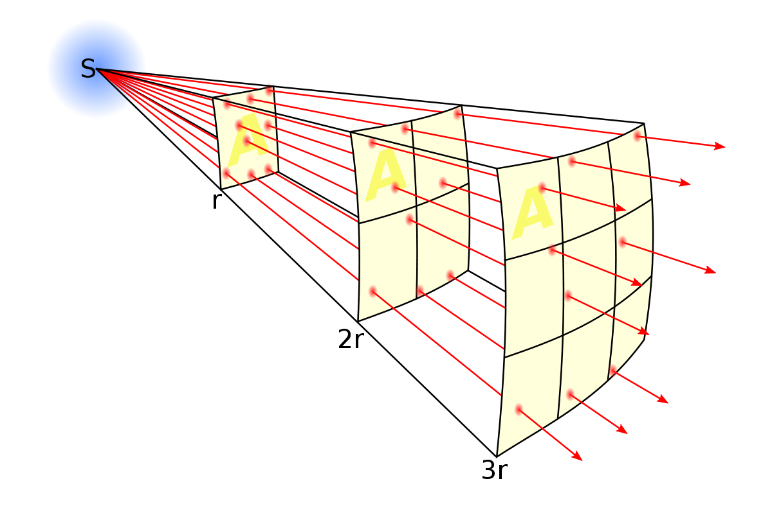
If you let signals go everywhere…The inverse square law
At distance, r we have an area for this signal of A
At distance 2r the area is 4A
And at distance 3r the area is 9A
The strength of the signal is inversely proportional to the square of the distance
Isaac Newton applied this to gravitational forces, but…

Slide 4
How to create an optical waveguide

Slide 5
How Does Optical Fibre Work?
Only room for one mode
SiO₂ + GeO₂
Single mode fiber
Cladding
SiO₂
Core
Light is guided to stay in the core – hence, waveguide
Refractive
Index
Graded Index
Notes:
As light enters the core, it may be travelling at a slight angle, and will hit the refractive index boundary. As long as the angle of incidence is shallow, the boundary will act as a mirror, and reflect the light back into the core at exactly the same angle. This phenomenon is known as Total Internal Reflection, and I’ve given some references to the topic in your Further Reading section. So instead of leaving the fibre, the light is guided down it, bouncing off the sides as it goes.

Slide 6
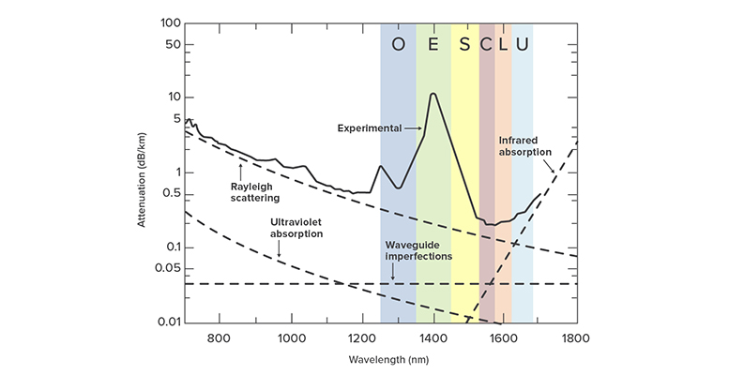
Silica Core Optical Fiber: Attenuation vs Wavelength
Minimum attenuation in the C and L Bands
Note: When I talk about “capacity limits”, I’m assuming C+L operation
Visible spectrum (380-700 nm)

Slide 7
Don’t shout so loud: What is a nonlinear effect?
Imagine you’re listening to music and you keep turning up the volume
Above a certain volume level the music will become distorted
There are several nonlinear effects
Self Phase Modulation
Cross Phase Modulation
Four Wave Mixing
It’s similar with optical fiber – above a certain optical power level the signals will distort – adding lots of noise!!

Slide 8
Capacity Limits of Today’s Optical Fiber
42 Tb/s
42 Tb/s
Extended C-Band
Extended L-Band
50 Tb/s
50 Tb/s
Super C-Band
Super L-Band

Slide 9
Capacity at Longer Reach
100 Tb/s
Super C-Band
Super L-Band
1,000 km
75 Tb/s
Super C-Band
Super L-Band
3,000 km
50 Tb/s
Super C-Band
Super L-Band
7,500 km

Slide 10
Latency: Glass Core vs Air Core
Glass core
Refractive index = 1.46
4.897 µs per km
Air core
Refractive index = 1.000293
3.353 µs per km

Slide 11
What have I told you about conventional optical fiber?
Optical fiber acts as a waveguide
Single mode operation – no modal dispersion
Attenuation varies with wavelength
Today’s optical communication is in the C-Band and L-Band
There is so much more potential capacity in today’s optical fiber, but only at shorter distances because of higher attenuation
Glass is a nonlinear medium – a major limiting factor
Glass core fiber has higher latency than transmission through air

Slide 12
Which means that…
A wider bandwidth waveguide would increase capacity-reach
A more linear optical waveguide would increase capacity-reach
As a separate market driver (ie. not related to capacity-reach) it would be great to find a waveguide that has lower latency than glass
All of these limitations derive from using fiber with a glass core

Slide 13
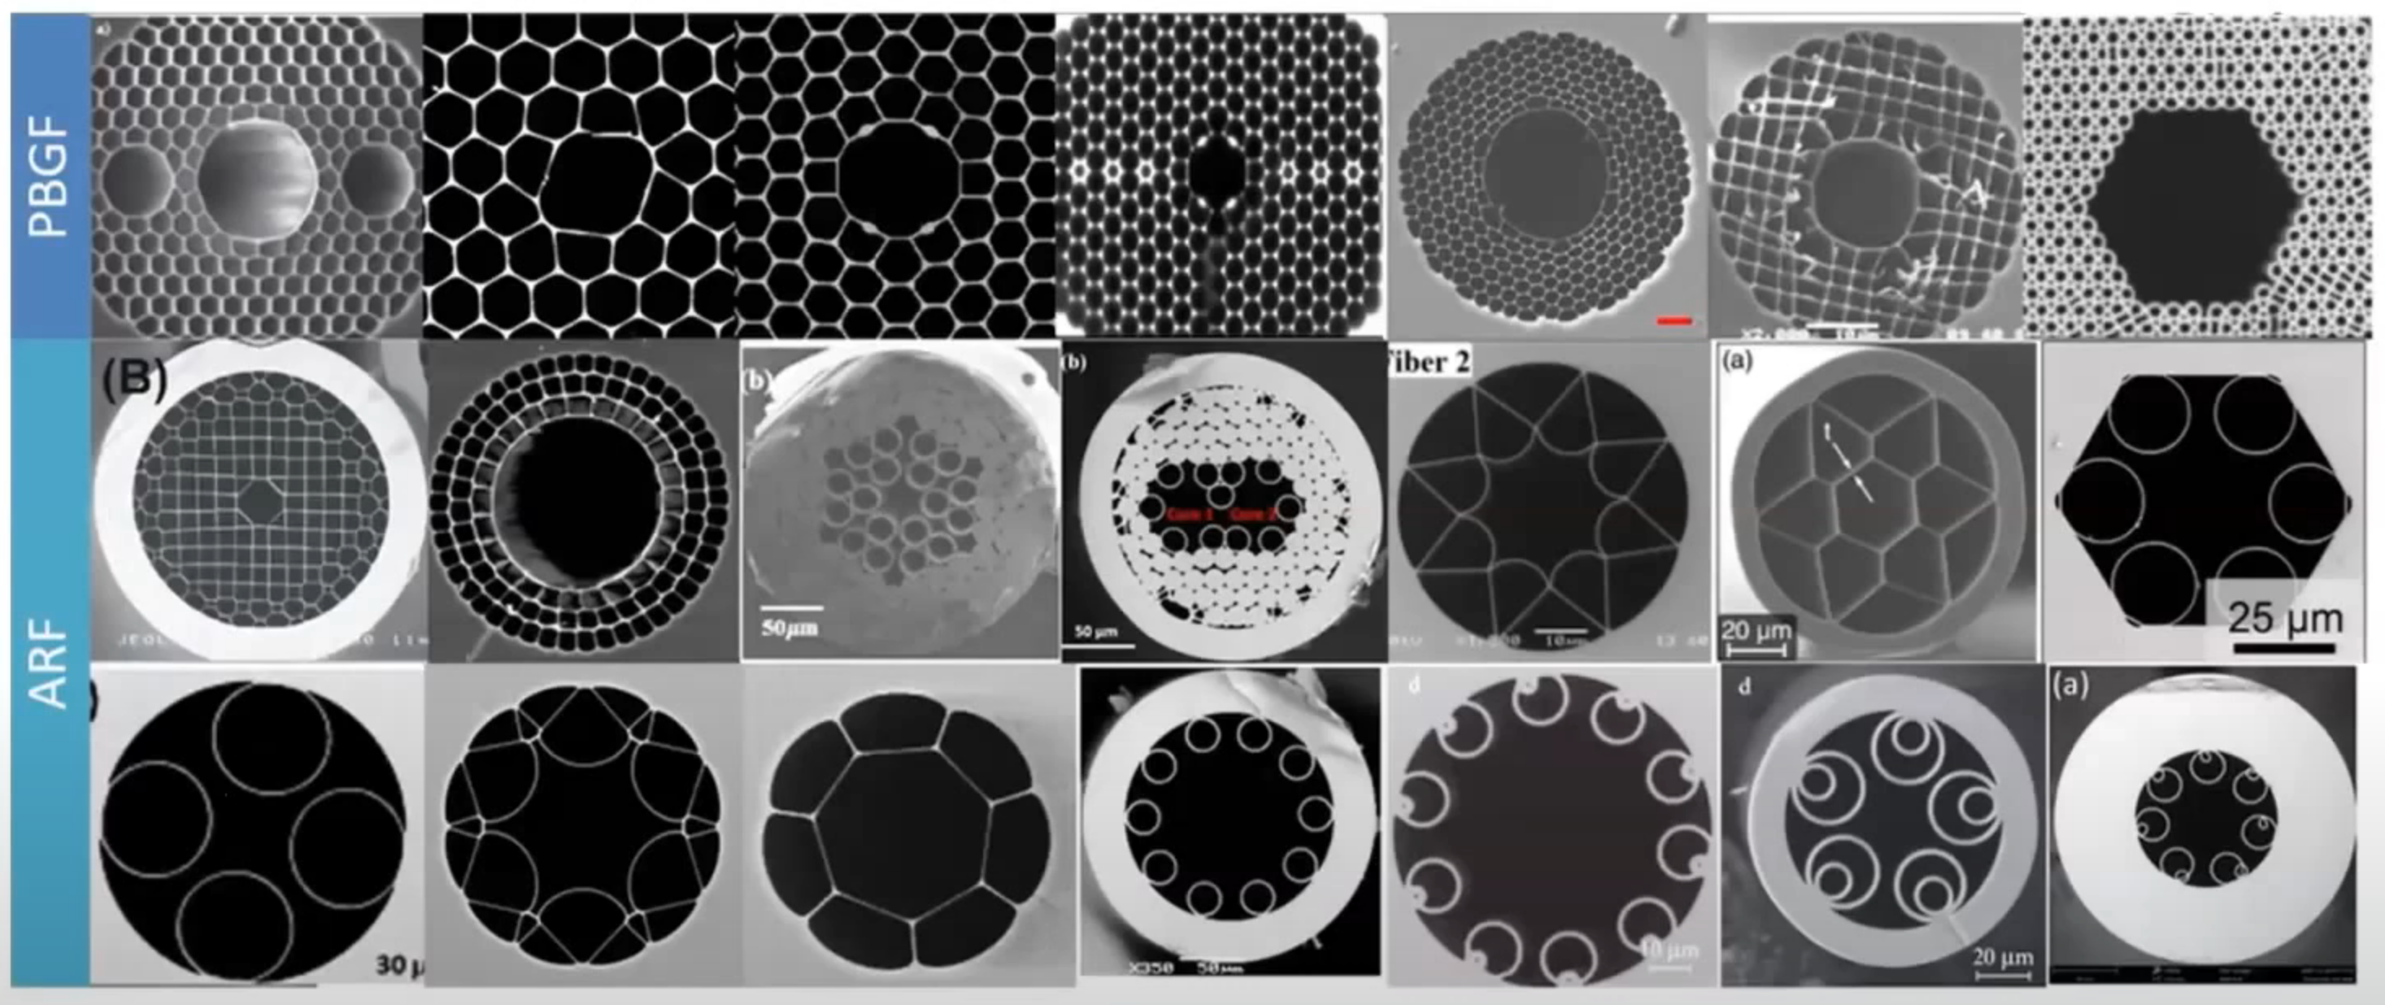
Hollow Core Fiber

Slide 14
Types of HCF: How they create the waveguide
1991
Seems to be at a “technology dead end”:
For optical communications
For the moment
Photonic Bandgap
Hollow Core Fiber
Today
2011
Dual Nested Anti-Resonant Nodeless Fiber (DNANF)
Anti-Resonant

Slide 15
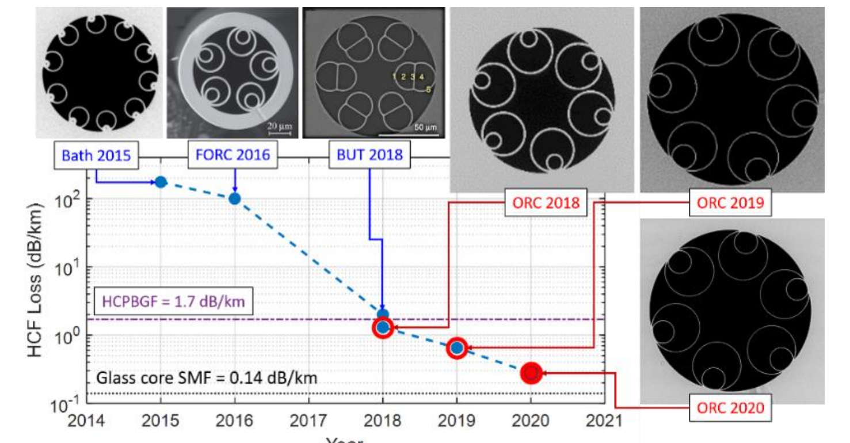
HCF is (mostly) a Great British Invention!!
First HCF proposal in 1991 was Photonic Bandgap
First AR-HCF proposal in 2011 by Dr. AD Pryamikov
The most recent breakthroughs have been at Southampton University

Slide 16
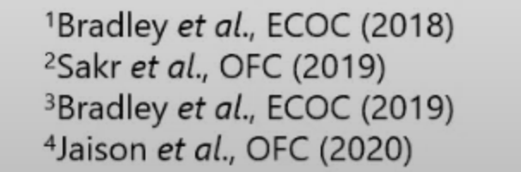
Another evolutionary view
PBG → ARF
PBG
ARF
∅30 µm
∅10 µm
Nested
structures
125 µm

Slide 17
The Big News This Year (Announced at OFC)
SMF-28e+
More spectrum = more capacity
DNANF
<0.35 dB per km at 1310 nm
<0.20 dB per km at 1550 nm
<0.22 dB per km at 1310 nm
<0.18 dB per km at 1550 nm
vs
SMF-28 ULL
<0.31 dB per km at 1310 nm
<0.17 dB per km at 1550 nm

Slide 18
So what are people using this for?

Slide 19
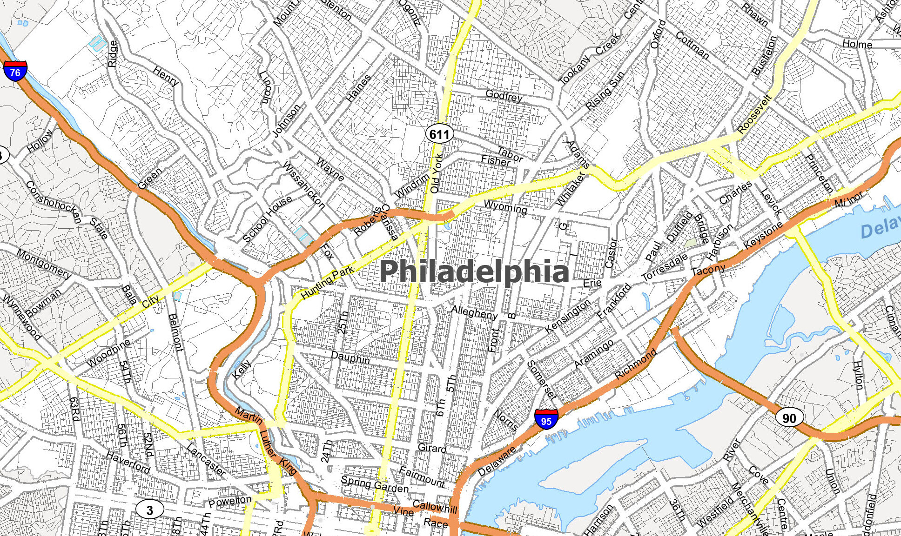
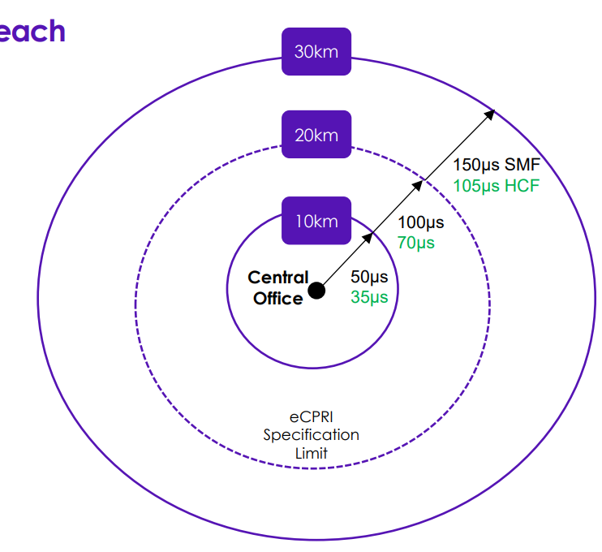
Today it’s all about lower latency
Low Latency Financial Services
Distributed DC
Server Performance
5G Fronthaul Network Enhancement

Slide 20
Future Potential for HCF

Slide 21
Lower Attenuation Over More Spectrum
Silica core fiber has low attenuation here
HCF has already shown low attenuation here…
…and there may be more to come

Slide 22
Lower Nonlinear Penalty (potentially)
BUT…this may depend on what you fill it with
AIR
The NL penalty in HCF may be multiple orders of magnitude lower than silica core fiber
INERT GAS
A low NL penalty means we can send much stronger optical signals into the fiber, and boost fiber capacity as a result
VACUUM

Slide 23
Questions About The Practicality of HCF
Can it be made in quantity?
Does it work with the existing fiber ecosystem?
Deployment guidance vs conventional fiber
Pull force, bend radius, connector fitting
How will HCF age after deployment?
Are the microstructures vulnerable to in-service deformation? (e.g. in subsea)
How can we amplify over those additional wavebands?
What are the nonlinear advantages of the HCF you choose to deploy?

Slide 24
A really brief summary of HCF status today
HCF is being deployed today in low latency applications, with multiple field trials in progress
HCF has the future potential to deliver far more fiber capacity with wideband, low nonlinear performance
Between then and now there are quite a few practical challenges with HCF…but most are engineering problems

Slide 25
THANK YOU
Geoff Bennett
gbennett@infinera.com

