Slide 1
O’REILLY
Why you
should not follow textbook examples
A TEXTBOOK ABOUT HOW NOT TO
FOLLOW TEXTBOOK EXAMPLES
Gary Steers

Slide 2
DISCLAIMER
I am not the copyright holder of the original text
I will not disclose any networks that were found to be ‘vulnerable’
All instances have been ethically reported and subsequently fixed

Slide 3
Task: Re-Invent the wheel for a new install
While designing a network for a platform deployment I decided to use the grey matter and not copy and paste boilerplate configs
I decided to follow the well known ‘RTFM’ method (not to be confused with RFC2721)
Picked an O’REILLEY book for the majority of the reading “O’REILLY® - Juniper MX Series”
This was not for an MX Series device, but All JunOS is equal right?.... (different talk for a different time)

Slide 4
Chapter 4: Routing Engine Protection and DDoS
I need to write a firewall to protect the device from the bad guys
New platform and new feature sets
Need to validate firewall config will protect the system and still allow operation of new features
Be a good internet citizen and respond correctly to diagnostic packets (ICMP/Tracerotue/PMTU etc etc)

Slide 5
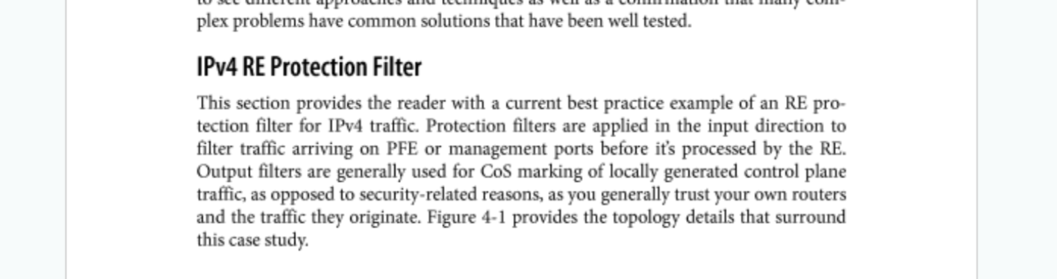
Chapter 4: Routing Engine Protection and DDoS
This is a GREAT place to start right?

Slide 6
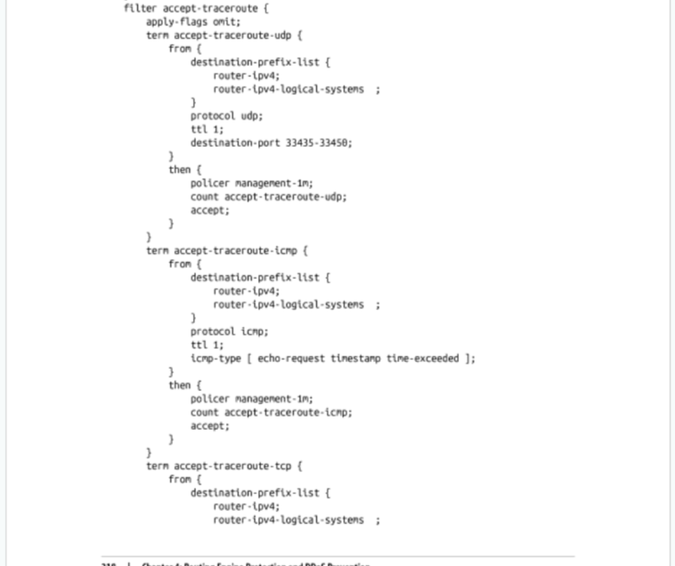
Allowing Traceroute...
Looks Good!...
WAIT...
WHAT ON EARTH IS THAT?????

Slide 7
Allowing Traceroute...
Did you spot the problem?

Slide 8
Allowing Traceroute...
Where Destination is one of routers IP’s
Where the Protocol is TCP
Where TTL == 1
ACCEPT == Let the packet through the firewall so that the kernel can respond with the appropriate response...
That’s all fine right?

Slide 9
What is TTL?
Time to live (TTL) or hop limit is a mechanism that limits the lifespan or lifetime of data in a computer or network.

Slide 10
What’s the relevance?
Where Destination is one of routers IP’s
Where the Protocol is TCP
Where TTL == 1
ACCEPT == Let the packet through the firewall so that the kernel can respond with the appropriate response...
ANY TCP PACKET WITH TTL == 1 gets through the firewall

Slide 11
DANGER!!!
The internet is FULL of bad guys

Slide 12
What’s the relevance?
ANY TCP PACKET WITH TTL == 1 gets through the firewall
Q: How do you manage a router?
Telnet?
SSH?
Some AaaS*
ALL OF THESE USE TCP
*Automation As A Service ^{TM pending}

Slide 13
IT’S OK, NO ONE FOLLOWS TEXTBOOKS OR DO THEY?
Junipers are common on the internet
Some ISPs have previously referenced this book for their firewall config
Juniper even recommend this book as good reference material
It’s co-authored by people at Juniper!
But it’s just an example right!

Slide 14
DISCLAIMER
I will not disclose any networks that were found to be ‘vulnerable’
All instances have been ethically reported and subsequently fixed
Don’t try this at home
(at least without permission from the owner)

Slide 15
Let’s try this out
Use a device that would not normally have access to the host
Verify it can’t access the host

Slide 16
Let’s try this out
Work out distance
Access the host

Slide 17
What next?
Report to the affected network(s)
Report to the vendor and the publisher

Slide 18
Questions?

