Slide 1
Security in/with Community Services
Camelia Simion, Client Support Specialist, Team Cymru

Slide 2
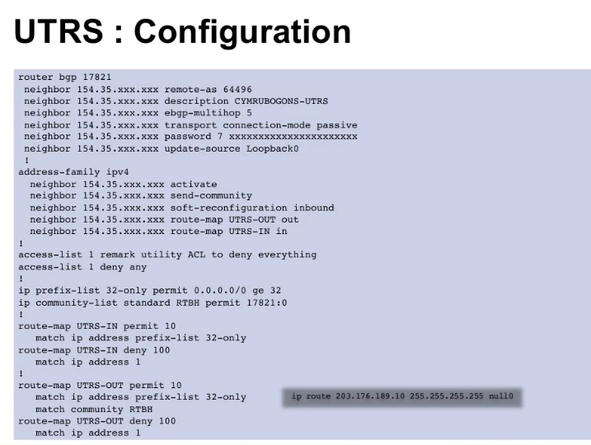

DDOS Mitigation using UTRS
You can help mitigate DDoS attacks as a community. How?
UTRS v2.0 uses techniques like remote-triggered black holes (RTBH) globally.
Together we enable you to protect yourself whilst helping to protect the internet.
You help your neighbour and they help you. Simple as that!

Slide 3
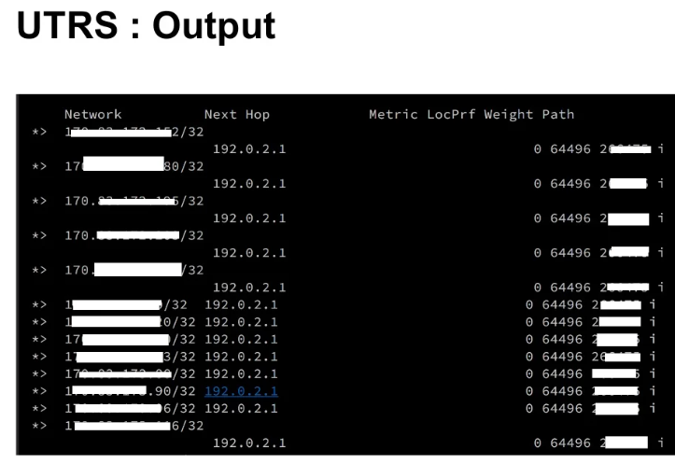

UTRS 2.0 is a no cost BGP-based service that is an effective tool to help mitigate large and concentrated DDOS attacks.
Exclusively for owners of globally unique ASN, UTRS 2.0 adds support for FlowSpec, IPv6, increases IPv4 and IPv6 announcement sizes, Enhanced reliability with redundant peering sessions, and ROA’s are honoured.

Slide 4
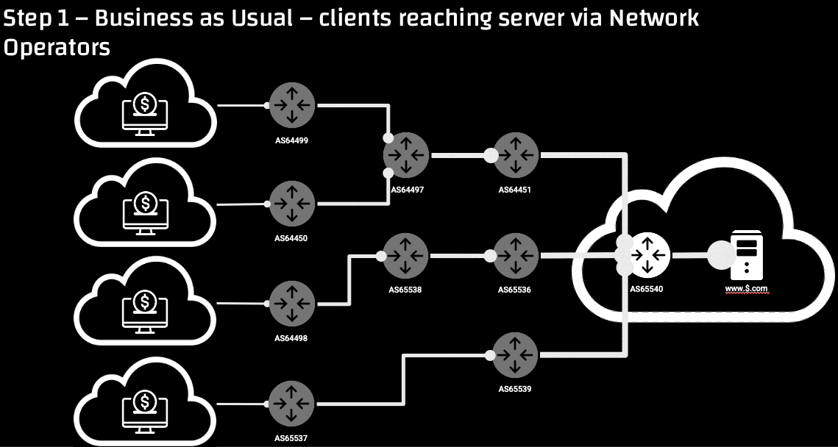

Slide 5


Bogons and Bogon Filtering
Just because an address is a bogon doesn’t mean it can’t be used in a private network.

Slide 6
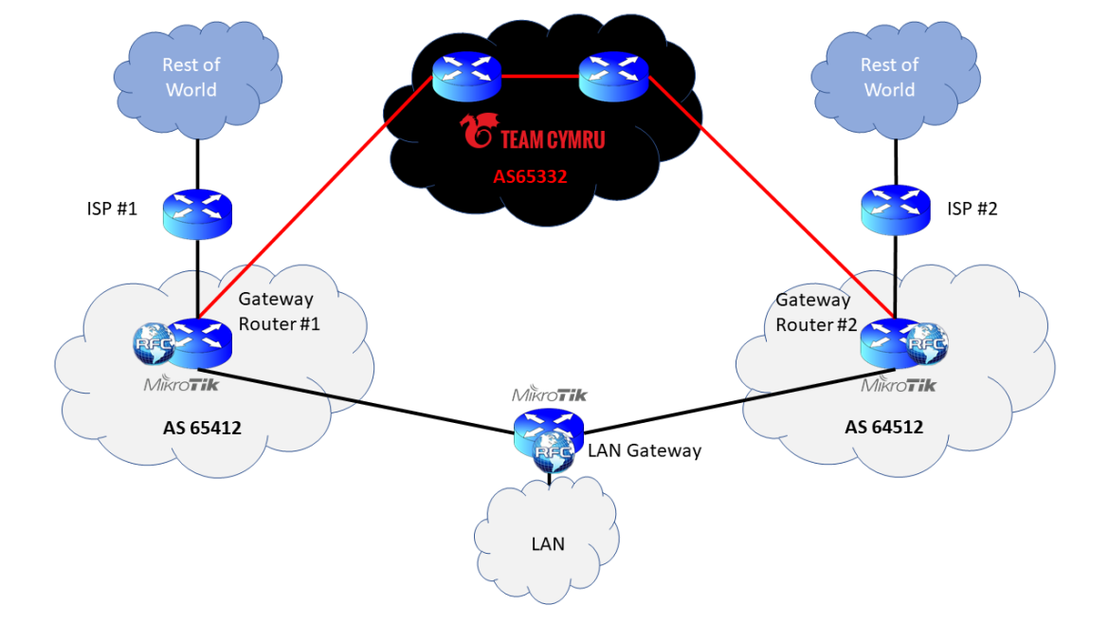

Slide 7
Why filter Bogons?
- To prevent private address space in your network from leaking out into the Internet.
- Bogons are often used in Spam and DDoS attacks
- Helps keep the Internet clean of addresses that shouldn't be routed

Slide 8
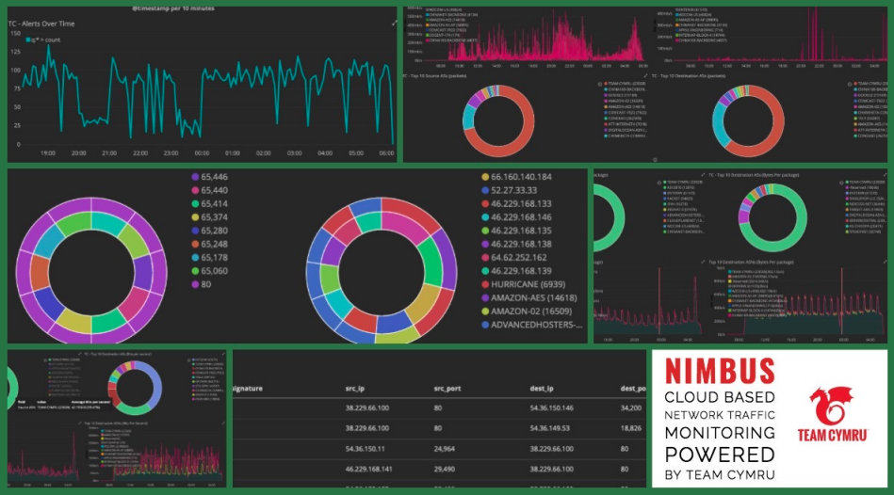
Nimbus Threat Monitor
No-cost Threat Detection for ISPs and Hosting Providers

Slide 9
• Near-real-time threat detection, powered by the world’s most comprehensive IP Reputation data.
• Matches your network flows against over 7,000,000 indicators that are updated hourly.
• Customized filtering, allows you isolate malicious activity by type, network address ranges and more.
- 18 alert filters
- 31 network statistics filters
• SOC dashboard provides an at-a-glance view of top cyber threats and associated details.
• A daily report informs you of your remediation priorities.

Slide 10
IP to ASN Mapping Service
Map IP addresses to BGP prefixes and ASNs
Team Cymru provides various service options dedicated to mapping IP numbers to BGP prefixes and ASNs. Each of the services is based on the same BGP feeds from 50+ BGP peers and is updated at 4-hour intervals.
Whois (TCP 43)
DNS (UDP 53)
HTTPS (TCP 443)

Slide 12
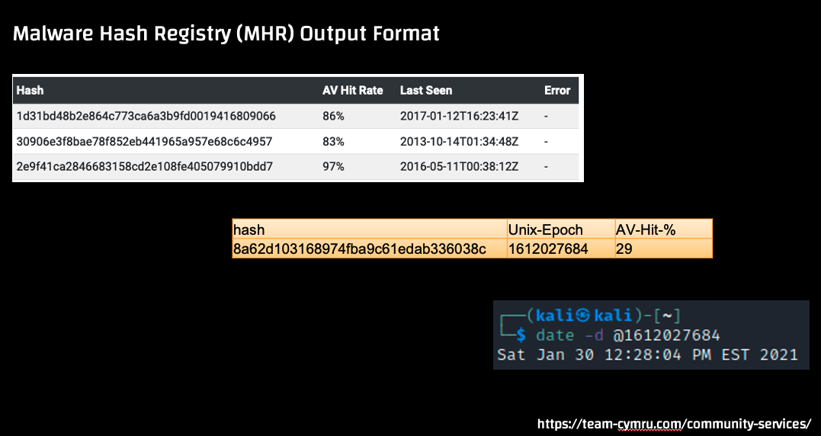
Malware Hash Registry (MHR)
An antivirus and malware validation force multiplier

Slide 13
A free malware validation tool that queries against 30+ undisclosed antivirus databases and plus TC 8+ years Db.
Various collection techniques, such as honeypots and crawlers, as well as leveraging private data-sharing agreements with partners.
Identify new or emerging malware that may not be detected by your existing anti-malware tools
We support MD5, SHA1, and SHA256 hashes

Slide 14
CSIRT Assistance Program
Helping CSIRT worldwide protect their countries.
Free Threat Intel for Non-Commercial National and Regional CSIRT Teams.
As part of Team Cymru’s mission to save and improve lives, we work with national and regional CSIRT teams globally by sharing our world-class threat intelligence. We provide this unique Pure Signal™ intelligence at no cost to you. We want to help secure the Internet, and we want to keep you informed of what we see in your region.

