Slide 1
Quantum Key Distribution activities within GÉANT and the NREN community
Piotr Rydlichowski, PSNC
Rudolf Vohnout, CESNET
Ivana Golub, PSNC
UKNOF50 Conference, 22.09.2022

Slide 2
Quantum Technologies
Quantum mechanics effects are used to enhance the capabilities of current measurement, simulation, computation and communication technologies. 2nd quantum revolution
Superposition, Entanglement, Sensing, Teleportation, Key Distribution
Since Quantum Manifesto (2016) many programs have been started by the European Commission to support the topic: Quantum Flagship, SU-ICT-04-2019, Quantum Internet Alliance, activities in ESA, OPENQKD H2020 project, Quantum Communication Infrastructure (QCI)...
These will be followed under Digital Europe Program in 2021 – 2027.

Slide 3
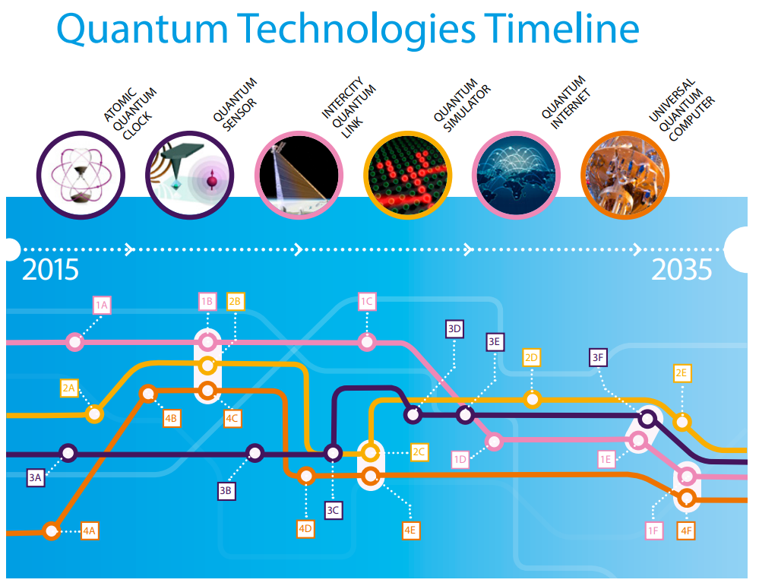
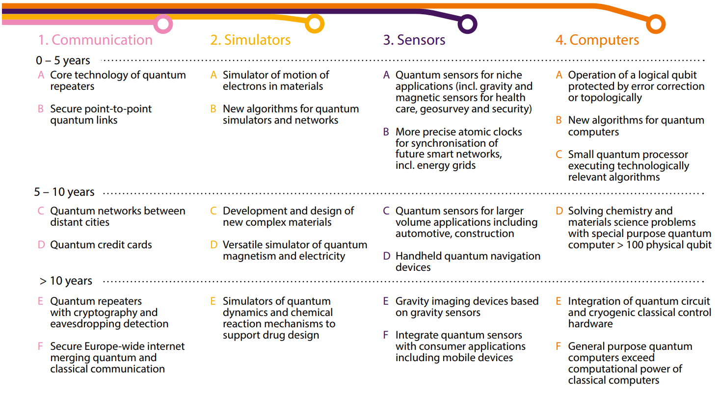
Overwiev of Quantum Manifesto, Quantum Flagship and Digital Europe Programs
https://qt.eu/app/uploads/2018/04/93056_Quantum-Manifesto_WEB.pdf

Slide 4
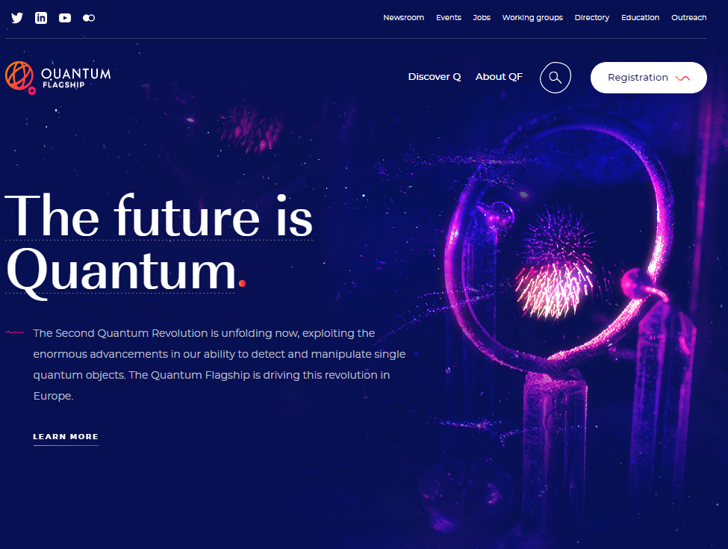
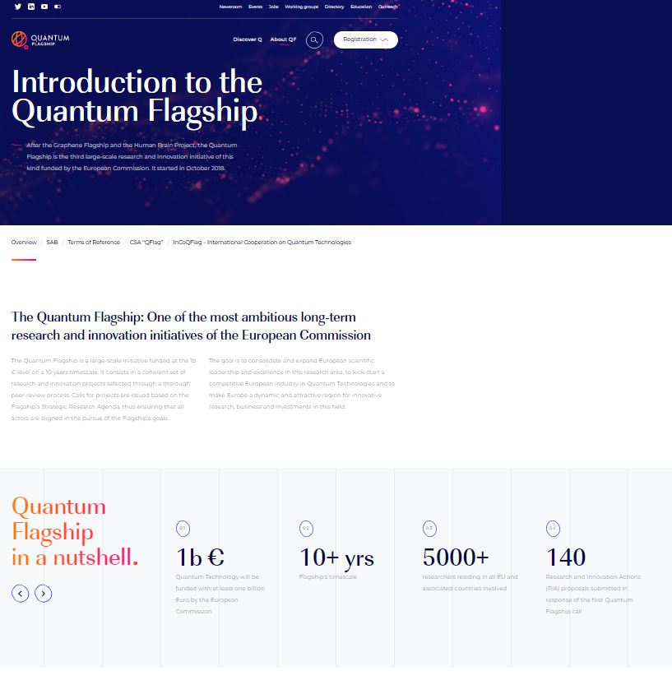
Overview of Quantum Manifesto, Quantum Flagship and Digital Europe Programs
https://qt.eu/

Slide 5
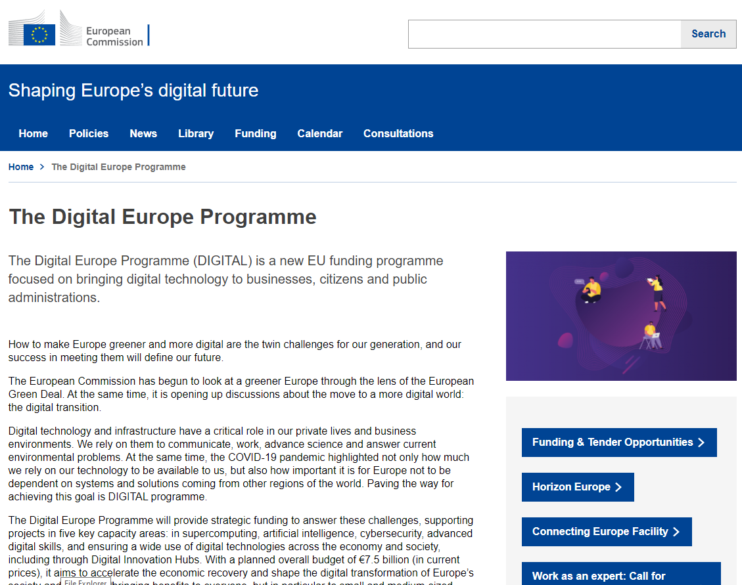
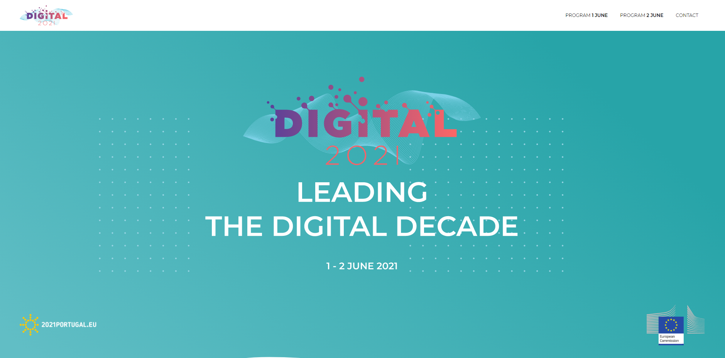
Overwiev of Quantum Manifesto, Quantum Flagship and Digital Europe Programs
https://leading-the-digital-decade.eu/
https://digital-strategy.ec.europa.eu/en/activities/digital-programme

Slide 6
Overwiev of Quantum Manifesto, Quantum Flagship and Digital Europe Programs

Slide 7
Overwiev of Quantum Manifesto, Quantum Flagship and Digital Europe Programs

Slide 8
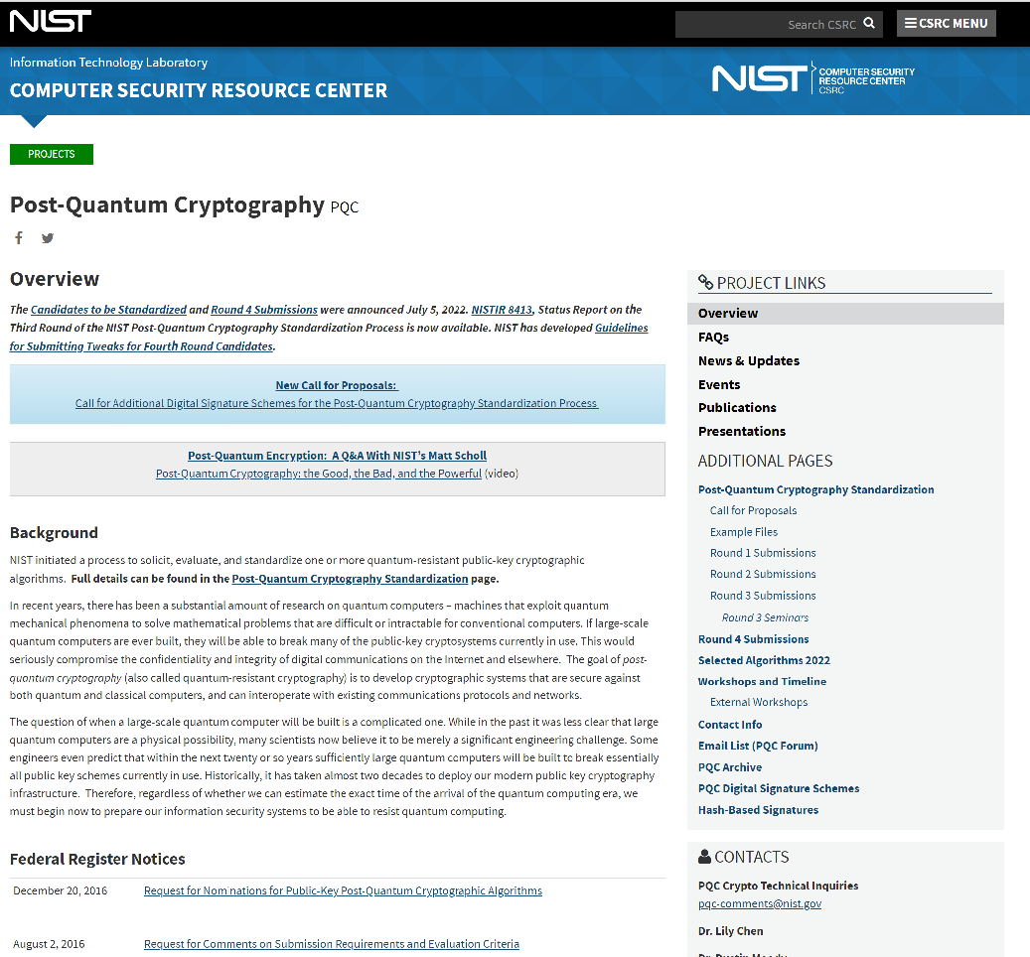
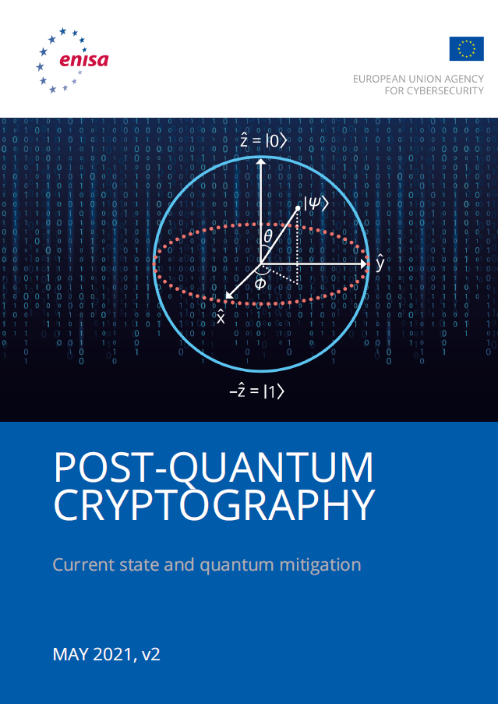
Quantum Key Distribution and Quantum Cryptography
Recognised as a first deployable use case for quantum communication and first step toward “full” quantum communication networks
Quantum computing infrastructure can potentially disrupt existing encryption mechanism
Store and decrypt later problem
Post Quantum Encryption Algorithms complement the QKD technology
  CRYSTALS-Kyber won NIST PQC
  https://sectigo.com/resource-library/who-are-nists-post-quantum-algorithm-winners

Slide 9
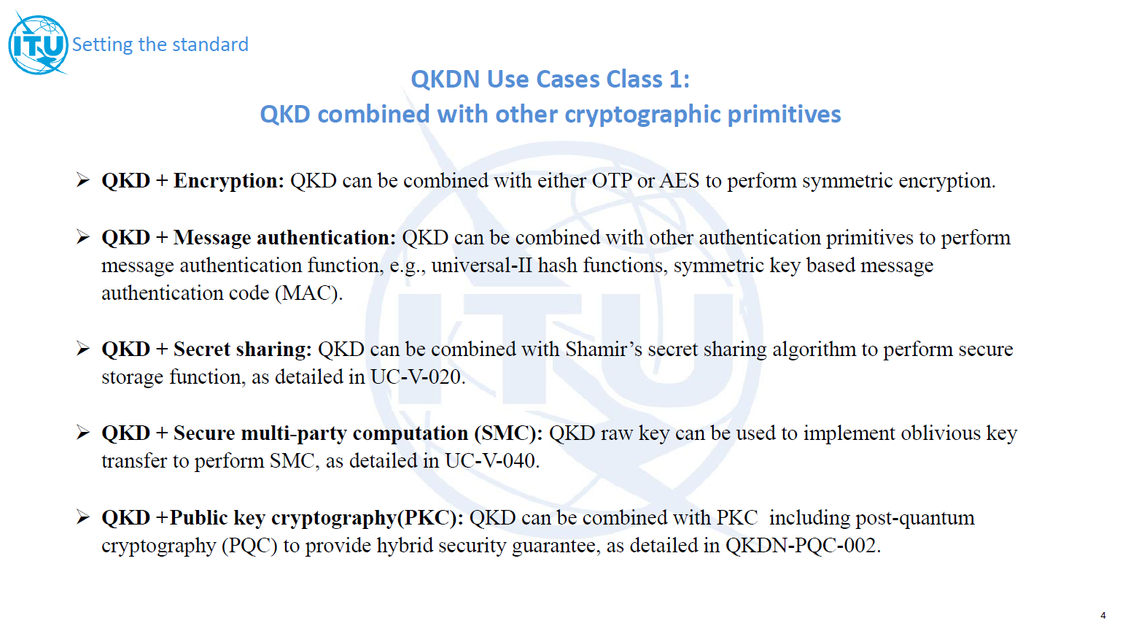
Quantum Key Distribution and Quantum Cryptography
ITU-T formed FG-QIT4N Focus Group to work on the QKD Use Cases - 6 different classes. New documents published February 2022.
9

Slide 10
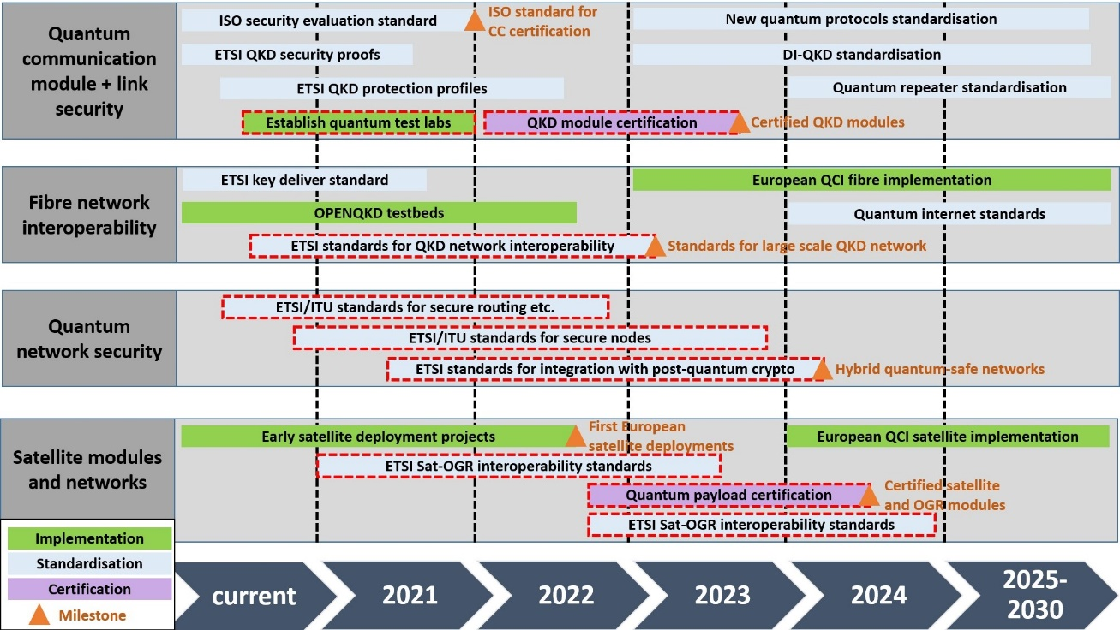
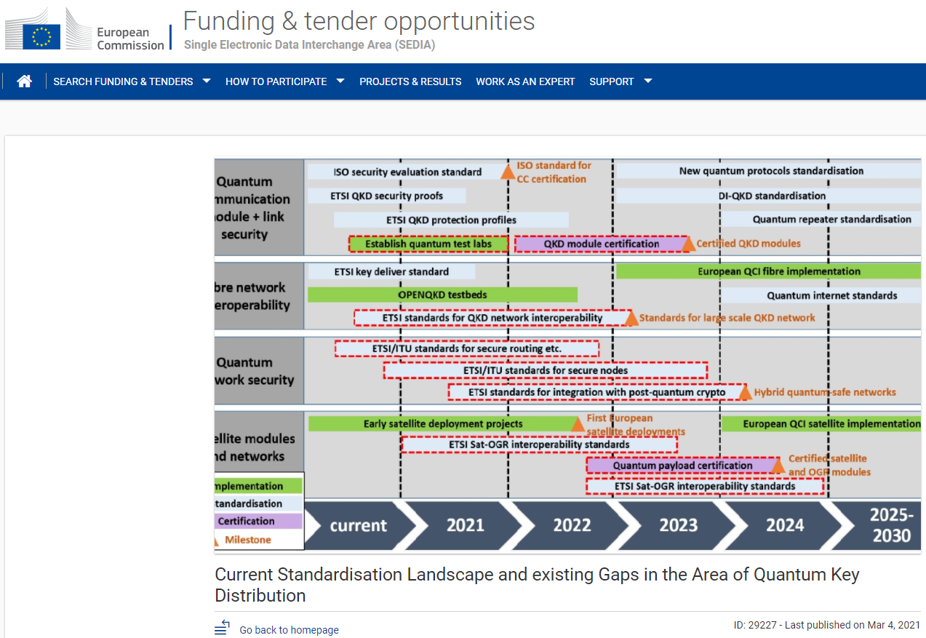
Quantum Key Distribution Standardization Outlook
https://ec.europa.eu/info/funding-tenders/opportunities/portal/screen/opportunities/horizon-results-platform/29227

Slide 11
Quantum Networks
QIRG activities
https://datatracker.ietf.org/rg/qirg/documents/

Slide 12
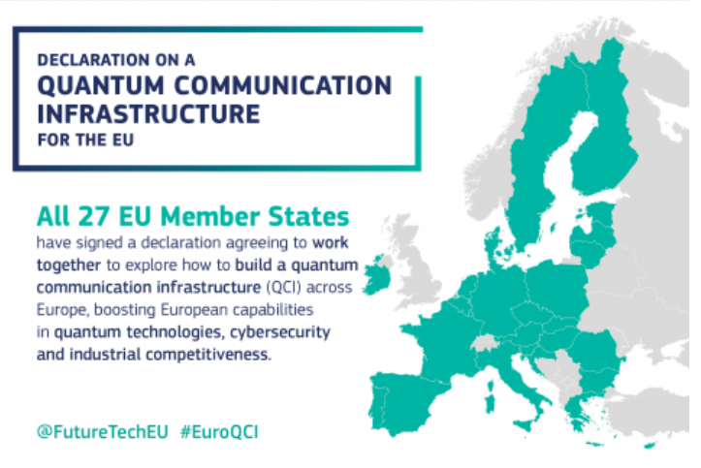
QKD and Quantum Communication activities in NRENs
European Commission strongly supports.
Most of the NRENs are involved in the EuroQCI.
Many of them already have know-how and thus advantage (PSNC, CESNET, SURF …)
Plus the ESA QKDSat activity

Slide 13
Outline for future activities - EuroQCI
NRENs and GÉANT involved in all QCI calls started in March 2022
In June 2022 QCI proposals Topic 1 – Topic 3 were evaluated and agreements are being prepared
In October 2022 call for Cross-border QCI connection is planned to be opened

Slide 14
Quantum Technologies and NRENs, activities within GÉANT
Within the GN4-3 project, WP6 T1:
Sharing the knowledge - Several Info-shares towards the community.
Quantum eAcademy - training materials about Quantum Technologies.
  Complementary to e.g. https://qtedu.eu/ by Quantum Flagship.
  Labor market - see https://qt.eu/jobs
QKD Proof of Concept - collaboration with Toshiba and OpenQKD project
Open Quantum Group has been formed to discuss technical topics
For more information - contact netdev@lists.geant.org
https://wiki.geant.org/display/NETDEV/QKD

Slide 15
Quantum Technologies and NRENs, activities within GÉANT
The QKD theory and technologies was explored further on GÉANT recent infoshares:
GÉANT Infoshare: Quantum Technologies - Principles, Challenges and Applications - https://events.geant.org/event/353/
GÉANT Infoshare: Quantum Key Distribution - Practical Implementations, Challenges, R&E Use Cases and Standardisation outlook –
https://events.geant.org/event/453/
GÉANT Infoshare: Quantum Key Distribution (QKD) Simulation
https://events.geant.org/event/991/
GÉANT Infoshare: Quantum Key Distribution (QKD) Physical implementation and testbed
https://events.geant.org/event/1006/

Slide 16
Quantum Key Distribution Technologies in NRENs,
activities examples

Slide 17
Quantum Key Distribution Technologies in NRENs, activities examples (1)
TNC2017 conference

Slide 18












Quantum Key Distribution Technologies in NRENs, activities examples (2)
Selected NRENs have undertaken activities in the Quantum communication area, an example of such projects are TNC18, TNC21 presentation and demos, QIA, OPENQKD, QUAPITAL and EuroQCI.
Post Quantum and QKD algorithms demo - TNC18 conference https://tnc18.geant.org/core/event/96.html
Poznan
Hamburg
Oslo
Trondheim
Inband PQ key exchange
QKD over fiber
100G end-to-end AES256 encryption
2800 km distance

Slide 19

Quantum Key Distribution Technologies in NRENs, activities examples (3)
Austrian Institute of Technology coordinator, PSNC partner
The planned start date for works is October 2019, 3 years.
PSNC is one of the main testbeds for new QKD solutions.
Implementation of several scenarios and applications using QKD technology.
Development of software for testbed management and performance monitoring, integration with existing transmission infrastructure.
Participation in the work related to the preparation of the concept of implementing QKD technology into scientific and operational networks.
Discussion on solutions integrating the transmission of DWDM system signals, quantum channels and time / frequency reference signals.
Promotion of the project and its results.

Slide 20
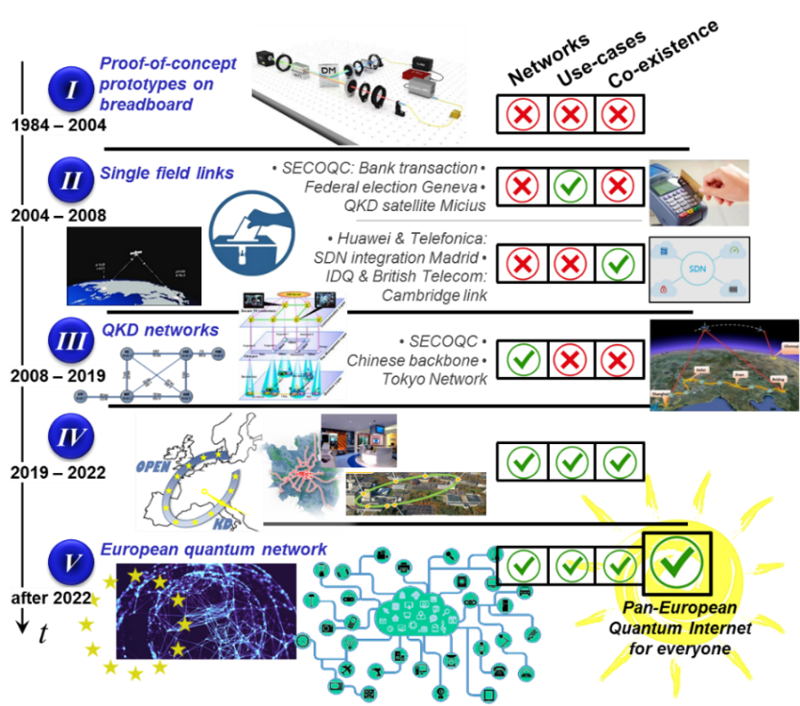
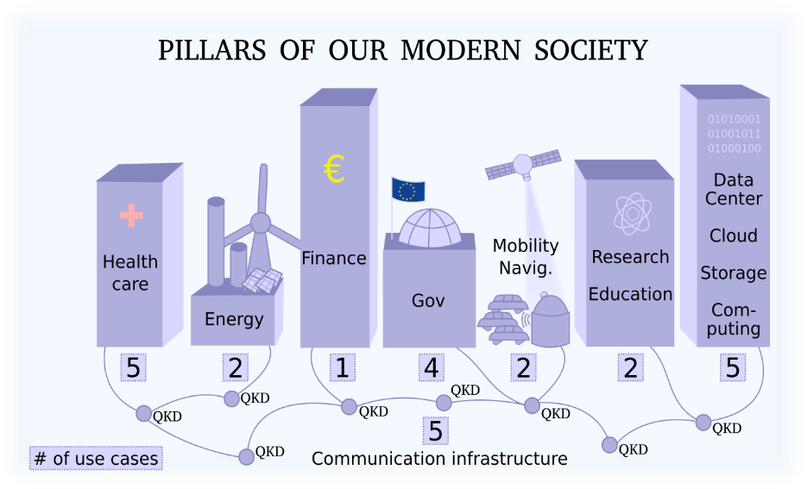
Quantum Key Distribution Technologies in NRENs, activities examples (4)

Slide 21
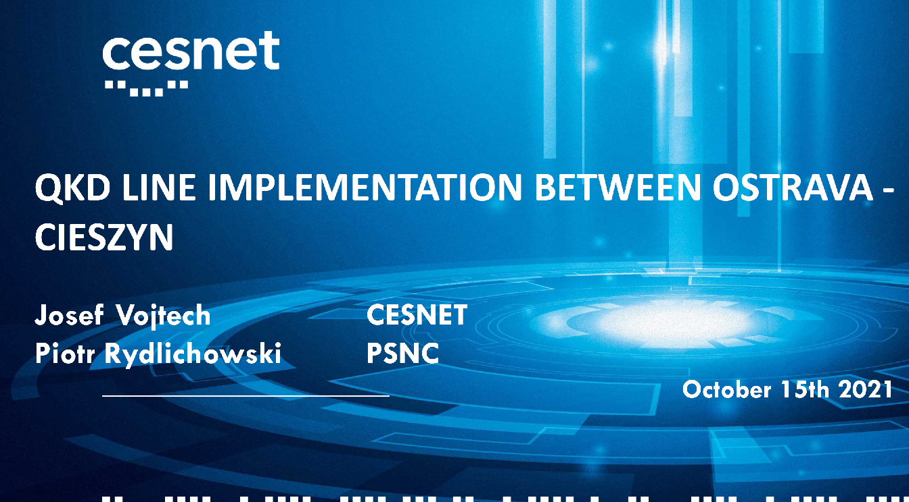
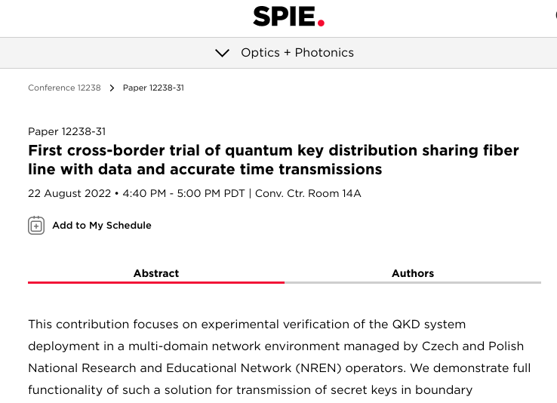
Quantum Key Distribution Technologies in NRENs, activity examples (5)

Slide 22
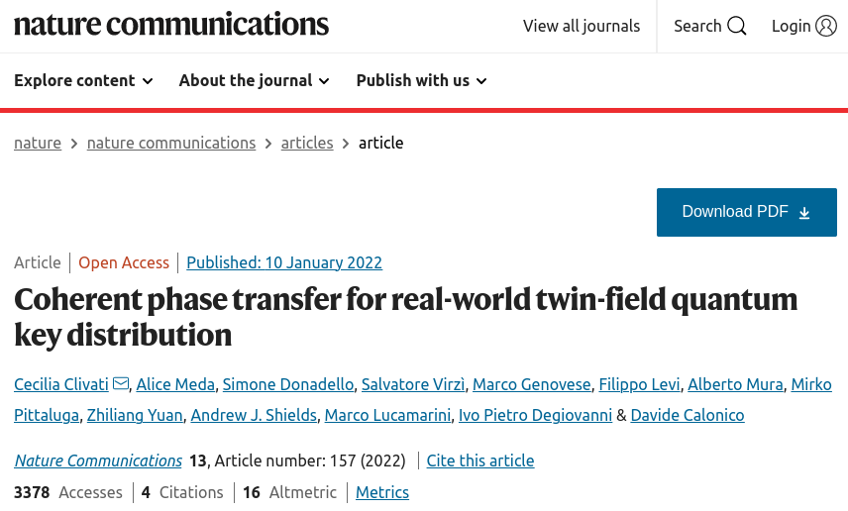
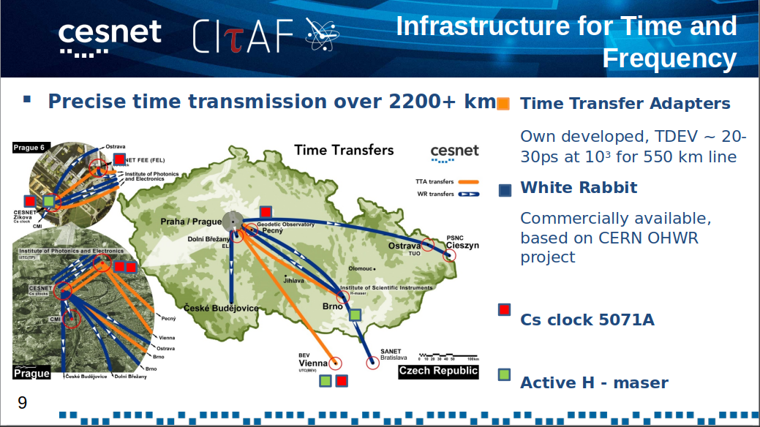
Quantum Key Distribution Technologies in NRENs, support activity example (6)

Slide 23
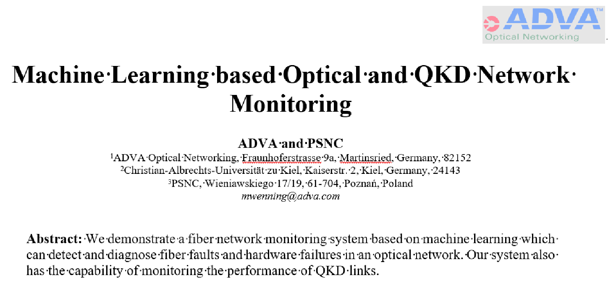
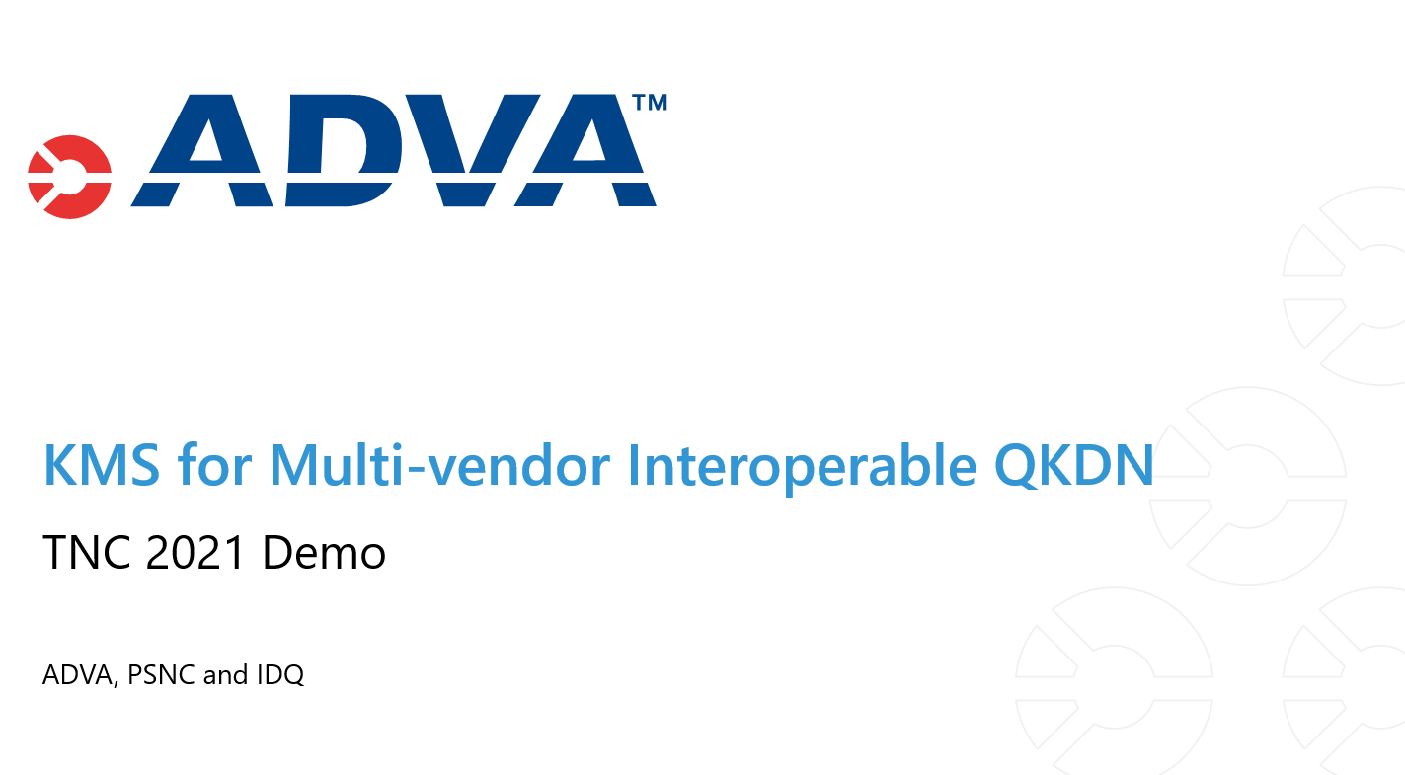
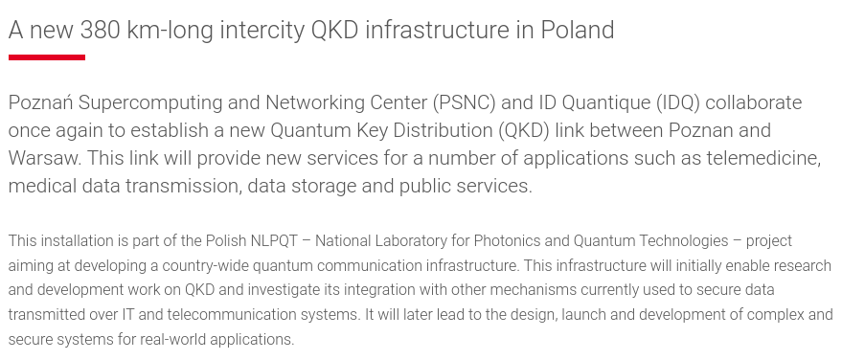
Quantum Key Distribution Technologies in NRENs, activities examples (7)
Live Demo at TNC21 & TNC22 conference – PSNC booth
https://tnc21.geant.org/demonstrations/#c562

Slide 24
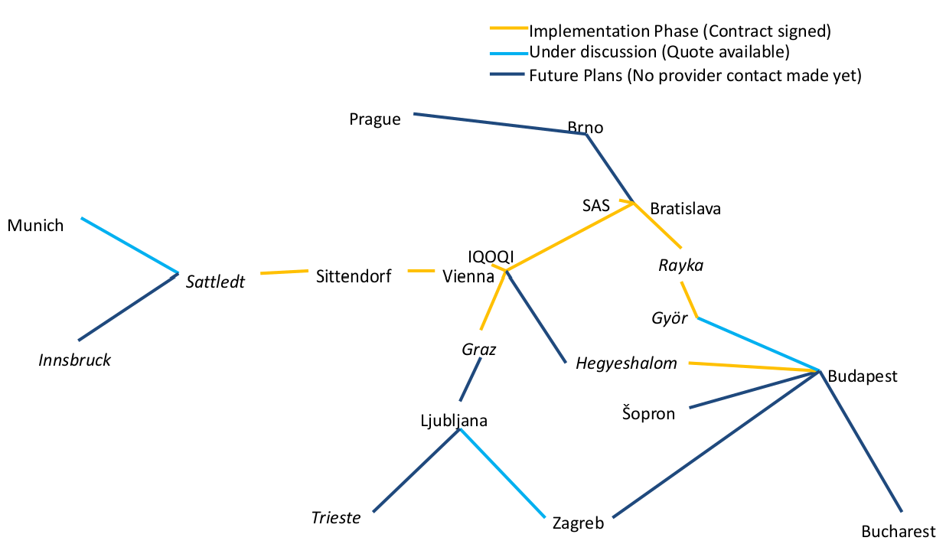
Quantum Key Distribution Technologies in NRENs, support activity example (8)
QUAntum Photonic Intercity TrAnsmission Lattice (QUAPITAL) - https://quapital.eu/
Driven by IQOQI Vienna, Austria.
Not supported by any project.
Step towards quantum internet
Using existing fibre infrastructure.

Slide 25
Quantum Key Distribution Technologies in NRENs, support activity example (9)
SURF webinar – „Connecting to Quantum Internet” 15th June 2021

Slide 26

Quantum Key Distribution Technologies in NRENs, support activity example (10)
PSNC metro QKD links – NLPQT and OPENQKD projects
Intercity 380 km trusted node link Poznań – Warsaw – NLPQT project

Slide 27
Existing National Projects and NRENs engagement
European countries launched national development initiatives for quantum technologies
They complement the Quantum Flagship initiative
NRENs are directly or indirectly involved
The study of National Programs has been included in the GEANT white paper „Quantum Technologies Status Overview” https://about.geant.org/wp-content/uploads/2021/12/GN4-3_White-Paper_Quantum-Technologies-Status-Overview.pdf
Countries: Austria, Croatia, Czech Republic, Fance, Germany, The Netherlands, Poland, Switzerland, UK …

Slide 28
Summary
GÉANT project WP6 T1 group support NRENs in quantum technologies developments and advancements.
GÉANT and NREN communities have the infrastructure, services and use cases to fully support Quantum communication development.
Close cooperation established between QKD, Quantum Communication devices vendors, GÉANT and NRENs
QKD and quantum communication testbeds, use cases within GÉANT and NRENs are beeing prepared and implemented.
GÉANT together with NRENs actively support Quantum technologies education and training via eAcademy portal.
Implementation of evaluated QCI proposals calls and involvement in next QCI calls – this and next year.

