Slide 1

#UKNOF50 by Rene

Slide 2
Our IT / Tech Community is one big family.
We don't think in colors, we don't think in races or genders, we don't think in borders.

Slide 3
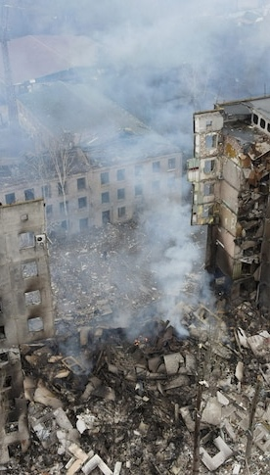
Keep Ukraine Connected
February 24, 2022
This was the day everything began.
War started in Ukraine.
Dark days for Ukrainian people,
but also for Internet Service Providers in the region.

Slide 4
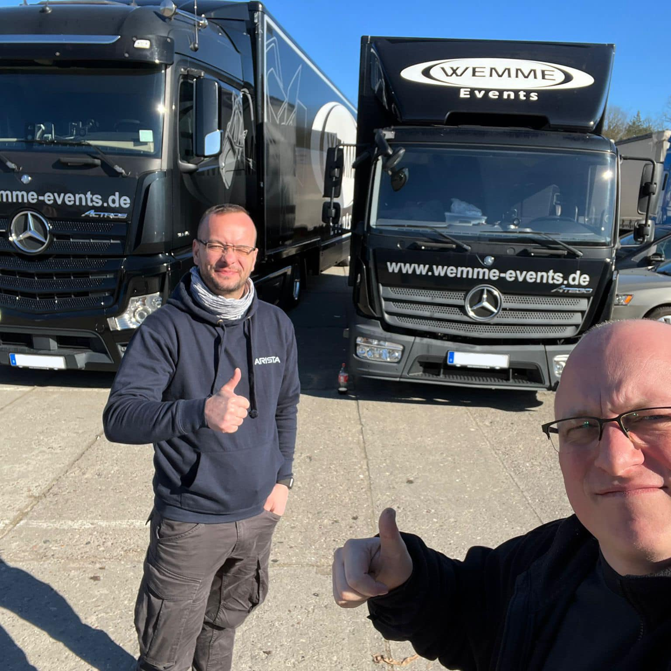
The beginning…
When Russia invaded Ukraine, our chair René Fichtmüller didn’t want to stand idly by. He first got together with his friend Patrick, and helped organise two truck’s worth of relief, which they dropped off at the Ukrainian border in the second week of March 2022.
However, of course, this was not enough.

Slide 5
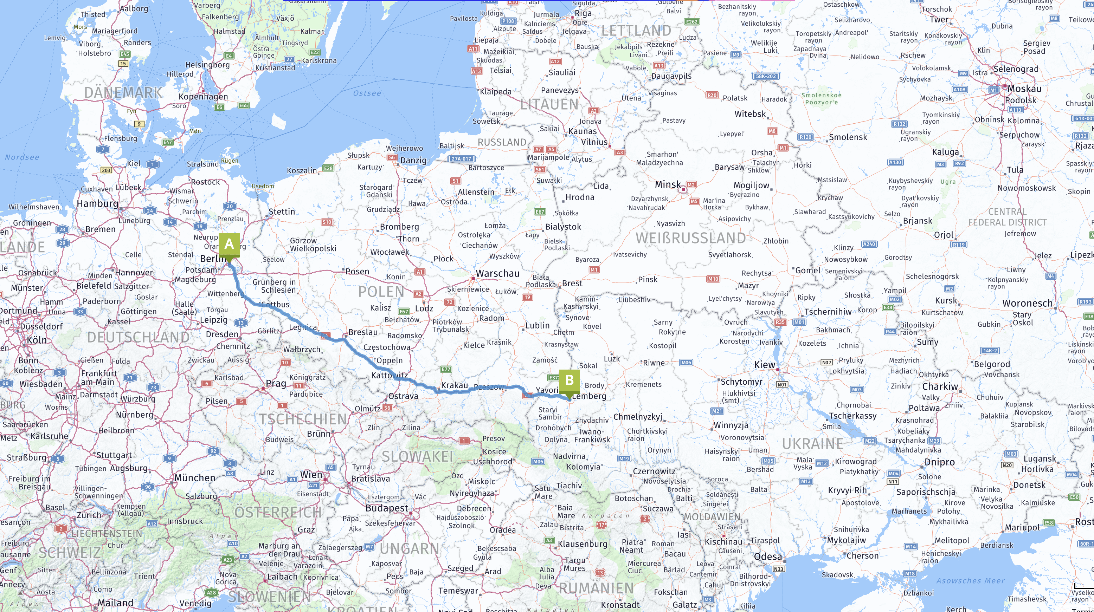

Slide 6
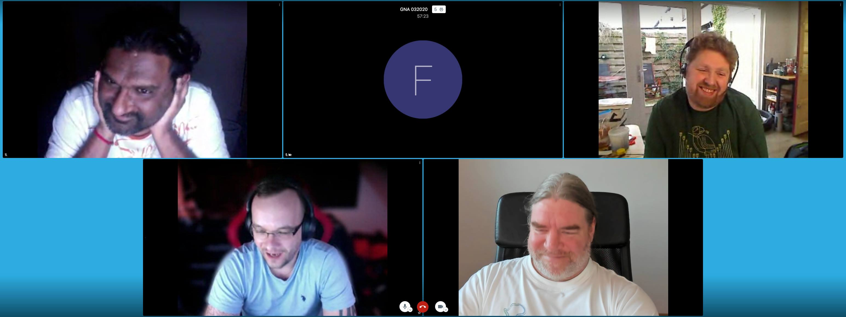
The next day…
At the Global NOG Alliance Board Meeting
Rene shared his thoughts on the next steps, and we all agreed that it was time to do exactly what the Global NOG Alliance was founded to do.
Help Network Operators.
We called this task force:

Slide 7
WHY?

Slide 8

…why are we doing this? (Part I)
Infrastructure perspective
WHY?

Slide 9
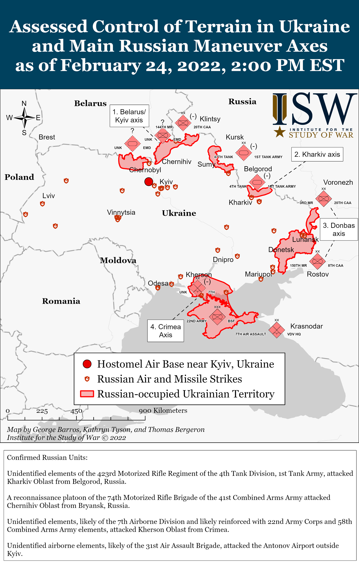

Slide 10
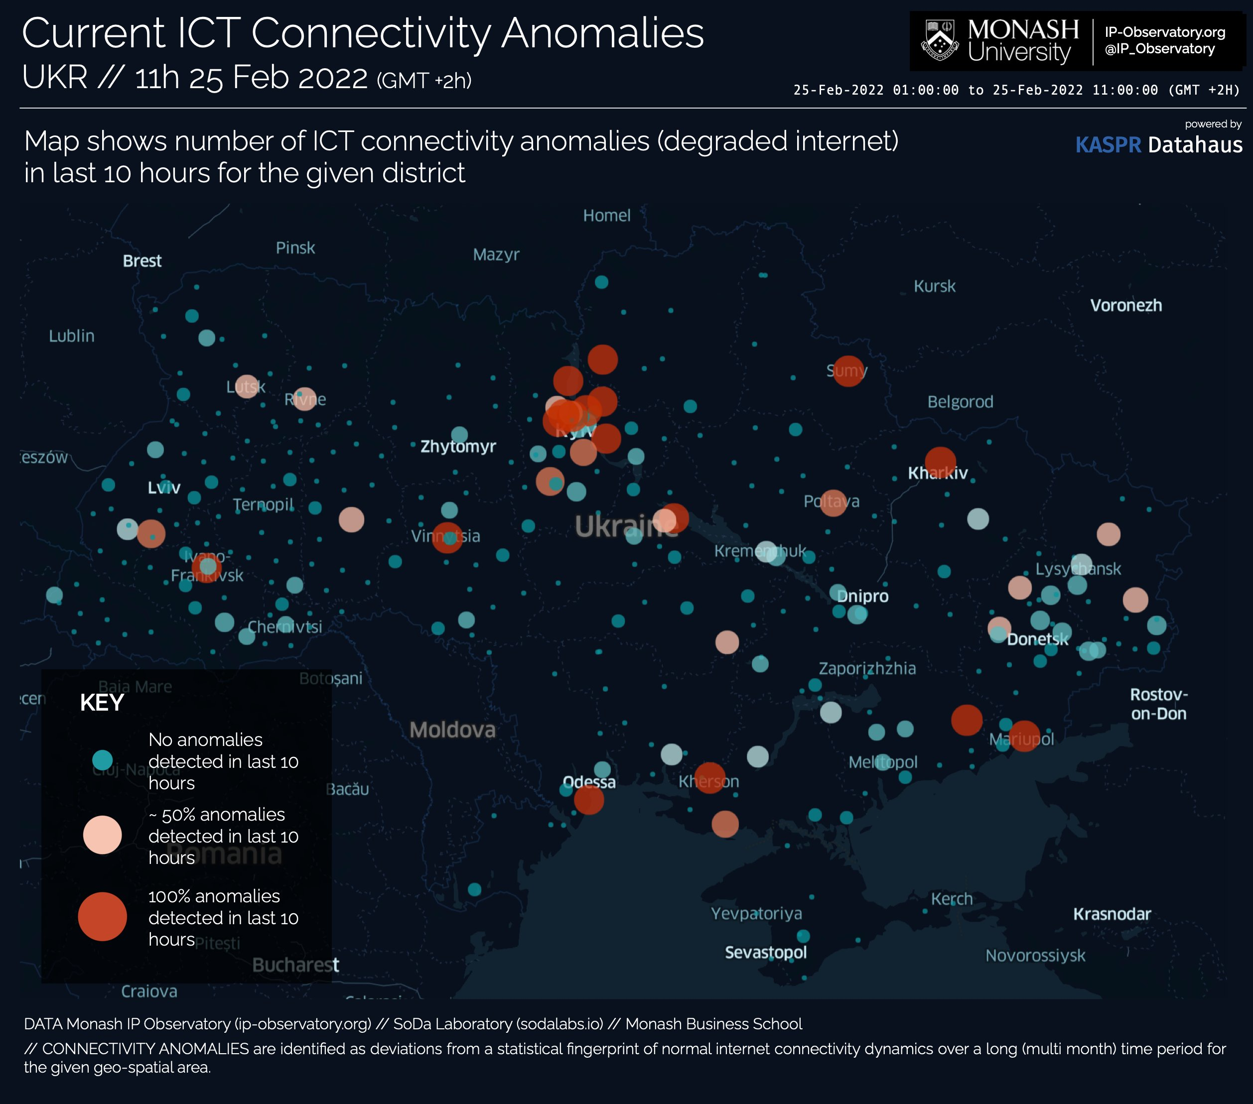
Source: https://i.redd.it/9k7i4olx3zj81.jpg
Notes:
25th Feb 2022
ICT connectivity anomalies

Slide 11
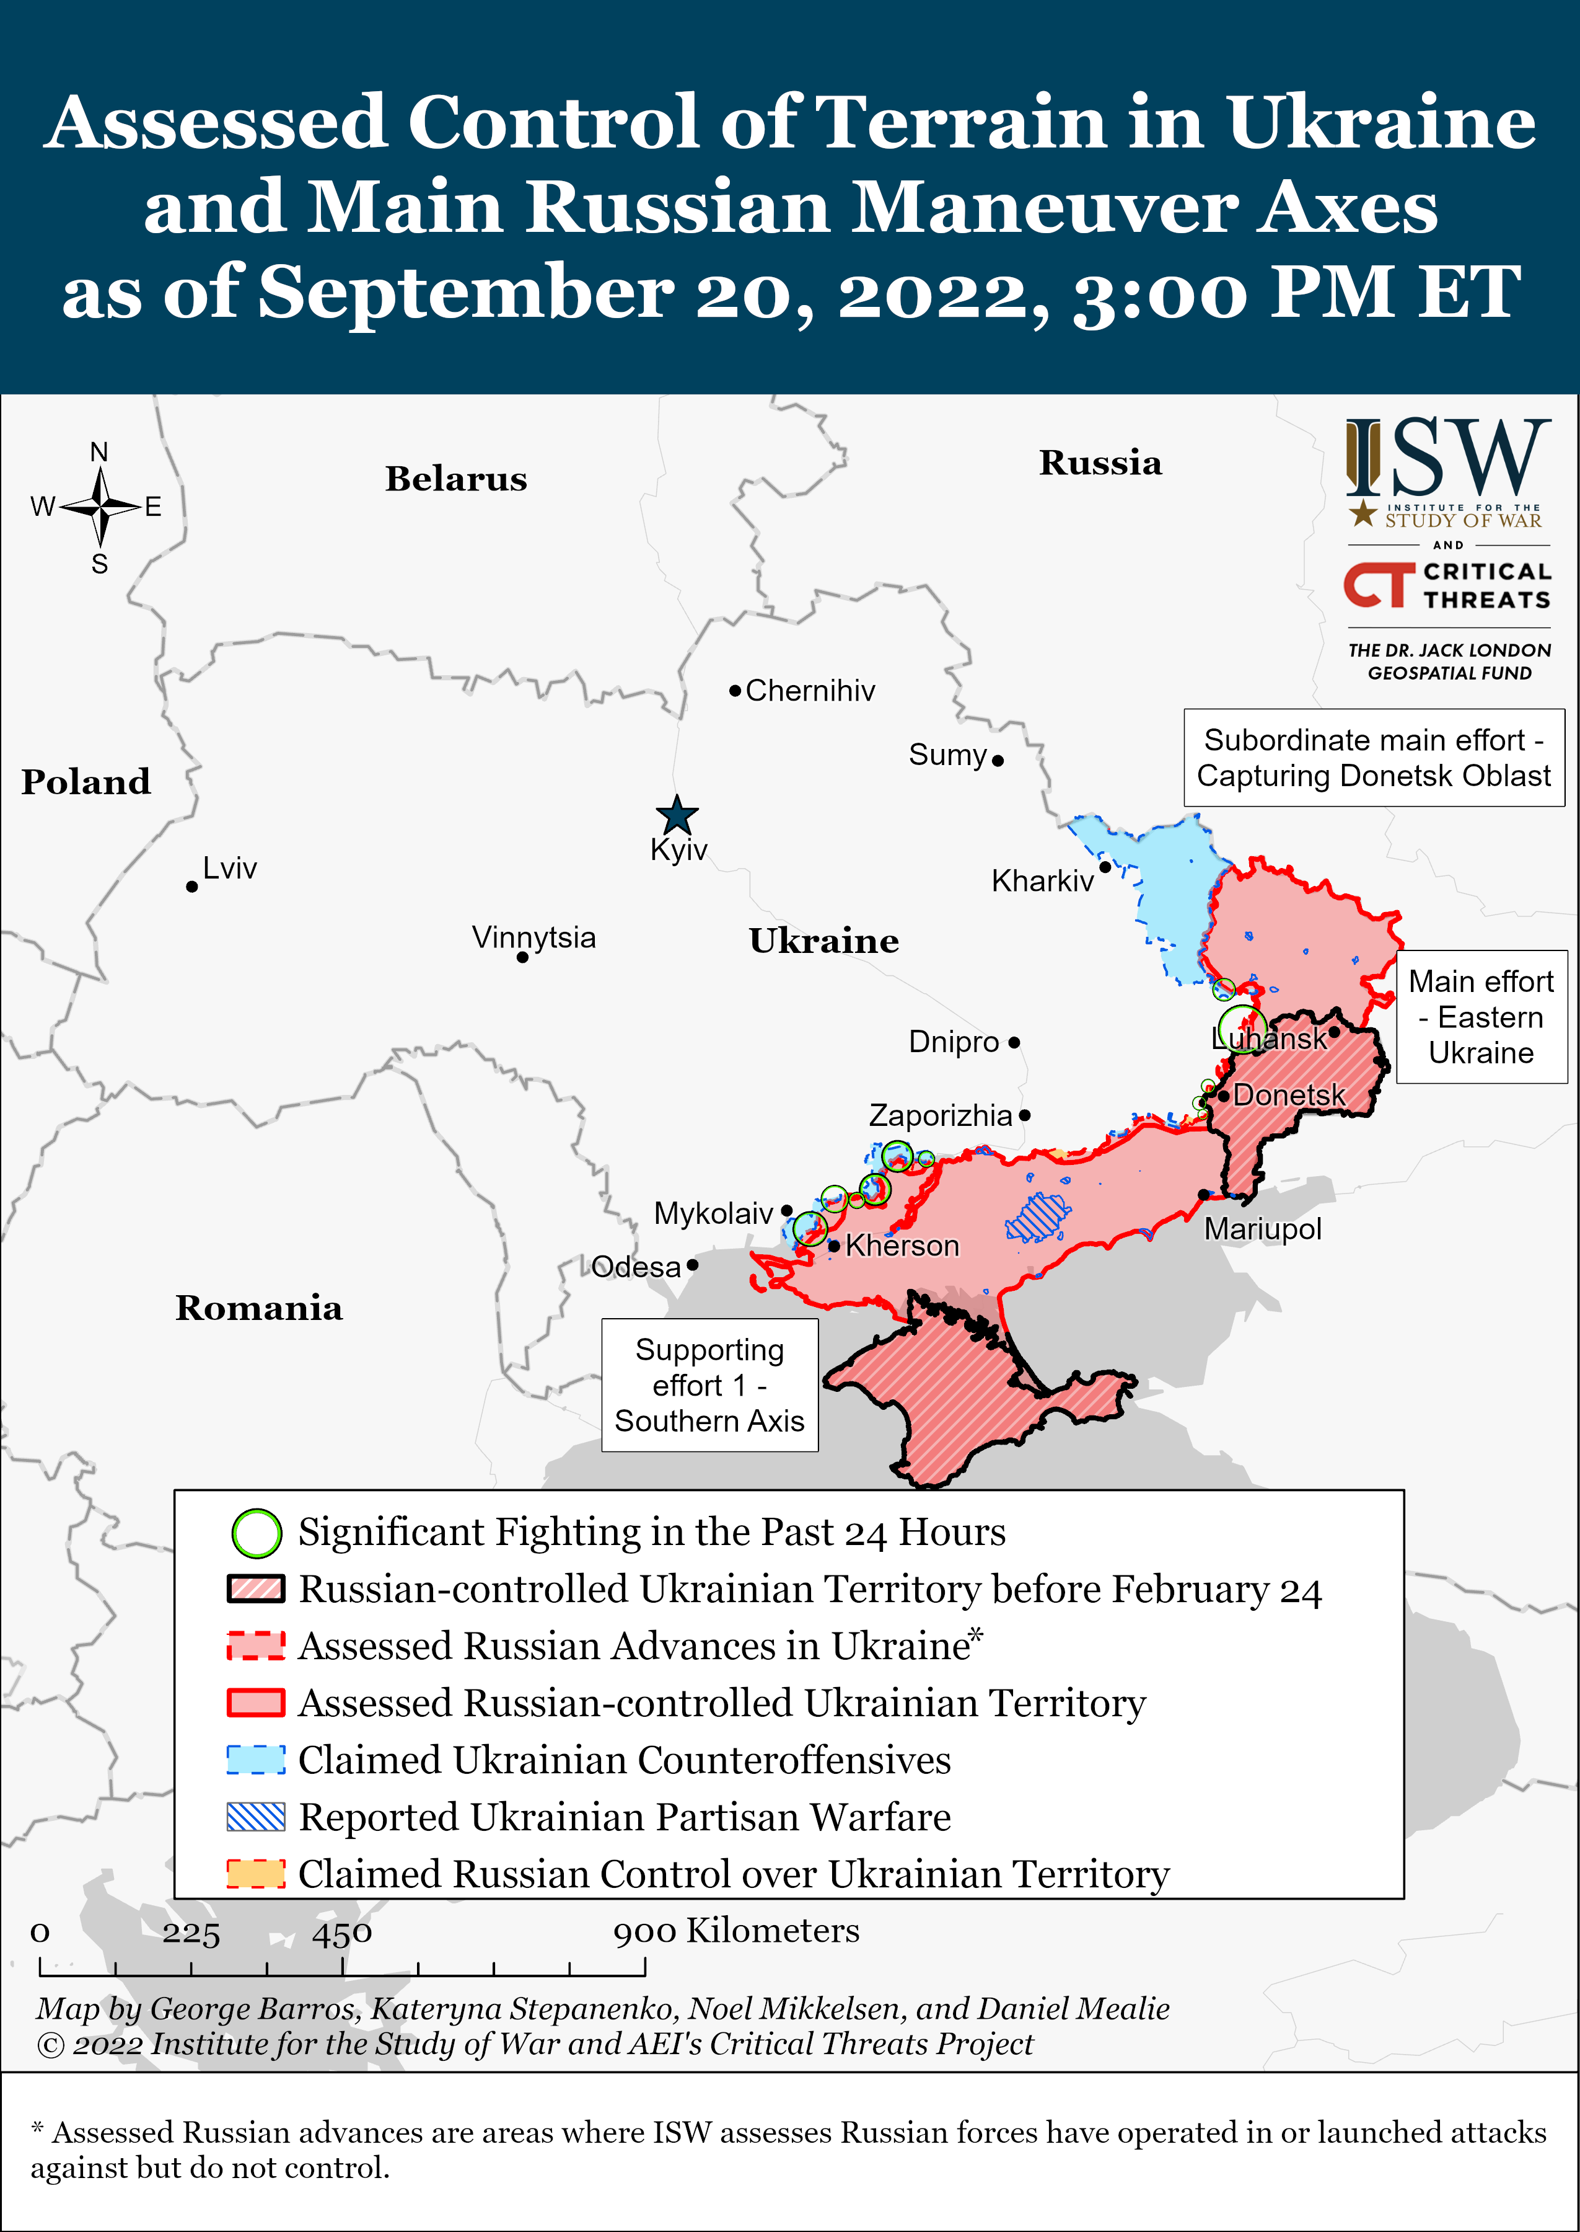

Slide 13
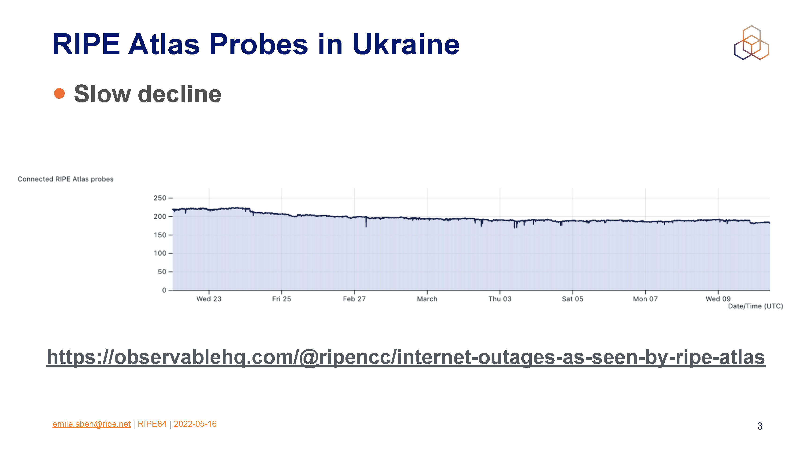
Source:
Emile Aben emile.aben@ripe.net - RIPE 84
https://ripe84.ripe.net › uploads › presentations

Slide 14
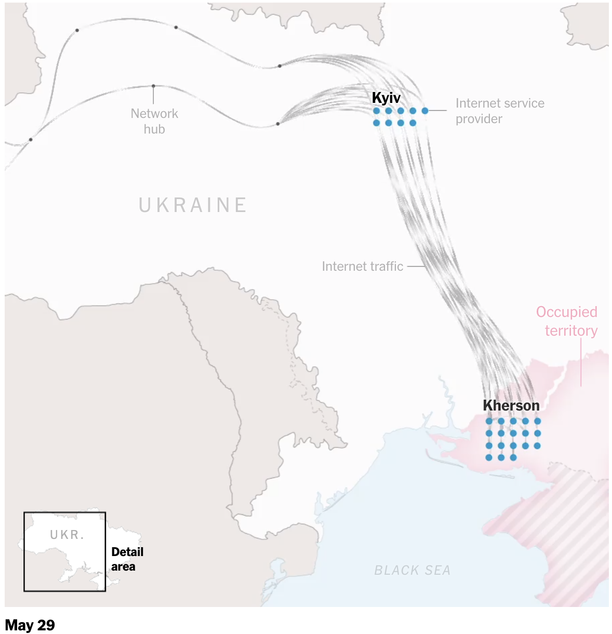
Source: https://www.nytimes.com/interactive/2022/08/09/technology/ukraine-internet-russia-censorship.html
Notes:
May 2
9Kherson stayed connected to the global internet even after Russian forces took control in March

Slide 15
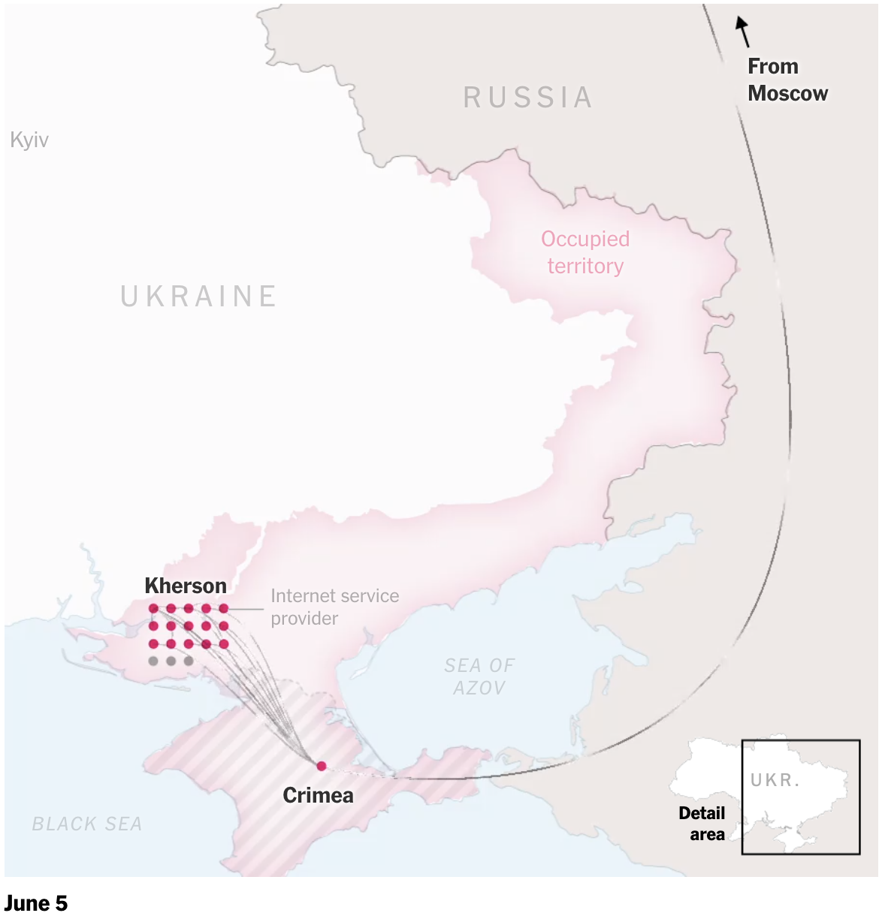
Source: https://www.nytimes.com/interactive/2022/08/09/technology/ukraine-internet-russia-censorship.html
Notes:
June 5
Russia has only added to the network infrastructure, routing more traffic through Moscow to strengthen its control of Kherson’s internet.

Slide 16
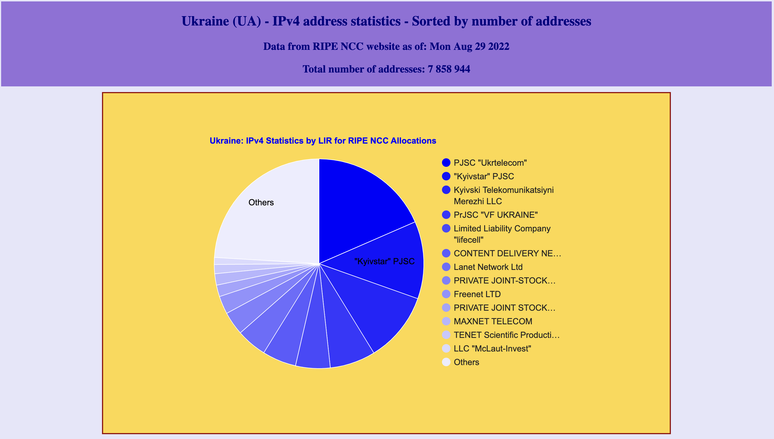
Source: https://www-public.imtbs-tsp.eu/~maigron/RIR_Stats/RIPE_Allocations/IPv4/ByNb/UA.html

Slide 17
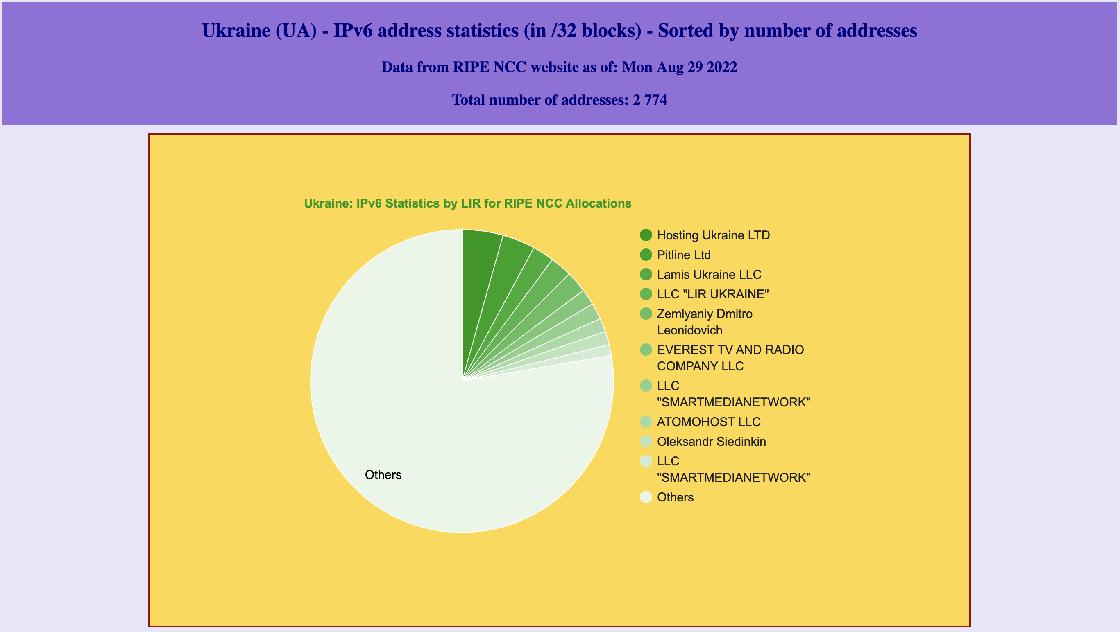
Source: https://www-public.imtbs-tsp.eu/~maigron/RIR_Stats/RIPE_Allocations/IPv6/ByNb/UA.html

Slide 18
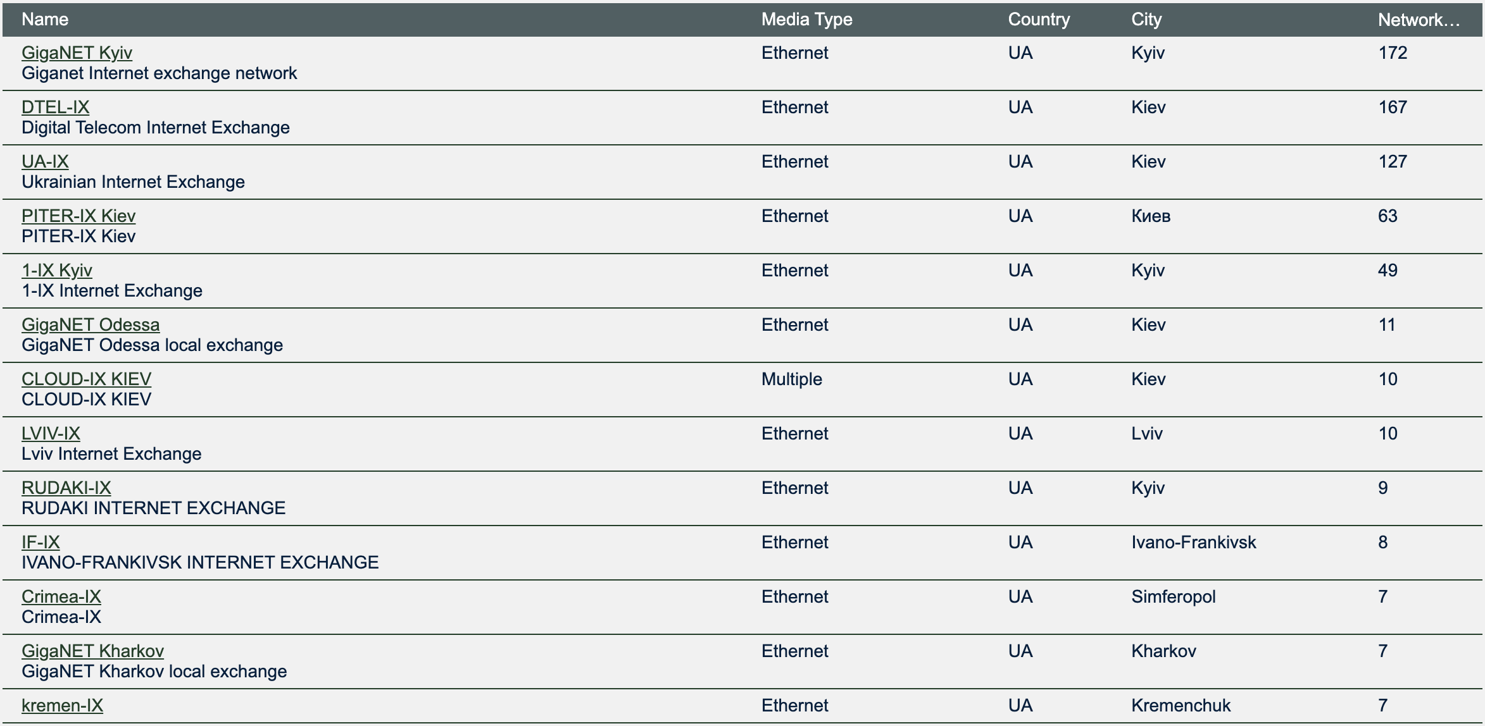
IXP UA Focus
Source: https://www.peeringdb.com/advanced_search?country__in=UA&reftag=ix

Slide 19
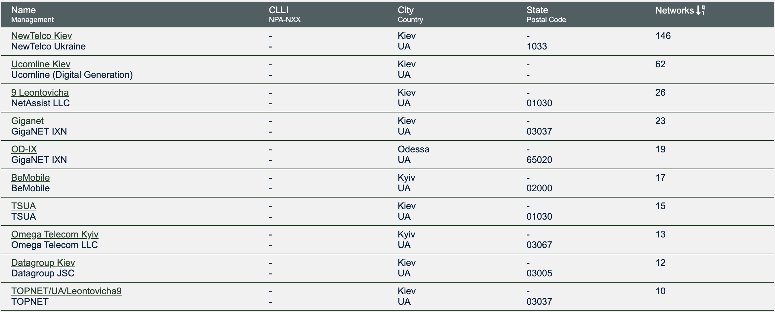
DC UA Focus Region
Source: https://www.peeringdb.com/advanced_search?country__in=UA&reftag=

Slide 20
Mapping Backbone Dataline

Slide 21
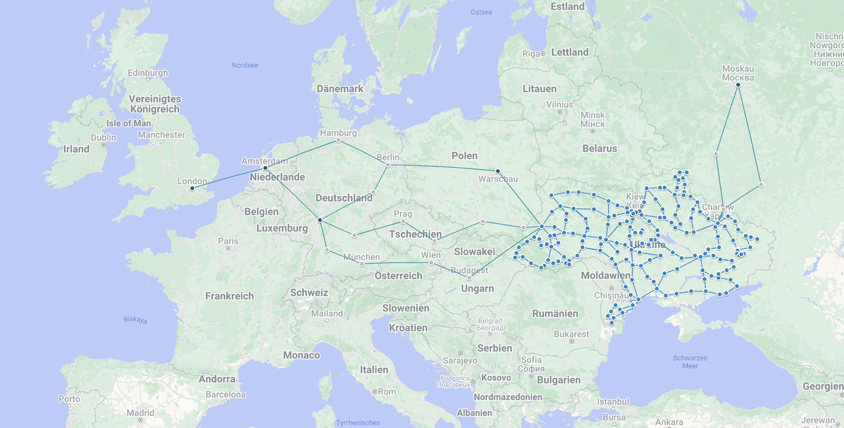

Slide 22
Backbone Mapping from RETN

Slide 23
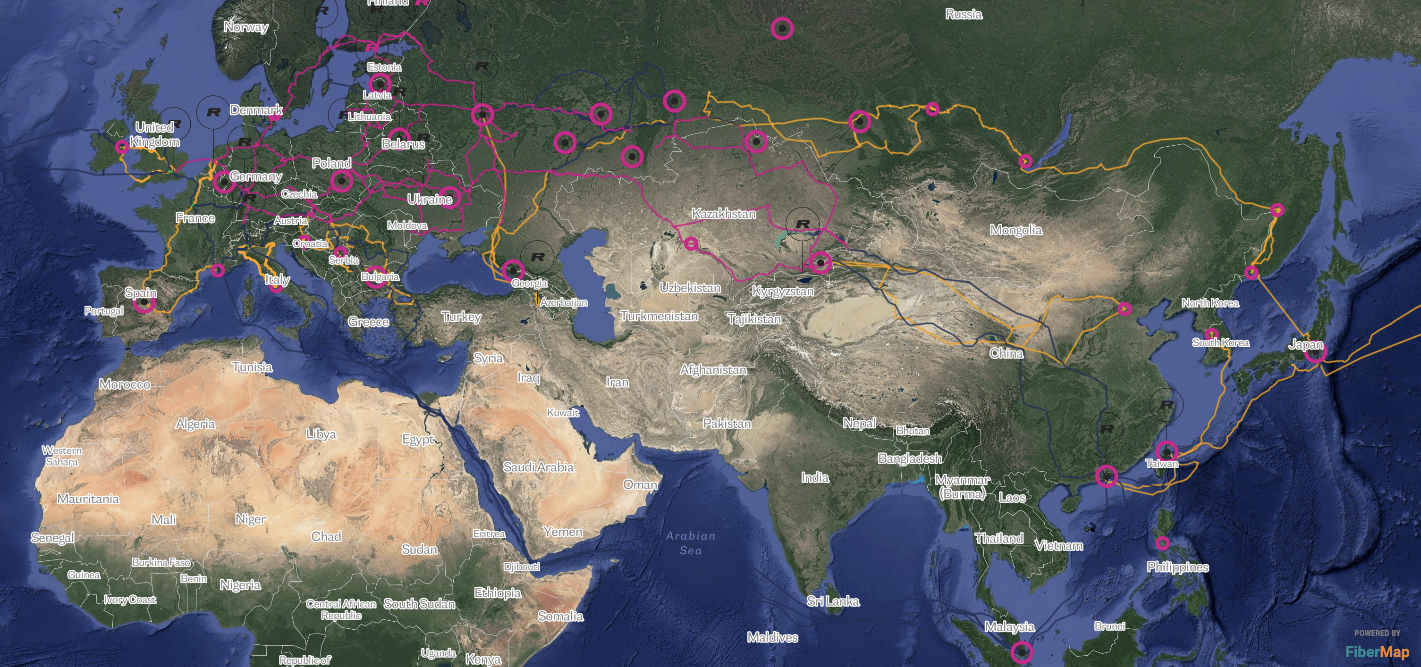

Slide 24
„They came to them and put guns to their head and just said:“
„Do this“
said Maxim Smelyanets, who owns an internet provider that operates in the area and is based in Kyiv.
„They did that step by step for each company.“
Source: https://www.nytimes.com/interactive/2022/08/09/technology/ukraine-internet-russia-censorship.html

Slide 25
„The first thing that an occupier does when they come to Ukrainian territory is cut off the networks“
said Stas Prybytko, who leads mobile broadband development in Ukraine’s Ministry of Digital Transformation.
„The goal is to restrict people’s access to the internet and block them from communicating with their families in other cities and keep them from receiving truthful information.“
Source: https://www.nytimes.com/interactive/2022/08/09/technology/ukraine-internet-russia-censorship.html

Slide 26
Our vision & mission
We are the Link between the Disaster Region and the global community.
We have contacts in the community and with the manufacturers. We wanted to use these contacts to do good things.

Slide 27
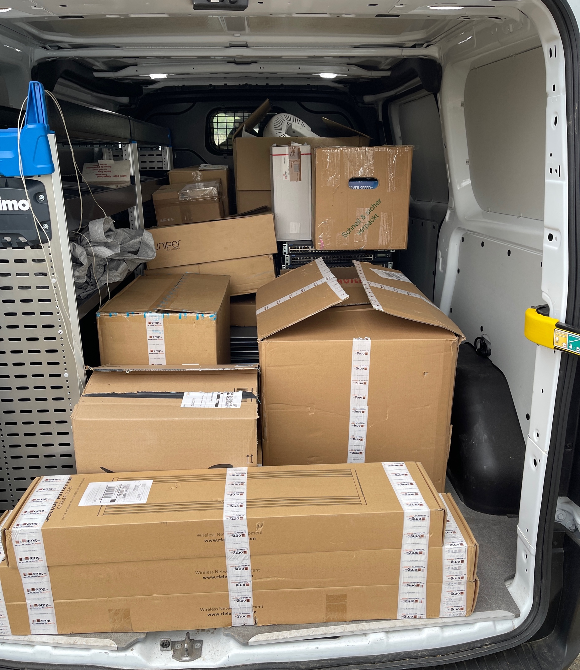
From a simple idea,
to supply chain managers…
The GNA Supply & Demand Database works very well. Anyone who wants to donate equipment can get a login from us, and can specify what they want to donate.
Using this database, we can manage which donations we‘ve received. This makes it easier for us to keep track of everything, and means we can show people from Ukraine who need equipment what we have in the system.

Slide 28
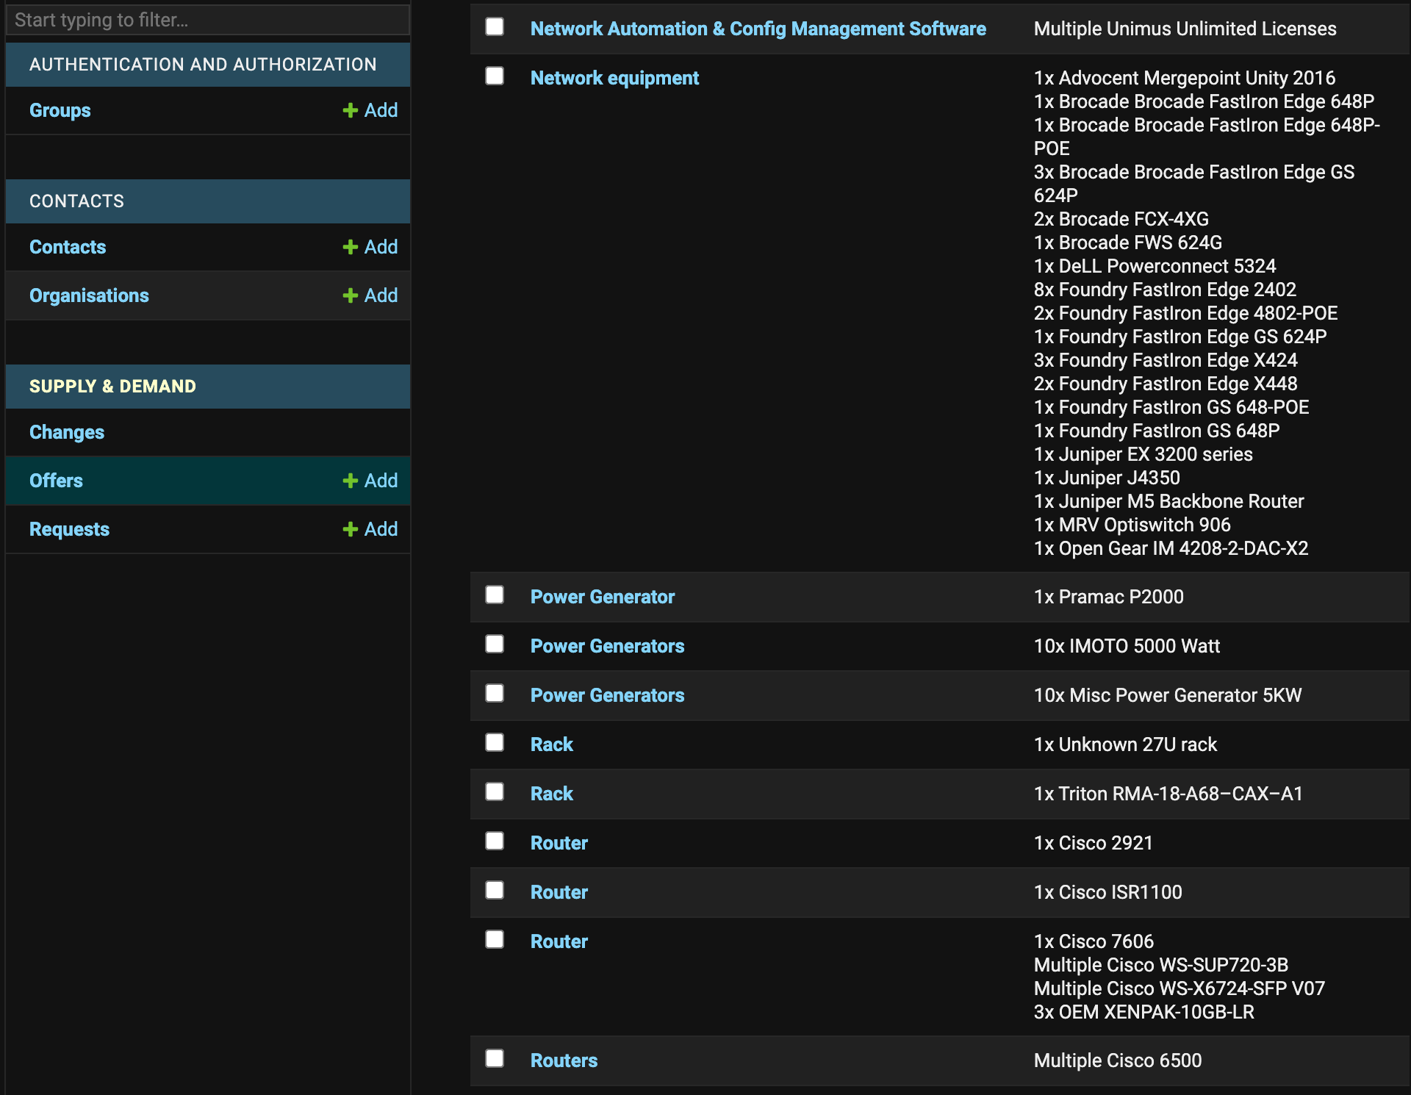
Supply & Demand Tool
v1.0

Slide 29
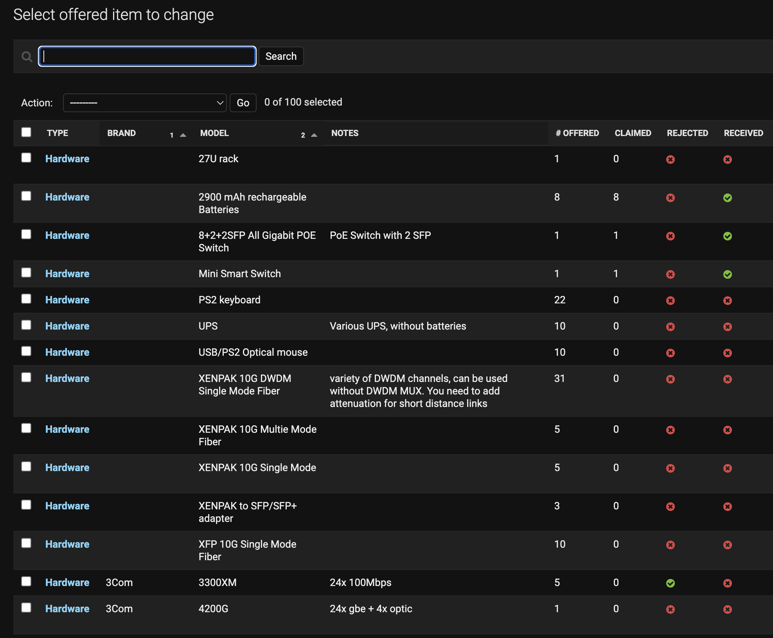
Supply & Demand Tool
(Requester View)
v2.0
Already claimed
Availability

Slide 30
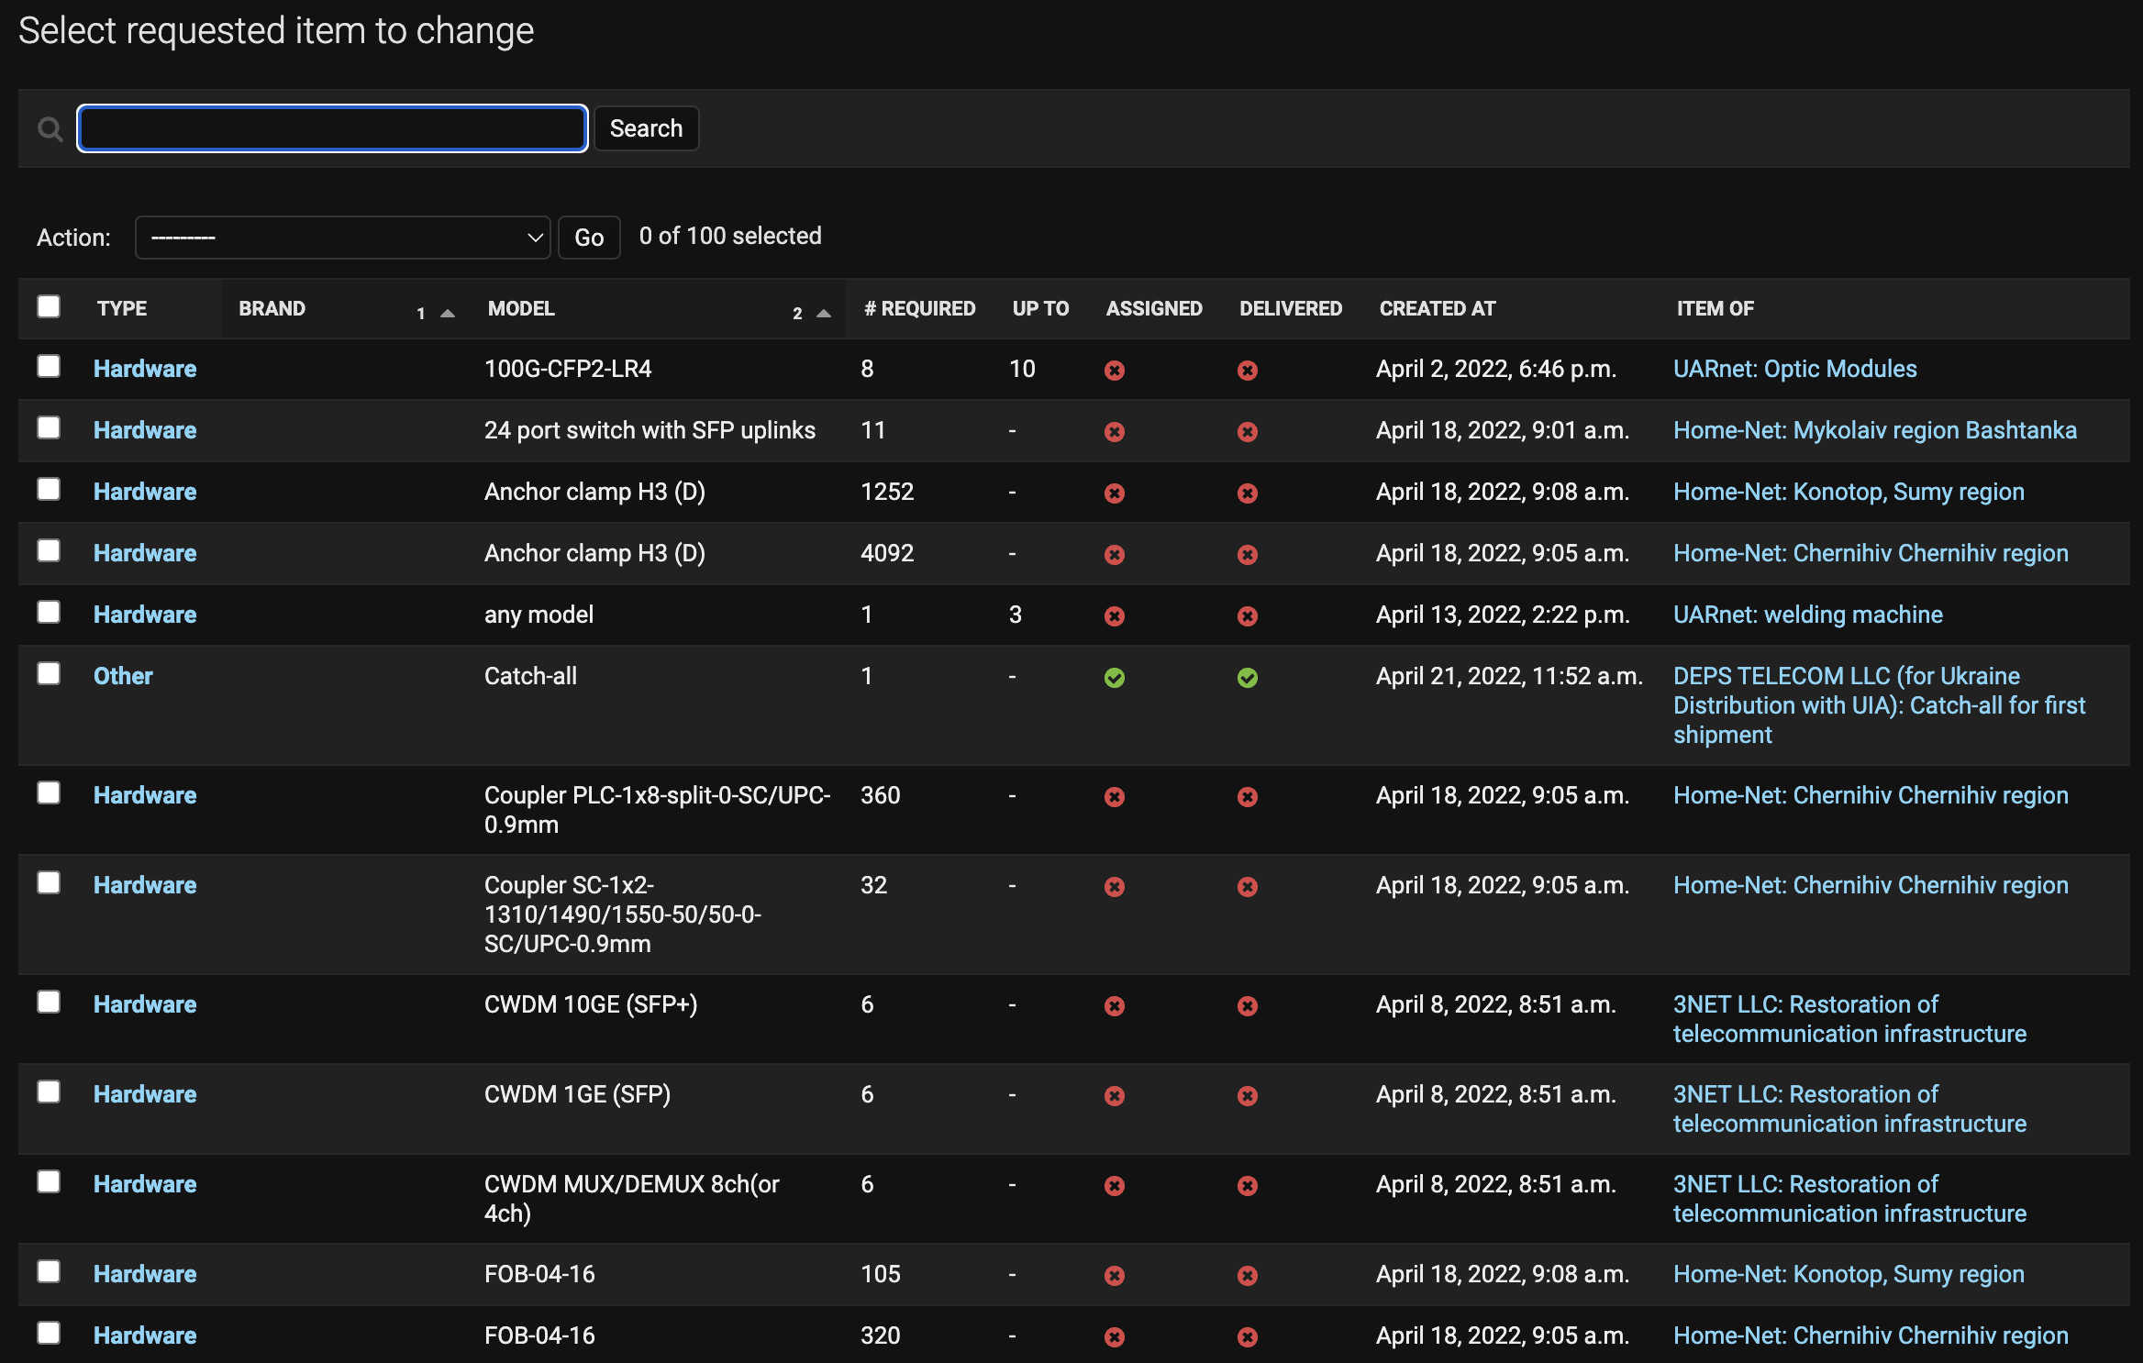
Supply & Demand Tool
(Donor View)
v2.0

Slide 31
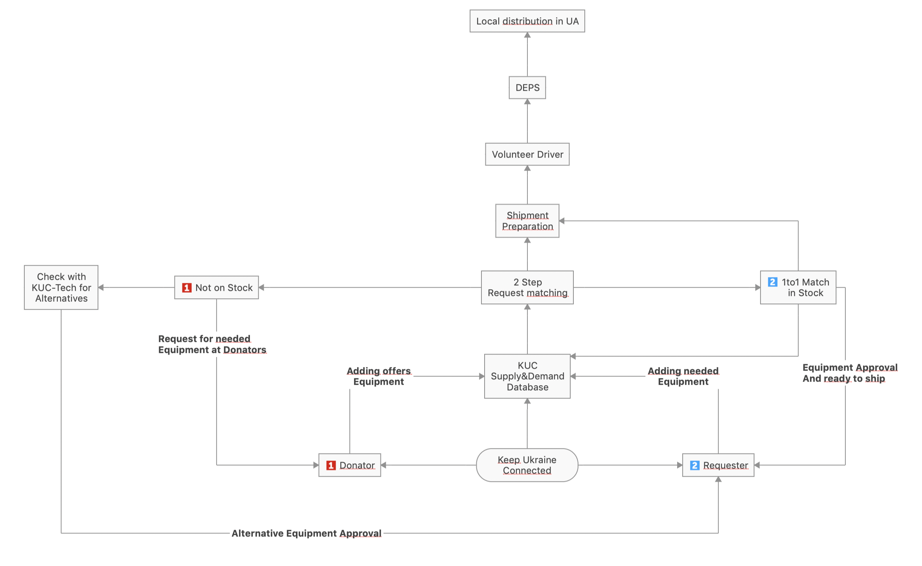
Workflow Chart
KUC

Slide 32
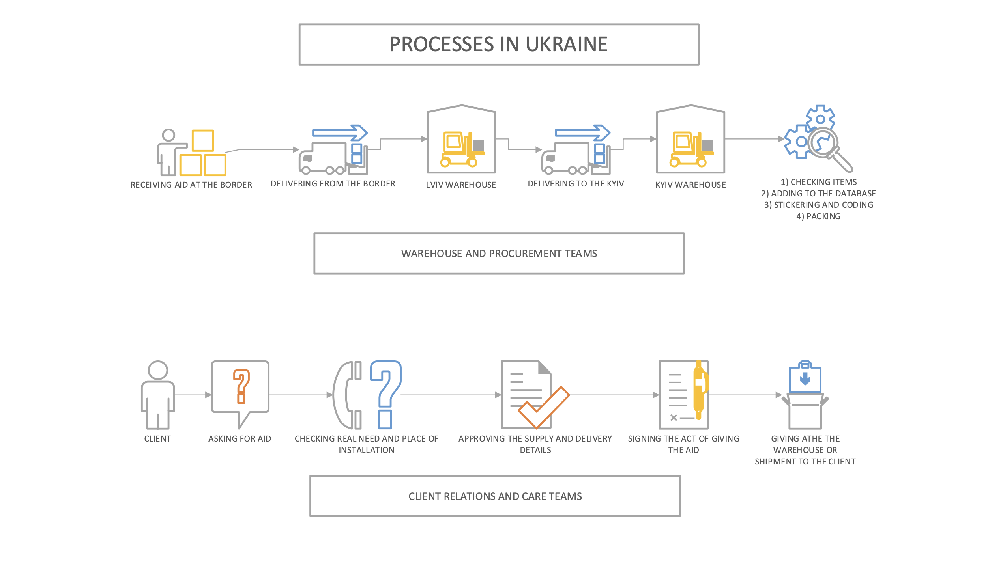

Slide 33



Our Friends & Partners
in Ukraine
We are currently working with the organisations listed below. They are helping us with paperwork, permits, and local distribution of the donated equipment.
Ministry of Digital Transformation
DEPS
(local distribution)
Ukrainian Internet Association

Slide 34
…why are we doing this? (Part II)
Human/ 2nd Family perspective

Slide 35
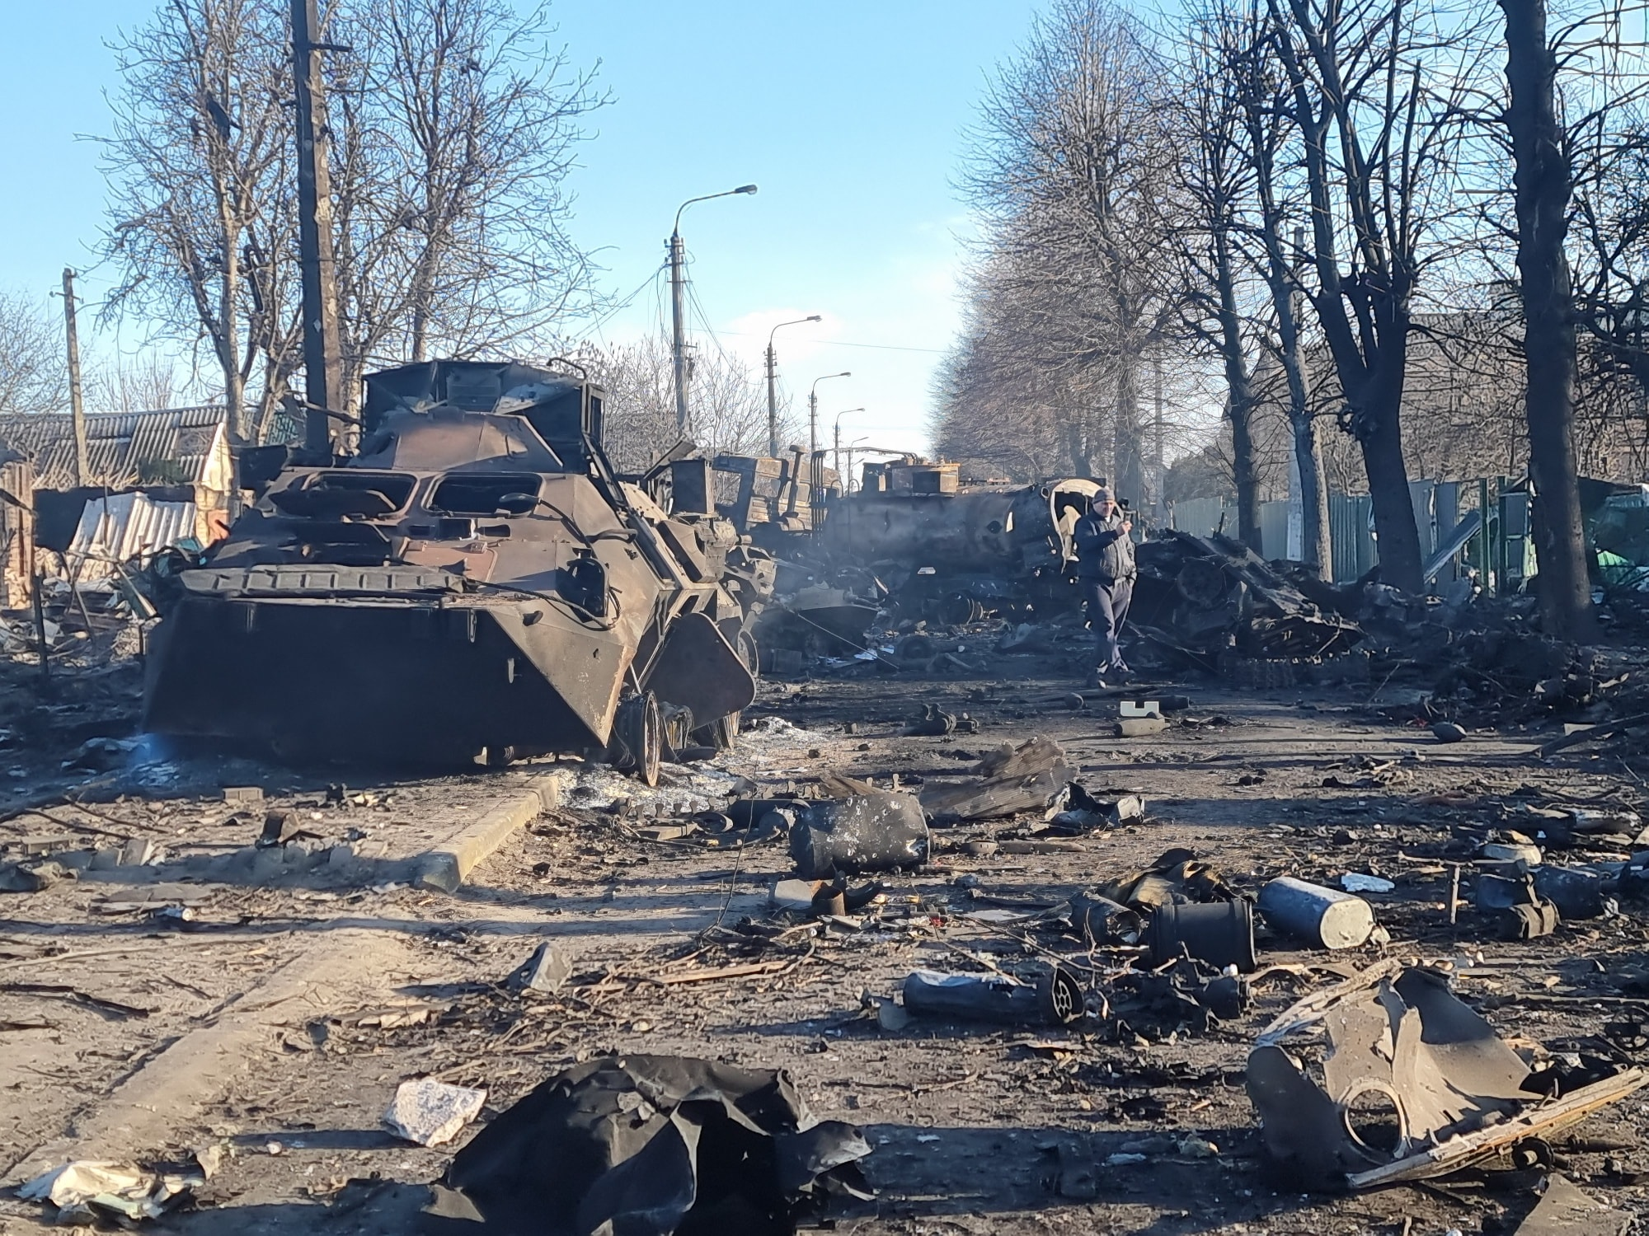

Slide 36
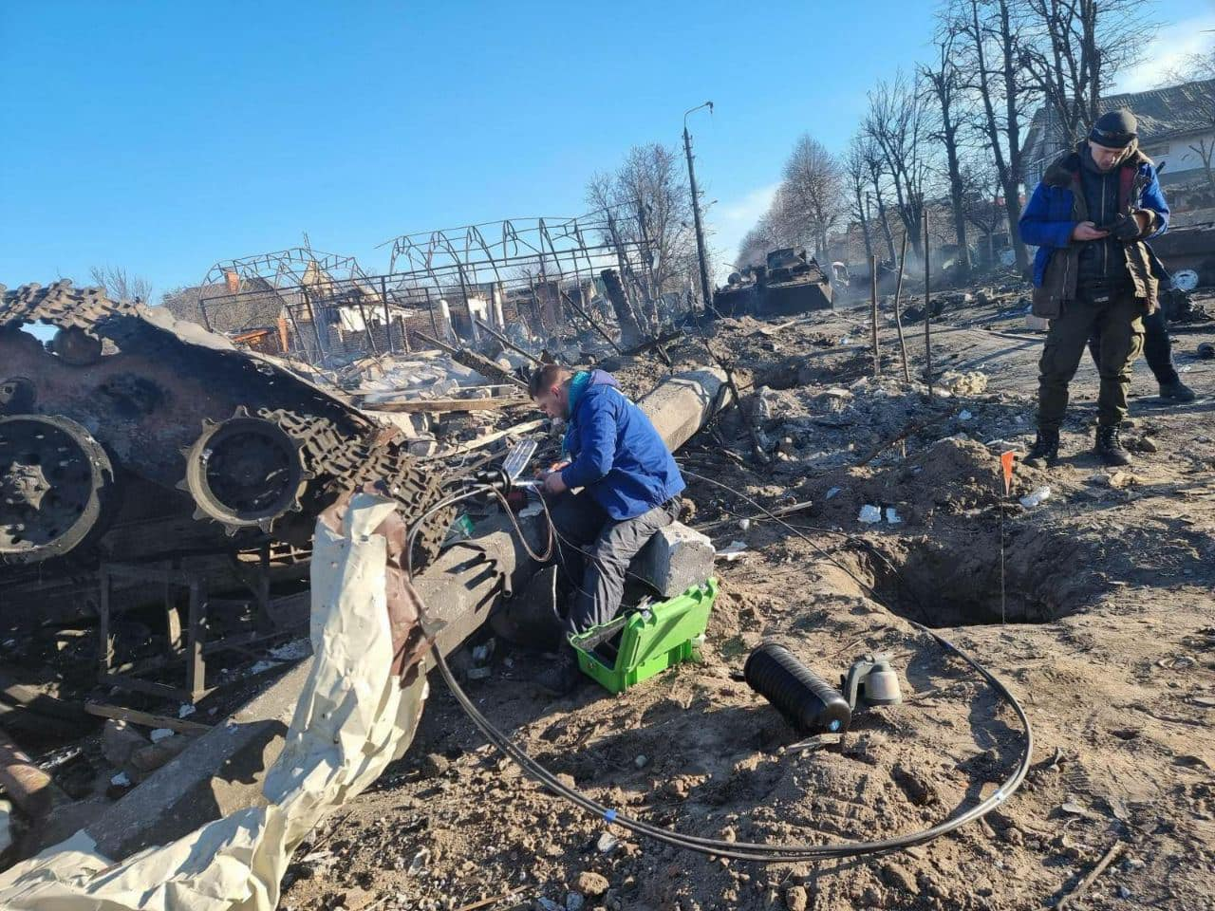

Slide 37
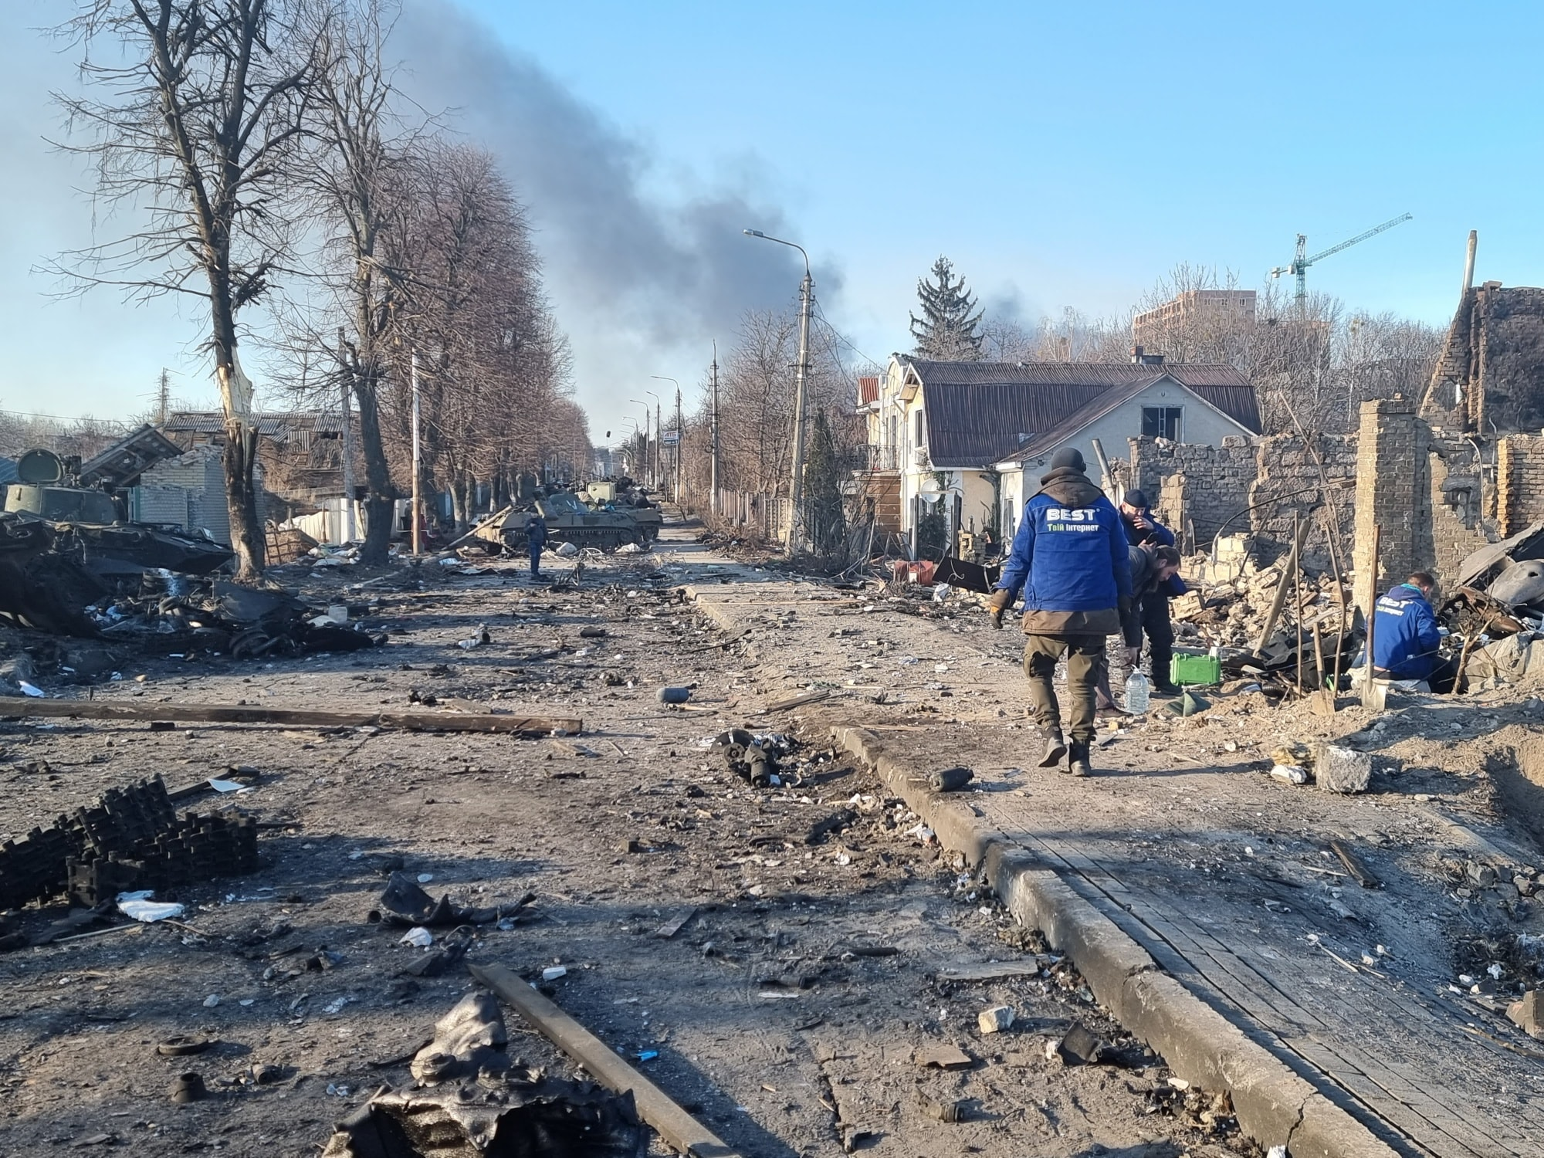

Slide 38
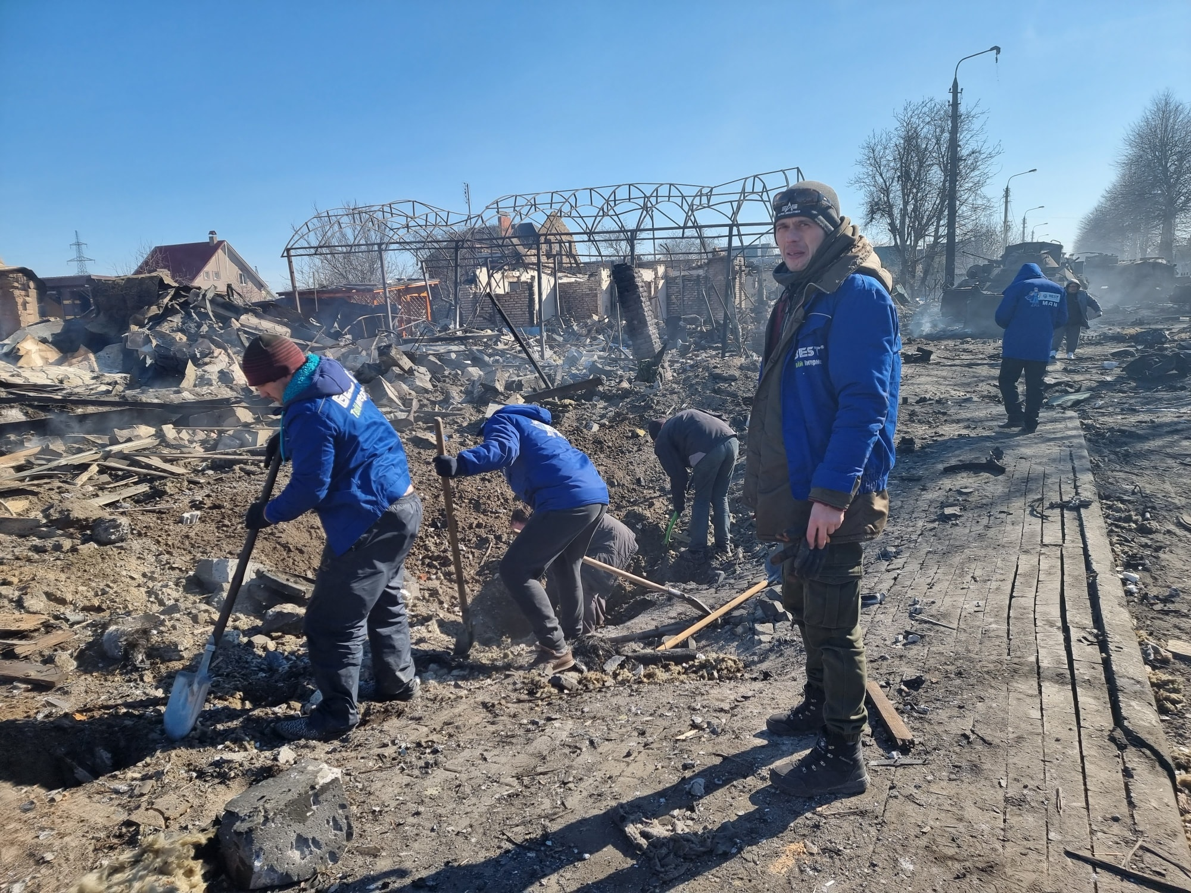

Slide 39
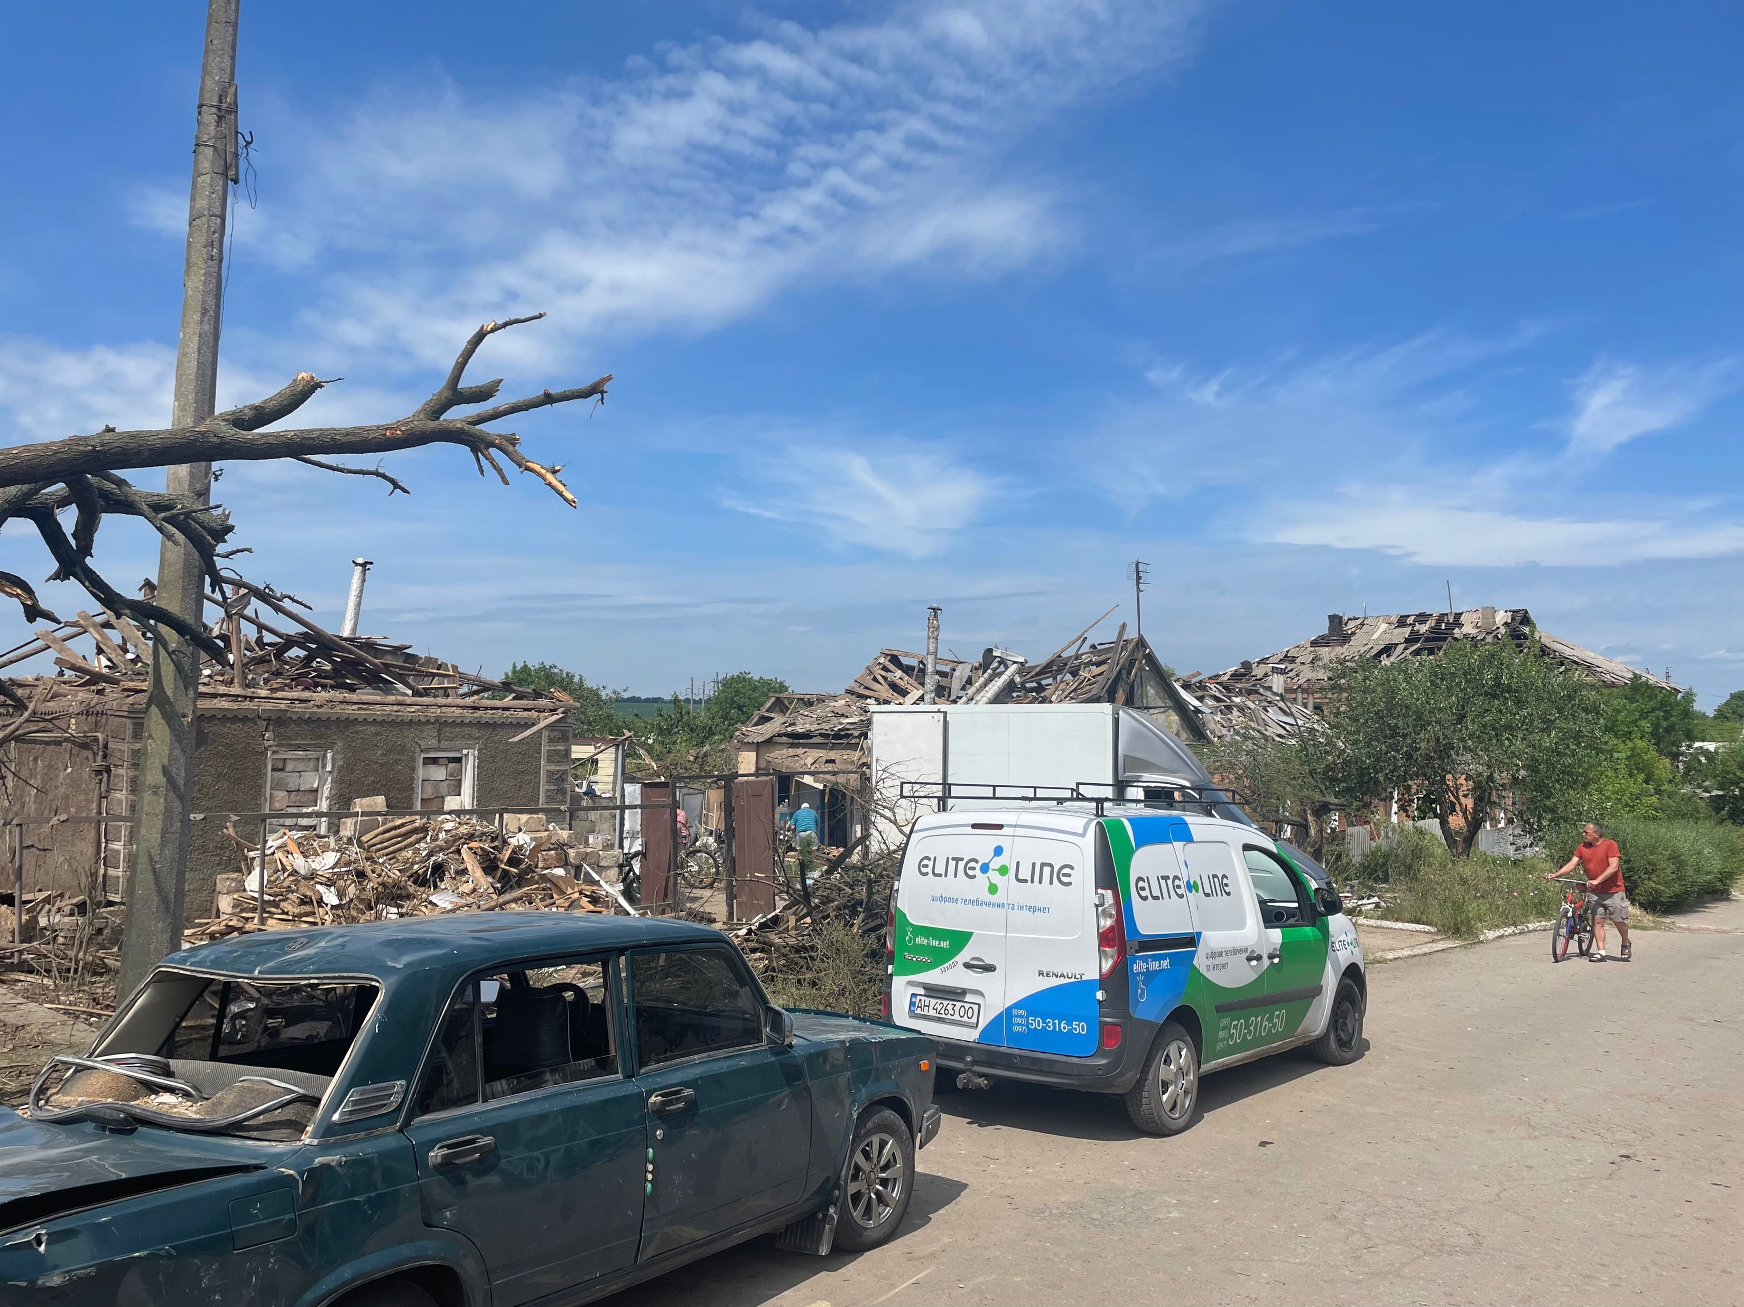

Slide 40
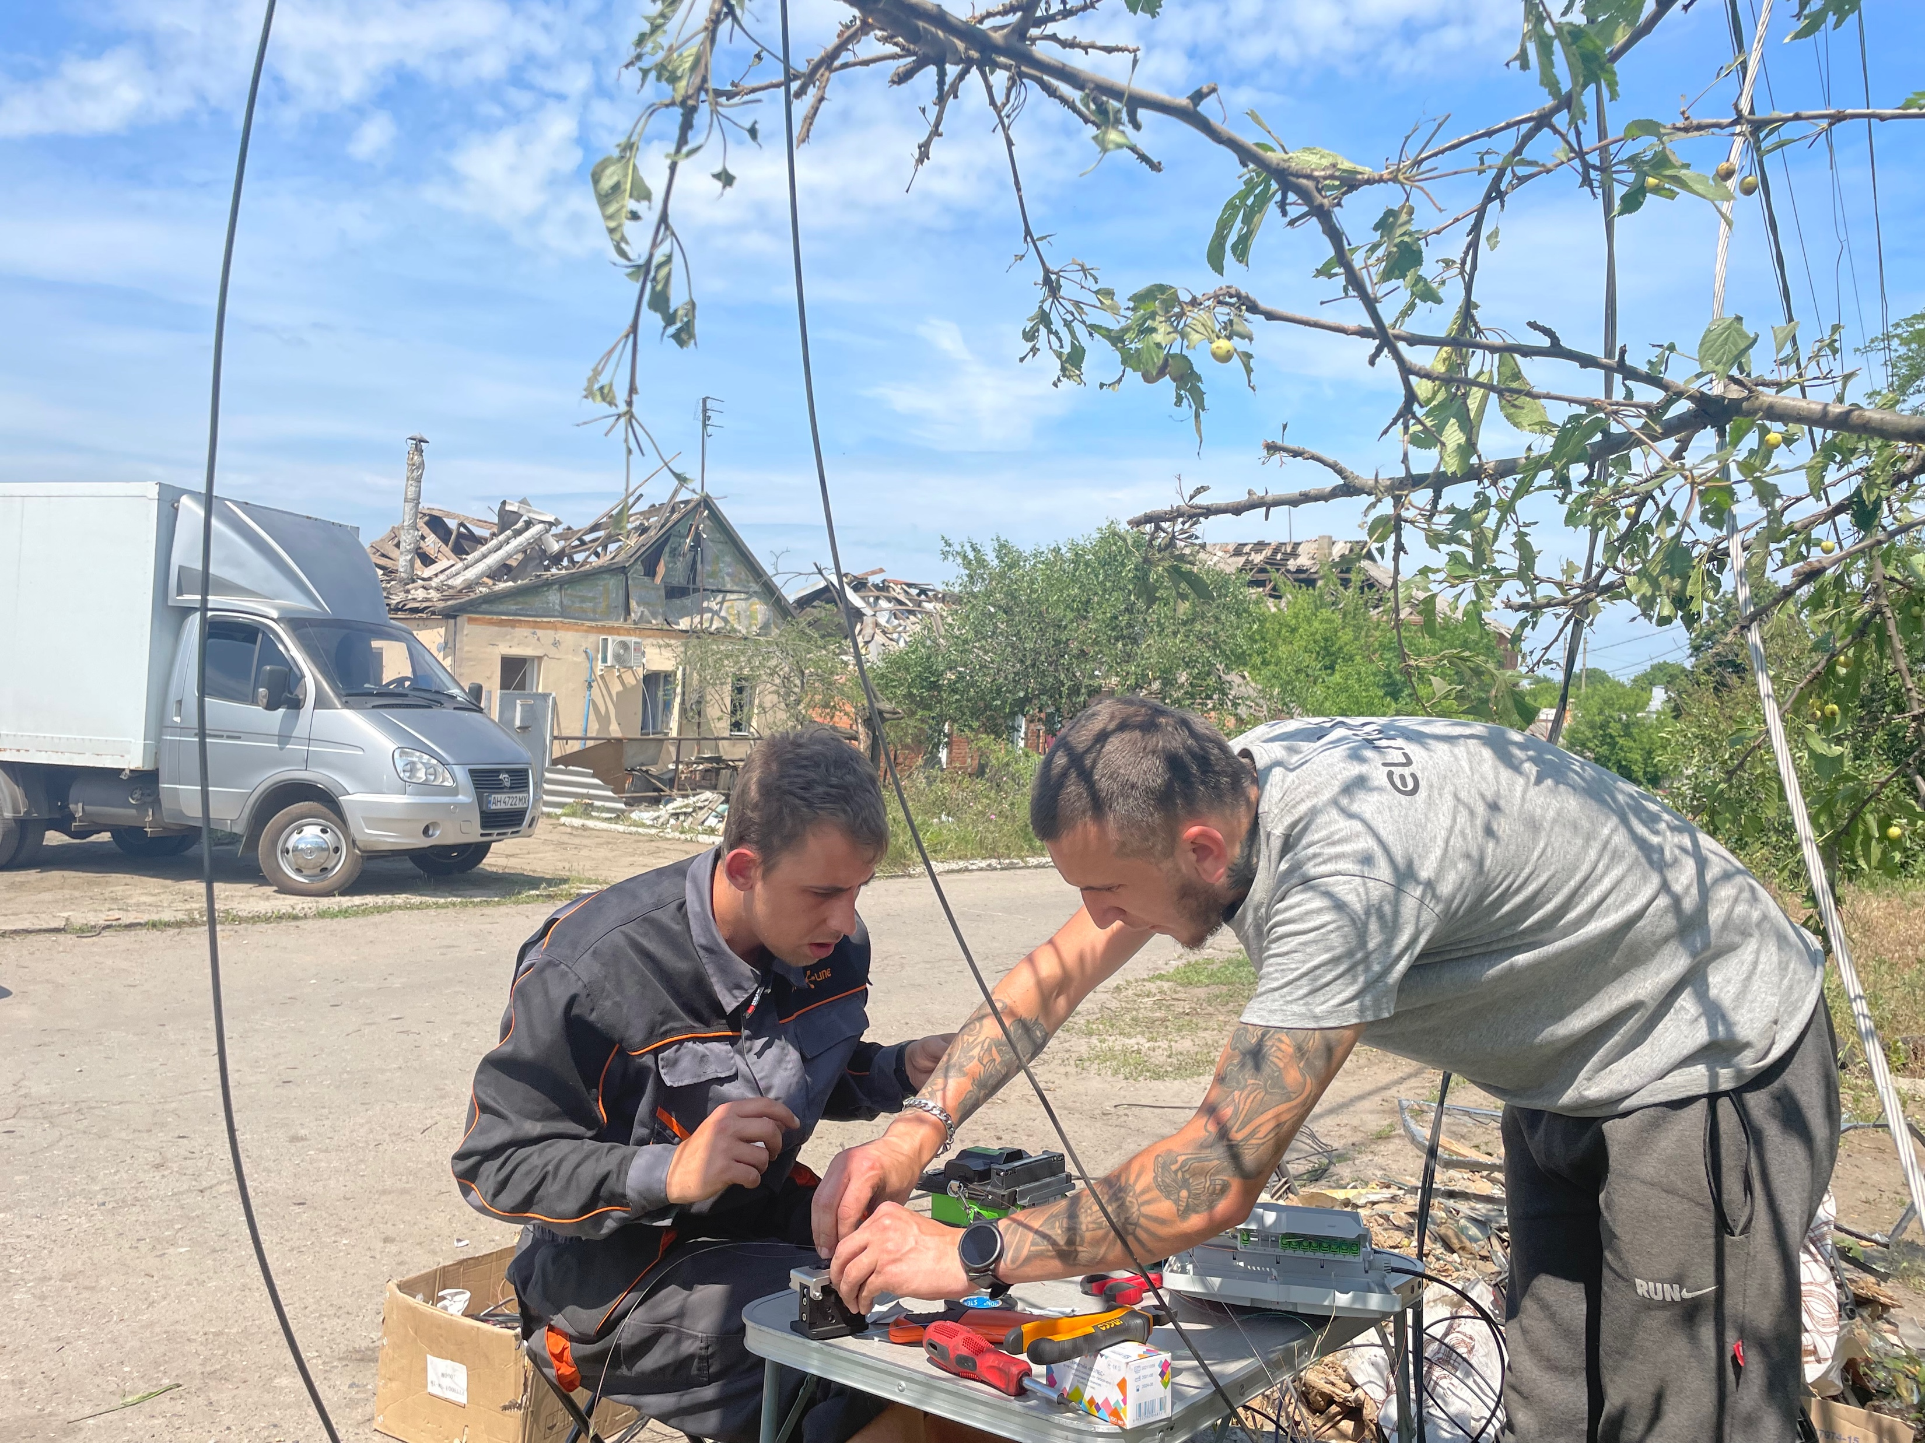

Slide 41
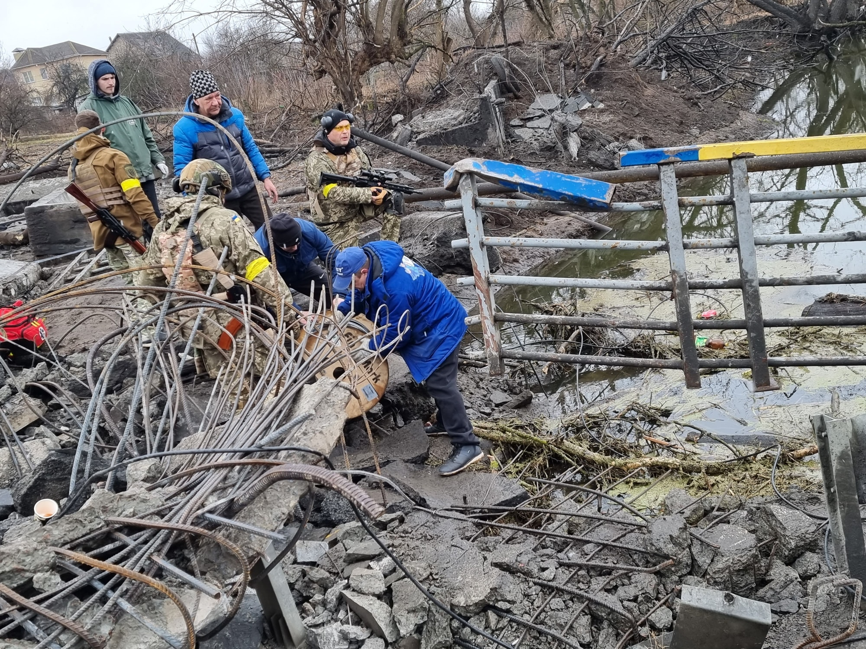

Slide 42
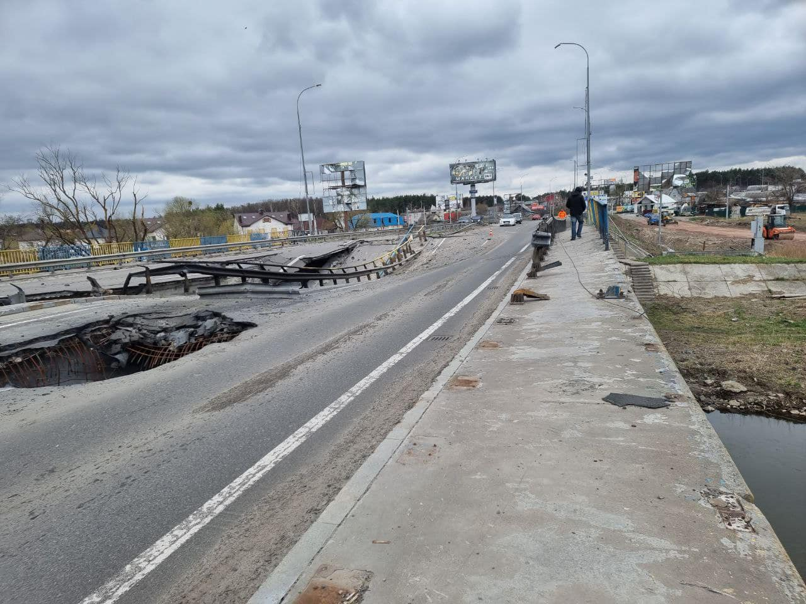

Slide 43
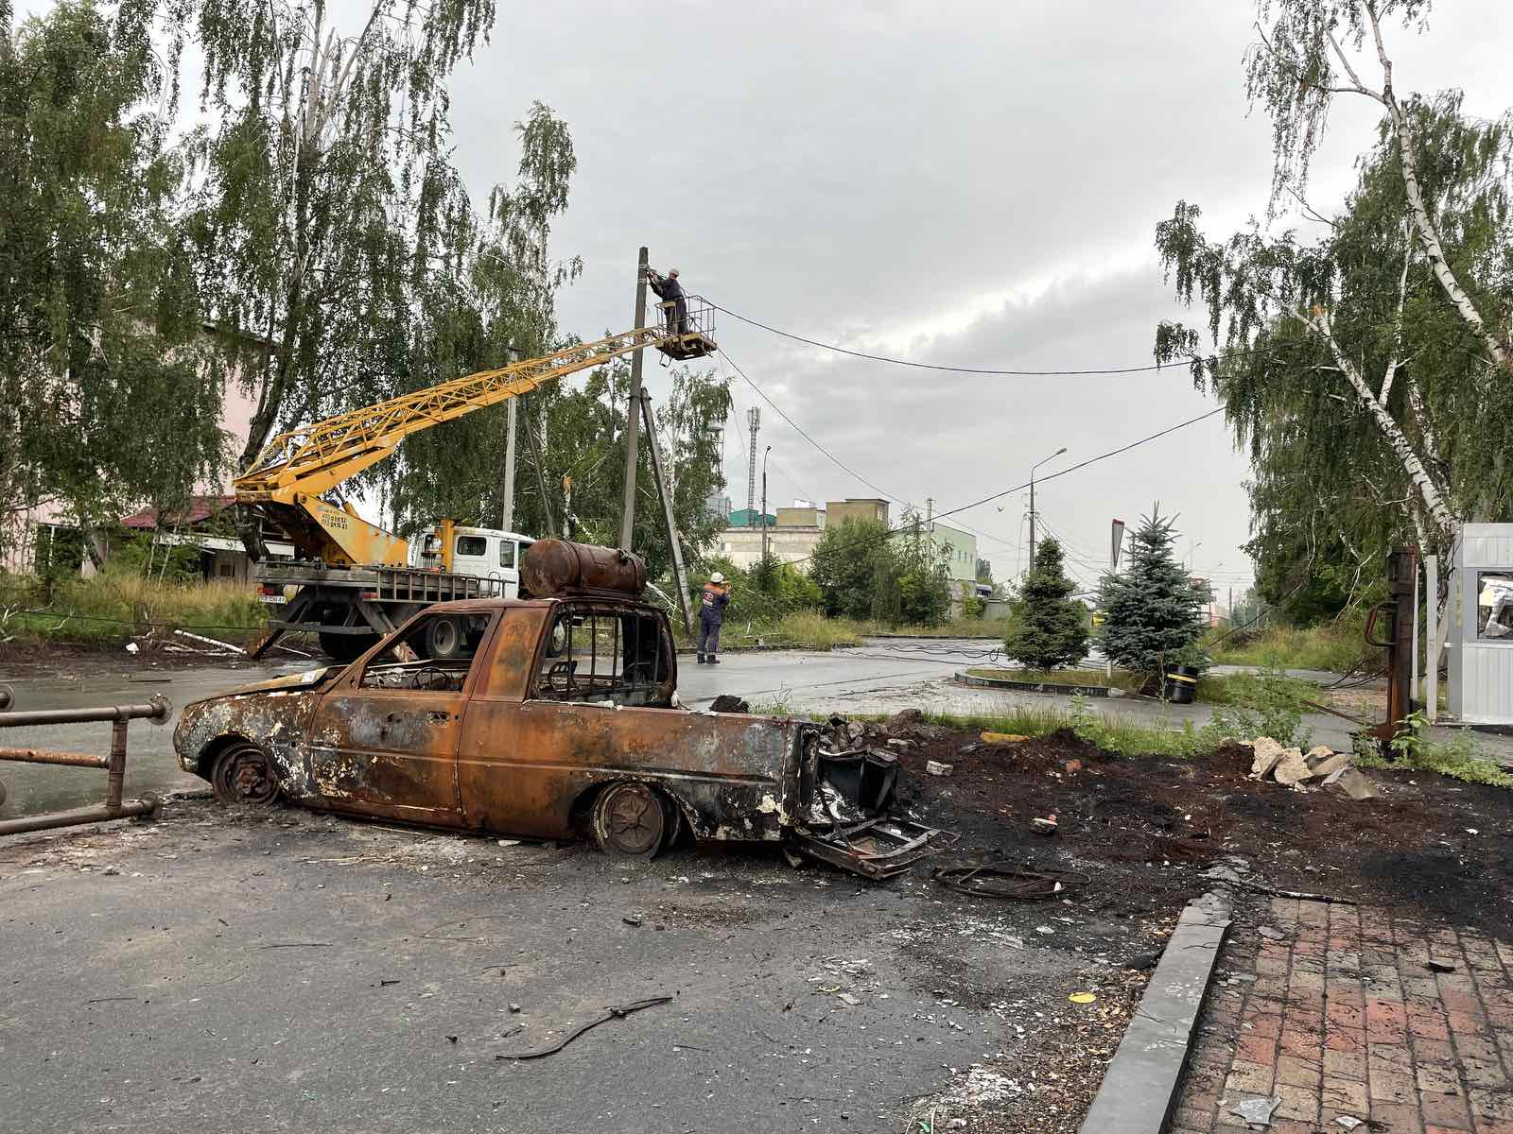

Slide 44
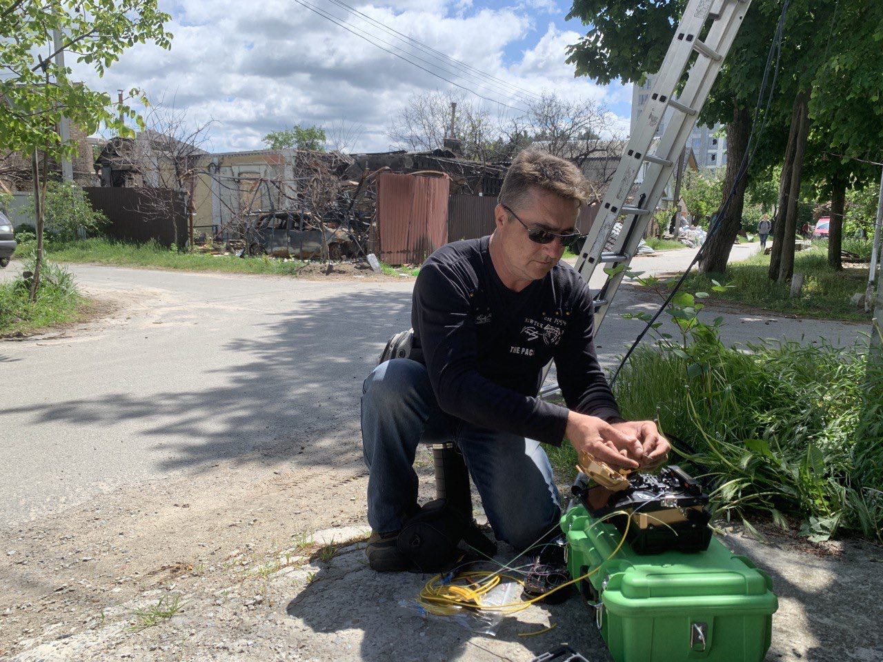

Slide 45
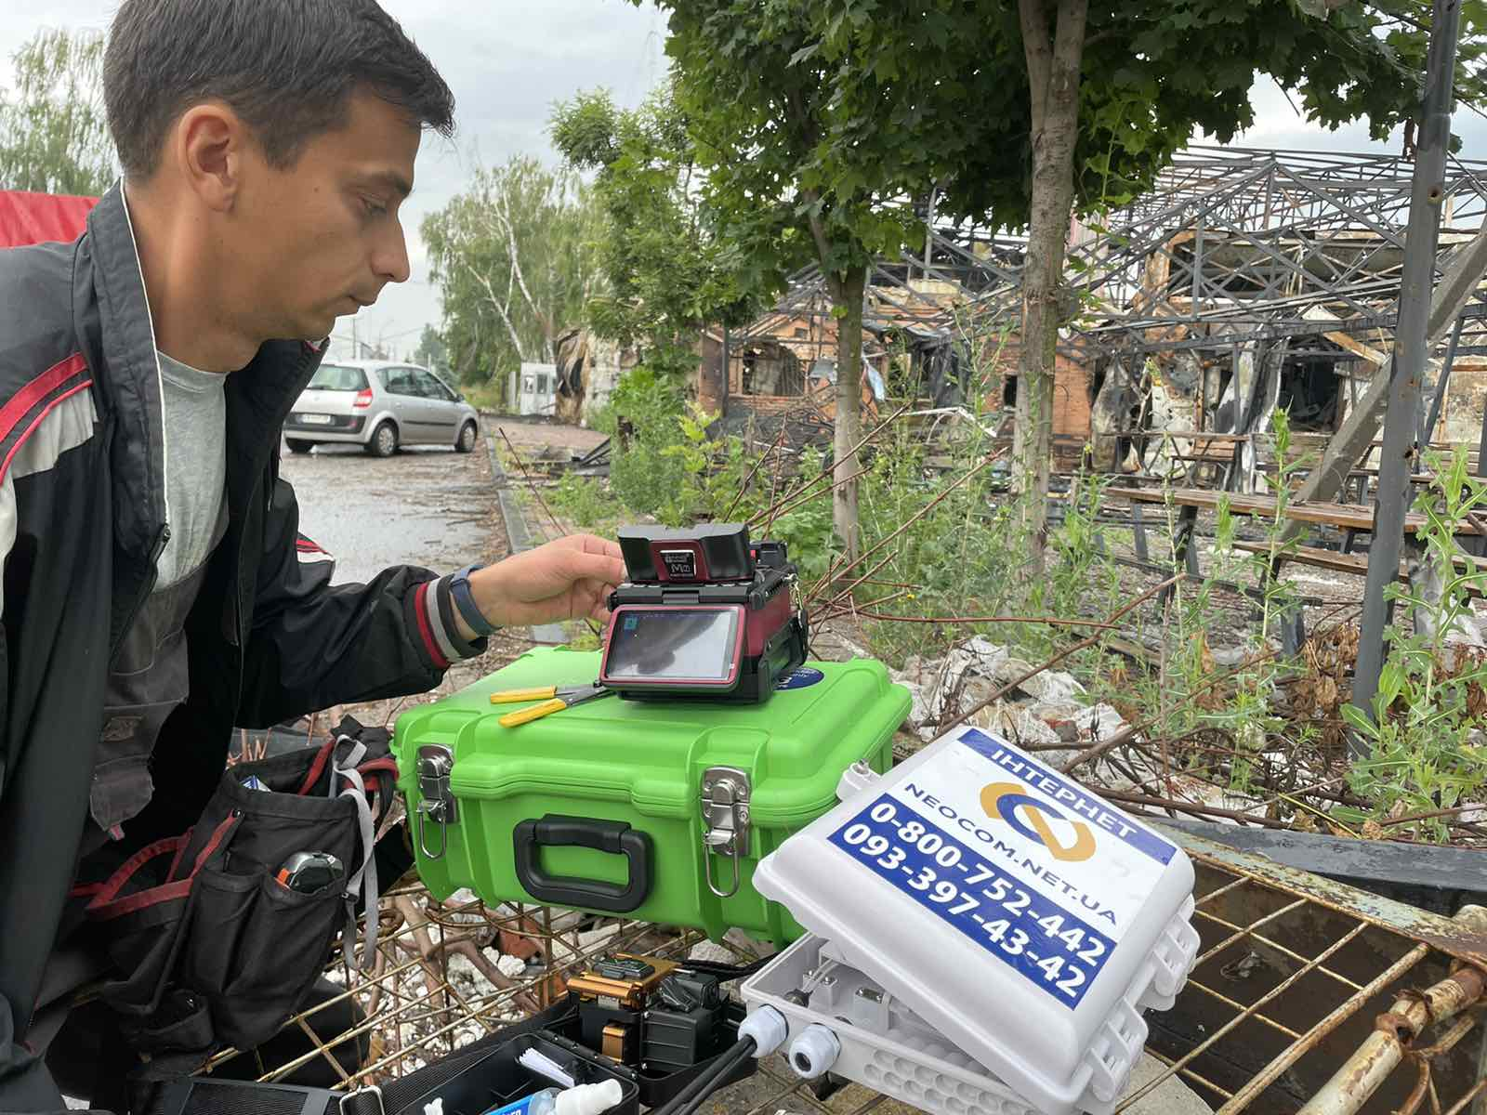

Slide 46
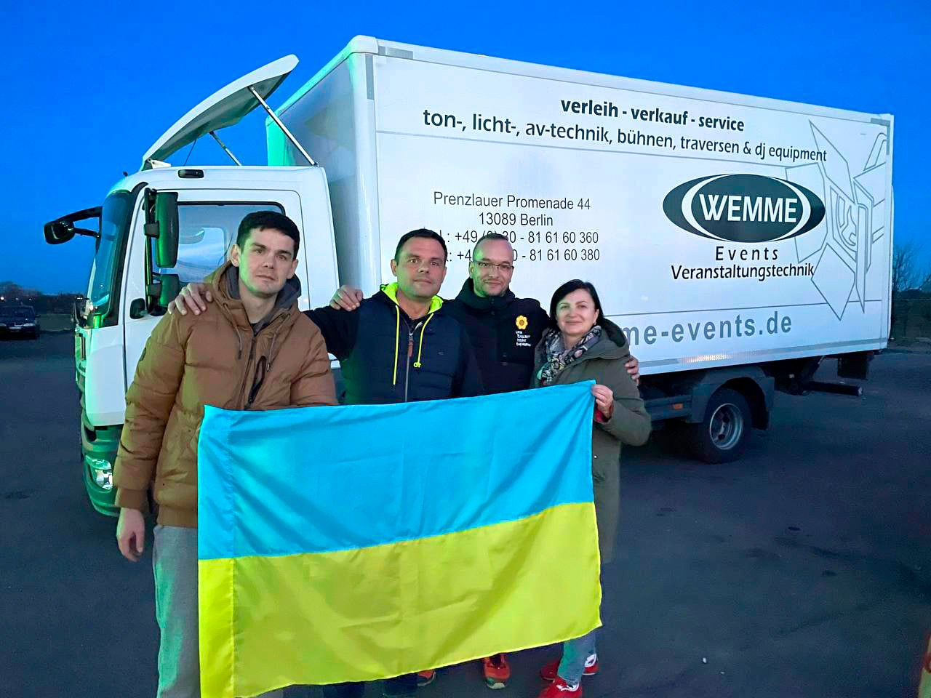
1st

Slide 47
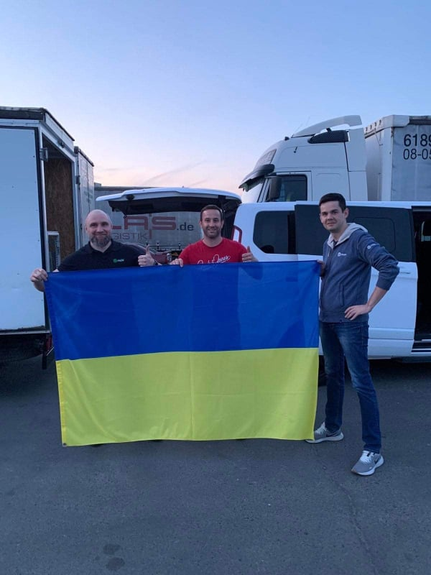
2nd

Slide 48
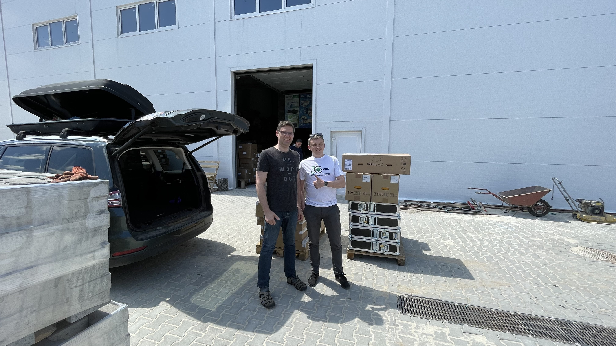
3rd

Slide 49
Overview
- 6 Deliveries (around 1mio€)/ 6 Tons
- 17 Splicers (around 85.000€) more ordered incl. OTDR Gear
- 100.000,00€ Donation from SES Satelites

Slide 50
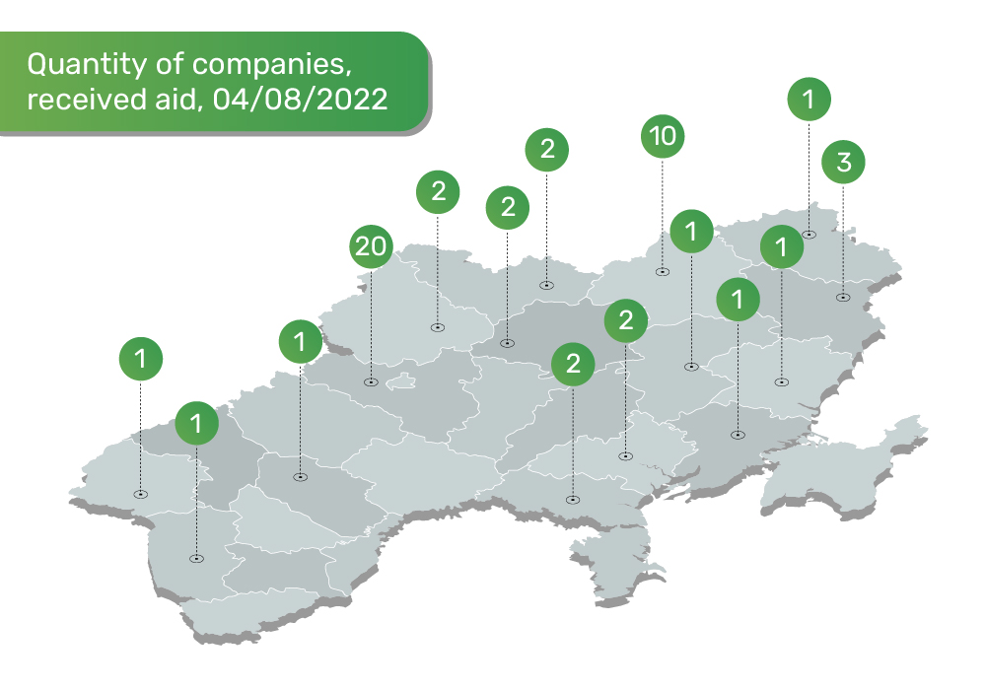

Slide 51
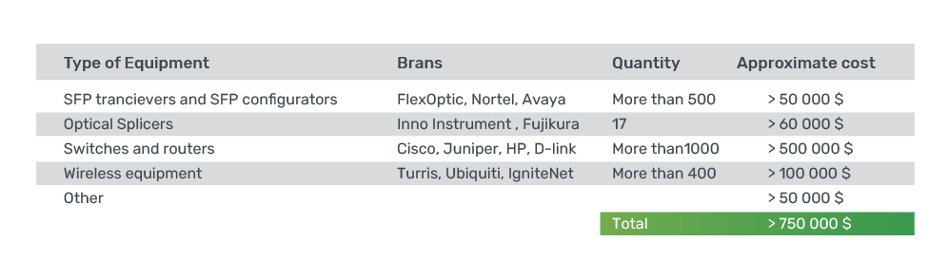

Slide 52
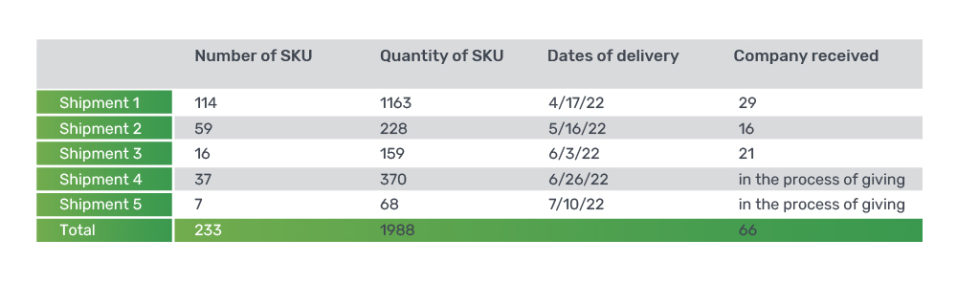

Slide 53
Who is behind the Task Force “Keep Ukraine Connected”

Slide 54
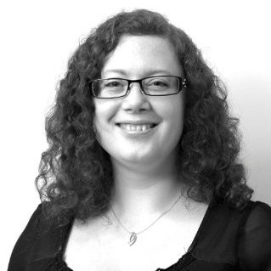
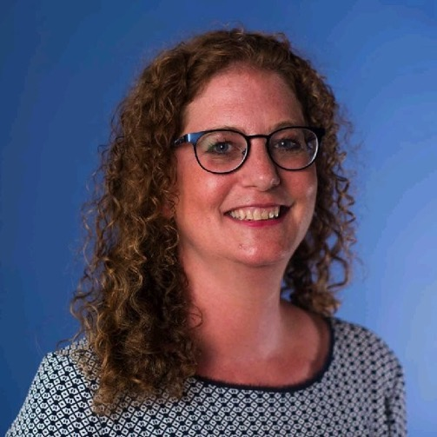
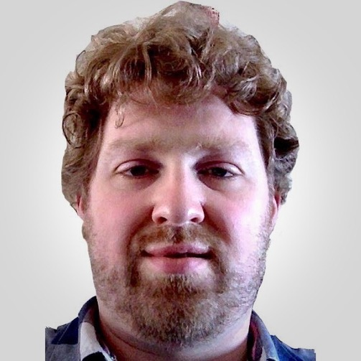
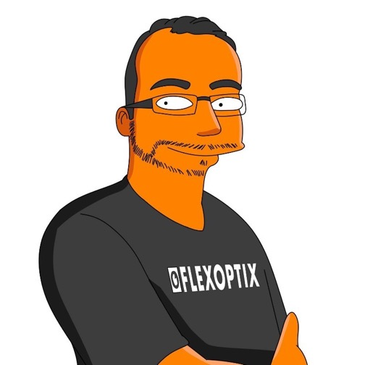
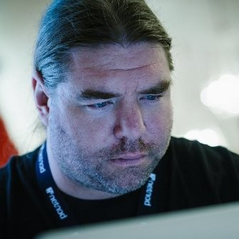
Who is behind the Task Force “Keep Ukraine Connected”
Corinne Pritchard
Nathalie Trenaman
Sander Steffann
Rene Fichtmueller
Jan Žorž

Slide 55
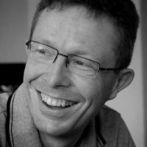
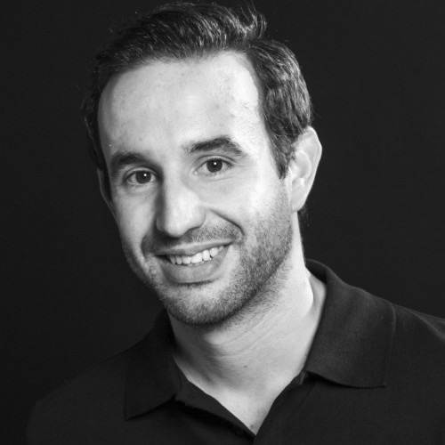
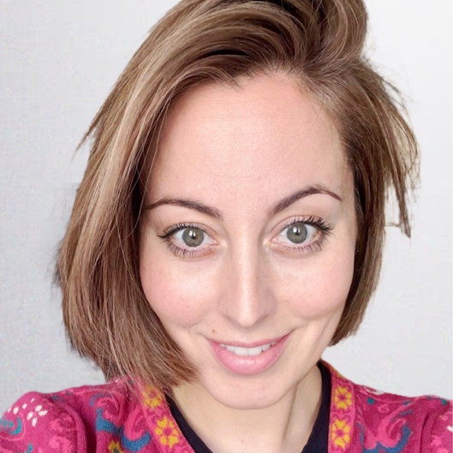
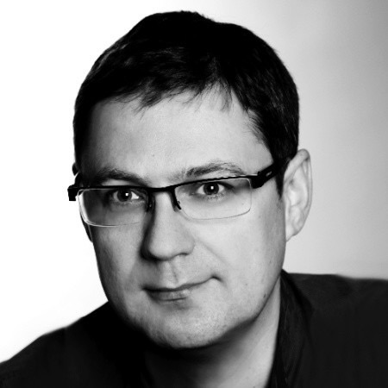
Who is behind the Task Force “Keep Ukraine Connected”
Corinne Pritchard
Nathalie Trenaman
Sander Steffann
Rene Fichtmueller
Jan Žorž
Erik Bais
Daniel Houben
Ester Paál
Marcin Kuczera

Slide 56


Slide 57
Thank you!
Mail us:
ukraine@nogalliance.org
Supply&Demand DB: www.keepukraineconnected.org/admin/login

