Slide 1
Ensure DNS Resilience from Multi-vector DDoS Attacks
Adil Baghir
Head of Technology and Solutions
Strategic Accounts (Telco/SP)
22 Sept 2022

Slide 2
Agenda
DNS infrastructure is a primary target
DNS attacks evolution and threats landscape
DNS DDoS defense strategies
Comprehensive DNS protection map
Q&A

Slide 3
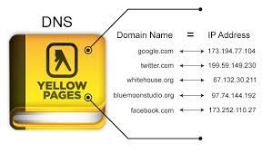
DNS Infrastructure is a Primary Target
www.google.com
= 74.125.224.72
Here is where you should look
Here is where you should look
“Not in my cache, I will go find it”
…
“Here it is 74.125.224.72”
Enterprise Authoritative
Name Server
TLD Server
Root Server
.com, .edu, .net…
Authoritative
ns.google.com
Authoritative
“.”
Authoritative
ISP DNS Server
Name Server
ISP.net
Cache
Recursive
page.corp.com
Authoritative
Phone book of the Internet
www.google.com
DNS Resolver

Slide 4
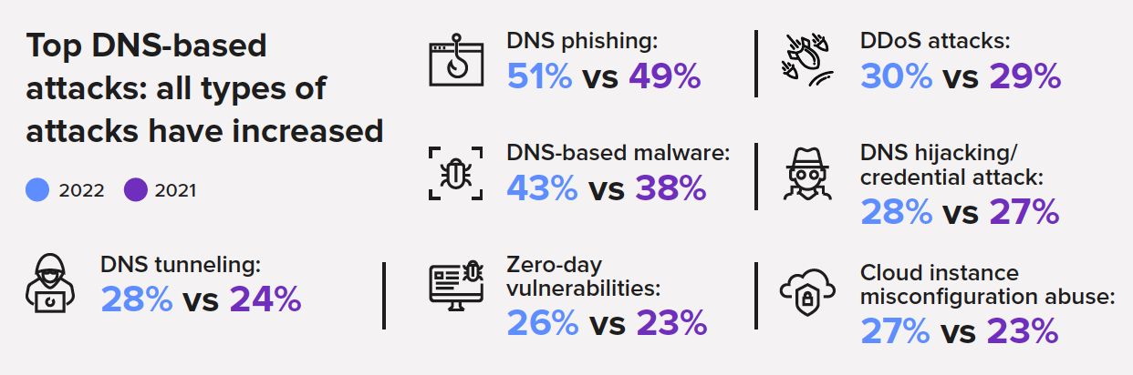
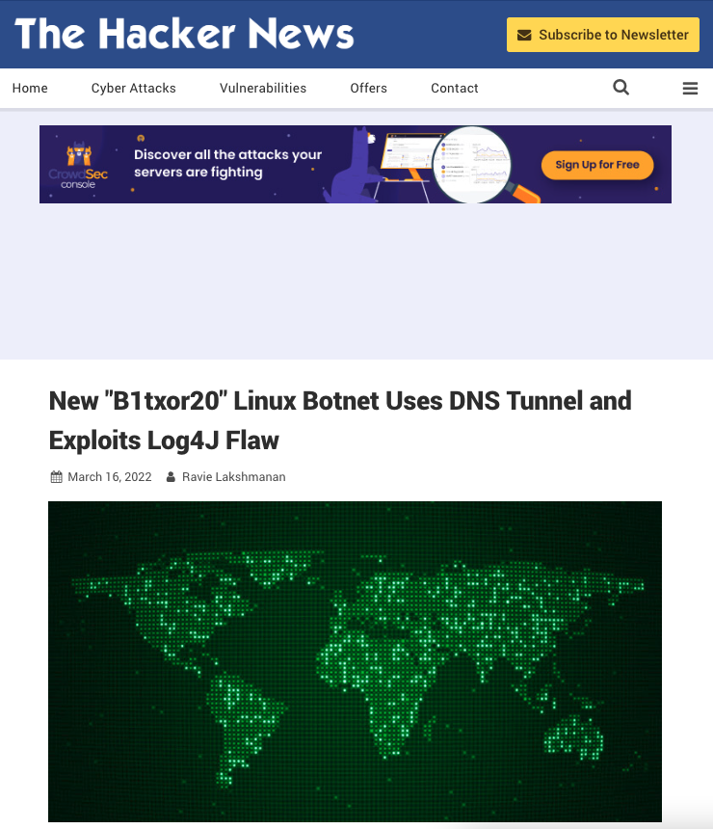
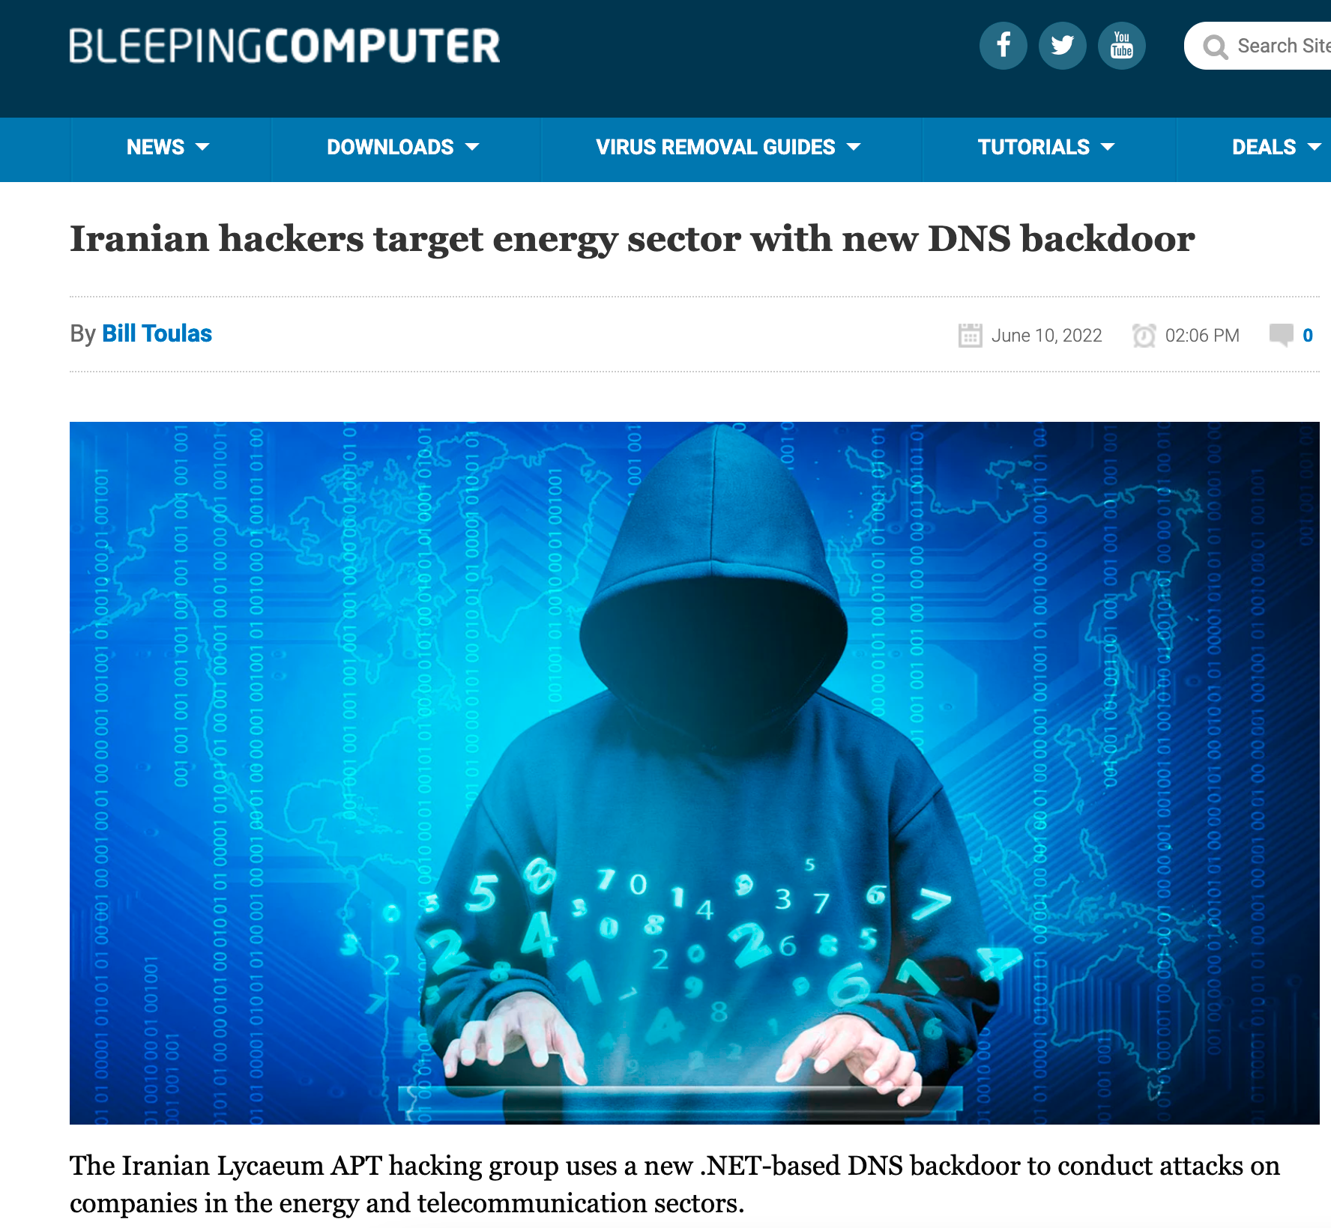
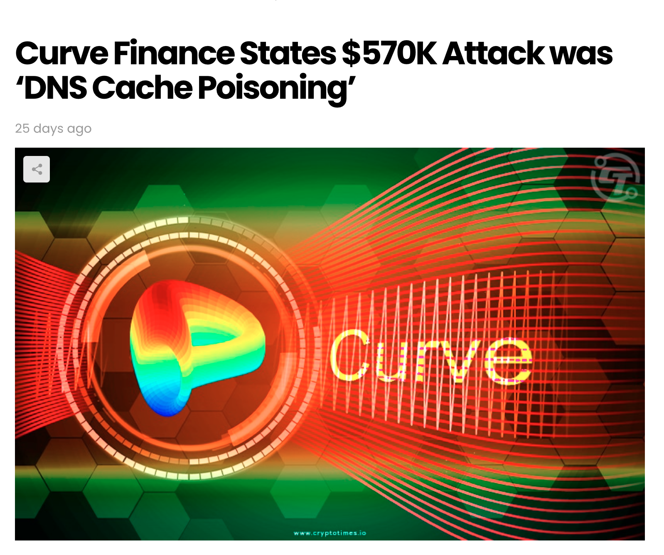
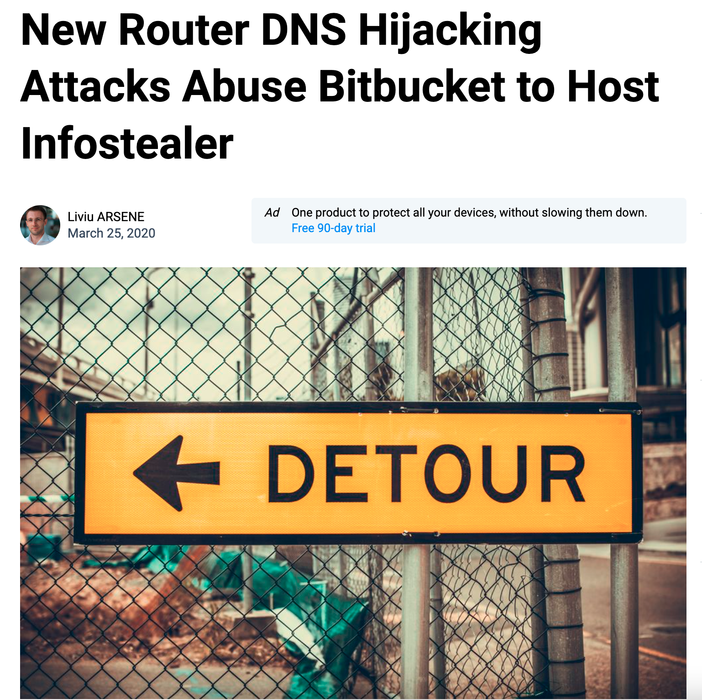
DNS Attacks Have Evolved
Notes:
Source: 2022 Global DNS Threat Report, EfficientIP
https://thehackernews.com/2022/03/new-b1txor20-linux-botnet-uses-dns.html
https://www.bleepingcomputer.com/news/security/iranian-hackers-target-energy-sector-with-new-dns-backdoor/

Slide 5
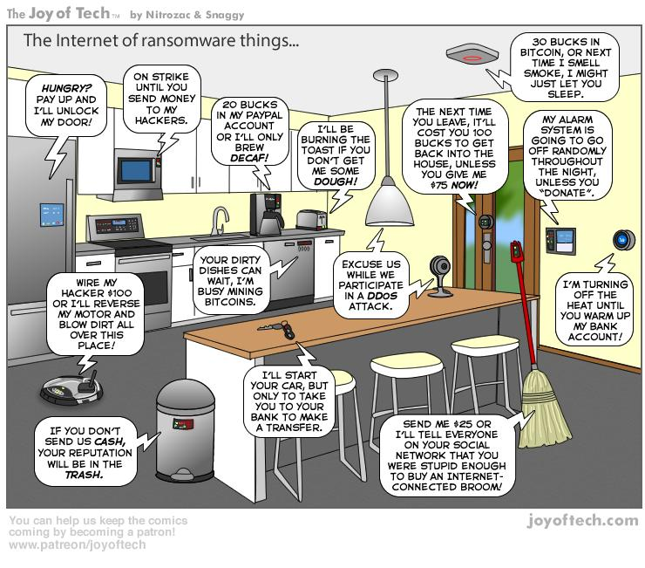
The DDoS of Things
Most IoT devices have limited computing resources to provide security functionality and typically are not securely coded
IoT devices can easily be compromised for use in large botnets
IoT devices are often deployed in remote areas or in environments where their behavior is difficult or impossible to monitor
Large numbers of potentially compromised or poorly designed IoT devices can be deployed within the SP network and, if compromised, could severely impact network availability
Notes:
Investigating Mirai https://www.a10networks.com/marketing-comms/white-papers/investigating-mirai/
*Cisco Annual Internet Report (2018–2023) White Paper - https://www.cisco.com/c/en/us/solutions/collateral/executive-perspectives/annual-internet-report/white-paper-c11-741490.html

Slide 6









DNS DDoS Attack Strategies
TCP/UDP/ICMP floods
L3/L4 packet anomaly
Spoofed source IP
DNS reflection/amplification
DNS protocol anomaly
Repetitive ANY queries
Random query names
The DDoS of Things (IoT)
Attacker
Cyber Criminal
Hacker
Prankster
Hacktivists
Competitor
Weapon
IoT Botnet
Open DNS Resolvers
Infected Zombie Botnet
Delivery
Victim
Enterprise
Name
Server
ISP
Recursive
Server
TLD
Authoritative
Server
Root
Authoritative
Server

Slide 7
DNS Defence Strategies
DNS Firewall and
DNS DDoS Defence
Encrypt
DNS
  Mitigation against DNS-based volumetric and DDoS attacks
  DNS Protocol validation (filter & inspect traffic based on DNS query types)
  Recursive and Authoritative DNS cache
  Zaro-day attack protection (ZAP)
  IP Threat Intelligence
  DNS traffic analytics
  DoH/DoT
    Enables user privacy and prevents interception
  DNSSEC
    Authenticates responses and prevents spoofing

Slide 8
DNS Defense Techniques against DDoS Attack
1 | DNS validation | Malformed DNS traffic check | Packet anomaly TCP/UDP/ICMP floods
2 | User authentication | DNS retry, force over TCP | Spoofed source IP Reflection attack
3 | FQDN check | Label length/count, black/white domain list | Random query names Water torture attack
4 | DNS record type check | Drop ANY, limit allowed DNS record types | Repetitive ANY queries DNS protocol anomaly
5 | Source rate limit | Per-record type, NXDomain response rate | DNS flood attack DNS reflection attack DNS amplification attack Zero-day attack
6 | Destination rate limit | Per-record type, per-FQDN, per-FQDN and per-Src IP, label count
7 | Pattern matching | Packet-level filter with Regex, BPF (Berkeley Packet Filter)
8 | Zero-day Attack Pattern Recognition (ZAPR) | ML-powered automatic attack pattern recognition and filter creation

Slide 9
5-Level Adaptive Protection for Precision
Protect your DNS with optimal multi-stage protection
Protection level automatically escalated depending on the degree and persistence of anomaly
Administrators have the option
to manually intervene at any stage of an attack
Traffic monitoring
Multi-stage protection with auto escalation
Countermeasure examples for DNS
Level 4
+ Blacklisting based on
per-SRC traffic rate
DST | SRC
Final countermeasures
Level 3
+ FQDN label check
+ Destination rate limit
DST | SRC
Aggressive countermeasures
Level 2
+ DNS record type check
+ User authentication
+ ZAPR filter
DST | SRC
Increase countermeasures
Level 1
+ DNS packet validation
+ ZAPR analysis
DST | SRC
Add countermeasures
Level 0 - Peacetime
DST | SRC
Basic sanity check
Establish Baseline
Packet anomaly check
5-level Auto-Escalations

Slide 10
Enable Authoritative DNS Cache
Run Thunder TPS as an authoritative DNS cache
Let the TPS answer all DNS queries during war-time
BGP route injection for traffic redirection
Combine with TPS mitigator for comprehensive authoritative DNS protection
TPS Detector
xFlow Telemetry
Detection
BGP Router
Notification
BGP update
During War-time
aGalaxy
TPS Mitigator
Management
orchestration
console and report
Mitigation
Router
During War-time
TPS Auth. DNS Cache
Zone Transfer
High-performance auth. DNS cache
DDoS mitigation (query validation, rate limit, etc.)
BGP route injection
Authoritative DNS

Slide 11
Comprehensive DNS Protection Map
TLD Server
.com, .edu, .net…
Authoritative
Authoritative
Name Server
Root Server
ns.google.com
Authoritative
DNS Server
(Resolver)
“.”
Authoritative
ISP.net
Cache &
Recursive
DNS load balancing
DNS Application Firewall
RPZ
Recursive DNS
DoH/DoT
Threat intelligence
DNS service visibility
DNS traffic analytics
DDoS protection for DNS (UDP/TCP)
Zero-day Attack Protection (ZAP)
Threat intelligence
Authoritative DNS cache
Users

Slide 12
Choosing The Best DDoS Defense
What Makes a DDoS Protection Solution
Better than the Other?
Avoid costly
detection and
mitigation errors
Make personnel
limitations more effective
and efficient
Optimize short-term
and protect
long-term investments
Performance by design
to offer solutions
that make economic sense
Efficacy
Automation
Scalability
Affordability

Slide 13
Q
A
&

Slide 15
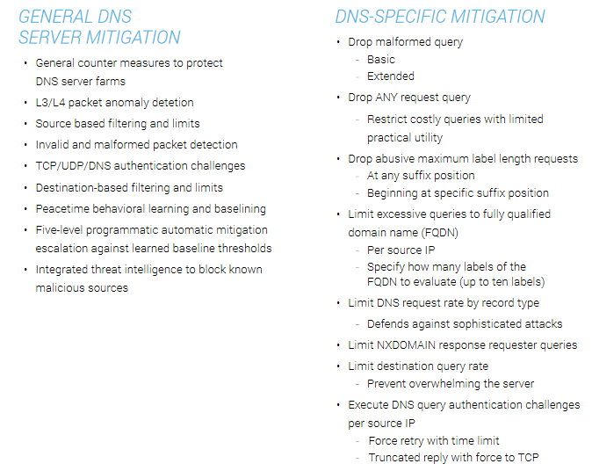
DNS Defence Detail
Complete DNS infrastructure protection
  General attacks
  DNS-specific attacks

