Slide 1


UKNOF 50
Simon Beevers
Septemeber 2022

Slide 2
Paragon Active Assurance (PAA)

Slide 3

Name: Simon Beevers.
Role: Systems Engineer for UK&I T2 Service Providers, focusing on Metro and Aggregation.
Stakeholder Management ● Strategic Planning ● Technology Leadership and Direction
Overview: Network Architect working in the UK SP space for nearly 15 years, with a deep passion for end user experience and working with SP to deliver efficient future proof networks with the end user in mind.
Job History: I have worked as a Network Architect/Team manager within several UK Utilities and Broadband providers such as Glide, PCCW Global Networks UK (formerly Keycom), and achieved Senior Operations roles within Plusnet/BT, Griffin Internet.
Joined Juniper in June 2021.
Volunteering: An independent member of the LINX Program Committee (LPC).
Contact: https://www.linkedin.com/in/meckanix/
Notes:
Who am I and why am I giving this presentation?
For those in the who don’t know me, I’ve been operating since 2008 on several UK SP networks, and joined Juniper in 2021.

Slide 4
Personal Mission Statement:
“My passion is for designing networks focused on customer experience.”
Simon Beevers
Junipers Mission Statement:
“…we need to get the network out of the way, so we can focus on executing strategies and driving business forward.”
Rami Rahim
https://blogs.juniper.net/en-us/service-provider-transformation/juniper-moves-the-network-out-of-the-way-so-you-can-focus-on-customer-experience.
Notes:
what does it mean to get the network out of the way? Simply stated, it means that we need to build and operate networks in such a way that they become transparent to end-users

Slide 5
Paragon Active Assurance (PAA)

Slide 6
What is Paragon Active Assurance (PAA)?
This offers end-to-end monitoring of your network and can give the customer service(s) that you’ve just provisioned an accurate and clear ‘birth certificate’.
Ease of use:
Networking KPIs out-of-the-box
Instant SaaS
Deep networking capabilities:
L2 to L7 traffic generation
Flexible networking
Automated testing and monitoring:
Validate deliveries & changes
Real-time data plane monitoring
https://www.juniper.net/us/en/products/network-automation/paragon-active-assurance.html
Notes:
What is PAA and how does it help get the network out of the way?
Starting at the bringing newly provisioned services can have a ‘birth certificate’ which allows you the operator to give that level of guarantee to the customer that their service will be working 1st time.
And from this it gives you a benchmark to come back to if there’s any service faults. This can be done via normal BAU OPS methods, or by running PAA to re-validated the initial steps to highlight which (if any) parameter is beyond your agreed SLAs.
To do this PAA uses:
Deep networking capabilities:
L2 to L7 traffic generation
Flexible networking
Automated testing and monitoring:
Validate deliveries & changes
Real-time data plane monitoring

Slide 7
Reality Check – Customers First to Find Problems
60% of network problems are discovered first by end-users
– or not reported at all
Source: Independently conducted survey of 200 US enterprises, requested by Netrounds in May 2019
Business impact
Operations spending most of their time in “War Rooms”
Notes:
We’ve all had it when operating networks, in a lot of cases it is the user that finds the problem 1st, not the operator.
And as we know this leads to dissatisfied customers.
Due to the positioning and limitation of most classic monitoring systems aren’t capable of actually monitoring the customer experience, i.e., the classic system might be able to check to see if HTTPS on a web server is responding, and maybe it can capture if the response time is say, greater than 200 seconds. However, that is on say a 5min poller, and don’t check to see if the page is rendered correctly.
Then there is the whole world of streaming services and how to measure and monitor those, and I’m sure there’s a PHD thesis waiting for someone there.

Slide 8
Reality Check – Services Not Tested Thoroughly
Business impact
Failed deliveries lead to bad reputation and churn, plus expensive repair
Notes:
So, what is the current state?
And what problem are we trying to solve?
The current state is that most NOC NMS show a green service, however that service could be degraded, and a simple ping or SNMP response isn’t going to capture that. Whether that be in-life BAU or post maintenance, upgrade or install.
Failed deliveries of service lead to bad reputation and churn, plus expensive repair
And as a result, operation teams can spend a lot of their time trying to replicate customer problems and where applicable send a truck roll to sit to see the problem in action.

Slide 9
Underlying Reasons Why Users Discover Problems
Yesterday
Today
Consequence
Rate of configuration changes
Increased risk for negative network quality impact
Low
High
Degree of network outsourcing and partnering
Low
High
Reduced visibility
Demands on network quality
Lower tolerance for network issues
Medium
High
Notes:
What I noticed over my 15yrs of operating is that today, we make more day-to-day configuration changes in active networks than before (even if they’re not scheduled via a formal process).
Customers demand higher quality networks due to the bandwidth intensive applications they’re not running.
So, there’s quite a few touch points or degrees at which the networks we’re measured at before.

Slide 10
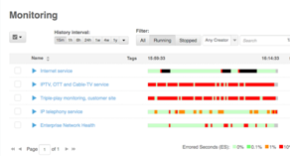
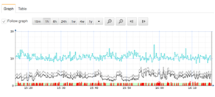
One Solution for the Operational Service Lifecycle
Validate Designs and Changes
Discover Issues Earlier
Resolve Problems Faster
1
2
3
Eng
Ops
Ops
Eng
Ops
Synthetic testing at operational load scale before release
Non-intrusive active monitoring
Troubleshooting tests for reduced restoration time
Example Service Activation Testing:
One-way Jitter
Packet Loss
Service Latency
QoS Prioritization
Augment service change with comprehensive synthetic testing
Monitor end-to-end SLAs using active traffic with realtime KPI drill-down
Automate trouble-shooting at any location in service delivery chain
Notes:
So how will PAA help you this these problems?
PAA allows you to identify problems within your networks and see the current state end-to-end, and quality of your network.
PAA can validate your designs and as mentioned in the opening slides, if needed produce a PDF ‘birth-certificate’, detailing what tests were undertaken and the results of said tests.
PAA is also useful post-maintenance window, because how many of us have completed a maintenance window and whist our OSS/NMS give us an all clear, and as per the earlier slides the customer experience is broken in someway which we can’t detect without end-to-end testing which PAA can provide.
And with end-to-end testing it helps improve the BAU operational mean-time-to-repair (MTTR).
NOTE
This is done via TWAMP or echo replies … etc.

Slide 11









Paragon Active Assurance: Active Traffic on the Data Plane
Test Agent
Built-in reflector
HTML5 Test Agent
Active traffic for test sequences or continuous monitoring
Public
Cloud
4G/5G
5G
Campus
Internet/
SD-WAN
Partner
Partner
Private
Cloud
SD-WAN/
Edge
Wi-Fi
Data plane measurements required to
understand and resolve quality issues
Notes:
ANIMATION – 3 clicks
CLICK 1
So how can PAA look to resolve this? As you can see, we have a few devices here such as an IoT car, factory machines, end users, connected via a variety of different mediums.
Using PAA we can measure between L2 and L7 for SLAs, and this can easily extend to nearly any device connected to your network.
CLICK 2
PAA can be deployed as a dedicated test agent, use RPM or TWAMP as a reflector, or be called into life via a traditional HTML5 browser.
CLICK 3
Tests can be run end-to-end or between agents, giving you different perspectives on your network.

Slide 12

















Validate service quality with Active Assurance
ASSURE
Paragon Active Assurance
Assures customer experience
Confirm service levels support
business objectives
Validate changes, ensure nothing breaks
L2−L7 service quality metrics
Accelerates time to revenue
Automate turn-up testing processes
Simple deployment for visibility across
complex networks
Cloud-ready SaaS or on-premises deployment
Shortens time to resolution
Empower operation engineers with
real-time data plane monitoring
Quickly locate issues in end-to-end
service chain
Gain visibility over third-party
provider networks
Confirm performance in virtualized networks
OSS
Control center
Service request
Dashboards
Test templates
Management and
data collection
Service KPIs
Virtual test agents
Automation
Control
center
Remedial action
SaaS
On-premises
Customer
premises
Access
Metro
Core
HTML5
device testing
NFX/SRX
ACX
MX
Test
Agent
PTX
Edge cloud
Public
multicloud
Test
Agent
Test
Agent
Private DC/
private cloud
Multi-layer, multi-QoS active traffic
Active reflecting traffic using TWAMP
Built-in reflector
Notes:
Validate service quality with Active Assurance
Paragon Active Assurance uses active test agents within the physical, hybrid, and virtual networks to assure service experience. It utilizes synthetic traffic to verify application services across the lifecycle of the service.
Combine PAA with anuta Atom, and you have the ability to set automatic remediate to the ‘know good state’ of your parameters and configuration.
With Paragon Active Assurance, you can now assure customer experience by:
Confirming that network service levels support business objectives
Validating changes to ensure nothing breaks
Assuring based on L2−L7 service quality metrics
You can now accelerate time to revenue by:
Automating turn-up testing processes
Simplifying deployment for visibility across complex networks
Cloud-ready with either SaaS or on-prem deployment options
You can now shorten the time to resolve problems by:
Empowering service operation engineers with real-time data plane monitoring
Quickly locating issues on the end-to-end service chain
Gaining visibility over third-party providers’ networks performance
Confirming performance in Virtualized Networks

Slide 13
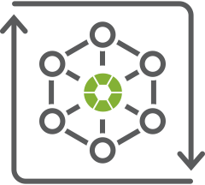





Juniper Paragon Automation Powers the WAN
Scalable IP Service Fabric
Paragon Planner
Design, Simulate, Optimize new services and network changes (formerly Northstar)
Paragon Pathfinder
Remediate, assure SLA through model-based closed-loop automation
(formerly Northstar)
Assured Service Experience
Cloud-Native
Open, DevOps
Atom (Anuta Networks)
Orchestrate, Automate workflows
Cloud SaaS
Paragon Insights
Correlate using AI/ML analytics to provide actionable insights (formerly Healthbot)
Paragon Active Assurance
Actively validate service quality (formerly Netrounds)
Open APIs
Real time streaming telemetry
Active Sensing
Access
Aggregation
Edge Cloud
Edge/Core
Notes:
With this in mind, Juniper is introducing Paragon Automation, a modular portfolio of cloud-ready software-based tools that deliver closed-loop automation to translate business intent into service performance, assuring your customers receive a differentiated service experience throughout the life of their service.
Its cloud-native software applications can be deployed in redundant clusters within your own private data centers and public or private clouds, providing cloud grade resiliency and scale. Its applications are fully integrated out of the box, with a common UI, UX and API for ease of adoption and deployment.
Paragon Planner provides service design, modeling, and testing, prior to deployment
Paragon Active Assurance validates actual service paths across pre and post deployment, and troubleshoots issues to reduce MTTR
Anuta ATOM automates process-oriented tasks, streamlining execution of service provisioning, resulting in greater efficiency and improved service experience
Paragon Insights leverages ML analytics to identify and remediate issues in a make-before-break fashion.
Paragon Pathfinder simplifies traffic engineering and path management, providing computation and provisioning capabilities for SR and Network Slicing.

Slide 14






Paragon Automation
On-Prem & SAAS in 2021
On-Prem
SAAS/On-Prem
Device Lifecycle Management Service Lifecycle Management
Service, Network, Device Health
IP Transport Planning & Management
Active Assurance
through synthetic traffic
API
Paragon Platform UI
API
Paragon Active Assurance
Paragon Insights
Paragon Pathfinder
Paragon Planner
Service Model Catalogue
Codify Service Models
Service Health
RCA
Stateful TE & Topology Management & Deployment
Provision Services
Network Health
Device Health
BW Calendaring
Network Design
Zero Touch Activation Testing
Configuration Inventory
Configuration Policy
Closed Loop
Path Management
Planning
Orchestrated Assurance
Conf. Policy Enforcement
Playbook Catalogue
Continuous SLA/O Monitoring
Service
Computation
Simulation
Workflow Catalogue
Codify Workflows
Network
Installation
Execute Workflows
Monitoring
Device
Optimization
Test Agents
Inventory
RT Topology
offline Topology
Configuration Deployment, Exec
Telemetry Collection (Stats, Events)
Inventory
JunOS
OC
3rd party
JunOS ST
xFlow
SNMP
3rd party
Device Discovery
Notes:
API’s following Junipers API 1st methodology.

Slide 16
APPENDIX - Paragon Active Assurance (PAA)

Slide 17








Business Benefits
Service Lifecycle
ROI
Change/Delivery – Day 1
Deliver pre-assured services
Confirm new configurations – right first time
Validate changes – ensure nothing breaks
13% reduction in failed service delivery rate
Reduction in incident resolution times
Day 1
Activation Testing
Faster time to revenue - billing commences ~6 days earlier for new services
Operations/Service Desk – Day 2
Understand performance issues before users
Shorter time to resolve problems
Confirm that network service levels support business objectives
8% lower OPEX for service delivery
No services placed into production have performance issues
Day 2
Active Monitoring
Increased customer satisfaction
Note: ROI statistics from Netrounds’ customers

Slide 18
Experience a Top Priority for Service Providers
Question: What are your most important strategic priorities over the next three years?
% of responses
Source: Ernst & Young Global Telecommunication study 2019.
“We need to invest in the customer because of disruptive competition.”
“Our industry is plagued by churn levels that would terrify any other industry.”
—Operator survey participant
—Operator survey participant
Notes:
Experience is top strategic priority for Service Providers
In an Erns & Young survey, many CSPs answered the question “What are your most important strategic priorities over the next three years? With the resounding “improving customer experience”.
The net promoter score that measures the customer rating is pretty low compared to the other industries – This leads to customer churn.
CSPs do understand the “customer experience” is the only way to differentiate and grow.
They also understand that delivering service experience is the best driver of the customer experience.

Slide 19
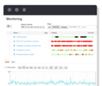
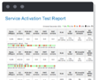




Architecture
Control Center
SaaS or on-prem options
Network Automation
Ex. Anuta ATOM
NETCONF & YANG
Dashboards
REST
Test templates
GUI
Analytics
Ex. Healthbot
REST
Monitor templates
Management &
Data Collection
Juniper ACX, MX, PTX, SRX
Physical Network Elements
Reflection
Active Traffic
Application Requests
Performance Testing
IP Path Tracing
HTML5 devices
Juniper NFX150
Virtual Test Agents
SaaS or On-premises – Supporting Public, Private or Hybrid Environments
Notes:
The Control Center other than supplying the APIs and GUI, also provides the command-and-control elements of the agents keeping them up-to-date, collecting the metrics and programing them for the test cycles.
As per the opening slides for hosting the agent, we support all of the major cloud environments, as well as various computing options and several routers support our agent. As well as prebuilt Kube and Docker images.
Test from the agent can be used in five different ways:
1. Between agents.
2. Reflection - y1731, TWAMP, IP reflection.
3. Application/activation requests or as part of our L2 through L7 feature set, we can test applications by using calls to the applications to get determined responses.
4. IP Path Tracking by path tracing with Paris traceroute and measuring the TTL expiry messages of the path taken to work out the quality of the path and if there’s been any path changes.
5. Performance testing via an HTML5 browser.

Slide 20
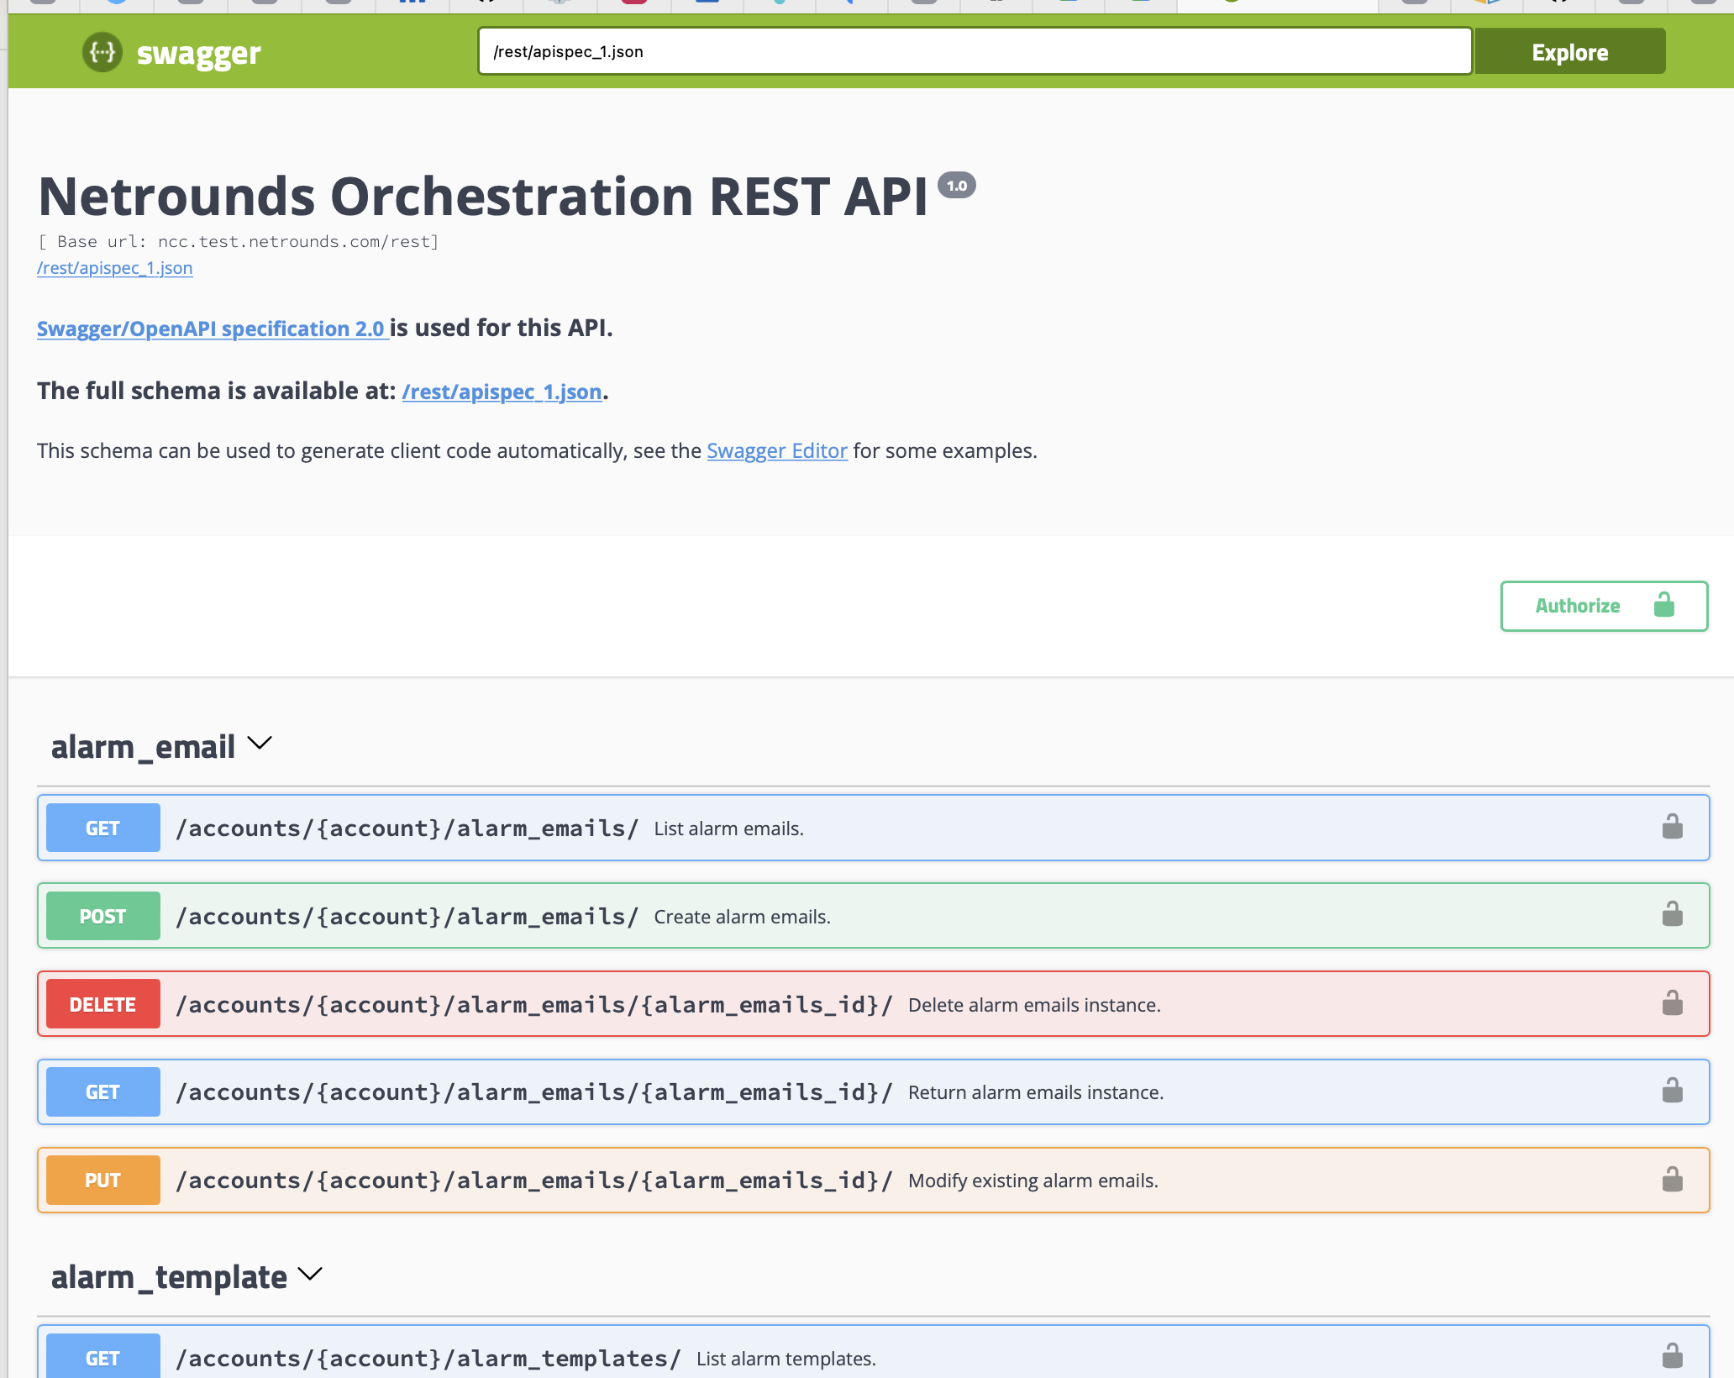
Automation features/APIs
Control Center
Orchestrator
NETCONF & YANG
REST
GUI
Analytics
REST
KAFKA
SQL
Test Agents
Swagger/OpenAPI
Multiple different image formats
Support for all major public cloud environments
PNF, VNF and CNF
VNF: Support for cloud-init
CNF: Certified to run on Open Shift
“Call home” functionality

Slide 21
L2-L7 Data Plane Metrics in One Platform
WI-FI
MOBILE
NETWORK
PERFORMANCE
IPTV & OTT VIDEO
VOICE
INTERNET
PERFORMANCE
REMOTE PACKET
INSPECTION
SWITCHER
SWITCHER
UDP
IPTV
SIP
DNS
PACKET CAPTURE
LOGGER
LOGGER
Y.1564/MEF 48
ETSI TR 101 290
REGISTER
RESPONSE TIME
LIVE FEED
SCAN
UNI/ MULTICAST
MULTI-CHANNEL
CONNECT
EXPECTED RESPONSE
PCAP FILES
P2P/ HUB-AND-SPOKE/
FULL-MESH
IGMP JOIN/LEAVE
DISCONNECT
WIDE RECORD TYPE
SUPPORT
WIRESHARK COMPATIBLE
INLINE
CALL STATISTICS
STATEFUL TCP
HTTP/OTT STREAMING
MOS
HTTP
RFC 6349
APPLE HLS
VOIP UDP
TCP CONNECT
MULTI-SESSION TCP
PLAYBACK RATE
G.711/G.723/G.729/
GSM-EFR
TIME TO FIRST BYTE
QOS POLICY PROFILING
DOWNLOAD RATE
PAGE LOAD
REFLECTOR
BUFFER
MOS
DOWNLOAD RATE
Y.1731 – LB/DM/SLM
NETFLIX
HTML5 TESTS
802.1AG – LOOPBACK
NETFLIX SPEEDTEST
RATE, RESPONSE TIME
RFC 5357 – TWAMP FULL/ LIGHT
DOWN-/UPLOAD RATE
LATENCY, JITTER
PING
ICMP, UDP
PATHTRACE
Test & monitor templates used for automation and to structure measurements in flexible order and combination

Slide 22







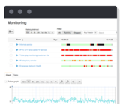



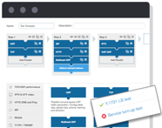




Proven Across All Operational Environments
Stand-Alone in Today’s Networks
Fully Orchestrated Networks & Services
Orchestration
Performance Mgmt
OSS
Operations
Service
Delivery
or
Change
Management
AIOPs
Orchestration API
NETCONF/YANG
REST
Metrics API & Events
REST
Kafka
SNMP traps
e-mail
Analytics
Support
Example integrations - not a comprehensive list

Slide 23
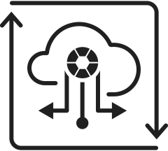

Example automation workflow
Service order request
Architecture
Outcome
1
5
Activation
test result
6
Service activation test reports
Orchestrator (eg. ATOM)
2
Configure devices
and test functions
Start test
8
Real-time service quality dashboard
3
7
Monitor
Paragon Active
Assurance
Optional: Deploy Test Agent
4
Test metrics
Test traffic
Test traffic
PAA Test Agent
Test traffic
PAA Test Agent
Notes:
Let me briefly describe a typical workflow when PAA is used for automated active assurance, just to make this important part a bit more concrete.

Slide 24
Customer Use Cases

Slide 25

Central TWAMP for Backhaul Network Performance
MPLS/SR domain
Access
Metro
Core
Partner/
Peering
Public Multicloud
ACX
MX
PTX
Edge cloud
TA
Private DC/
Private Cloud
Customer example:
Two options for Test Agent deployment in private data center:
As VM or Container on existing compute infrastructure
Stand-alone on dedicated Juniper NFX150
TA
Netrounds Active Test Agent Software as VM or Container
Active reflecting traffic using TWAMP
Pain points
Underlying reasons
Solution
Undetected problems
Problems difficult to find – long MTTR
Lack of visibility
Misconfigurations (QoS)
Bursty traffic patterns
Validate QoS policies
Test that that changes do not break anything
Sectionalize and pinpoint problem area

Slide 26

Core Network Performance
MPLS/SR domain
SRX
TA
Access
Metro
Core
TA
Partner/
Peering
MX
NFX
Public Multicloud
ACX
MX
PTX
TA
TA
Private DC/
Private Cloud
non-Junos
Customer example:
Test Agent deployment on metro sites
As VM or Container on existing compute infrastructure
Stand-alone on dedicated Juniper NFX150 (shadow routers)
On Provider Edge router (roadmap item)
TA
Netrounds Active Test Agent Software as VM or Container
Active reflecting traffic using e.g., TWAMP
Pain points
Underlying reasons
Solution
Core router performance from end user perspective (IP, IPTV etc)
Routing and forwarding issues
Planned work
Complex network designs
Node monitoring does not reveal all possible errors (e.g., how route changes affect forwarding)
Automated testing, performed at changes
Active test traffic on the data plane to continuously detect and sectionalize when and where issues occur

Slide 27
Multi-Cloud and Data Center Interconnect
MPLS/SR domain
TA
Access
Metro
Core
Partner/
Peering
Public Multicloud
ACX
MX
PTX
TA
Private DC/
Private Cloud
TA
Edge cloud
Customer example:
Two options for Test Agent deployment in private data center:
As VM or Container on existing compute infrastructure
Stand-alone on dedicated Juniper NFX150
TA
Netrounds Active Test Agent Software as VM or Container
Multi-layer, multi-QoS L2-L7 active traffic
Pain points
Underlying reasons
Solution
Intermittent outages and quality degradations
Many parties involved – long MTTR
Dependent on public Internet and other shared infrastructure
Limited or no visibility into public cloud networking
Complex routing and security policies between clouds
Active test traffic to validate actual end-to-end quality
Continuous detection of when and where issues occur
Rapid, efficient and cloud-agnostic troubleshooting

Slide 28
5G Edge Slicing and Cloud Network Performance
MPLS/SR domain
Access
Metro
Core
Partner/
Peering
Public Multicloud
ACX
MX
PTX
TA
TA
Private DC/
Private Cloud
Edge cloud
Customer example:
Two options for Test Agent deployment in private data center:
As VM or Container on existing compute infrastructure
Stand-alone on dedicated Juniper NFX150
TA
Netrounds Active Test Agent Software as VM or Container
Multi-layer, multi-QoS L2-L7 active traffic
Pain points
Underlying reasons
Solution
Escalations from mobile customers due to poor performance
Problems difficult to find – long MTTR
Very complex, multiple overlay network, with limited visibility
Dynamic nature of cloud native renders traditional device assurance not applicable
Active test traffic on the data plane
Validation of network data plane, embedded in CI/CD process
Continuous detection and sectionalization of when and where issues occur

Slide 29
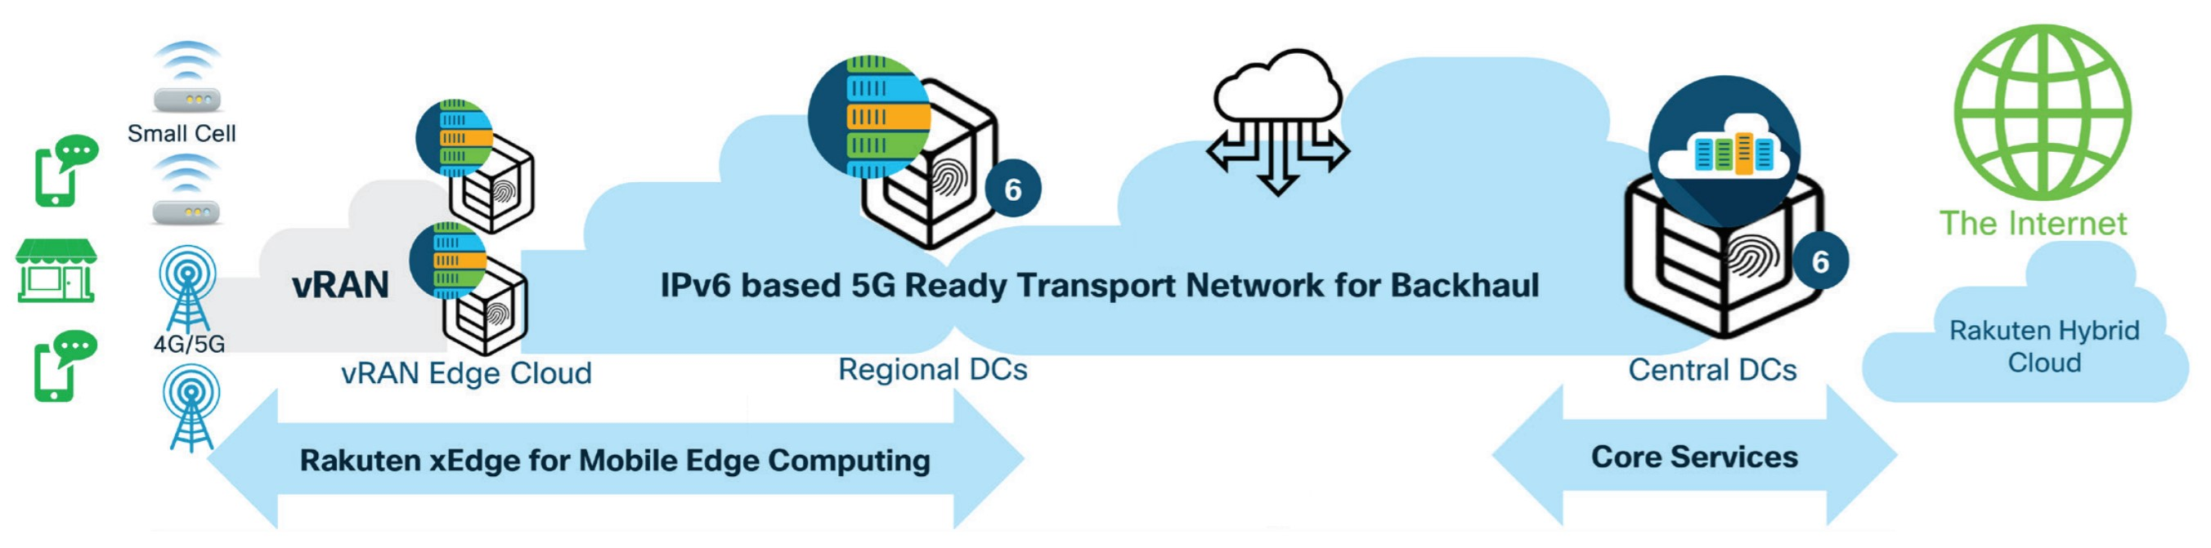
Distributed Computing Enables Active Assurance
Netrounds Active
Test Agent VNF
vCU
VNF
other
VNFs
Netrounds Active
Test Agent VNF
vEPC
VNF
other
VNFs
Hypervisor / Compute
Hypervisor / Compute
virtio
sr-iov
sr-iov
virtio
Source: Reimagining the End-to-End Mobile Network in the 5G Era
Metrics
active IPv6 traffic across the data plane
in 3x QoS (BE, AF41, EF)
One-way latency / jitter
Packet loss / reordering
Throughput

Slide 30
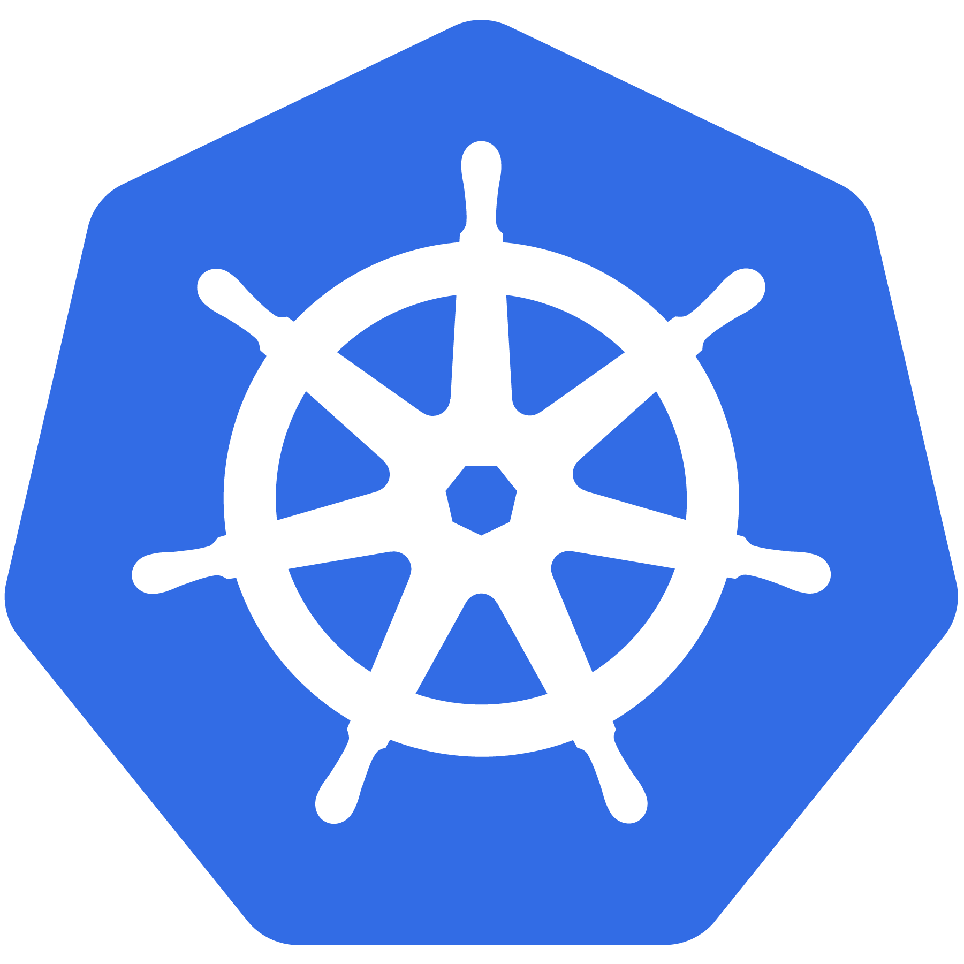

K8s Combined Assurance for CNF 5G stack
K8s #1 DU Service
K8s #2 CU Service
K8s #3 UPF Service
Node X
Node Y
Node A
Node B
vDU Pod
vCU Pod
UPF Pod
UPF Pod
TA CNF
vDU
TA CNF
vCU
TA CNF
UPF
TA CNF
UPF
Cluster Network
Cluster Network (eg. VXLAN, VLAN, L3)
Cluster Network
Ingress service
Ingress service
EDC-RDC
EDC-Core
Measurements and test traffic

Slide 31
Enterprise - End-User Performance
MPLS/SR domain
Access
Metro
Core
TA
Partner/
Peering
SRX
Public Multicloud
ACX
MX
PTX
TA
Private DC/
Private Cloud
Edge cloud
Customer example:
Two options for Test Agent deployment in private data center:
As VM or Container on existing compute infrastructure
Stand-alone on dedicated Juniper NFX150
TA
Netrounds Active Test Agent Software as VM or Container
US Department of the Interior
HTML5 Performance Test
Pain points
Underlying reasons
Solution
Loss of employee productivity
Complaints from internal organizations
Many vendors, providers and technologies
Complex Internet gateways with security stacks, DPI, NAT, proxies and caches
Test connectivity and performance on demand from any HTML5 web browser
Supports all devices – mobile, tablet and laptop

Slide 32
Deploying and Invoking
Fully Orchestrated Active Assurance

Slide 33

Step 1: E2E Service Provisioning
Service order
OSS
Pathfinder
Anuta ATOM
Contrail
Service
Orchestrator
VNFM
VNFM
VNFM
MPLS/SR domain
Generic IP network
Access
Metro
Core
NETCONF/CLI
Partner/
Peering
NFX/SRX
Public Multicloud
ACX
MX
PTX
Private DC/
Private Cloud
Edge cloud fabric
Contrail
Controller
Contrail
Controller
Anuta transforms inbound service order to network configurations to fulfill requested intent.

Slide 34
Step 2: Orchestrated Test Agent Deployment Using VNFMs
TA
Active Test Agent Software as VM or Container
ATOM
VNFM
VNFM
VNFM
MPLS/SR domain
Generic IP network
TA
Access
Metro
Core
Partner/
Peering
TA
NFX/SRX
Public Multicloud
TA
ACX
MX
PTX
TA
Private DC/
Private Cloud
Edge cloud fabric
TA
VNFM
As specified in service chain or slice descriptors, ATOM deploys active Test Agents
on compute nodes connected to the E2E service

Slide 35

Step 3: Orchestrated Turn-Up Testing
TA
Active Test Agent Software as VM or Container
Active reflecting traffic using TWAMP
ATOM
Request turn up tests
Netrounds
Test templates
Multi-layer, multi-QoS L2-L7 active traffic
Test result/report
Data plane metrics storage
Management
TA
Access
Metro
Core
Partner/
Peering
TA
NFX/SRX
Public Multicloud
TA
ACX
MX
PTX
TA
Private DC/
Private Cloud
TA
ATOM requests service turn-up validation from PAA, by referring to a pre-defined test template.
If OK, ATOM starts service monitoring using pre-define templates, otherwise service config is rolled back.

Slide 36
Step 4: Service-Oriented Closed Loop with Paragon Insights
TA
Active Test Agent Software as VM or Container
Real-time service KPIs
Active reflecting traffic using TWAMP
Insights
ATOM
Active
Assurance
Monitor templates
Device KPIs
Request monitor
Data plane metrics storage
Multi-layer, multi-QoS L2-L7 active traffic
Correlated device and service issues
Automated or approval-based workflows for corrective actions
Management
TA
Access
Metro
Core
Partner/
Peering
TA
NFX/SRX
Public Multicloud
TA
ACX
MX
PTX
TA
Private DC/
Private Cloud
TA
Paragin Insights concludes root cause candidate devices by using playbooks to correlate
device-centric KPIs with service-oriented KPI from Paragon Active Assurance

