Slide 1
Electrickery
PUBLIC
Steve Wright
steve.wright@redcentricplc.com

Slide 2
PUBLIC
Agenda
Pre-amble…
Power Flows & Non-Commodity Costs
Buying your Commodity (Wholesale Market Generation)
Risk Management & Appetite
Climate Change Agreement
Government Announcement
Questions!

Slide 3
PUBLIC
Components of a Bill
Charge | Charge Description
Energy | kWh Units (Wholesale Generation - Commodity)
Energy | Standing Charge
3rd Party | Balancing Services Use of System Charges (BSUoS)
3rd Party | Contracts for Difference (CfD)
3rd Party | Capacity Market (CM)
3rd Party | Feed in Tariff (FiT)
3rd Party | Renewable Obligation (RO)
CCL | Climate Change Levy
DUoS | DUoS Standing Charge (DUoS = Distribution Use of System)
DUoS | Red, Amber, Green usage charges
DUoS | Excess reactive power charges
DUoS | Agreed capacity charges
DUoS | Excess capacity charges
TUoS | Transmission use of system charges

Slide 4
PUBLIC
Power Flows
Energy (Commodity)
DUoS
TUoS

Slide 5
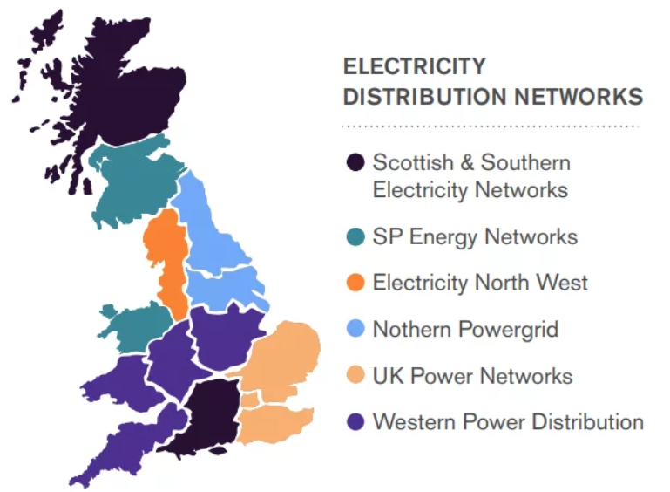
PUBLIC
DNOs - Distribution Network Operators

Slide 6
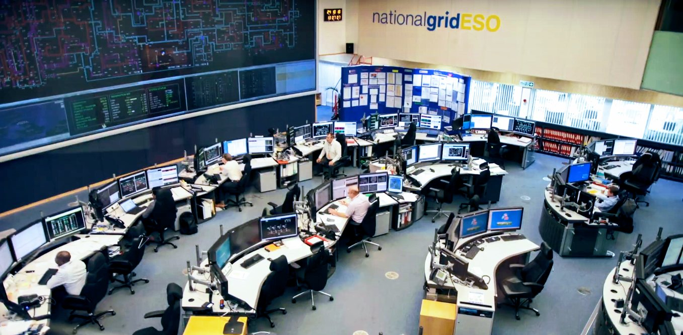
PUBLIC
Components of a Bill
Charge | Charge Description
Energy | kWh Units
Energy | Standing Charge
3rd Party | Balancing Services Use of System Charges (BSUoS)
3rd Party | Contracts for Difference (CfD)
3rd Party | Capacity Market (CM)
3rd Party | Feed in Tariff (FiT)
3rd Party | Renewable Obligation (RO)
CCL | Climate Change Levy
DUoS | DUoS Standing Charge (DUoS = Distribution Use of System)
DUoS | Red, Amber, Green usage charges
DUoS | Excess reactive power charges
DUoS | Agreed capacity charges
DUoS | Excess capacity charges
TUoS | Transmission use of system charges
!!!

Slide 7
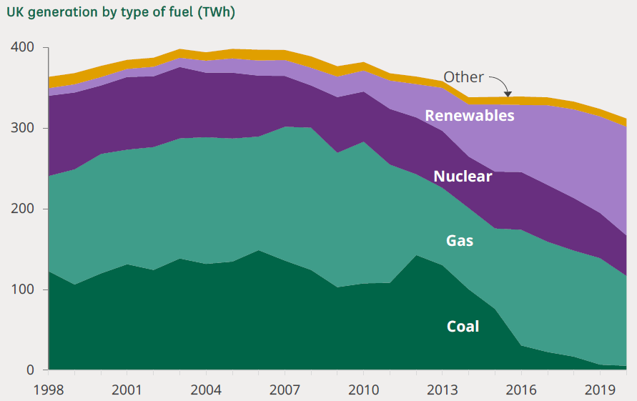
PUBLIC
Generation Mix
Wait.. what
Great News!
☹
Not ideal…

Slide 8
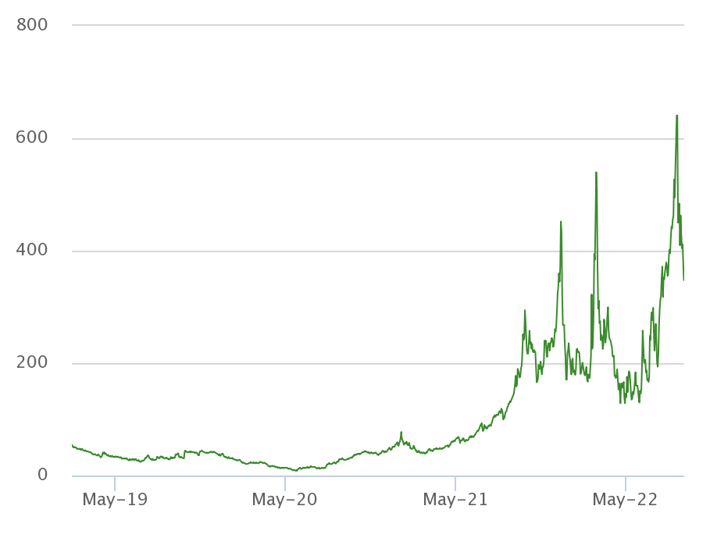
PUBLIC
Gas Market

Slide 9
PUBLIC
Percentage Split

Slide 10
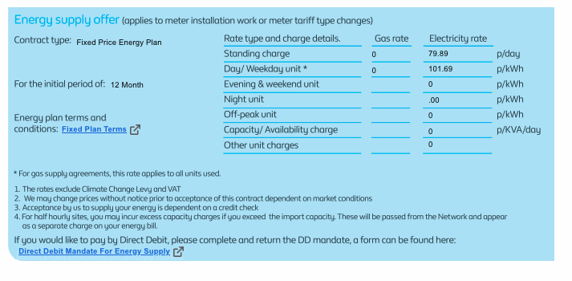
PUBLIC
Fixed Contracts

Slide 11
PUBLIC
Futures Market

Slide 12
PUBLIC
Futures Market

Slide 13
PUBLIC
Day Ahead Market

Slide 14
PUBLIC
Risk Management
Buying energy at scale is all about managing risk
Hedging policy generally provided boundaries that everyone had previously agreed
Different hedging levels and contracts for all operators
Can also differ per site or location

Slide 15
PUBLIC
Climate Change Agreement
Climate Change Levy (CCL) – Government Tax to encourage being efficient
Climate Change Agreement (CCA) – Data Centres late to the party!
92% discount on the CCL charges for those signed up to the CCA!
About 1% of the total energy bill now
Initial Target: 15% PUE Improvement between 2011 – 2020
Achieved 16.72% across sector!
Driving improvements and investment in energy efficiency!

Slide 16
PUBLIC
Government Announcement!
Late Breaking…
Still final detail to be released but…!
Commodity Floor: £211/MWh Government Discount up to £405/MWh Market price (potentially) up to £616/MWh
Don’t forget all those other charges (~8p/kWh)
Commodity | Discount | Cost
£ 150 | £ - | £ 150
£ 211 | £ - | £ 211
£ 250 | £ 39 | £ 211
£ 616 | £ 405 | £ 211
£ 800 | £ 405 | £ 395

Slide 17
PUBLIC
Futures Market

Slide 18
Questions?
PUBLIC

