Slide 1
Deploying a Backbone in APAC
HOW we failed, What we’ve changed, what we’ve learned
APRIL 3rd, 2023 UKNOF51

Slide 2
Table of content
Who is F5
Backbone History
APAC deployment
F5 Backbone Today

Slide 3
Who is F5
Notes:
No sales pitch or commercial stuff
Just need to clarify why F5 needed a backbone in the first place

Slide 4
Who is F5
FROM HW/Appliance
You probably know F5 for the BIG IP
F5 is often seen as a HW/Appliance company
This was true a few years back but it’s no longer the case
Notes:
You may know F5 for the BIG IP (application delivery service : LB, DNS etc) and/or that it’s a HW/Appliance company. This was true a few years back but we’re no longer that company.

Slide 5
Who is F5
To SAAS/Services
F5 acquired several companies to build a strong services portfolio
These services need a network to be delivered
Notes:
All these services are now under the F5 Distributed Cloud name
F5 is no longer a HW/Appliance company, it’s a cloud/SaaS company
We also changed our name from F5 Network Inc. to F5 Inc.
Cloud service with L3 to L7 protection

Slide 6
Backbone History

Slide 7
Backbone History
It all started as a small French network Start Up.
A few guys and a small network foot print, the goal was to be better at DDoS mitigation
Notes:
Start up.
Started with a few guys and a small network foot print

Slide 8
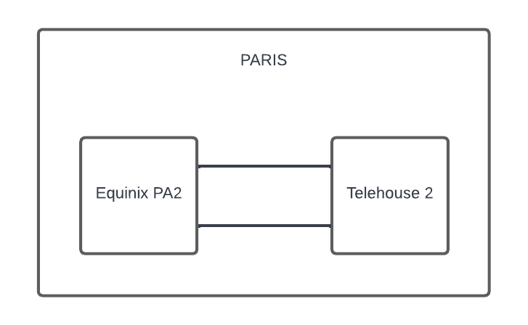
Backbone History
Started in France with the 2 main POPs in Paris
Notes:
Paris – PA2 and TH2, two essential pops for network connectivity

Slide 9
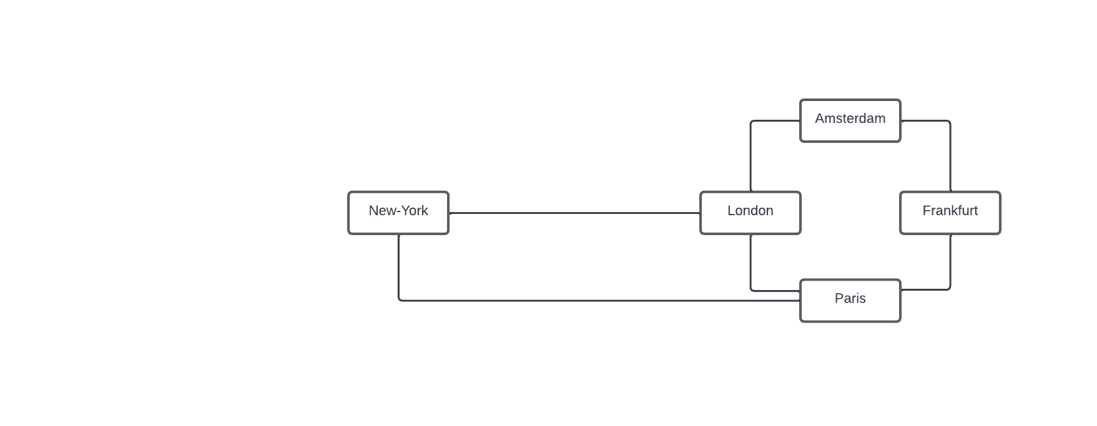
Backbone History
Expanded pretty fast to the main Europe locations and started to connect the US
Notes:
We expanded pretty fast to the main Europe Locations and started to connect the US

Slide 10
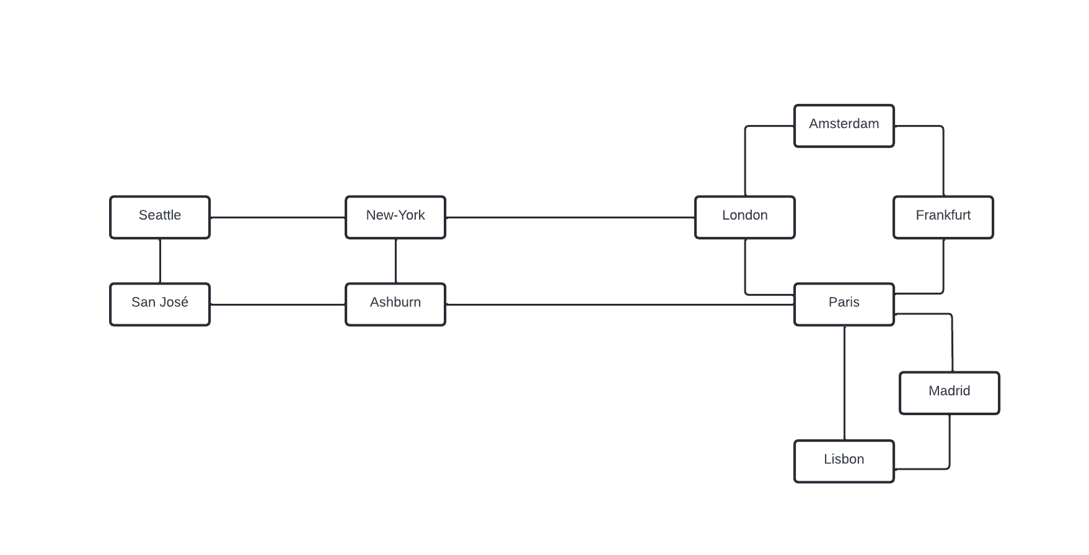
Backbone History
The Merger with Volterra allowed expansion in the US
The next step was to connect the APAC region
Notes:
The Merger with Volterra allowed us to expand our coverage in the US, the next step was connecting the APAC region

Slide 11
APAC deployment

Slide 12
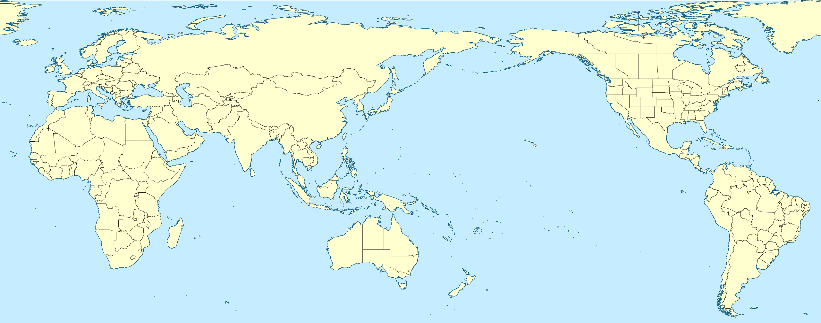
APAC deployment
Several challenges
Distances / Latencies
Costs
Where do we start ?
Notes:
APAC is far away we can connect either from Europe or US West Coast.
Had a previous experience in APAC where POP were islands, no backbone between the POPs.
Had a good knowledge about transit, peering but not much related to backbone circuits.
Different scope than Europe :
Our 2 most distant European pops : STO-LIS = 50 ms RTT
Comparing it to APAC :
HKG-TKY = 50 ms
Lowest latency in our backbone in APAC
HKG-SIN = 30 ms -> approx. 4xLON-PAR or LON-AMS
SIN-TKY = 80 ms
SYD-TKY = 175 ms
SYD-SIN = 100 ms
Where do we start ?
We decided to start connecting from the US first -> cheaper than from Europe with the redundancy we wanted

Slide 13
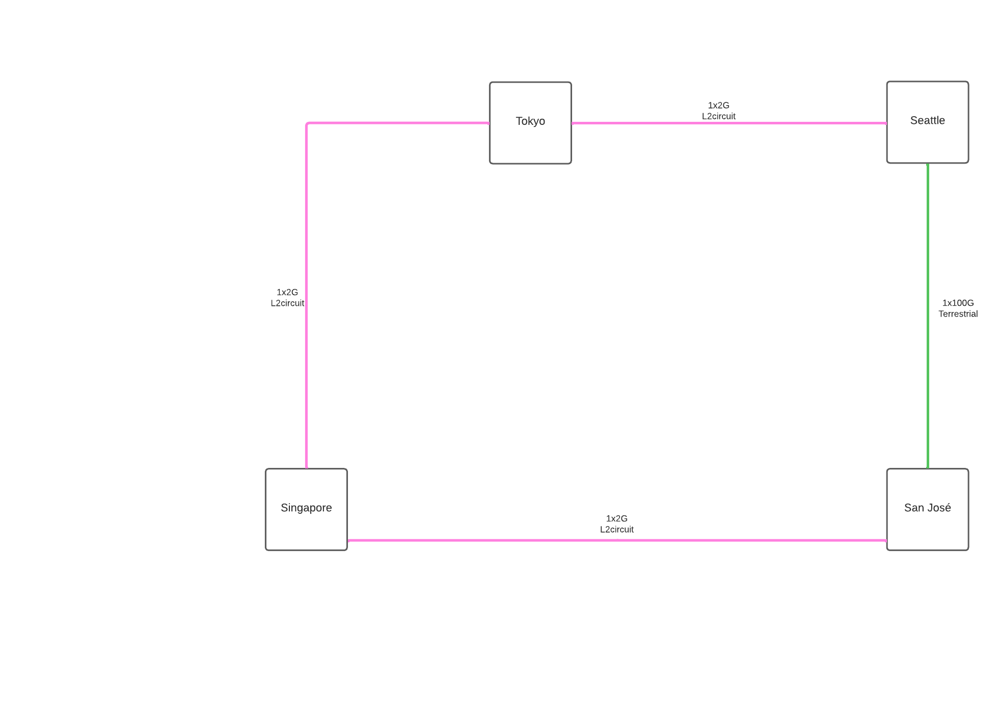
APAC Deployment
Q1-2020
Started with L2circuit with cost efficiency and resilience in mind
It was horrible : unreliable, frequent packet loss, hard down, latency increase etc
We worked with the provider to try to improve the situation with no results
After a few months we looked at other solutions
Notes:
Started with MPLS circuits to limit costs and add resilience
Was unreliable, had lots of issues with it al lthe time. Loss, latency, hard down etc
September started to look for new solutions as production was growing and we needed more capacity and reliability

Slide 14
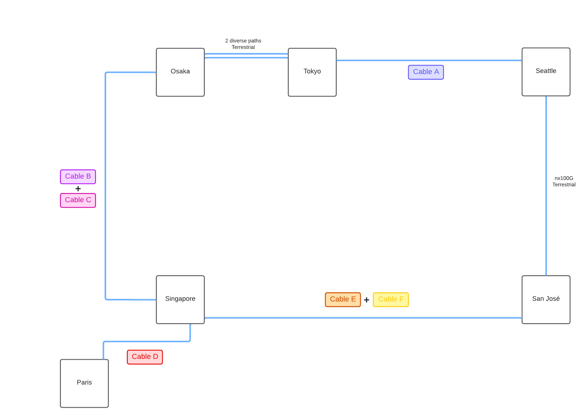
APAC Deployment
Q1-2021
Ditched L2circuits
Went with 10G Wavelengths
3 paths per POP
Submarine cable diversity
Notes:
We went for 10G waves and thought ”how hard can it be to do this ourselves ?”
We thought we would be good with this : 3 paths for each DC
Using different cable system and checking all kmz for terrestrial backhaul see next slide

Slide 15
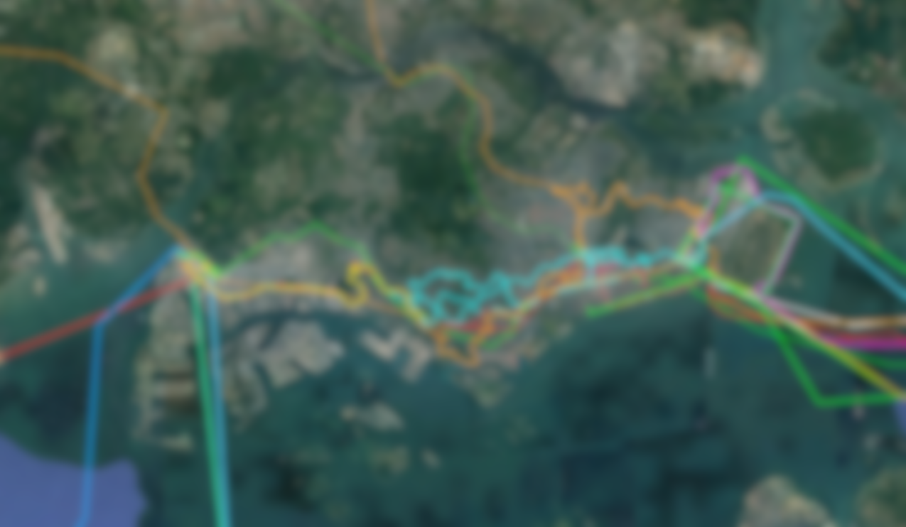
APAC Deployment
Singapore terrestrial example
Singapore terrestrial backhauls
We studied all terrestrial backhauls between CLS and POPs for diversity
But it’s not enough
Cuts happen frequently and can take several weeks until repaired
Maintenances are more frequent than terrestrial cables in our experience
*CLS : Cable Landing Station
Blurred on purpose
Notes:
Singapore terrestrial
We looked at kmz, checked the cable landing station, beach man hole to have the best diversity.
we were wrong thinking it wasn’t difficult to do it ourselved -> maintenances happen more often than terrestrial circuits (often without impact but we need to be prepared just in case)
Cut are way longer, can take 6-8 weeks or even more.
-> there are a few boats in the region responsible each for multiple cables. If 2 cables managed by the same ship is damaged, it takes even longer.
Boat has to get there, wait for good weather conditions, try to locate and repair the fault, go back to shore before going to the next cut
More stable than before with more capacity but incidents last longer.
3 paths is not enough, while there is a long cut on 1 path, another can go under maintenance or another cut can happen and we’re left with only 1 path on a single router that can fail or another maintenance is possible.
Singapore got entirely cut once for a few hours.

Slide 16
Why so many issues ?
Notes:
Maintenances

Slide 17
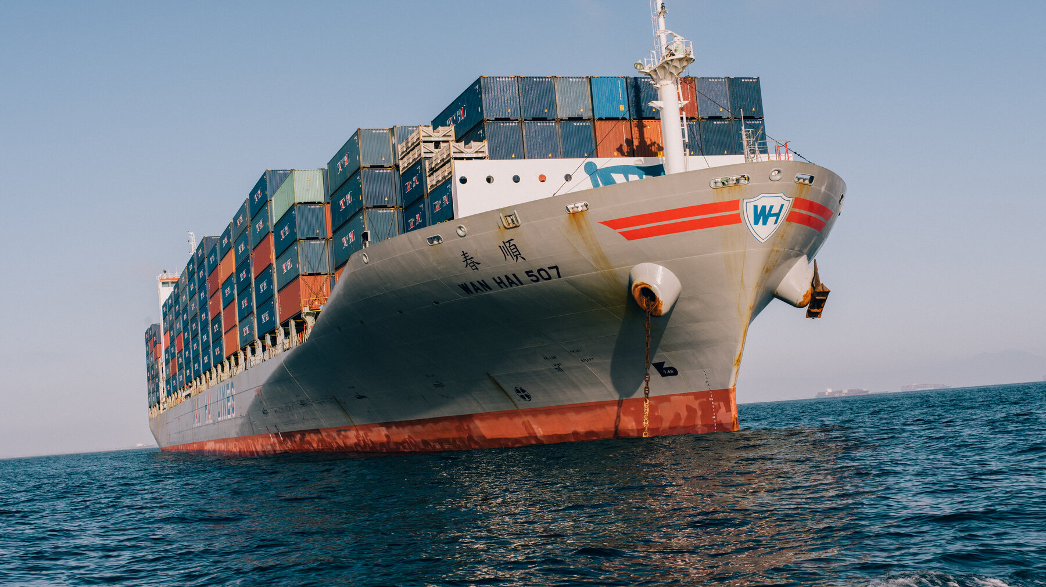

Slide 18
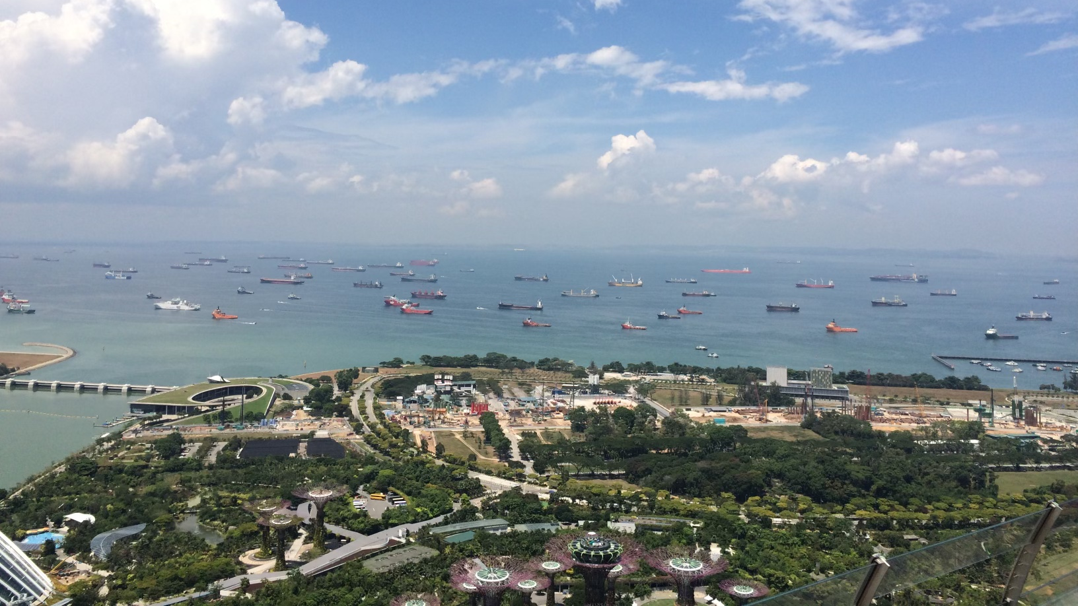
Singapore Harbor
Notes:
Singapore Harbour

Slide 19
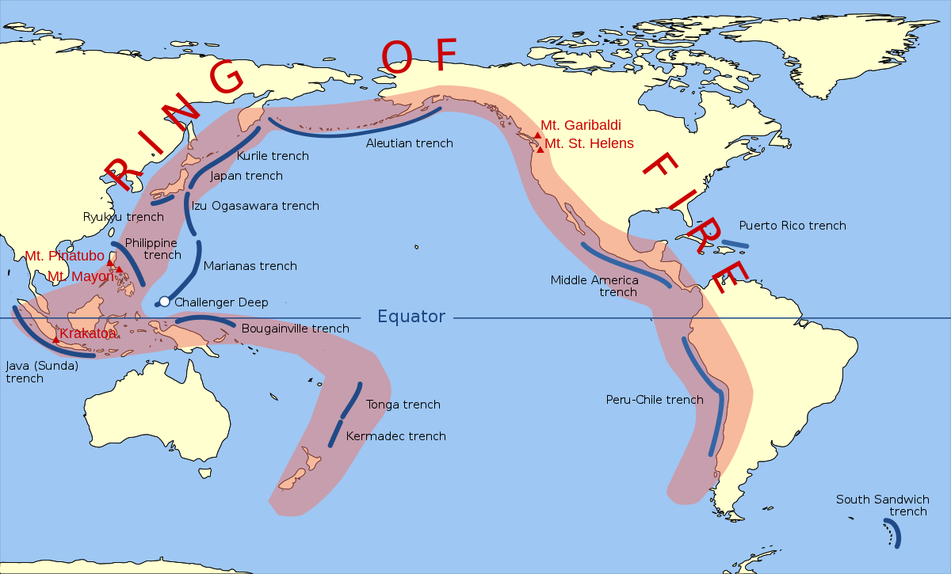
Notes:
Ring of Fire -> geological mouvements
We needed more capacity and resilience
We’ve seen more maintenances and longer outages than terrestrial links

Slide 20
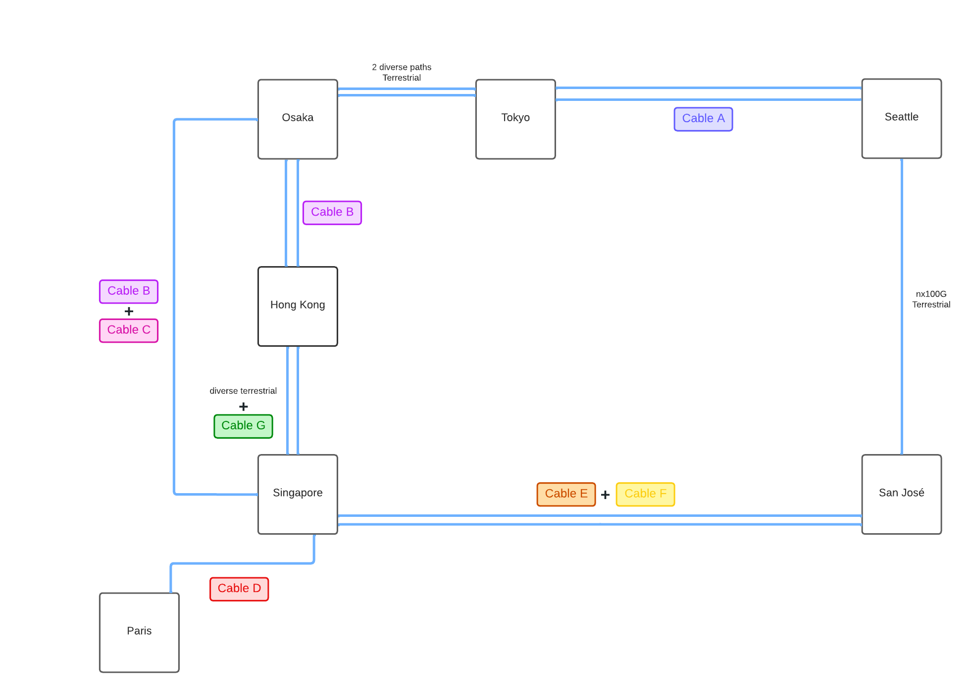
APAC Deployment
Q3/Q4-2021
Upgraded capacity (120 Gbps)
Added more paths
Still not enough
Now that the backbone is part of F5, as a global cloud company we have to and can do better
Notes:
Better : 2x10G, more paths but not enough
even for Singapore these paths were not enough (during cable G delivery, cable C was down for weeks, + maintenance on Cable E and Cable D failed for 3 hours)
F5 acquisition is official since Q1 and we started to get needs for even more resilience and bandwidth
Note that in the mean time we also continued to expand the backbone in Europe, North America and LATAM

Slide 21
Back to the drawing board
Notes:
With our previous experience, we now know that 3 routes is not enough.
Minimum of 4 routes is what we need to achieve close to 100% availability
Re-studied every thing
Every cable system, every cable landing station, every beach manhole, every terrestrial backhaul
Bring this together with pricing

Slide 22
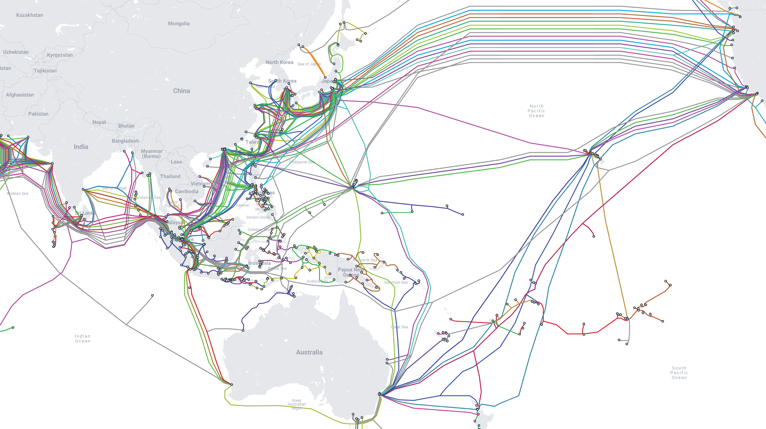
We heavily studied all cable systems in the region that are commercialy available
Notes:
Spent hours on https://www.submarinecablemap.com and other resources
Started serious study on Cable Landing Station

Slide 23
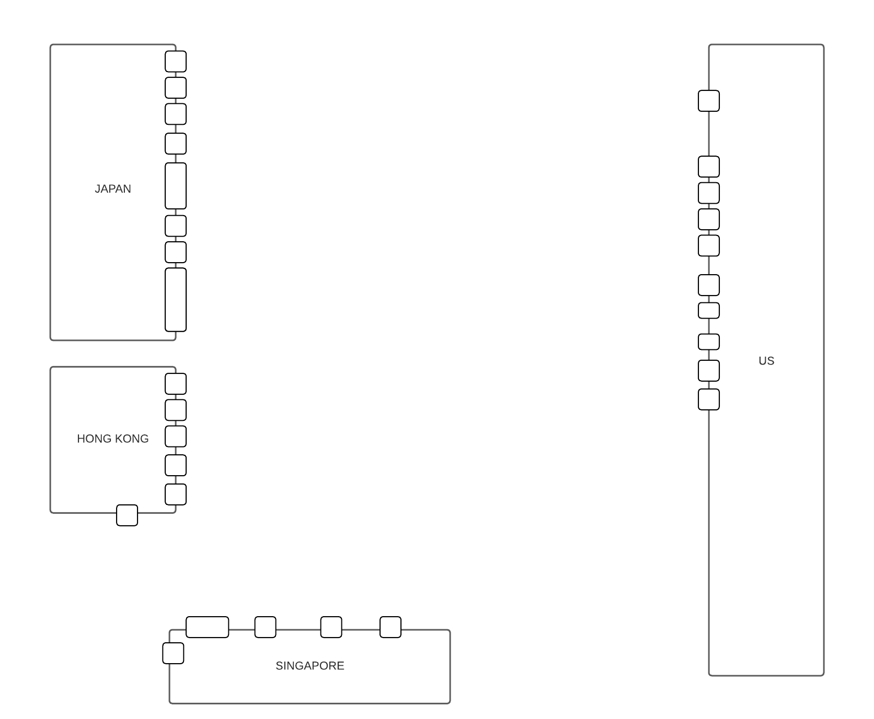
Each small square/rectangle represent a CLS
(Cable Landing Station)
Notes:
Landing station in APAC

Slide 24
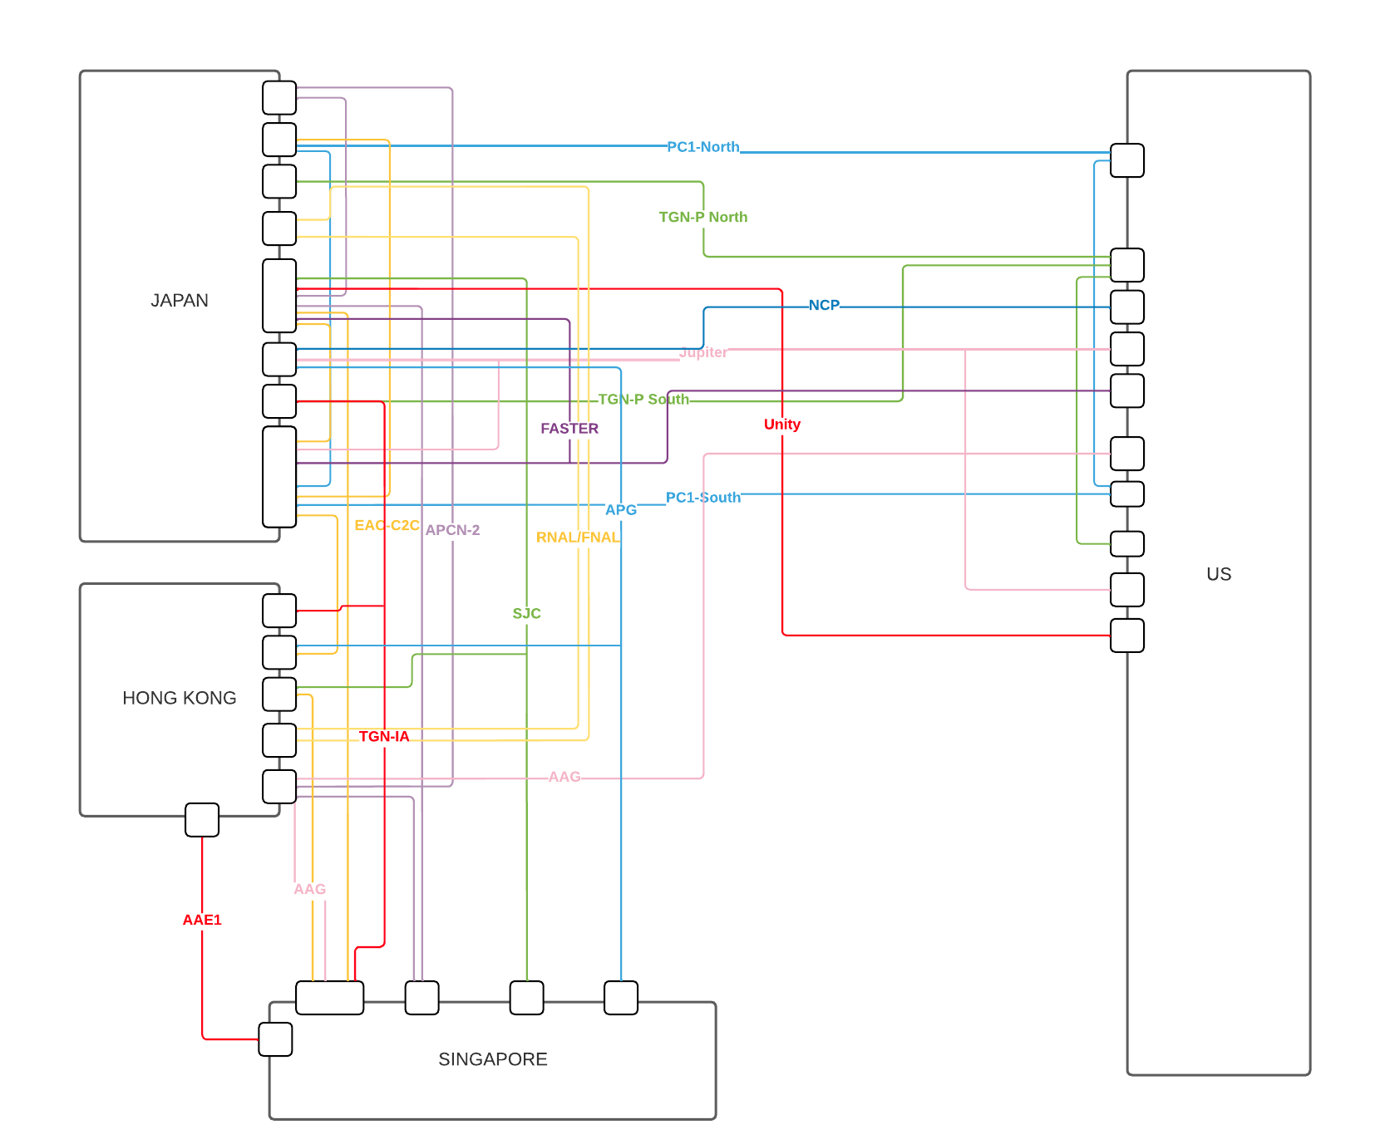
We mapped out most cable system we could get capacity on and studied the Cable Landing Station diversity
Notes:
Landing station in APAC
As you can see there is only 1 trans-pacific cable which doesn’t land in Japan : AAG but available capacity is difficult to get and it’s financially challenging compared to other options (which are not cheap by any means).

Slide 25
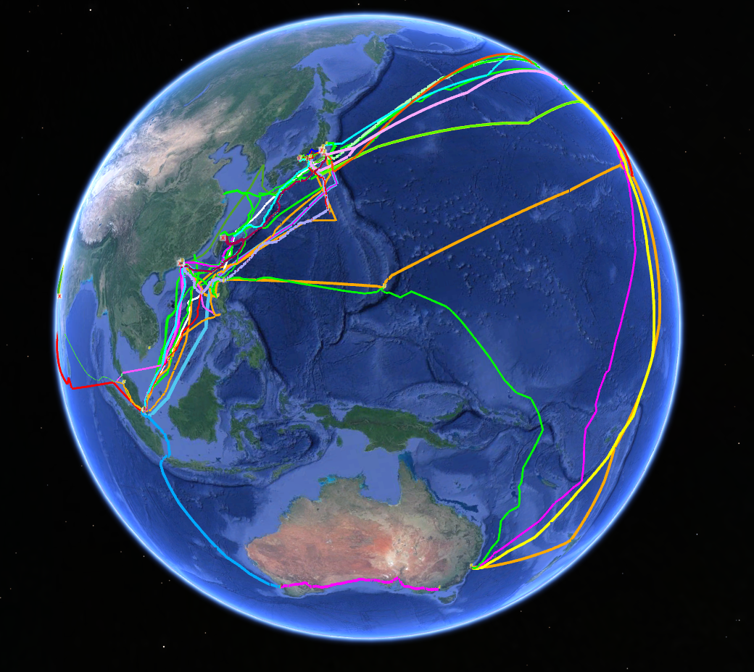
Mapping out all kmz as well to check diversity between CLS, BMH, POPS
CLS : Cable Landing Station
BMH : Beach Manhole, where the subsea cable meets terrestrial fiber to go to the CLS
Notes:
Spent hours on google earth studying CLS, BMH
Cables can use different landing station but same BMH
Or different BMH and same CLS

Slide 26
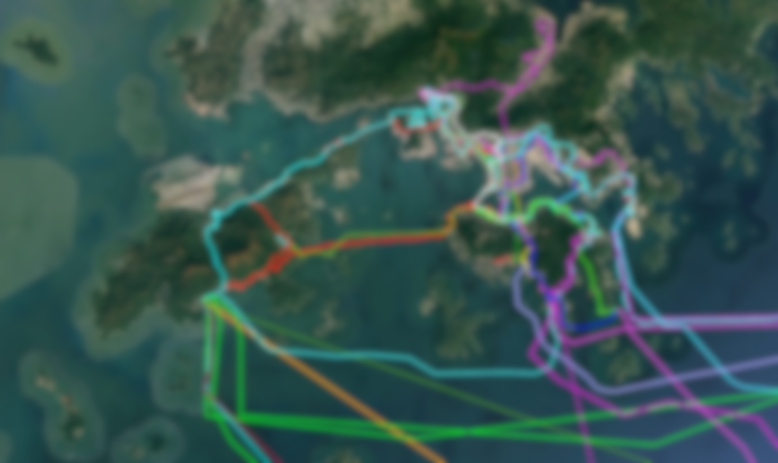
APAC Deployment
Hong Kong
Our Hong Kong DC of choice makes it difficult to find resilient paths for the terrestrial backhaul
Blurred on purpose
Notes:
Hong Kong terrestrial backhaul is very challenging, not a lof of diversity
Studied DC campus kmz as well
Difficulty to choose when backaul and cls are great in Hong Kong but leads to diversity issues on the other end like Tokyo or Singapore
Spent time with wave providers and dc providers for terrestrial backhaul diversity

Slide 27
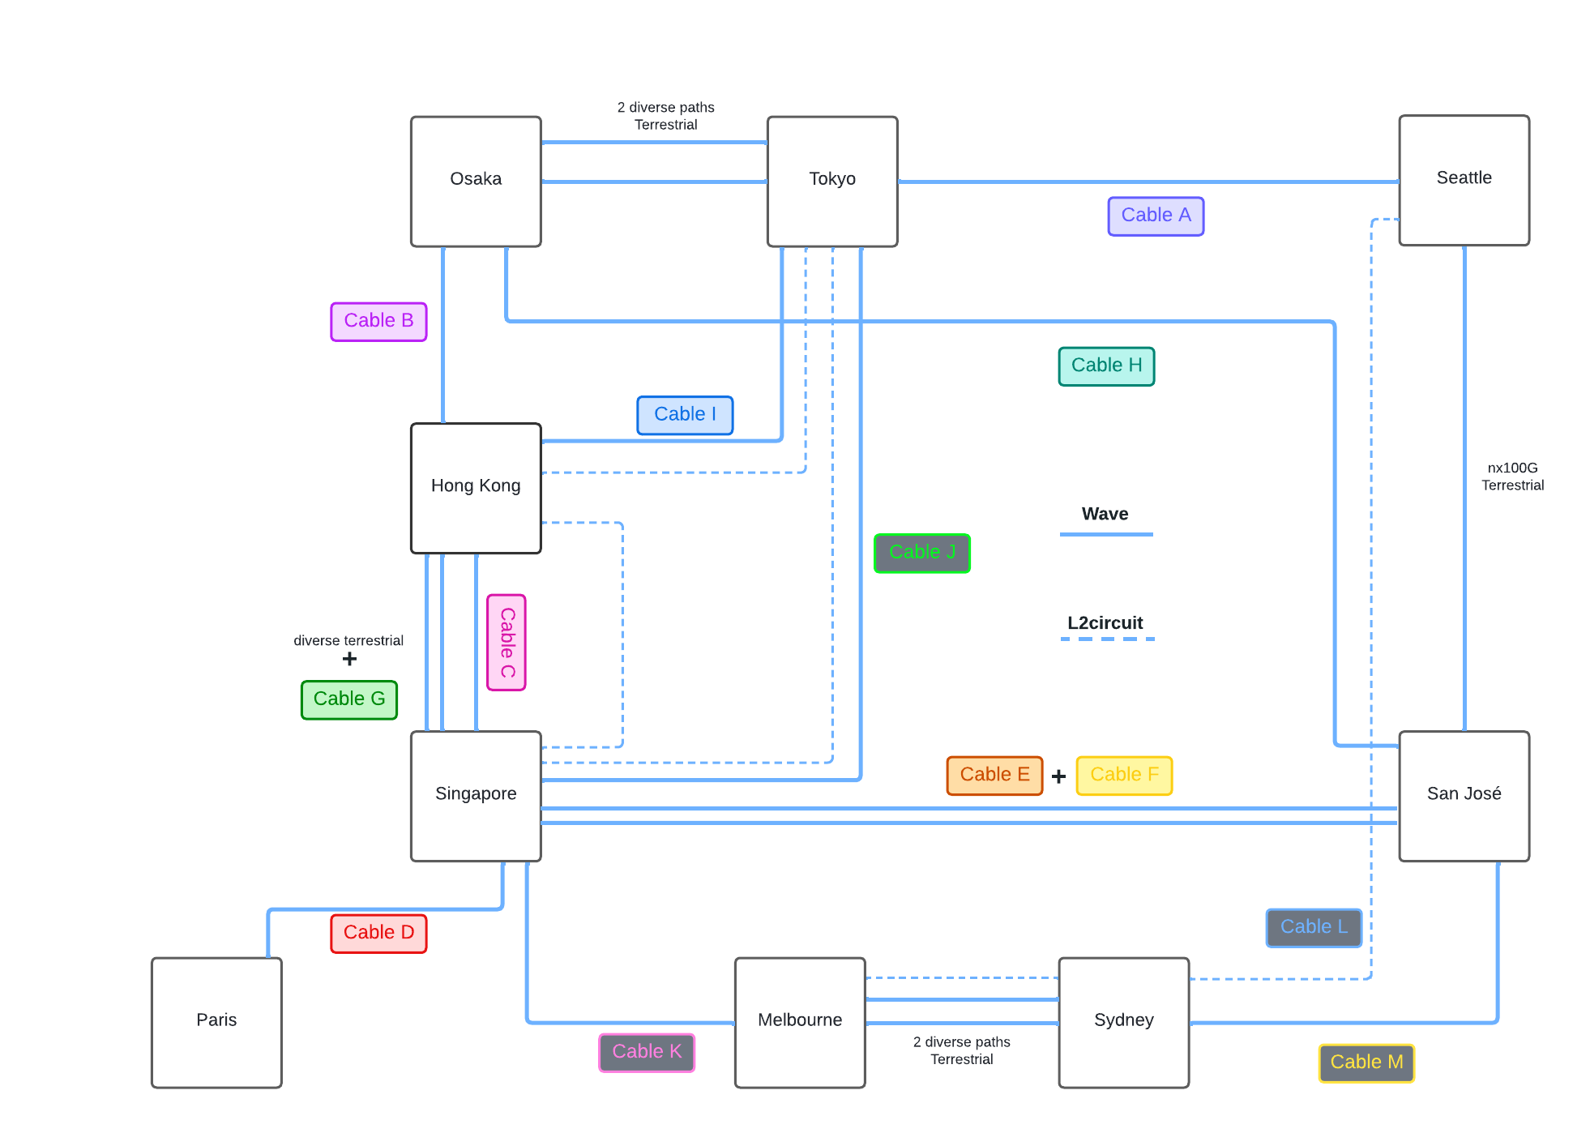
APAC Deployment
Q3 2022
Upgraded capacity (1 Tbps)
More paths (4+) per POP
More cable diversity
New POPs
Layer 2 as last resort backup
(not the same provider as last time)
Notes:
Dotted blue = mpls l2circuits
Each site has at least 4 exit routes. There might be some terrestrial similarities. Especially in HK but we were able to achieve full redundancy there (we even studied our DC campus x-connect kmz to know which path we should order).
We used as much different BMH, CLS as we possibly can. Providers were very supportive in alternative routes, close relationship with them, spent hours with them as well.
Went from 12x10G = 120G to multiple 100G and a few 10G to reach approx 1Tbps of capacity
import/export/customs difficulties when shipping network gears
This is still what we're running today (as of April 2023)

Slide 28
APAC Deployment
Experience
Like before, outages last for ever
No POP downtime due to circuits availability issue …
…But we had a close call
4 out of 5 circuits down were related to our Hong Kong POP

Slide 29
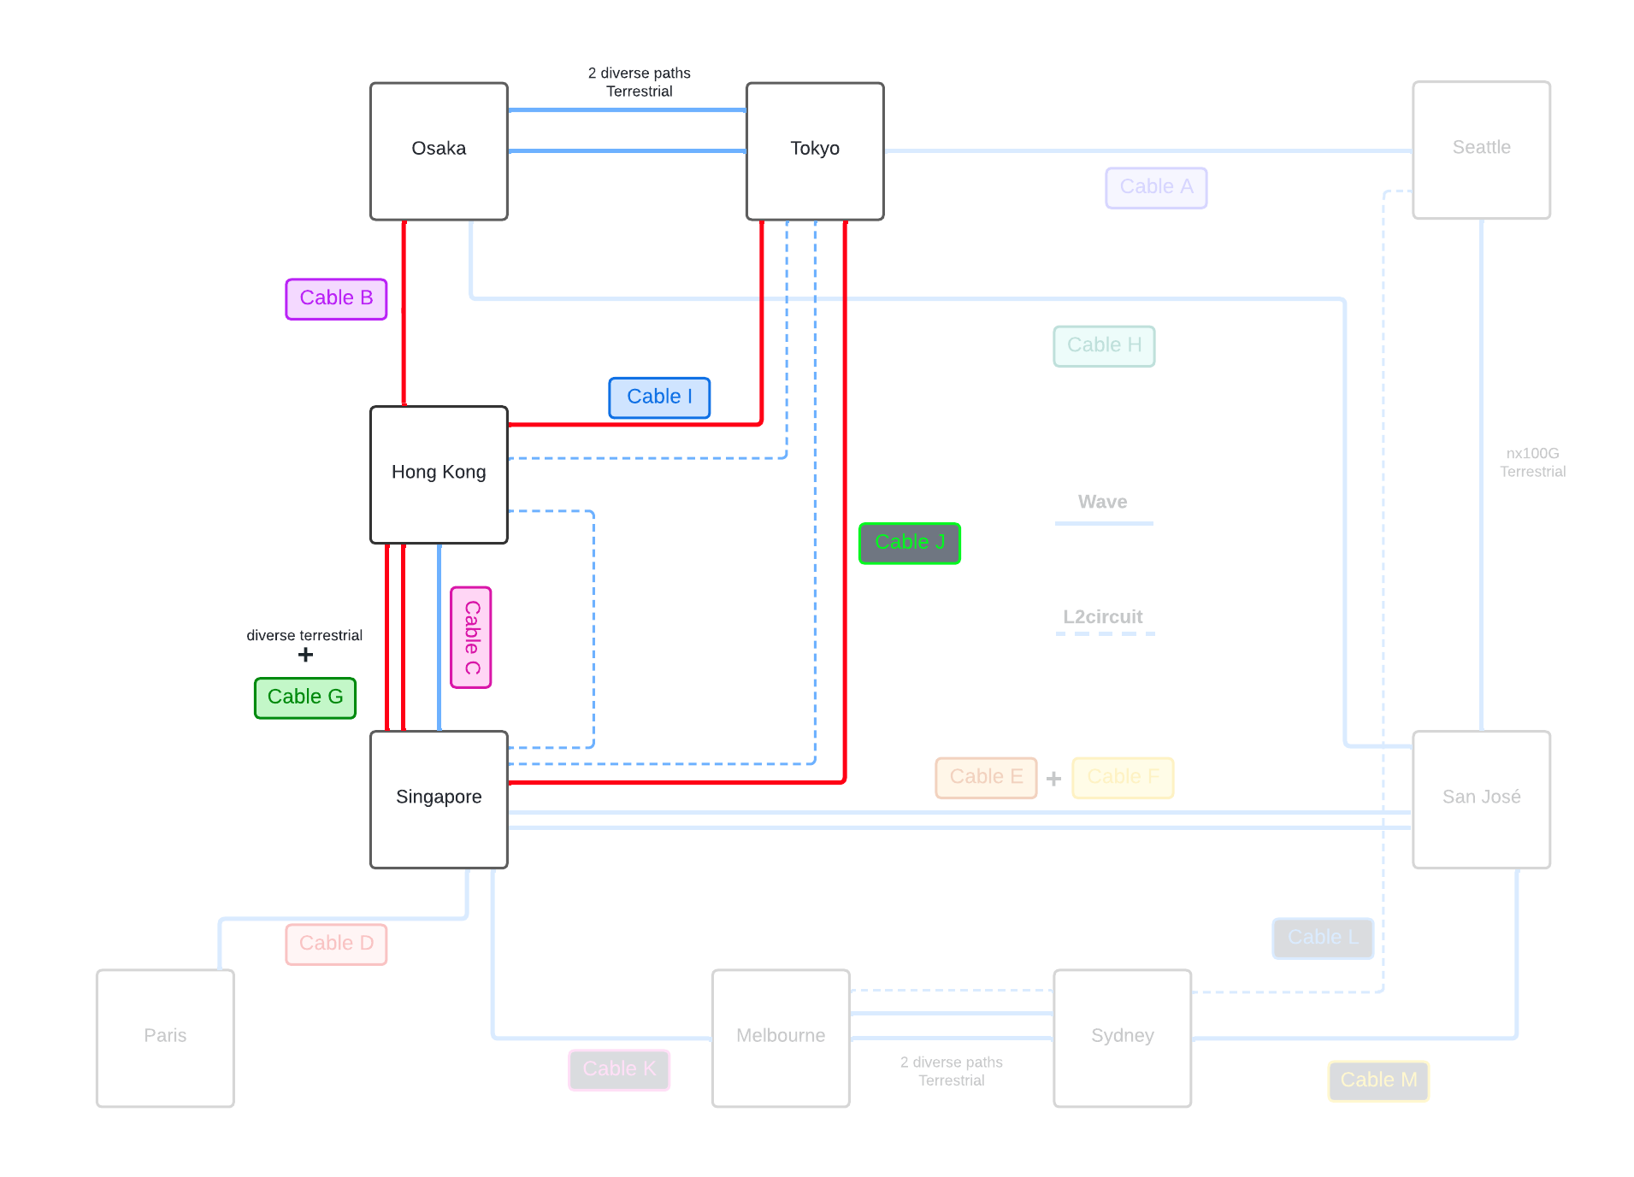
APAC Deployment
Experience
Like before, outages last for ever
No POP downtime due to circuits availability issue …
…But we had a close call
4 out of 5 circuits down were related to our Hong Kong POP
The last circuit connecting Hong Kong to our backbone had CRC errors on it …
Thankfully we were able to use our Layer2 backup with some adjustments
So far we’re happy with our design
How does this compare to other regions ?
Notes:
Adjustements : Remove some anycast services from HK to reduce bandwidth
We dedicated the pop for local network customers only
L2 is last resort and we don't have the same capacity as waves
TKY-HKG wasn't really a cut, delivery was delayed because of a maintenance on the cable

Slide 30
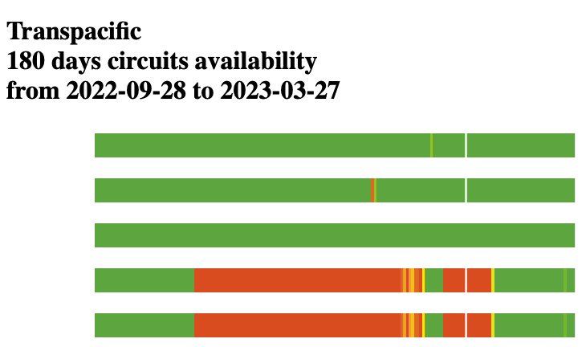
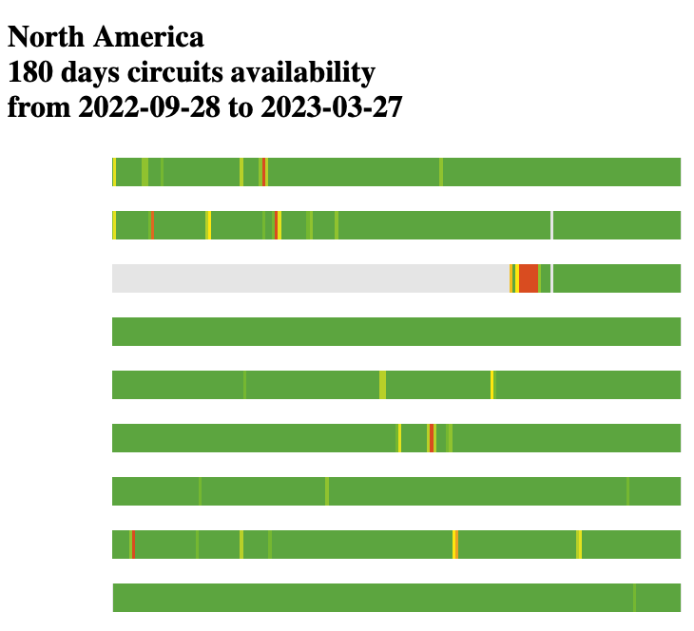
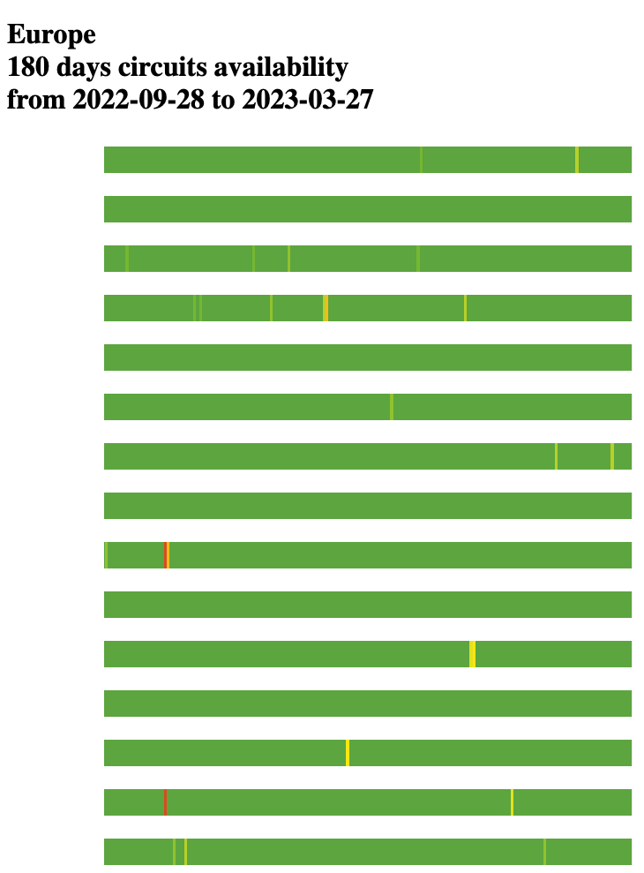
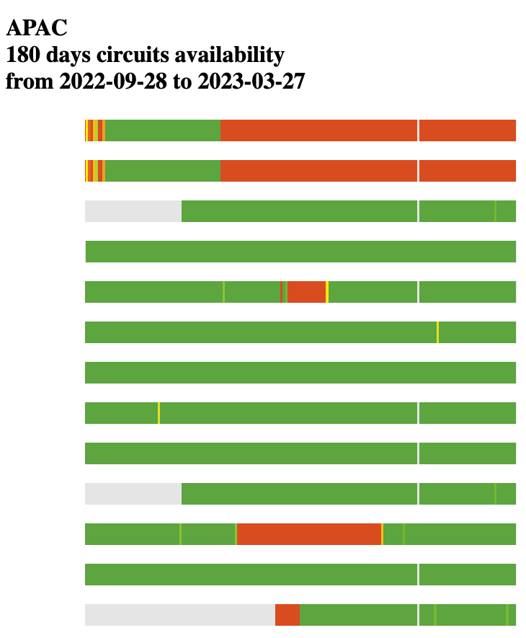
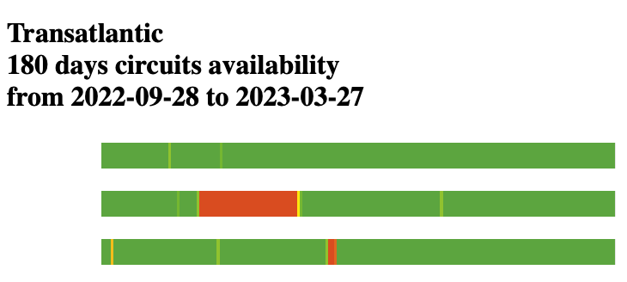
APAC Deployment
Experience
No surprise here, submarine cables means longer outages
APAC and Transpacific outages usually last longer than Transatlantic
North America / Europe (mostly terrestrial) are obviously more reliable (and way cheaper)

Slide 31
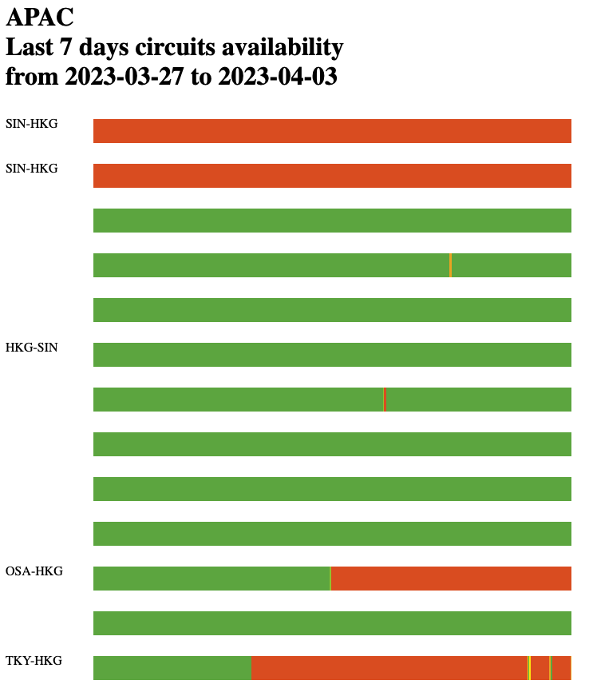
Last Minute Bonus
Experience
Still waiting for authorization to repair
We’re back at 4 out of 5 circuits down towards our Hong Kong pop (3 different paths)
We (once again) activated our L2 backup just in case the last circuit (HGK-SIN 2nd path) goes down too.
Submarine cut confirmed
Planned maintenance until April 6th

Slide 32
F5 Backbone today

Slide 33
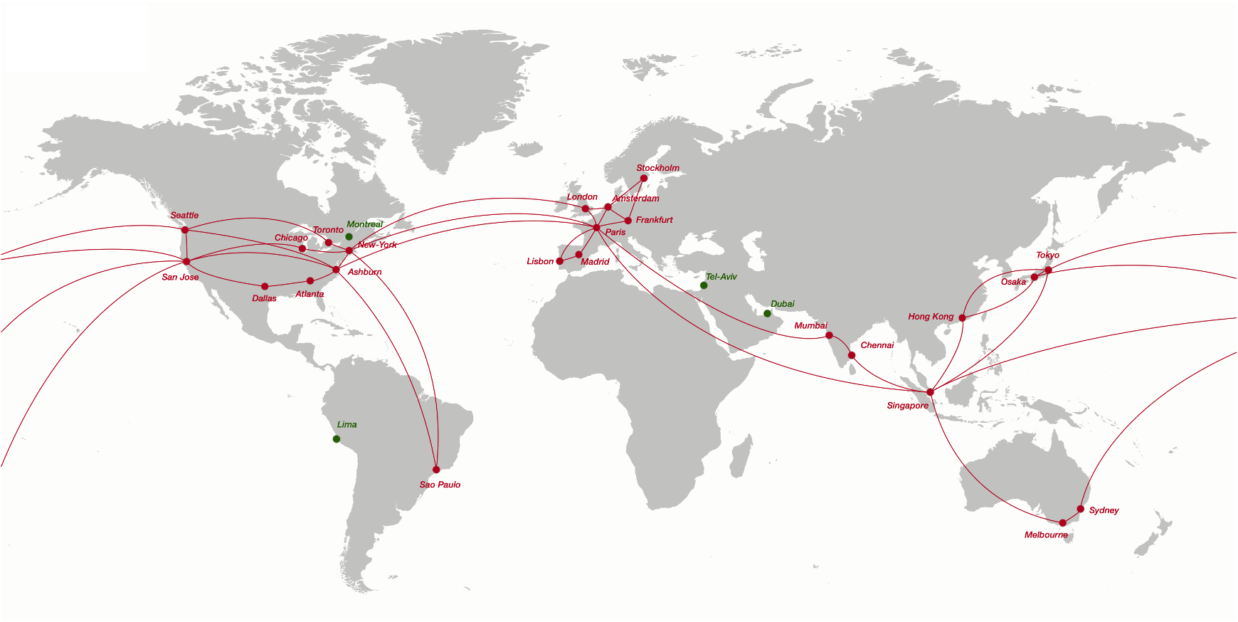
F5 Backbone
April 2023
Notes:
Green pops are the road map
So currently doing the same work/analysis for middle east and latin america

Slide 34
Our experience
What we’ve learned
Notes:
Australia has been great so far

Slide 35
Our experience
what we’ve learned
APAC is expensive, it accounts for approx. 50% of all backbone costs (transit/peering/circuits)
Submarine cables outages can last for months increasing the probability of having multiple cable cuts during the same time window
Requires a lot of path diversity, 4+ paths per pop gets you close to 100% availability but things can still go sideways
We initially thought L2 backup was overkill with our diversity, turned out we used it multiple times
It took a long time to study all routes (CLS+BMH+Terrestrial backhaul), but we think it was worth it
Our circuits providers were always ready to help with backhaul modifications to increase terrestrial diversity
Shipping hardware, dealing with customs is often difficult.

Slide 36
Thank You
Questions ?

