Slide 1
UKNOF Communications Committee
What we do, why you should join
Steve Karmeinsky April 3rd/4th 2023

Slide 2
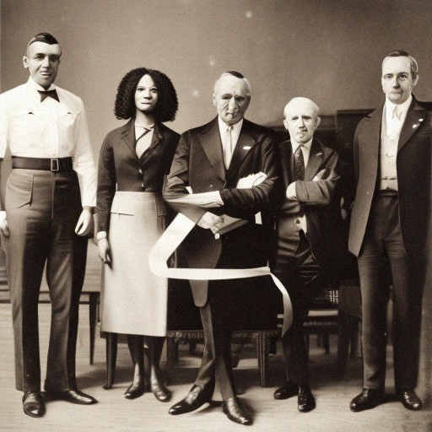
Type
Notes:
Standing Committee i.e. a permanent committee

Slide 3
Purpose
Notes:
Develop, maintain, and oversee the execution of the UKNOF communications strategy across multiple channels.

Slide 4
Outcomes
Notes:
Communications strategy Communications impact analysis with improvement recommendations
Communications to both new and current participants

Slide 5
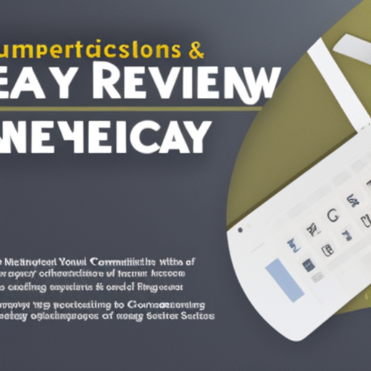
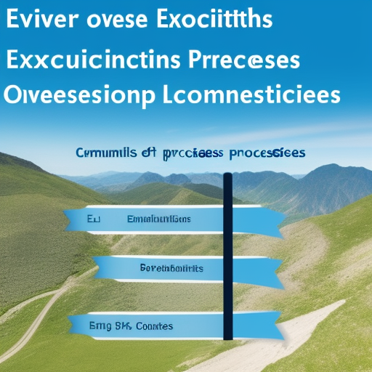
Responsibilities
Notes:
Develop and review communications strategy (annual) Oversee execution of communications processes (quarterly) Evaluate impact of communications and develop recommendations
for improvements
Regular communications

Slide 6
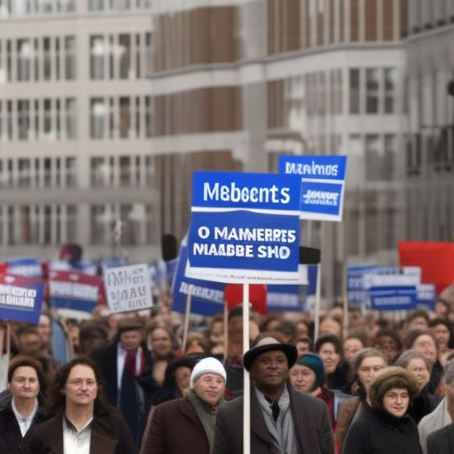
Decisions
Notes:
Decisions will be made by a simple majority of members and liaisons.
In order for any major decision or task to be consider, the committee must be quorate, whereby 60% of members must be present

Slide 7
Authority
Notes:
Recommend communications strategy for adoption by UKIF Ltd board
Develop and communicate liaison memos to other committees

Slide 8
Members
Notes:
In addition to the Chair and Vice Chair (appointed by the board) there will be up to six members of the committee. Some of these members will also act as a representative or communications conduit to and from the board and PC.
Other members my be co-opted for specific duties or tasks to aide with general activities

Slide 9
Terms
Notes:
Terms are two years, confirmed annually, starting on 1 January.

Slide 10
Term limits
Notes:
Members, including the Chair, Vice Chair, and liaisons, can serve a maximum of two consecutive terms.

Slide 11
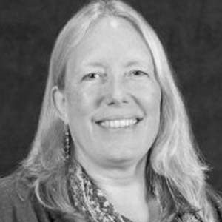
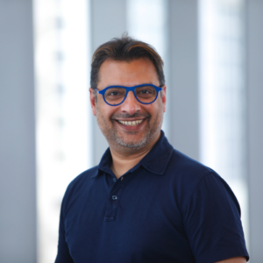
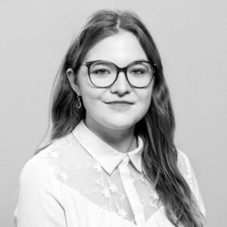
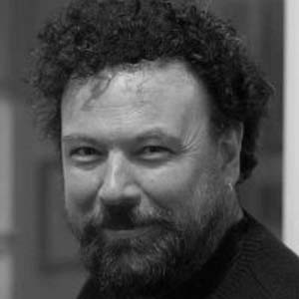
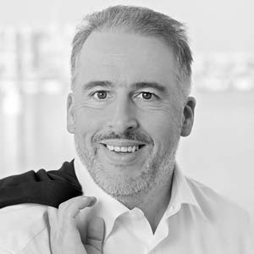
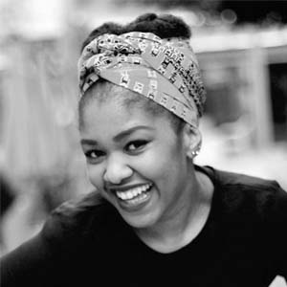
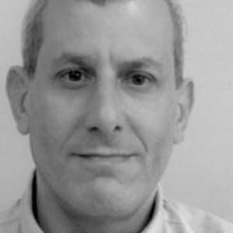
People
YOU?
Notes:
Cathy Denesh, Emma, Fearghas, Leo, Portia, Steve

Slide 12
UKNOF Communications Committee
cc@lists.uknof.org.uk

