Slide 1
UKNOF Programme Committee
What do we do, and why do you care?
Dave Wilson April 3rd/4th 2023

Slide 2
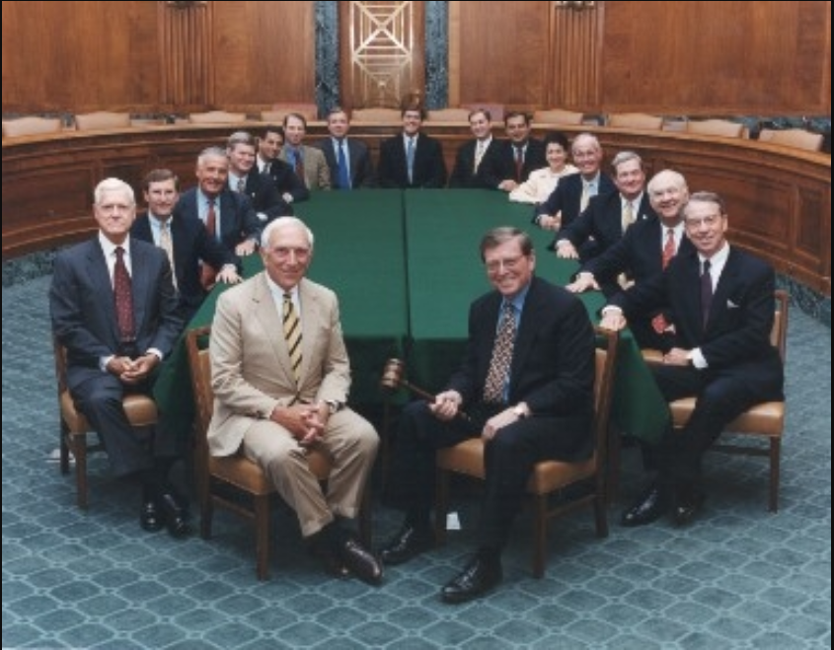
Committee?
Notes:
Committee Meetings? Oh Dear.
Don’t know if James has a big hammer.

Slide 3
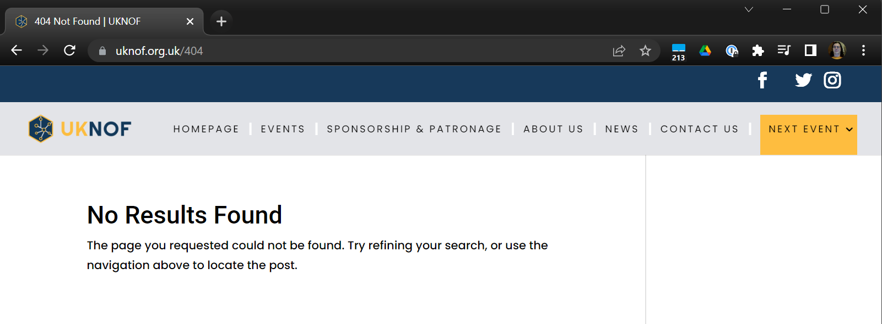
CONTENT!
Notes:
We’re all about what goes into the presentations at UKNOF.

Slide 4
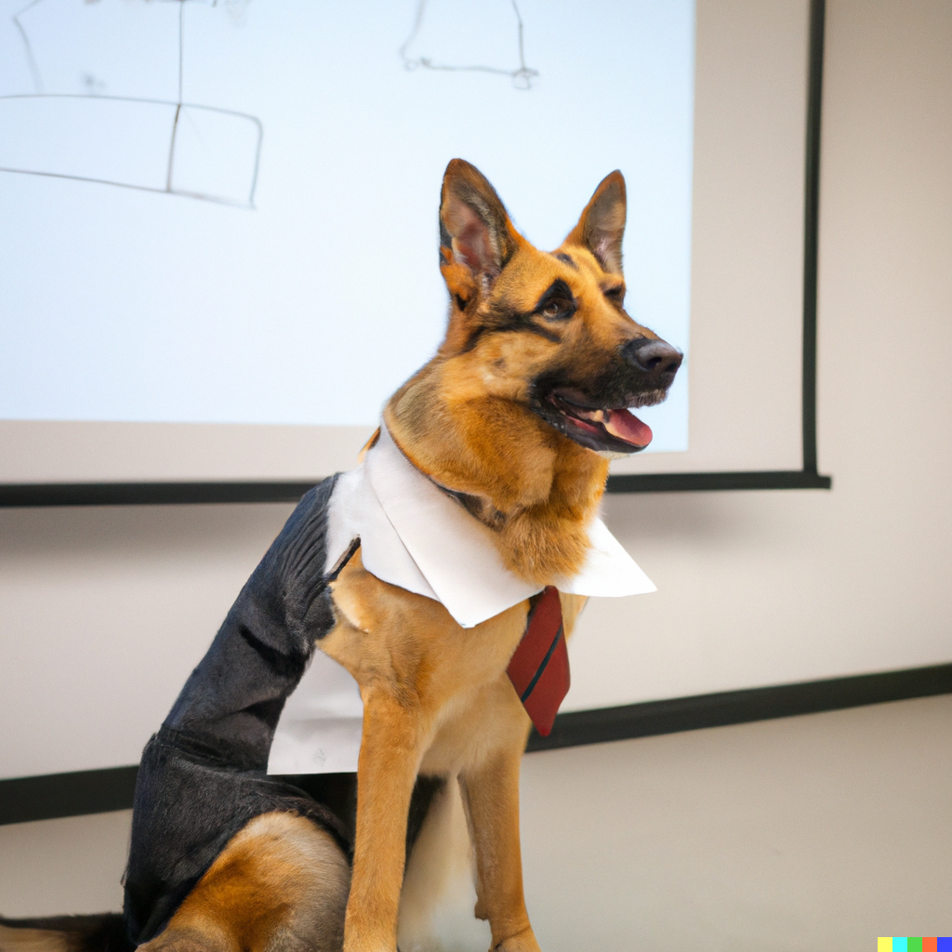
Shepherding
Notes:
With thanks to DALL-E.
He is a Good Boy

Slide 5
Value
Notes:
Sorry Neil!

Slide 6
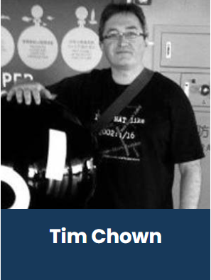
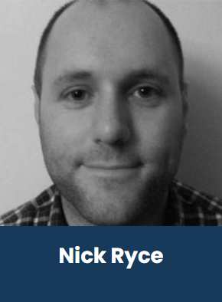
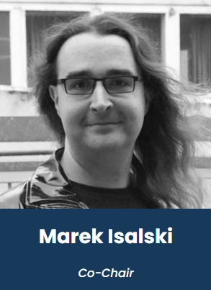
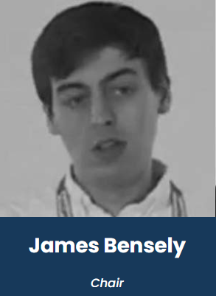
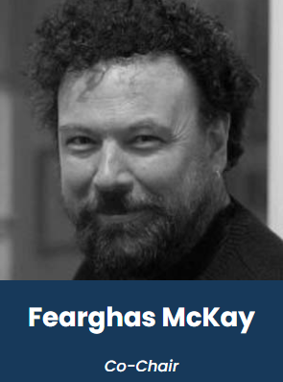
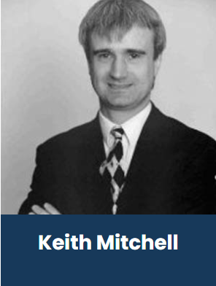
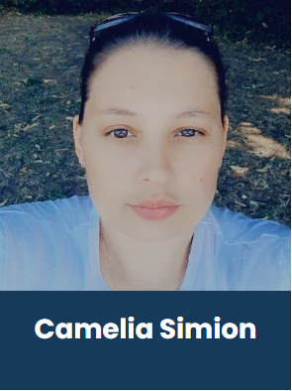
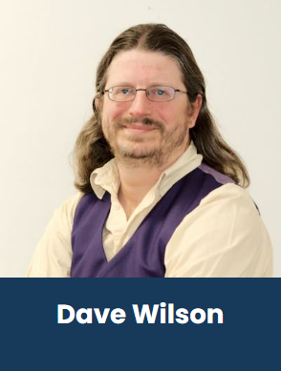
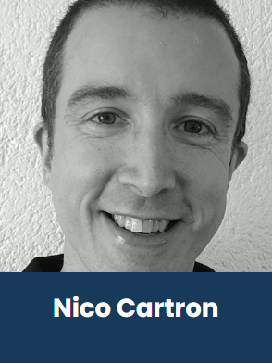
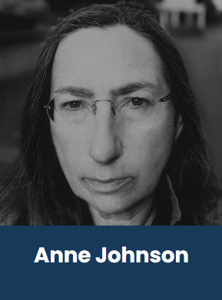
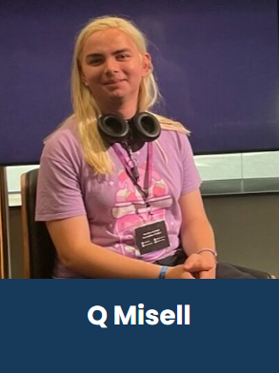
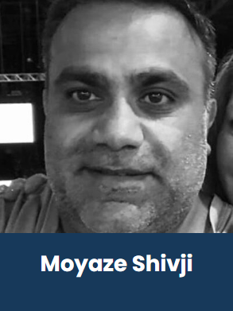
People

Slide 7
People

Slide 8
UKNOF Programme Committee
pc@lists.uknof.org.uk

