Slide 1
BGP Security
51
Hijack and Route Leak Detection
Lefteris Manassakis | COO, Code BGP
April 4, 2023 | Manchester, UK
lefteris@codebgp.com

Slide 2
About me
Lefteris Manassakis
COO & co-founder | Code BGP
lefteris@codebgp.com
https://manassakis.net/

Slide 3
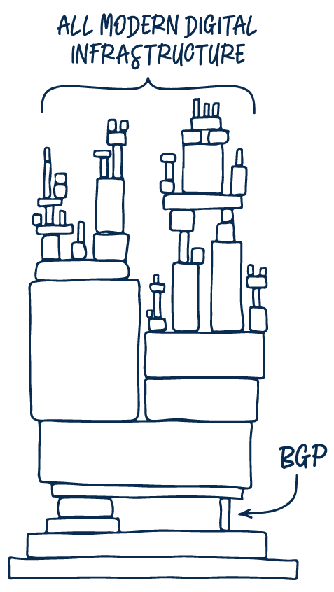
BGP hijacks, leaks & misconfigurations affect your network
BGP events critically affect reliability, security, and performance
Only the tip of the iceberg gets known

Slide 4
Types of BGP prefix hijacks
Classification by Announced AS-Path
Origin-AS (or Type-0): The hijacker AS announces – as its own – a prefix that it is not authorized to originate. This is the most commonly observed hijack type.
Type-N (N ≥ 1): The hijacker AS announces an illegitimate path for a prefix it does not own. The announced path contains the ASN of the victim (first AS in the path) and hijacker, e.g., {AS50414, ASx, ASy, AS1 – 212.46.55.0/24}, while the sequence of ASes in the path is not a valid route, e.g., AS50414 is not an actual neighbor of ASx.

Slide 5
Types of BGP prefix hijacks
Classification by Affected Prefix
Exact Prefix Hijacking: The hijacker announces a path for exactly the same prefix announced by the legitimate AS. Since shortest AS-paths are typically preferred, only a part of the Internet that is close to the hijacker (e.g., in terms of AS hops) switches to route towards the hijacker.
Sub-Prefix Hijacking: The hijacker AS announces a more specific prefix of the prefix of the legitimate AS. Since the more specific prefixes are preferred, the entire Internet routes traffic towards the hijacker to reach the announced sub-prefix.
Squatting: The hijacker AS announces a prefix owned but not (currently) announced by the owner AS.
For a comprehensive prefix hijack taxonomy please check the ARTEMIS paper.

Slide 6
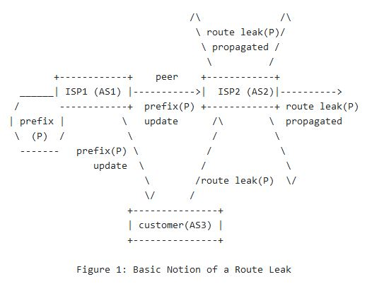
Route Leaks
Definition: A route leak is the propagation of routing announcement(s) beyond their intended scope.
For different types of route leaks please check RFC 7908.

Slide 7
Challenges of hijack and route leak detection
Speed
Accuracy
Evasion
Privacy and flexibility
Internet
User
Routing
changes
mins/hours
time

Slide 8
ARTEMIS
https://bgpartemis.org
On-prem open-source tool we developed
We support a community of users
Precursor of the Code BGP Platform
The Code BGP Platform is offered as a SaaS subscription
Both are self-operated, leveraging the contextual knowledge of the Network Operator
Detection + Mitigation
“ARTEMIS is a fantastic replacement for BGPmon. All around it seems like an incredibly well-built tool and I use it in prod all the time”
BEFORE
hours/days
ARTEMIS
< 1 min
Chris Cummings
Network Engineer & modem.show podcast host

Slide 9
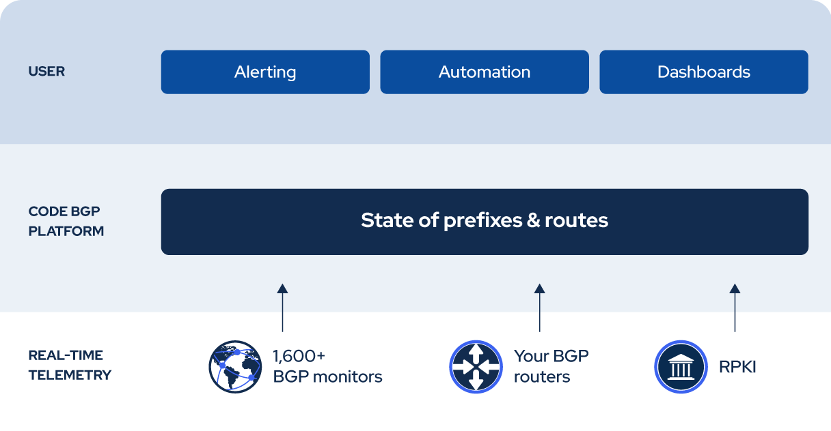
Code BGP Platform
Monitor • Detect • Protect

Slide 10
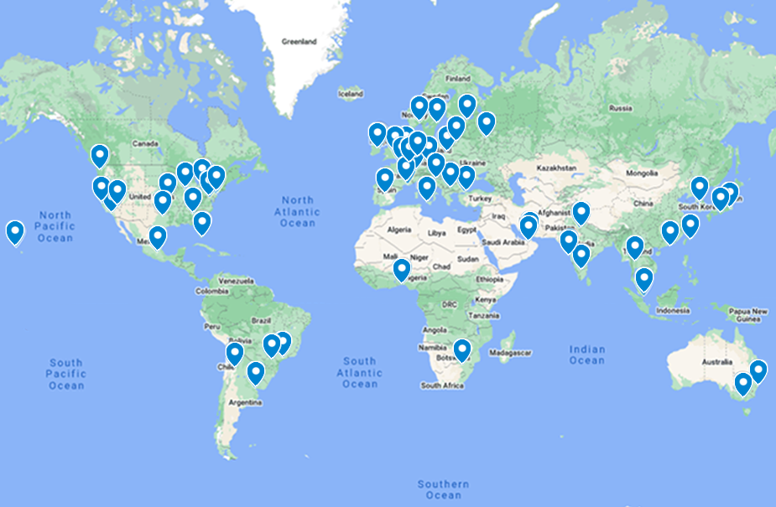
Data service: Code BGP Monitor
BGP Monitoring Service developed by Code BGP
Route Reflection (RFC 4456)
BGP Add-Path (RFC 7911)
186 full feed peerings (v4 & v6)
20 Upstreams
Monitors in 37 countries, 62 cities
monitors
Notes:
The Code BGP Monitor is the BGP Monitoring Data Service we developed. It is based on iBGP and Route Reflection so the next hop is not altered. This way we can identify the source for each update. We collect the routes in route collectors, and we propagate all of them to the Code BGP Platform instances that reside on the cloud, without letting the BGP best path selection algorithm kick in, since it would hide the alternative paths. The way we do that is by leveraging the BGP Add-Path capability.

Slide 11
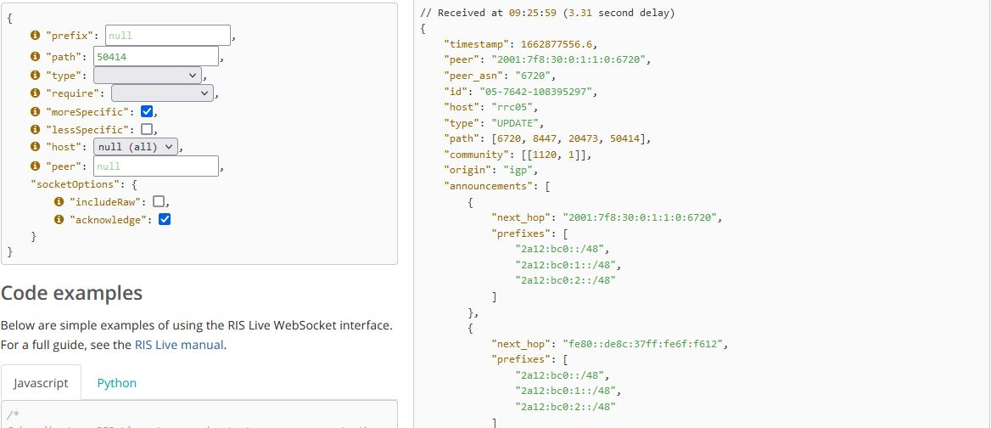
Data Service: RIS Live
Provides real-time JSON BGP messages via a fully filterable interactive WebSocket JSON API, and a full stream ("firehose") containing all of the messages generated by RIS. → https://ris-live.ripe.net/
Total peerings (IPv4 & IPv6): 1448
BGP full feeds:
IPv4: 366
IPv6: 401
List of Route Collectors: https://ris.ripe.net/docs/10_routecollectors.html
List of Peers: https://www.ris.ripe.net/peerlist/all.shtml
Notes:
RIS Live provides real-time BGP messages using a streaming API. It serves as a public resource, built by the community for the community. It collects BGP updates from hundreds of peers using Route Collectors, and provides them through a Websocket JSON API.

Slide 12
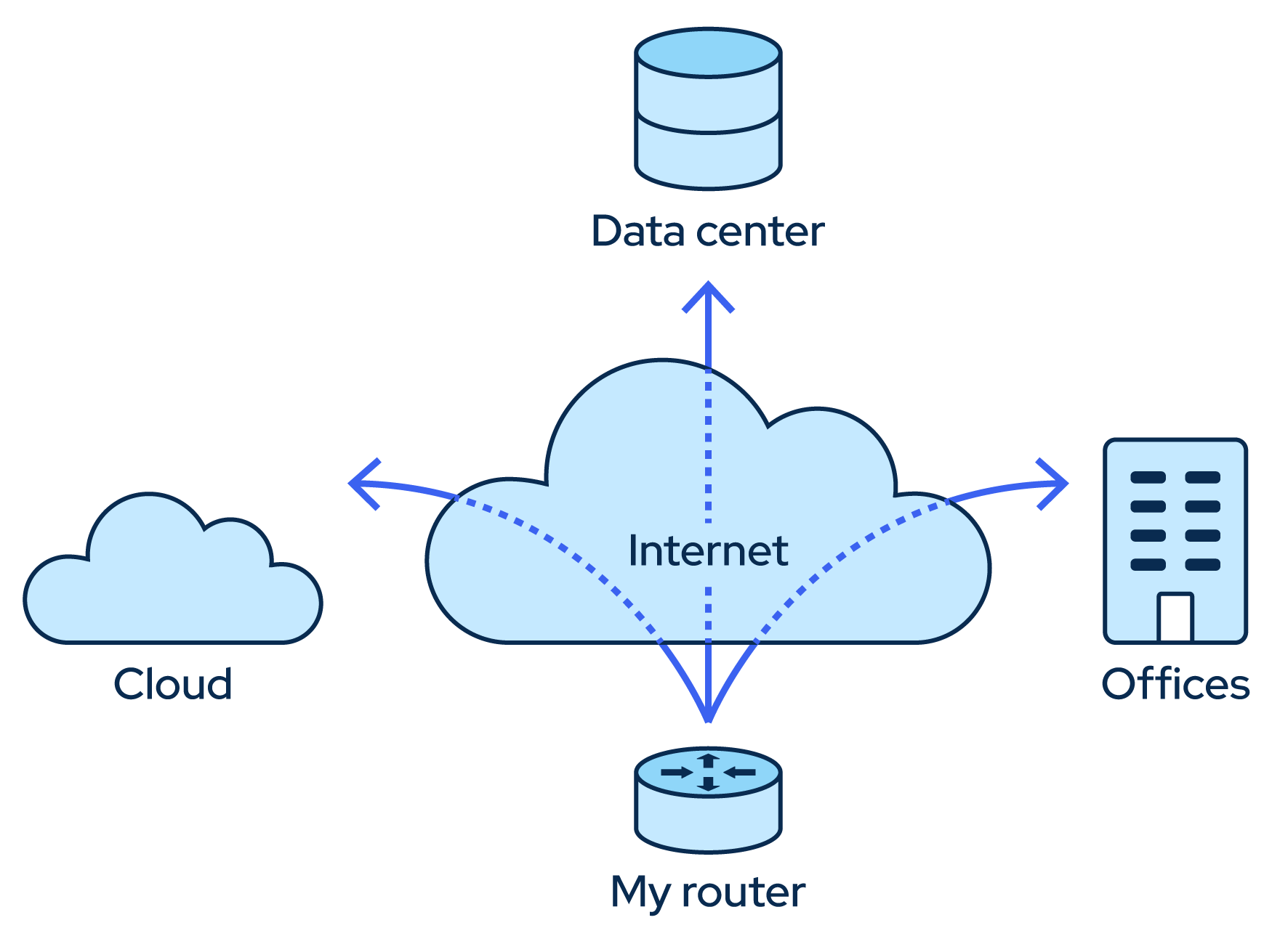
Data Service: Your routers
Multi-hop BGP sessions

Slide 13
Data Service: RPKI
Tracking the state of ROA certificates
Validating BGP updates and detecting invalids
Certificate Authorities
ROAs
Track certificates’ state
Validate
BGP updates

Slide 14
Alert Types
Supported Alert Types | Description
Exact Prefix Hijack | Illegal origin ASes that announce configured prefixes.
Sub-Prefix Hijack | Illegal origin ASes that announce subprefixes of configured prefixes.
Route Leak | Unexpected prefixes in the list of prefixes that are announced by configured ASes.
New Neighbor | New neighbors that appear to peer with configured ASes. Possible AS path manipulation.
Neighbor Leak/Hijack | New neighbors that not only appear to peer with configured ASes, but also propagate their prefixes.
Squatting | Illegal origin ASes announcing prefixes that are not currently announced by configured ASes.
Presence in AS Path | Presence of ASes in paths towards configured prefixes.
Invalid AS Path Pattern | Violation of valid pattern by AS paths towards configured prefixes.
Long AS Path | Paths towards configured prefixes exceed a specified length threshold.
Prefix Visibility Loss | Visibility of prefix falls below a configured data source count threshold.
Peering Visibility Loss | Visibility of peering falls below a configured data source count threshold.
Supported Alert Types | Description
RPKI-Invalid Detection | RPKI-Invalid announcements of configured prefixes by other ASes.
RPKI-Invalid Announcement | RPKI-Invalid announcements by configured ASes.
RPKI-Invalid Propagation | RPKI-Invalid routes propagated by configured ASes.
RPKI-NotFound Propagation | RPKI-NotFound routes propagated by configured ASes.
Bogon (Exact-)Prefix | Announcements of bogon prefixes by configured ASes.
Bogon (Sub-)Prefix | Announcements of bogon subprefixes by configured ASes.
Bogon AS | In-path presence of bogon ASes, in routes towards configured prefixes.
AS Path Comparison | Discrepancies in AS paths towards the same prefix, comparing between different Data Services, up to a terminating (end) AS.
Prefix Comparison | Discrepancies in prefixes announced by configured ASes, comparing between different Data Services.
Custom | User-defined

Slide 15
GraphQL basics
What it is
Query language for APIs
Runtime for fulfilling queries with existing data
Features
Ask exactly the data you need
Get many resources in single request
Single endpoint + type system: organized in terms of types and fields, not endpoints
No-version API evolution
Integration with own data + code
Supports subscriptions

Slide 16
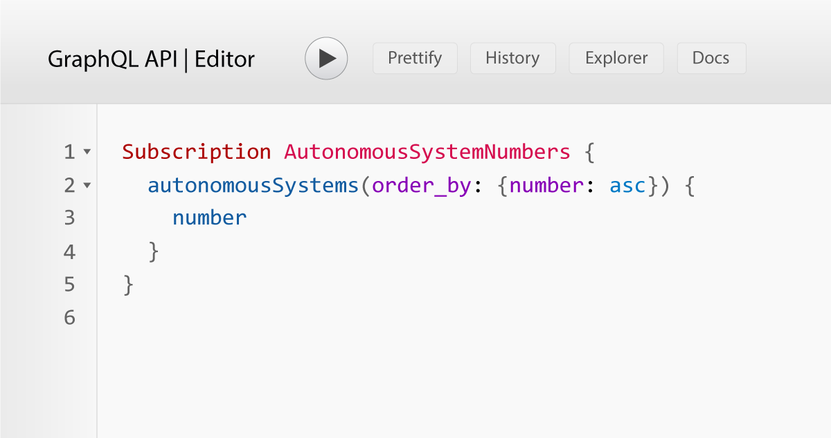
GraphQL subscriptions
Subscriptions are a GraphQL feature that allows a server to send data to its clients when a specific event happens. They are implemented with WebSockets, and the server maintains a steady connection to its subscribed client. This also breaks the “Request-Response-Cycle” that were used for all previous interactions with the API.
Instead, the client initially opens up a long-lived connection to the server by sending a subscription query that specifies which event it is interested in. Every time this particular event happens, the server uses the connection to push the event data to the subscribed client(s).

Slide 17
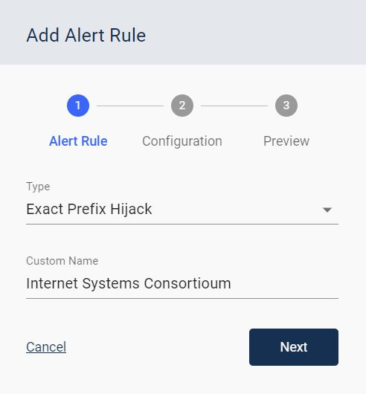
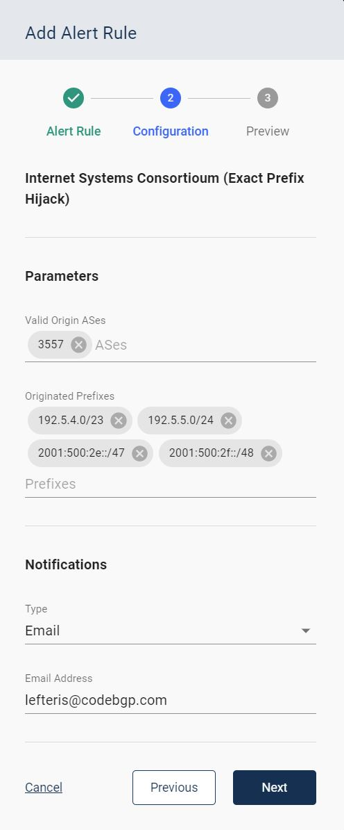
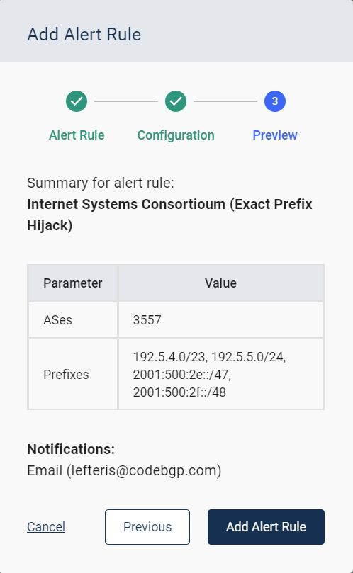
Insert Alert Rules using the UI
1
Add Alert Rule
2
Add Parameters
3
Preview Parameters &
Add GQL Subscription

Slide 18
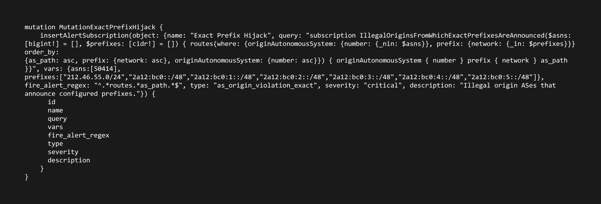
How we use GraphQL Subscriptions for Alert Rules
Example of a subscription query (which is entered to the system as a mutation) to detect exact prefix hijacks for prefixes belonging to Code BGP (AS 50414).

Slide 19
Root DNS Servers
The authoritative name servers that serve the DNS root zone
Name | IPv4 | IPv6 | Operator
A-Root | 198.41.0.4 | 2001:503:ba3e::2:30 | Verisign, Inc.
B-Root | 199.9.14.201 | 2001:500:200::b | USC, Information Sciences Institute
C-Root | 192.33.4.12 | 2001:500:2::c | Cogent Communications
D-Root | 199.7.91.13 | 2001:500:2d::d | University of Maryland
E-Root | 192.203.230.10 | 2001:500:a8::e | NASA (Ames Research Center)
F-Root | 192.5.5.241 | 2001:500:2f::f | Internet Systems Consortium, Inc.
G-Root | 192.112.36.4 | 2001:500:12::d0d | US Department of Defense (NIC)
H-Root | 198.97.190.53 | 2001:500:1::53 | US Army (Research Lab)
I-Root | 192.36.148.17 | 2001:7fe::53 | Netnod
J-Root | 192.58.128.30 | 2001:503:c27::2:30 | Verisign, Inc.
K-Root | 193.0.14.129 | 2001:7fd::1 | RIPE NCC
I-Root | 199.7.83.42 | 2001:500:9f::42 | ICANN
M-Root | 202.12.27.33 | 2001:dc3::35 | WIDE Project

Slide 20
Why Monitoring Root DNS Server Prefixes
Critical Internet infrastructure, worth protecting
These prefixes are heavily anycasted
BGP anomalies (e.g. exact prefix hijacks) will go largely unnoticed, due to their limited impact on the data plane
We provide access for free to a Code BGP Platform instance which monitors the root DNS prefixes
BGP updates from 1,600+ monitors
Root DNS server ASes
Root DNS server prefixes
+
Alerting

Slide 21
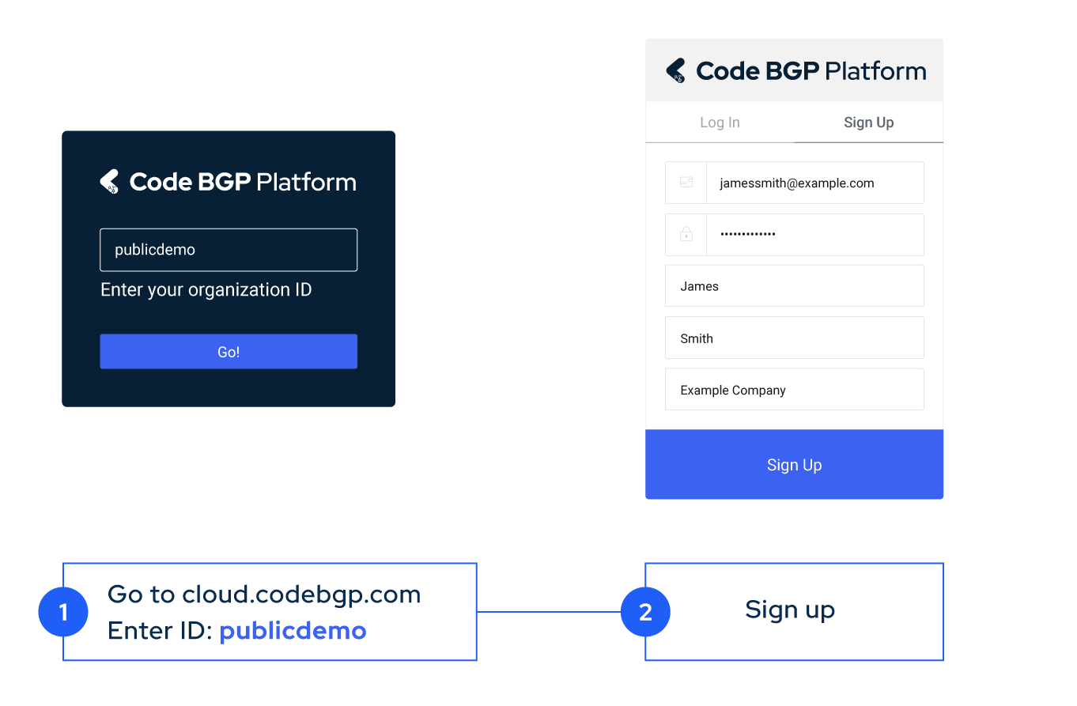
How to get access to the Route DNS monitoring instance
Go to https://cloud.codebgp.com/ and in the Organisation ID type “publicdemo”
Sign up
Docs: https://docs.codebgp.com/

Slide 22
Exact Prefix Hijack detected for root DNS prefix - Jan 27
AS 24028 announced prefix 2001:500:2f::/48 which belongs to ISC, and serves as the IPv6 prefix of the “F-Root” domain server (AS 3557)
Seen only by one source, which happens to be a neighbor of the offending network. The limited propagation is possibly due to RPKI ROV

Slide 23
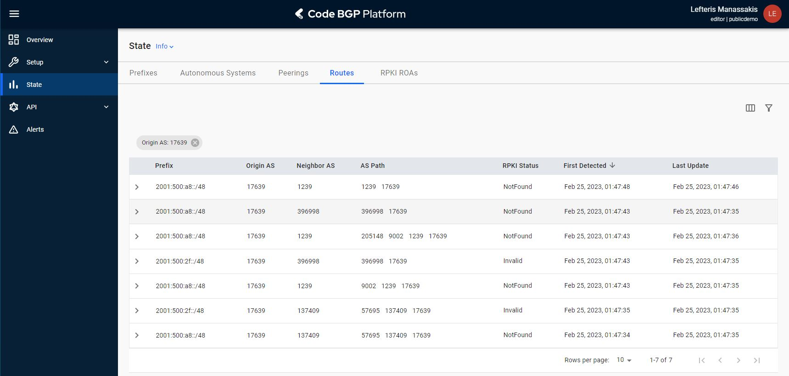
Exact Prefix Hijacks detected for root DNS prefixes - Feb. 25
AS 7639 announced prefix 2001:500:a8::/48 which belongs to NASA and is the IPv6 prefix of the “E-Root” domain server (AS 21556)
At the exact same time, the same AS 7639 announced prefix 2001:500:2f::/48 which belongs to F-Root (ISC AS 3557)

Slide 24
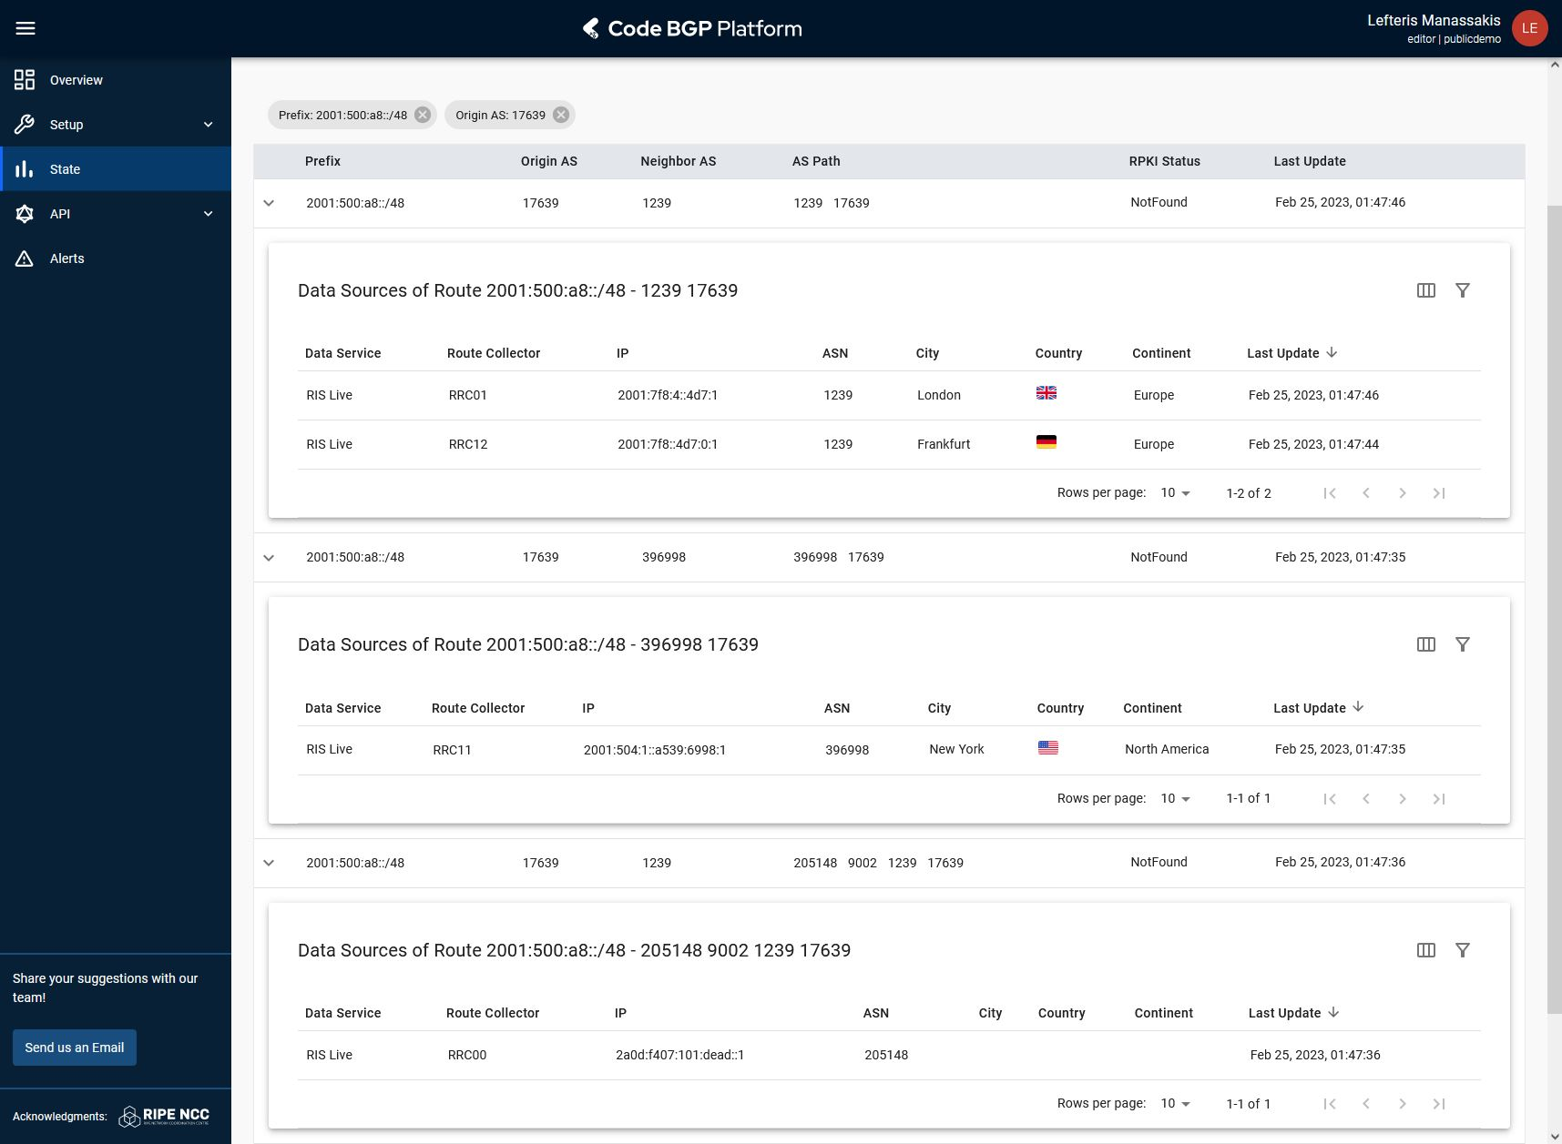
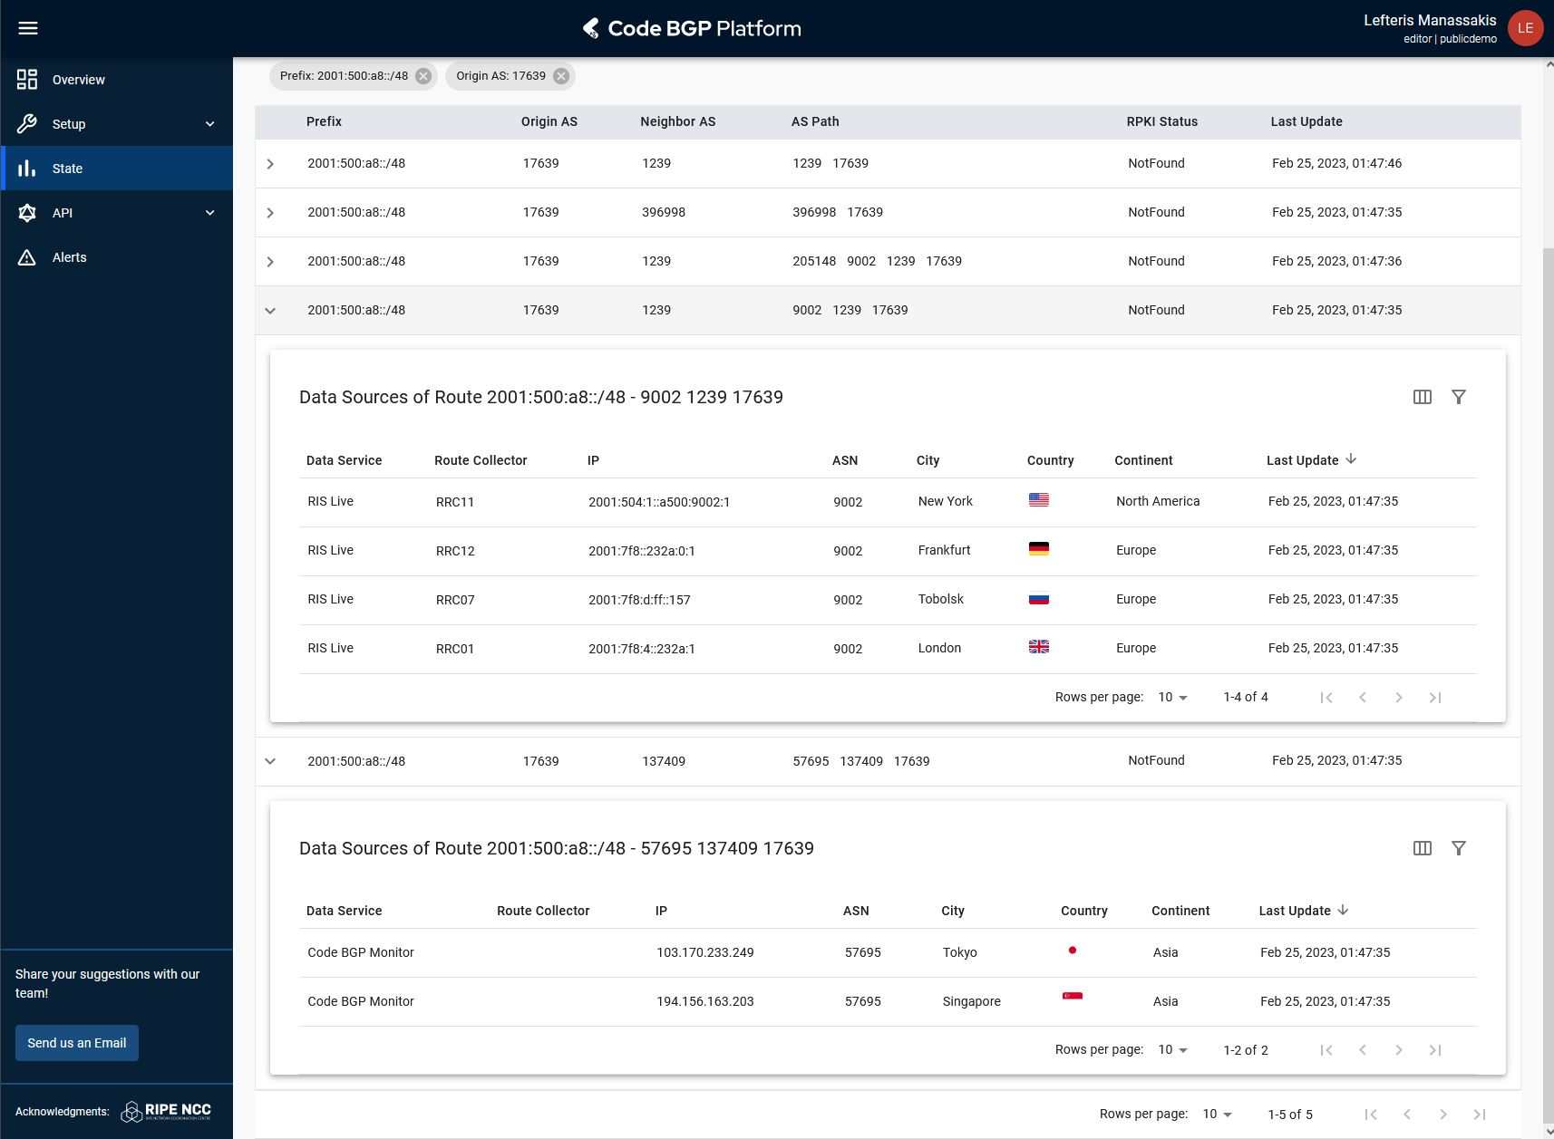
Exact Prefix Hijacks detected for root DNS prefixes - Feb. 25
The “E-Root” 2001:500:a8::/48 prefix is not covered by a RPKI ROA. The event lasted 2 days

Slide 25
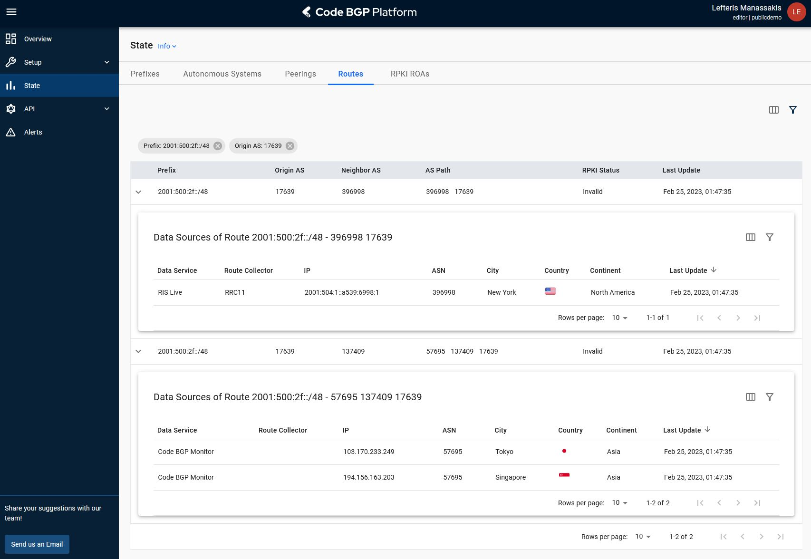
Exact Prefix Hijacks detected for root DNS prefixes - Feb. 25
The “F-Root” 2001:500:2f::/48 prefix is covered by a RPKI ROA. The event lasted 18 hours

Slide 26
Prefix Hijacking Demo

Slide 27
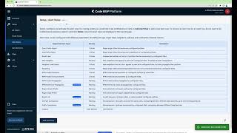

Slide 28
Questions
lefteris@codebgp.com
codebgp.com

