Slide 1
Network Log Aggregation with Loki
Dan Poltawski
UKNOF 51
dan.poltawski@tnp.net.uk
dan@fedi.talktodan.com

Slide 2
Why Loki?
Features
Open source (& self hosted)
Cost effective and easy to operate
Minimal infrastructure requirements
Highly available, horizontally scalable
Integrates with existing Prometheus infrastructure
Powerful Query Language (LogQL)
Metrics and Alerting
Supports Multi-tenancy
https://github.com/grafana/loki

Slide 3
Loki: contrast to other log solutions
2023-04-04T10:01:02.123456789Z {ip=”10.0.0.1"‚ hostname=”rtr1”} Login ‘danp’ from 10.0.0.2 (ssh)
Indexed
(Timestamp & Prometheus-style labels)
Unindexed
(Log content)
Indexing
Only indexes the metadata around source of log line
Small RAM requirements
Log data
Stored compressed in block storage chunks
Example - 40GB log data from webserver
100GB in Elasticsearch - 9GB in Loki
Filtering and Parsing
Happens at query time
Parallelised components for performance
Grafana Labs achieve query speeds of up of 80GB/s

Slide 4
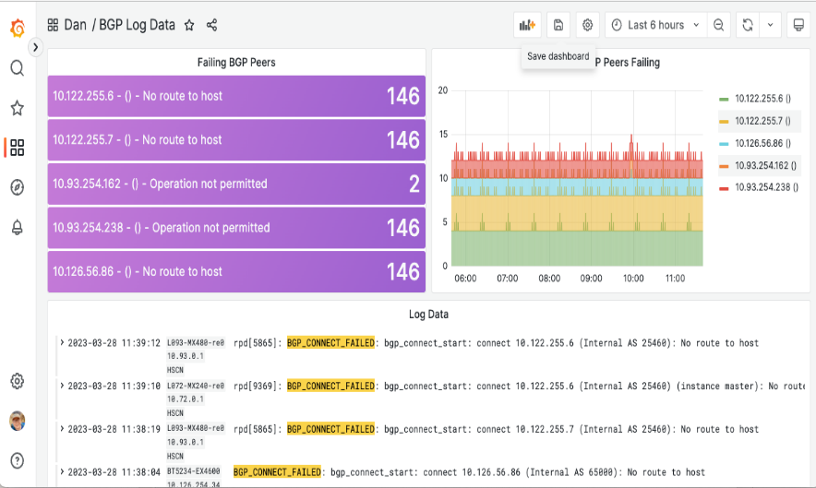
Overall Architecture
Alertmanger
Syslog UDP/514
rsyslogd
Syslog
TCP/1514
HTTP(S)
promtail
HTTP(S)
HTTP(S)
$ logcli query '{hostname=”XXX-re0"} |="AS 15169"' -o raw -q
RPD_BGP_NEIGHBOR_STATE_CHANGED: BGP peer 5.61.120.233 (External AS 15169) changed state from OpenConfirm to Established (event RecvKeepAlive) (instance master)
BGP_RESET_PENDING_CONNECTION: 5.61.120.233 (External AS 15169): reseting pending active connection (instance master)
RPD_BGP_NEIGHBOR_STATE_CHANGED: BGP peer 5.61.120.233 (External AS 15169) changed state from Established to Idle (event Restart) (instance master)
BGP_IO_ERROR_CLOSE_SESSION: BGP peer 5.61.120.233 (External AS 15169): Error event Broken pipe(32) for I/O session - closing it (instance master)
promtail
HTTP(S)
Logstash
Fluentd
[…]

Slide 5
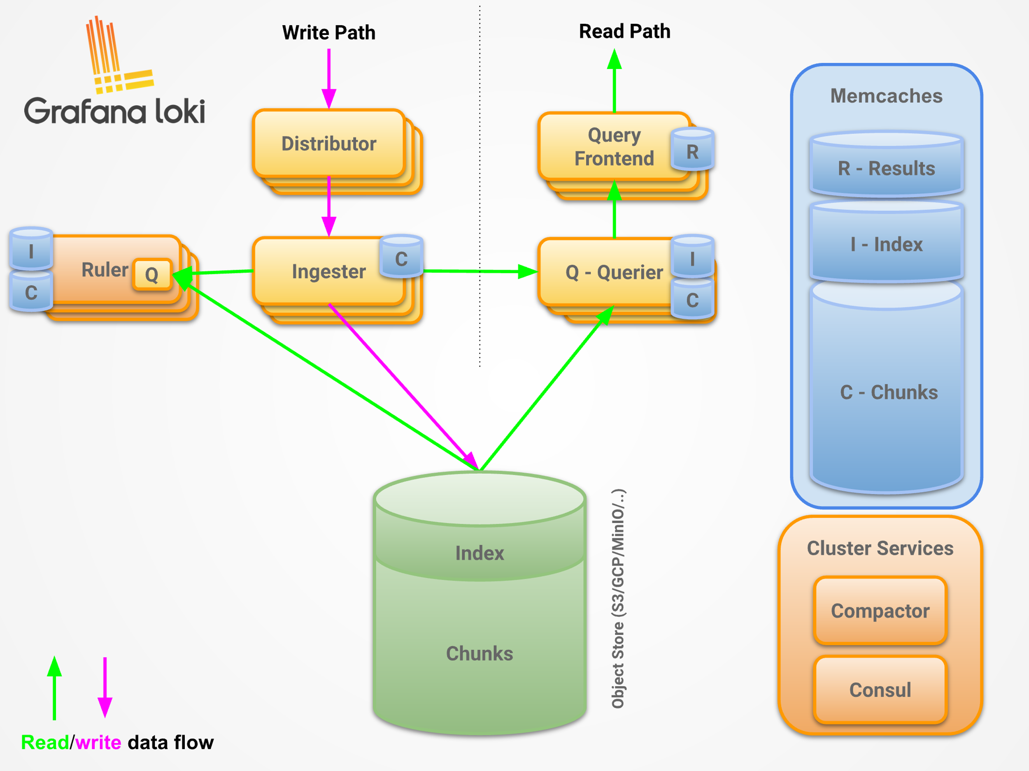
Loki architecture
Single binary (golang)
Deployment Options
Monolithic
Simple scalable deployment
Microservices
Storage – only dependency
Local Filesystem
S3 (plus substitutes like MiniIO)
Azure blob storage
GCS
Openstack Swift
(etc)
Full microservices architecture
Notes:
Monolthic = 100GB per day

Slide 6
Syslog Ingestion - Rsyslog & Promtail
Rsyslog
Forwarder in front of promtail to normalize messages via Syslog/UDP
Use `jsonmesg` to send all raw data to promtail
Promtail
Ingests syslog message from rsyslog
Runs pipeline on messages
Parse data from rsyslog
Transform or filter lines
Generate Prometheus metrics
Send onward to loki
/etc/rsyslog.d/send-to-loki.conf
module(load="imudp")
input(type="imudp" port="514" ruleset="networking-loki")
template(name="loki" type="list") {
constant(value="<")
property(name="PRI")
constant(value=">1 ")
property(name="TIMESTAMP" dateFormat="rfc3339")
constant(value=" ")
property(name="HOSTNAME")
constant(value=" ")
property(name="APP-NAME")
constant(value=" ")
property(name="PROCID")
constant(value=" ")
property(name="MSGID")
constant(value=" ")
property(name="STRUCTURED-DATA")
constant(value=" ")
property(name="jsonmesg")
constant(value="\n")
}
ruleset(name="networking-loki"){
action(type="omfwd" protocol="tcp" target="127.0.0.1”
port="1514” Template="loki" TCP_Framing="octet-counted”)
}
Link to full configs snippet

Slide 7
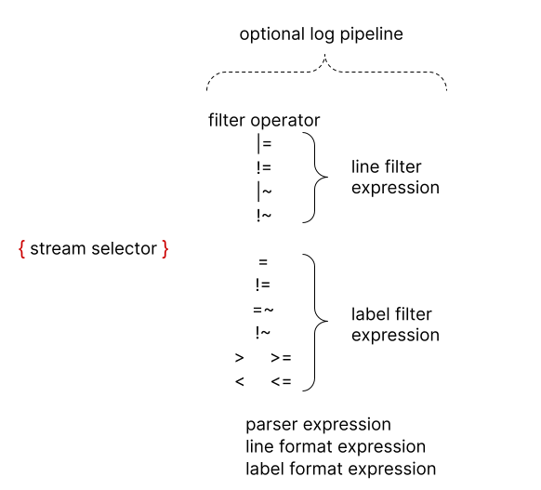
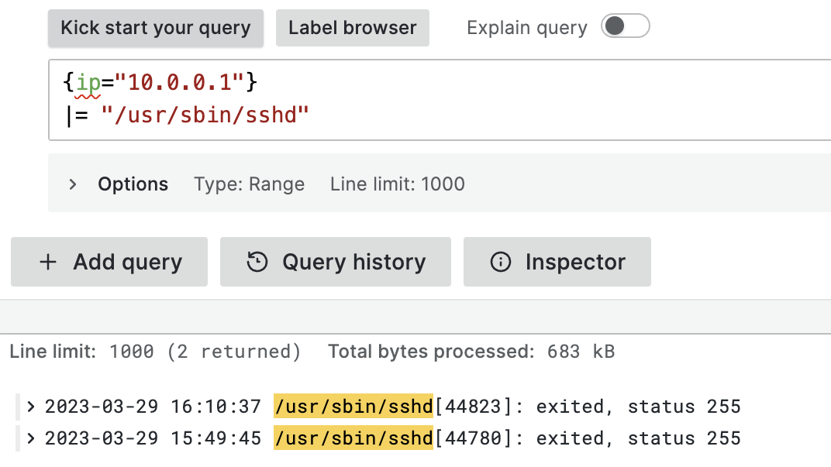
LogQL – basics

Slide 8
LogQL – Parsers: pattern
Log line:
Failed password for root from 61.177.172.147 port 39028 ssh2
Query:
{hostname=”HOSTNAME-TEST"}
| pattern `Failed password for <username> from <srcip> port`
| srcip != ip(`10.0.1.0/27`)
| line_format `{{.hostname}} - {{.username}} ({{.srcip}})`
Output:
HOSTNAME-TEST - root (61.177.172.147)
Notes:
Fastest parser

Slide 9
LogQL – Parsers: logfmt
Log line:
time=20:02:40 devname="Core-FG" eventtime=1680033760096179863 tz="+0100" logid="1059028704" type="utm" subtype="app-ctrl" eventtype="signature" level="information" vd="Corporate" appid=15895 srcip=10.64.128.6 srccountry="Reserved" dstip=1.1.1.1 dstcountry="Australia" srcport=52026 dstport=443 srcintf="v1974_ContInt" srcintfrole="lan" dstintf="VCorp-SvrGlob" dstintfrole="wan" proto=6 service="SSL" direction="outgoing" policyid=171 poluuid="575255da-1eac-51eb-ff8a-466643d7739b" policytype="policy" sessionid=1267665482 action="pass" appcat="Network.Service" app="SSL" hostname="cloudflare-dns.com" incidentserialno=252207910 url="/" msg="Network.Service: SSL" apprisk="elevated" scertcname="cloudflare-dns.com”
Query:
{type="fortios"} | logfmt | subtype=`app-ctrl`, dstip=`1.1.1.1`
| line_format "src: {{.srcip}} dst: {{.dstip}}”
Output:
src: 10.64.128.6 dst: 1.1.1.1

Slide 10
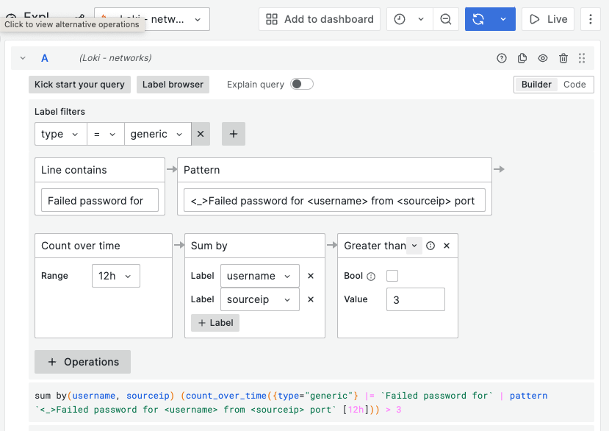
LogQL Continued
..yet more parsers
json – parses json much like logfmt
regexp – golang RE2 syntax to extract labels
Matching IP addresses with ip("<pattern>")
ip("192.0.2.0"), ip("::1")
ip("192.0.2.0/24"), ip("2001:db8::/32")
ip("192.0.2.1-192.0.2.7"), ip("2001:db8::1-2001:db8::8")
Graphical query builder in Grafana!
Experiment with the LogQL Analyzer
https://grafana.com/docs/loki/latest/logql/analyzer/

Slide 11
Metric Queries / Alerting

Slide 12
Questions?

