Slide 1
LINX Manchester and Expansion to Equinix MA5
Committed to Tech Growth in Manchester for more than a Decade
Colin Peckham
LINX Business Development Executive
3-4 April 2023
UKNOF51

Slide 2
Agenda
LINX: Working for the Manchester Tech Community
LINX Manchester: Who, What, Why, When?
Equinix MA5 Expansion
Attracting the Biggest Networks to Connect Regionally

Slide 3
London Internet Exchange
The LINX Story

Slide 4
The LINX Story
Established in 1994 by five London-based networks
A not-for-profit, membership organisation established to stop traffic ‘tromboning’ from the UK to the US and back
First international exchange established in Northern Virginia in 2014

Slide 5
The LINX Story
LINX are now a leading global Internet Exchange
Respected for engineering innovation
World class technical solutions for a wide range of interconnection needs
International presence in the UK, USA, Middle-East and Africa
900+ Member networks located in more than 80 countries worldwide
Members from all major cloud, data communications, telecoms, financial, and enterprise networks

Slide 6
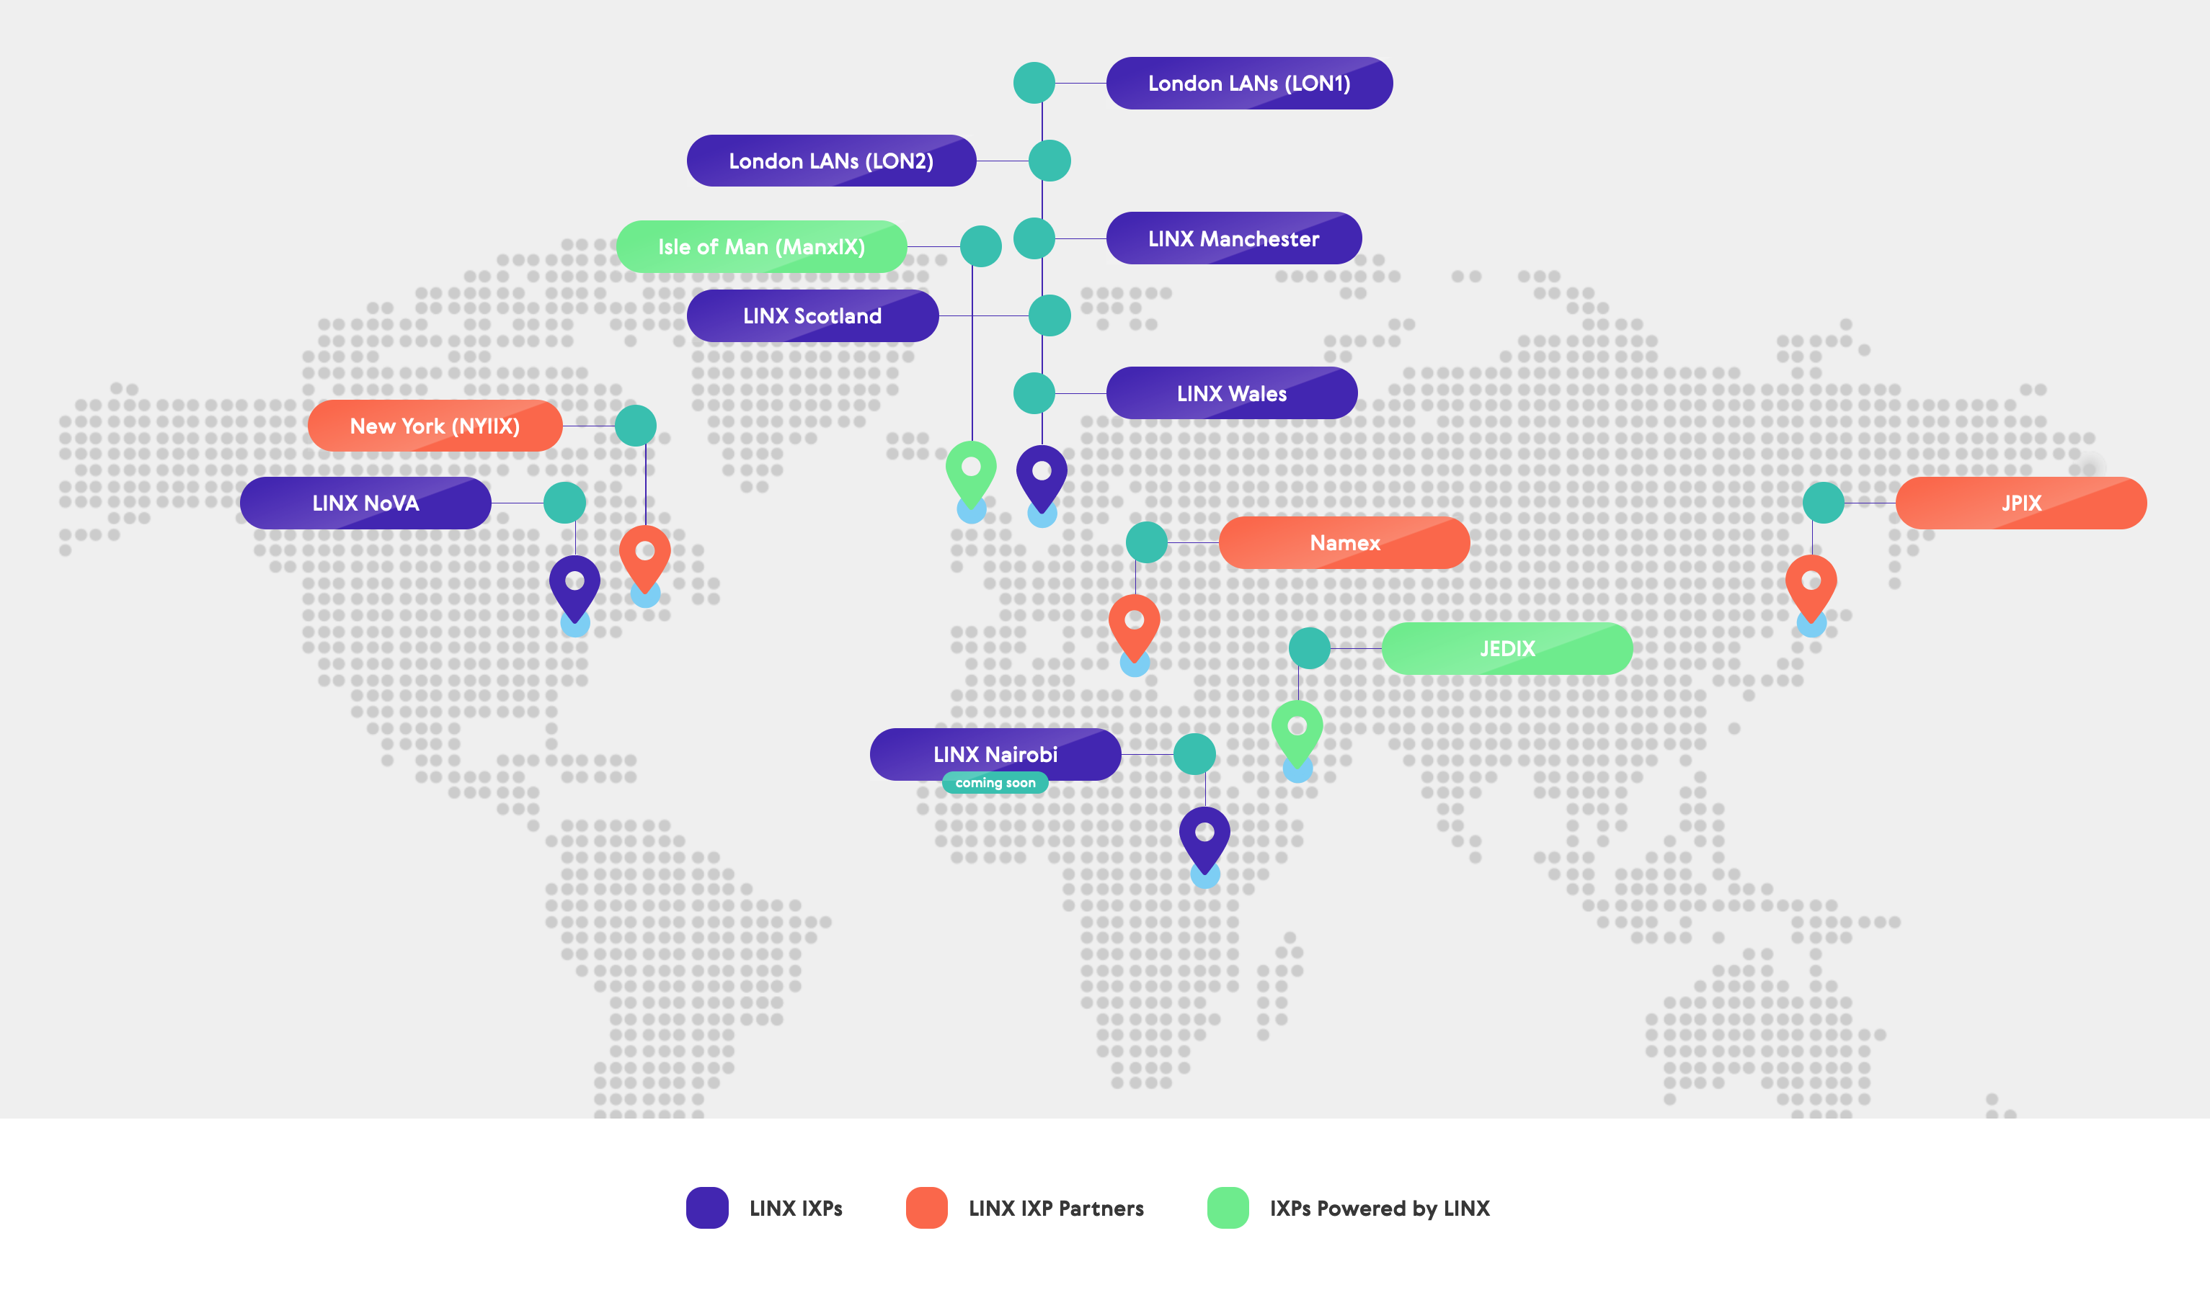
The LINX Network

Slide 7
LINX Statistics
March 2023
1783
Connected Member Ports
900
Member ASNs
Member-facing 10GE Ports
1128
877
LINX Members
7.898Tbps
Peak Traffic
54.913Tb
Connected Capacity
Member-facing 100GE Ports
418
80
LINX Member Countries
Member-facing 400GE Ports
4
8
LINX LANs

Slide 8
LINX Manchester
Originally known as IXManchester, LINX Manchester was LINX’s first Internet exchange established outside of London
Launched in 2012, LINX Manchester now has a physical presence in five sites across the city
There is a good mix of content providers and access networks present at the exchange including Akamai, BBC, Janet and Virgin Media.
Availability metrics achieves greater than the coveted 99.999% reliability
Resilience is a major feature, and this is reflected in our topology and our two route servers

Slide 9
LINX Can Support Different Network Types in Manchester
Enterprise Markets
Focus is more on specific connected networks, and varies from segments to segment
Mainly networks which provide cloud based services that the different market segments use i.e companies like Zscaler, Microsoft, Oracle etc.
These enterprise companies can take control over how they reach these providers of services
Partner Networks
Companies offering specific network services
They can use LINX products such as Private VLAN, Closed User Groups, and more, to bring their services closer to their customers

Slide 10
Services Available at LINX Manchester
Peering
Shared switching fabric based on layer 2 Ethernet technology, networks connect using a single physical port or use multiple ports together to create a large single virtual port
Private VLAN
Establish a simple, private connection between you and another LINX member on the same port you use to connect to our peering infrastructure
Closed User Groups
By creating a common, private connection between two or more members, closed user groups offer users greater control of their network traffic while helping to mitigate the risk of cyber-attacks
MAPS (coming Soon)
LINX Microsoft Azure Peering Service ensures all traffic enters and leaves through the nearest Microsoft Edge Point of Presence (PoP) location on the Microsoft Global Network.

Slide 11
LINX Manchester Networks (1)
34SP.com Ltd
Airband Community Internet Ltd
Akamai Technologies Inc.
Amazon
Amito Ltd
ANEXIA Internetdienstleistungs GmbH
ANS Group Limited
Apple Europe Limited
aq Limited
Ask4 Limited
Aspire Technology Solutions Ltd
Atlas Business Group of Companies Plc
Avensys Networks Ltd.
AVR Group Limited
Baltic Broadband Limited
BBC
Bogons Ltd.
Boundless Networks Ltd
Broadband for the Rural North (B4RN)
Cato Networks (UK) Ltd
CCANet
Cinos Limited
Cloudflare Inc.
Clouvider Limited
Connexin Ltd
Convergence Group Networks Ltd
Daisy Corporate Services Trading
Datatech UK Ltd
Defaultroute Limited
Domicilium (IOM) Ltd.
EdgeCast Networks
Emizon Networks Limited
Entanet International Ltd
Equinix
EuNetworks GmbH
Exa Networks Ltd.
Exascale
Faelix Limited
Fastly
Flexoptix GmbH
Fluency Communications Limited
Fluidata
Freethought Internet Limited
Fuse 2 Communications
Gamma Telecom Limited
GCI Network Solutions Ltd
GConnect
Glide
High Tide Group
Highland Network Limited T/A HighNet
HighSpeed Office Limited
Highwinds Network Group Inc.
Hurricane Electric
Hyperoptic Limited
iLand
Indigo Systems
Internet Central Ltd
Iomart Hosting Limited
IP River Ltd
IT Professional Services Ltd

Slide 12
LINX Manchester Networks (2)
Itility Limited
ITS Technology Group Limited
IX Reach
Jisc Services Limited
Kingston Communications (HULL) PLC
Layershift Limited
Limelight Networks UK Ltd.
Link IP Networks Ltd
Lothian Broadband Networks Limited
M247 UK Ltd
Merula Ltd.
Meta UK Ltd
Microsoft
MLL Telecom Ltd
NetActuate Inc
Netnorth Limited
Netrouting
Netskope UK Ltd
No One Internet Ltd
Node4 Ltd
Nomical Limited
Nominet UK
Oakford Internet Services
Odyssey Systems Limited
Packet Clearing House (PCH)
Packnet Limited
PhusionIM Ltd
Public Internet Ltd
Razorblue Ltd
SG.GS
Simwood eSMS Limited
Six Degrees Technology Group
Solway Communications Limited
Spectrum Internet Ltd
Sub 6 Limited
Suretec Systems Ltd. T/A SureVoIP
Synextra Ltd
SysGroup Trading Limited
TalkTalk
Telappliant
Telcom Networks Limited
Teledata UK Ltd
Telin
The Networking People (TNP) Limited
TouchTec Technology Limited
Ultra Networks
Unitas Global Inc
Virgin Media Limited
Vispa Limited
Vodafone UK Limited
VoiceHost Ltd
Voneus Ltd
Wavenet Limited
Wi-Manx
Wildcard Networks
X-on
YouFibre Limited
Zayo Group
Zen Internet Ltd
Zscaler Inc
Zycomm Electronics Limited

Slide 13
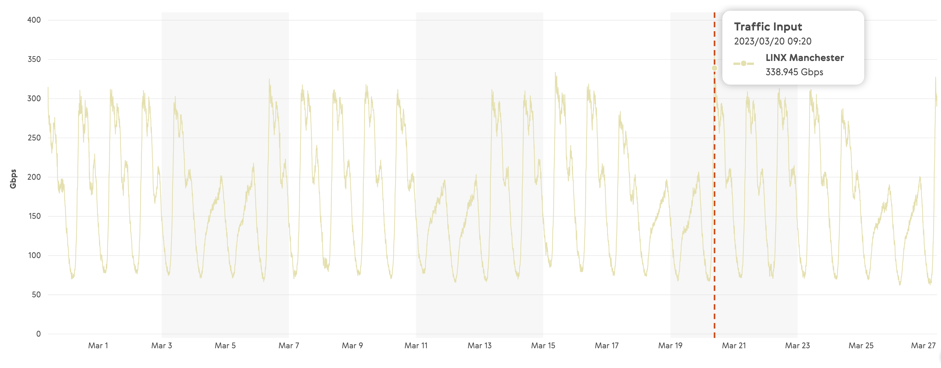
Network Traffic Levels
From traffic peaks of 174Gbps in November of 2020, LINX Manchester now regularly surpasses 300Gbps

Slide 14
Continued Demand for Capacity in Manchester
During the pandemic a number of the large content delivery networks required more capacity
LINX also saw higher demand from the enterprise sector looking to facilitate a reliable hybrid working set up for their staff
That demand hasn’t slowed for at LINX…
Manchester continues to grow and expand as a hive for technology and digital innovation, and the LINX Manchester hub will be here to meet that need

Slide 15
Equinix MA5 Expansion

Slide 16
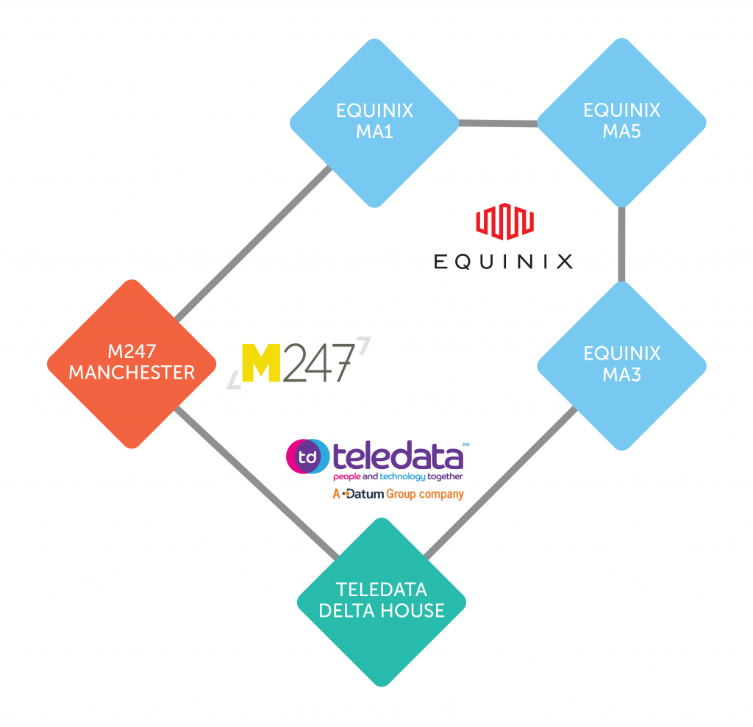
The LINX Manchester Network
NEW!

Slide 17
Equinix MA5 Expansion – Planning & Installation
The network design follows the “standard” MAN1 build, to cater for both 10G and 100G orders in the pipeline we had for MA5 before it was even brought live
Equinix provided fibres back to TCW (MA1) and TCJ (MA3)
Kit Installation was done over 2 days in Junuary 2022
Pre-planning meant we already had all equipment required avoiding supply chain delays

Slide 18
Equinix MA5 Expansion – Planning & Installation
Next step was full configuration of the network. At this point the build is still completely isolated from the network
Several steps of maintenance required to bring MA5 live without disruption
The new site sits between MA1 and MA3 on the network and replaces the previous direct link between the sites
Final step was to increase OSPF costs to drain traffic from the old ISL and once traffic was passing without issues via the new ISLs we decommissioned the old link

Slide 19
Equinix MA5 Expansion - Architecture
We deployed our disaggregated network solution
Edgecore Networks hardware
IP Infusion software
Leaf and Spine Topology
Smartoptics DCP-M devices running the optical transport
The maintenance involved went smoothly with no impact to existing members

Slide 20
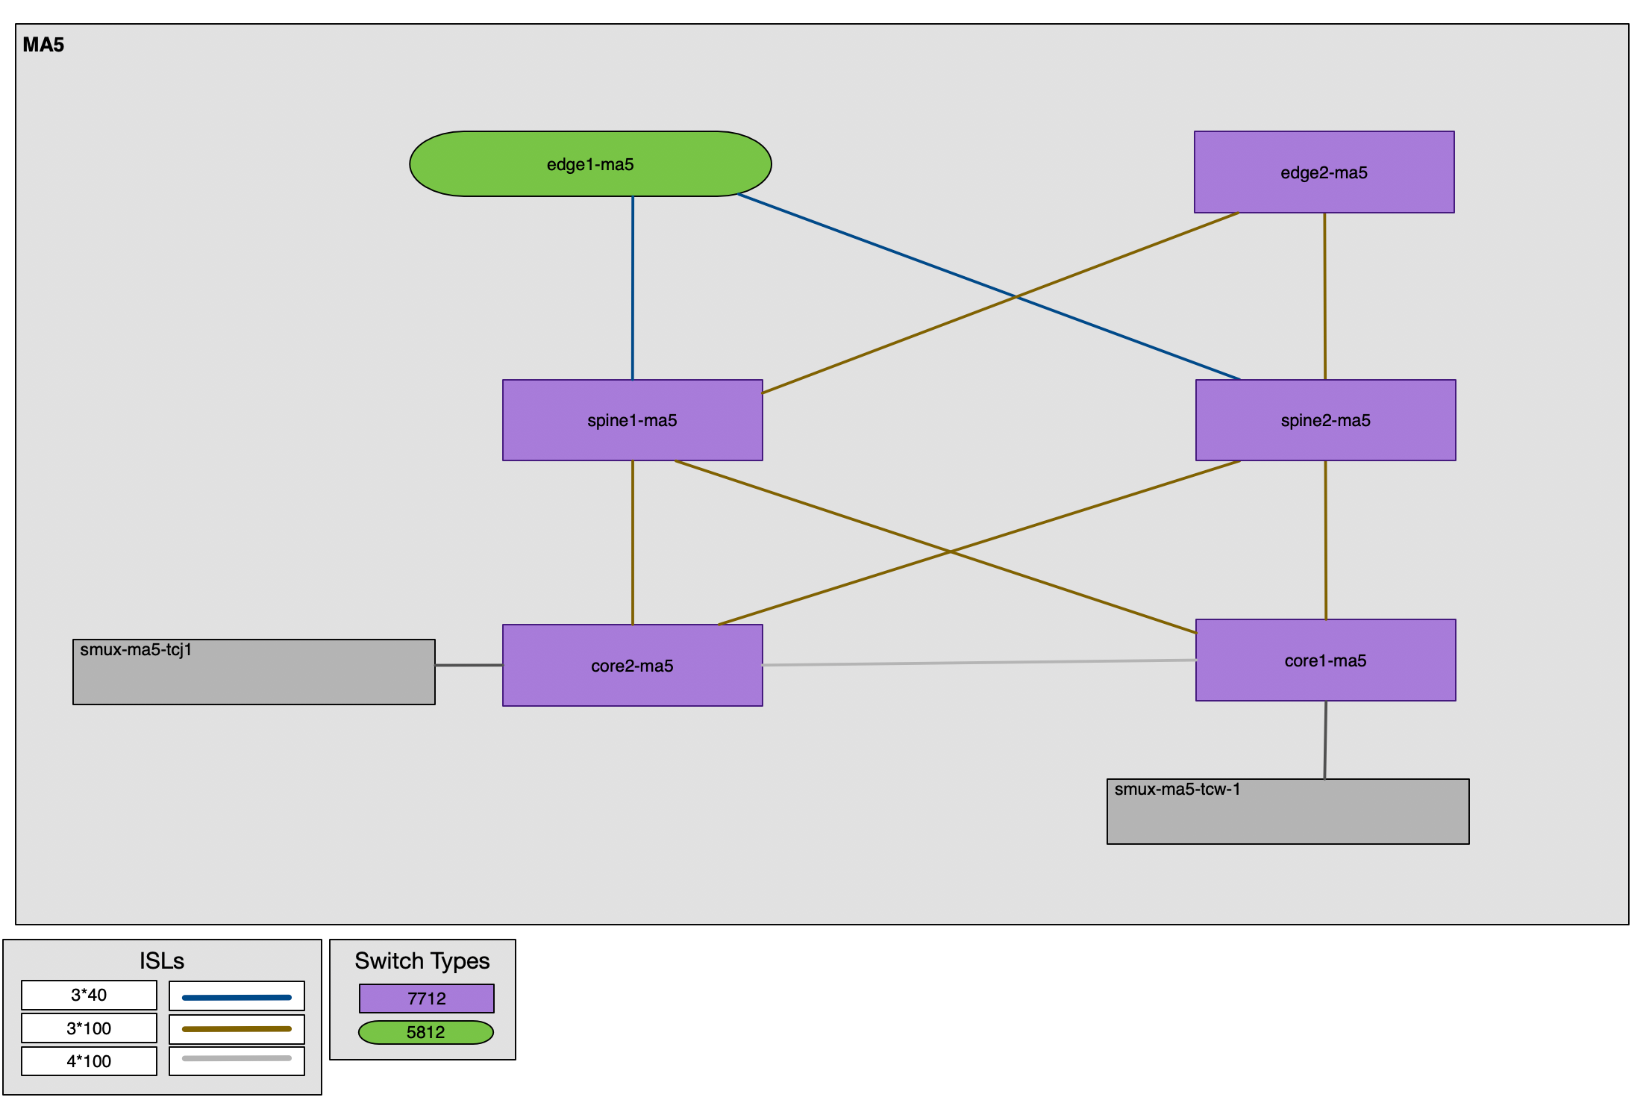
LINX Manchester Architecture (MA5)

Slide 21
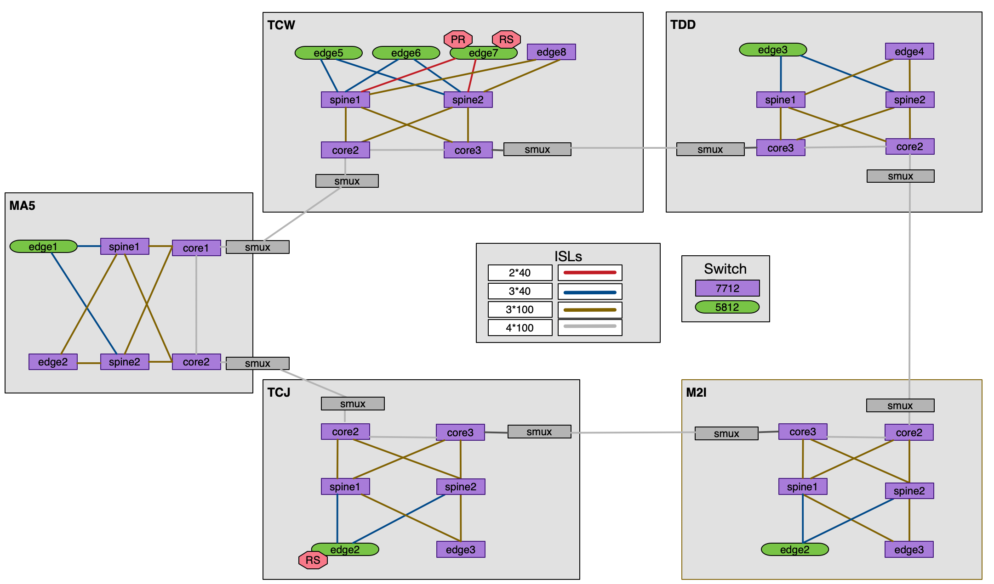
LINX Manchester Architecture (Full Network)

Slide 22
Why is LINX Manchester important?
Home to a £5bn digital ecosystem it raised a record £532m in funding in 2022 and is outperforming larger cities such as Rome, Warsaw, Lisbon and Brussels
Jobs in the tech sector have climbed 67% since 2020
Manchester is home to almost 3000 eCommerce and related businesses
Data Centre expansion from Equinix and Teledata (A Datum Company), and the new Atlas Edge facility established to cope with demand
Greater Manchester has been at the forefront of turning the UK into the most advanced eCommerce market in Europe. Major success stories like The Hut Group and AO.com are joined by the greatest concentration of eCommerce start-ups in the UK.— Lou Cordwell, Chair of Greater Manchester Local Enterprise Partnership (GM LEP)

Slide 23
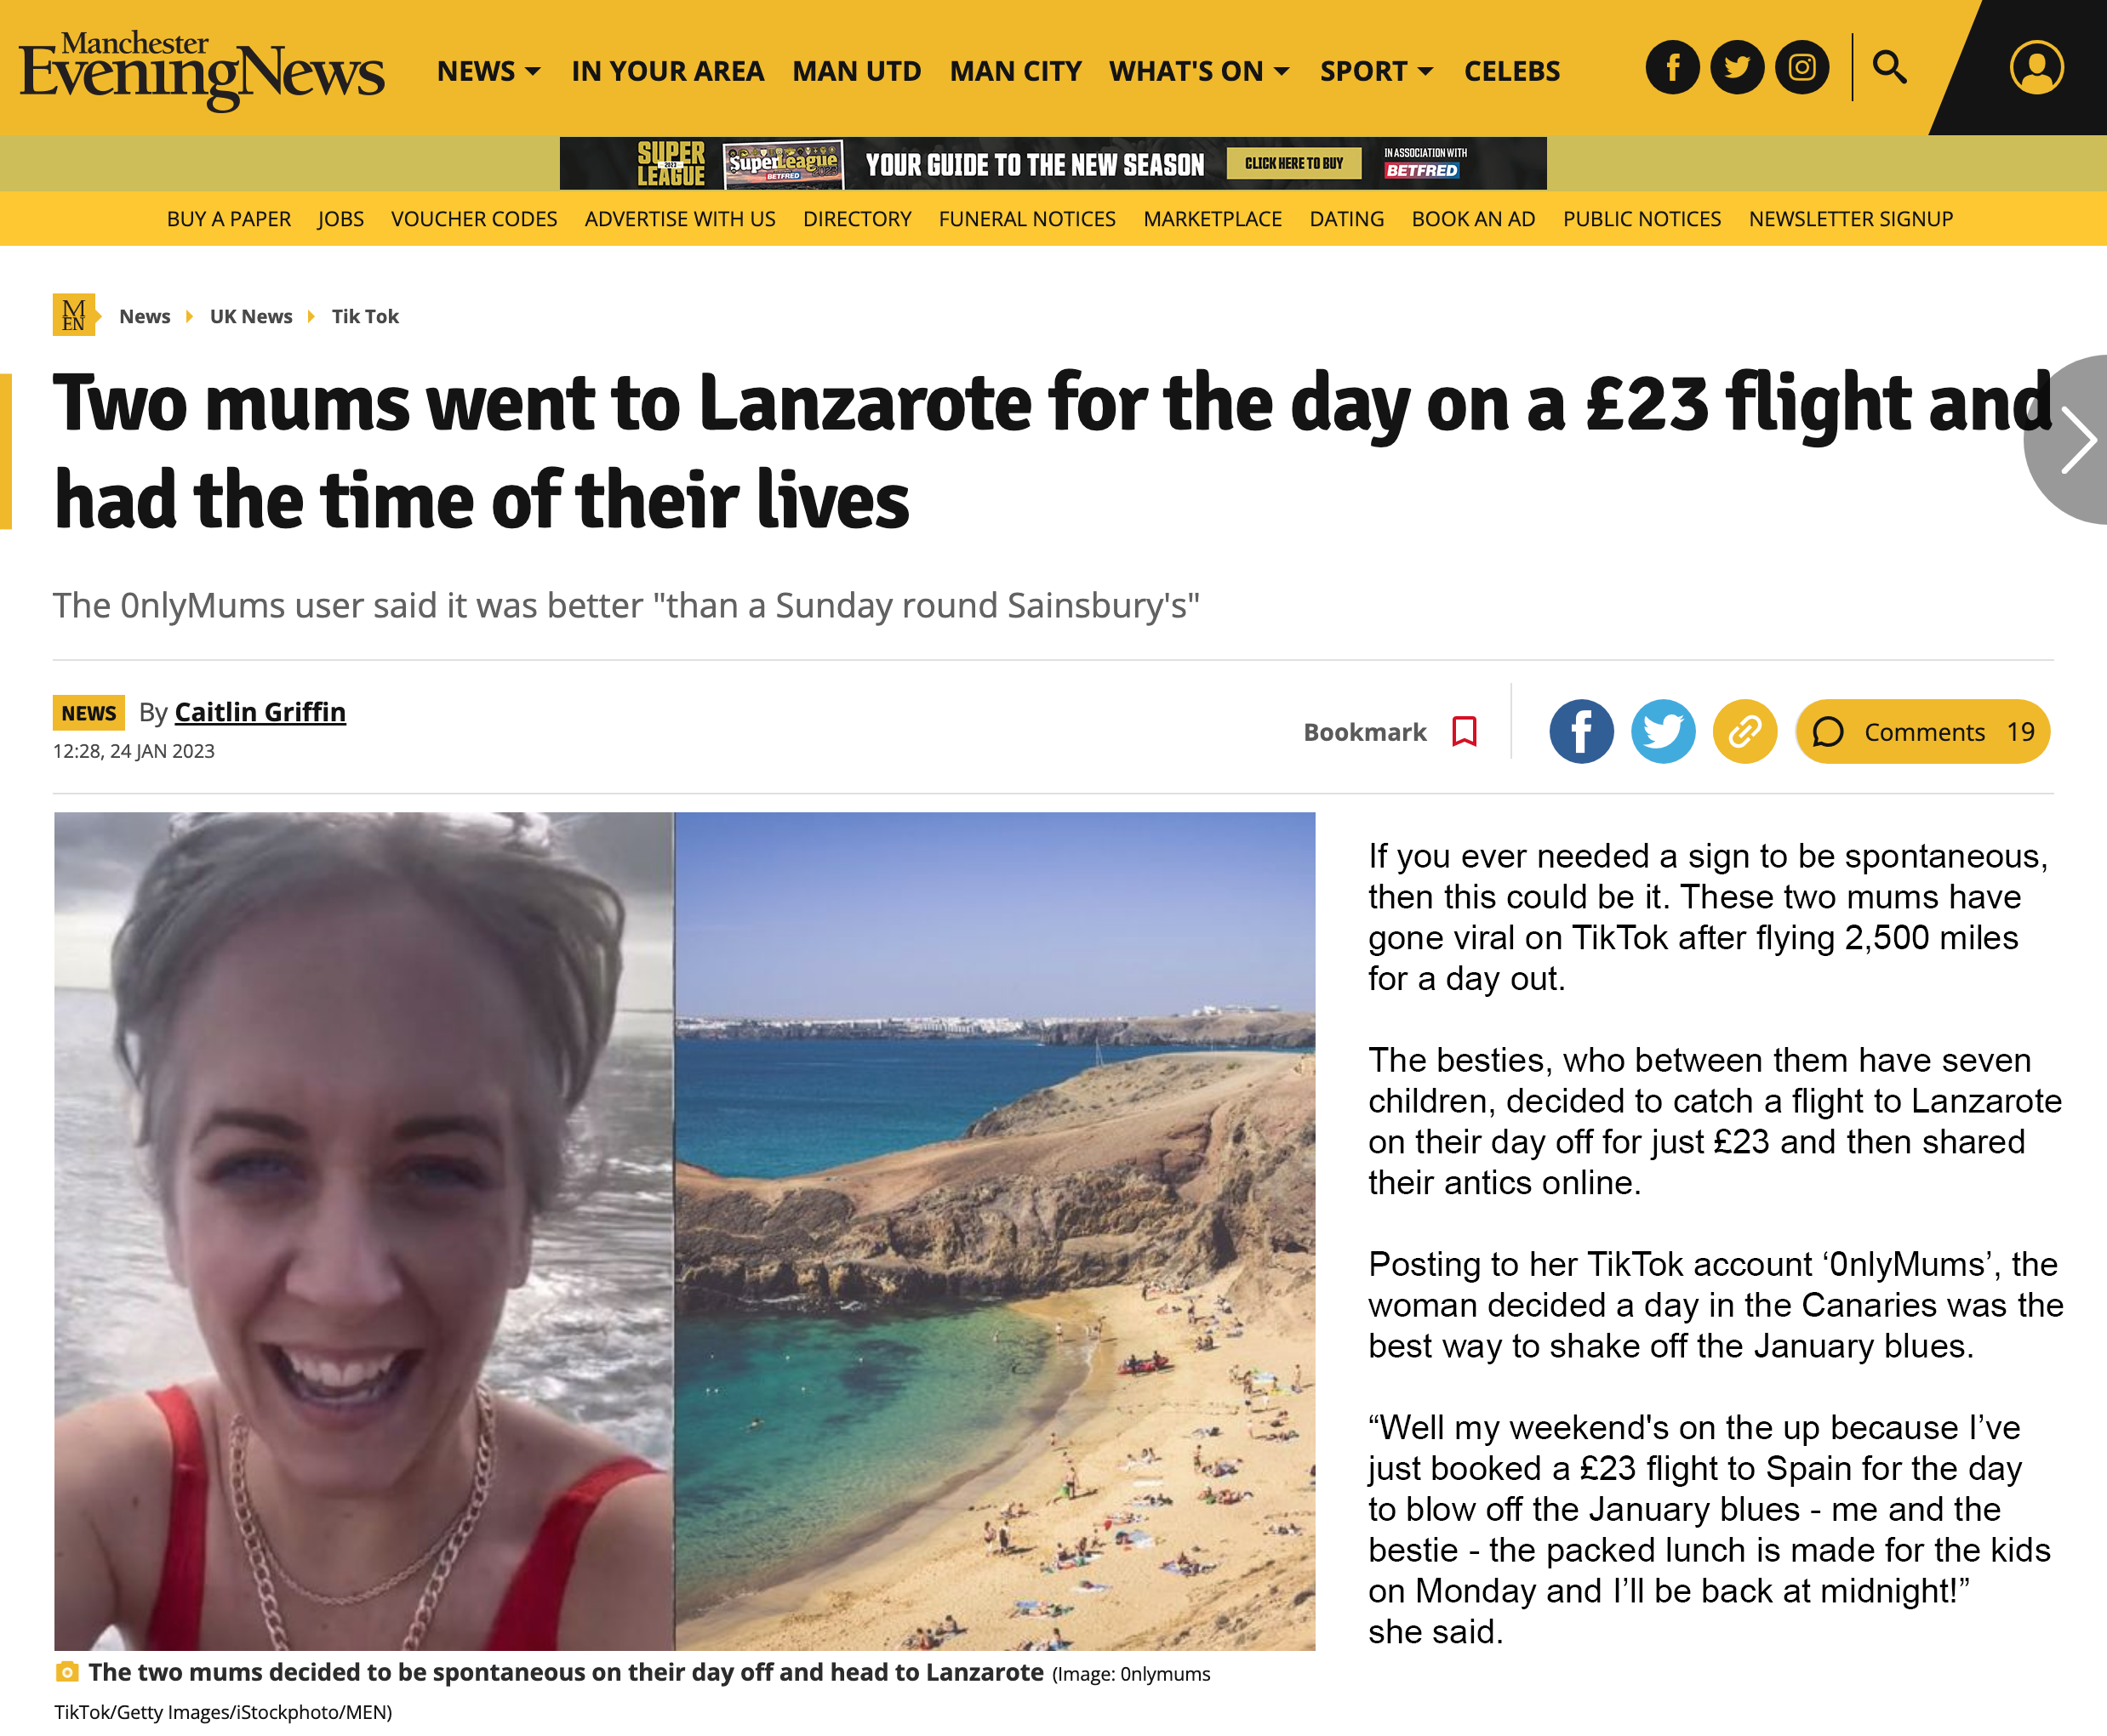
LINX Manchester in 2023
New networks connected
ByteDance (200G), Fibrus (100G), Lancashire County Council (10G)
Our first MA5 ConneXions reseller, Faelix, is live and has upgraded bandwidth
Stelia have a live 100G reseller port and will be bringing members from non-traditional hubs like Liverpool, Chester and Nottingham amongst others
Healthy pipeline of new networks and upgrades
LINX119 is in Manchester: Tue 16th and Wed 17th May
Revamp of the LINX Manchester steering committee

Slide 24
Want to Know More?
+44 20 7645 3500
sales@linx.net

