Slide 2
Some things to consider with 400G & DWDM

Slide 3
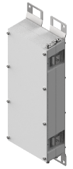
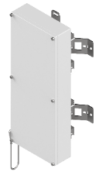
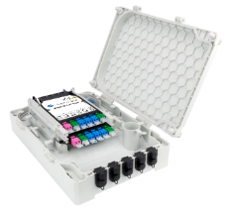
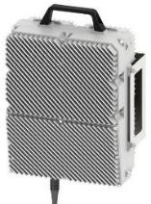
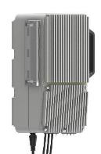
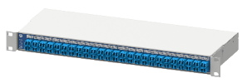
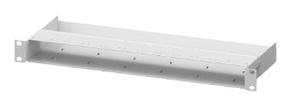
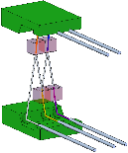
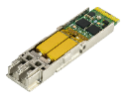
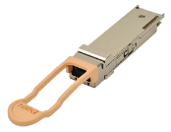
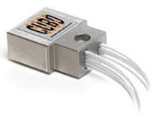
H+S Cube Optics – Product Map
 |  | Technology
 |  | Passive Optical Multiplexing | Active Systems (Transport)
Form Factor | Outdoor Hardened environment
 | Indoor 19” Chassis
 | Components Sub-Systems

Slide 4
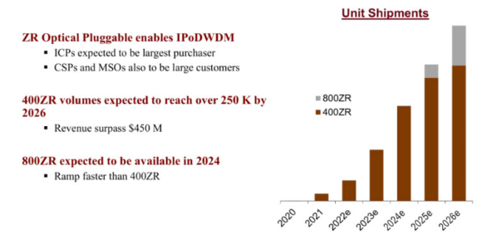
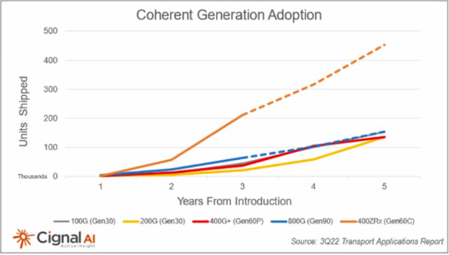
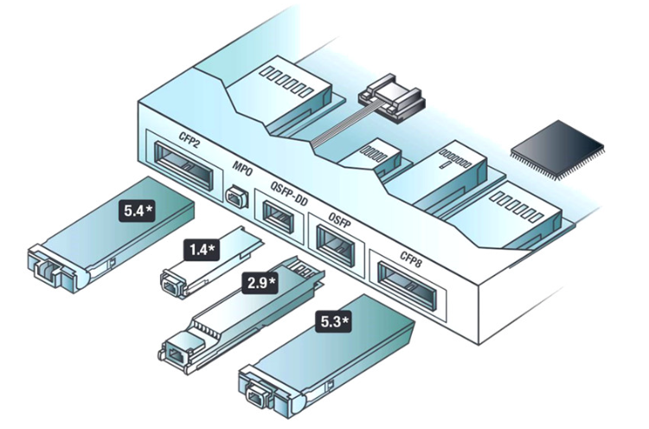
400G Coherent Market
New pluggable Coherent optics challenges:
More complexity
Increased power (heat)
but reduced cost per bit
Network integration

Slide 5
400G Transceivers
Type | Wavelength Channel Modulation | Optical Interface | Baud rate | Reach | Temp range / connector Type | power budget (dB) | Note:
SR8 | 8 / 850nm Band | 8x50G PAM4 MPO | 26.5625 GBd | 70M on OM3 100M on OM4 | 0-70°C / MPO | 1.9dB
DR4 | 4 / 1310nm Band | 4x100G PAM4 MPO | 53.125GBd | 500m | 0-70°C / MPO | 3dB
FR4 | 4 / 1271nm, 1291nm, 1311nm, 1331nm | 4x100G PAM4 LC | 53.125GBd | 2km | 0-70°C / LC | 4dB
LR4 | 4 / 1271nm, 1291nm, 1311nm, 1331nm | 4x100G PAM4 LC | 53.125GBd | 10km | 0-70°C / LC | 6.3dB
LR8 | 8 / 1310nm Band | 8x50G PAM4 LC | 26.5625 GBd | 10km | 0-70°C / LC | 6.3dB
ER4 | 4 / 1310nm Band | 4x100G PAM4 LC | 53.125GBd | 40km | 0-70°C / LC | 15.5dB | baud rate could be different due to FEC used
ER8 | 8 / 1310nm Band | 8x50G PAM4 LC | 26.5625 GBd ? | 40km | 0-70°C / LC | 15.5dB
ZR coherent (OIF Standard) | 16QAM, DWDM, c-Band tunable, ~1528…1567nm | 1x400G LC | 400G ZR 59.843 GBaud 16QAM modulation | 80km | 0-70°C / LC
ZR coherent (Open ZR+ Standard) | 16QAM, DWDM, c-Band tunable, ~1528…1567nm | 1x400G LC | 400G ZR+ 60.138 GBaud 16QAM modulation (400G mode) | ~80km...120km with EDFA | 0-70°C / LC | <5dB
ZR coherent (Open ZR+ Standard) | 16QAM, DWDM, c-Band tunable, ~1528…1567nm | 1x400G LC | 400G ZR+ 60.138 GBaud 16QAM modulation (400G mode) | 120+ km | 0-70°C / LC

Slide 6
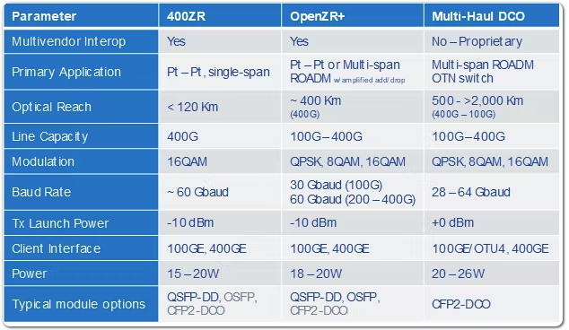
Comparing the Options – 400ZR/OpenZR+/Multi-Haul

Slide 7
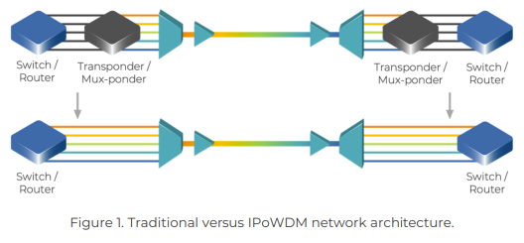
IP over DWDM
IP over DWDM (IPoDWDM) is used to integrate Routers/Switches directly over DWDM - ITU-T G.709
(Without the need for Transponders)
In this way IP devices can monitor the optical path and implement the transport functionality as FEC (Forward Error Correction) specified by ITU-T G.709/Y.1331 or Super FEC functionality defined in ITU-T G.975.1.

Slide 10
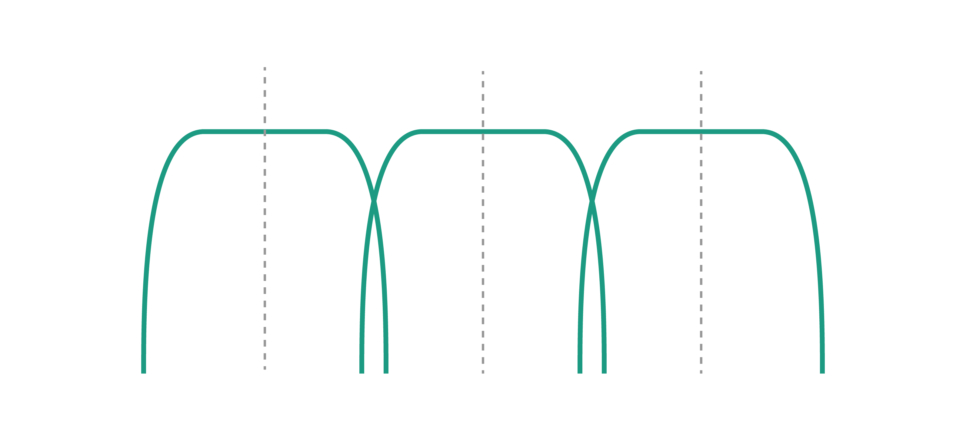
DWDM Grid Spacing
ITU G.694.1 standard DWDM region is from 1528.77 nm to 1563.86 nm that resides mostly within the C band.
A typical DWDM system would use 40 channels at 100 GHz (0.8nm) spacing.
100 GHz
100 GHz
…
C21
C22
C23
…

Slide 11
WDM Passband
Although the grid is100GHz, the passband of a DWDM generally is 50GHz
This means that the laser has a 50GHz window to pass through
50 GHz
Laser width

Slide 12
400G Coherent Lasers
400G is becoming more widely used
Multiple 400G connections are increasingly being deployed
The fastest/easiest to deploy and by far most cost-effective solution is passive optical multiplexing
However…
400G Coherent DWDM transceivers are available but their channel width is slightly broader than the usual DWDM transceiver
Result is that the 50GHz DWDM passband of standard 100GHz grid multiplexers isn’t always wide enough to work with some 400G Coherent optics
Standard DWDM
50 GHz Passband
Coherent laser width

Slide 13
75GHz Passband
400G coherent passband
You need a 75GHz passband for 100GHz DWDM grid
75GHz passband is wide enough for 400G coherent transceivers
Will work with other (10G, 100G) DWDM transceivers
Standard DWDM
50 GHz Passband
Coherent laser width
P
P
400G DWDM
75 GHz Passband

Slide 14
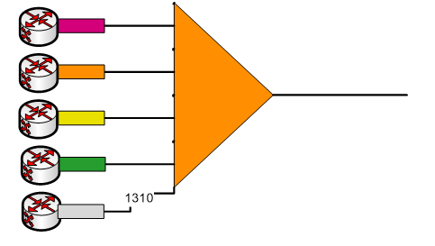
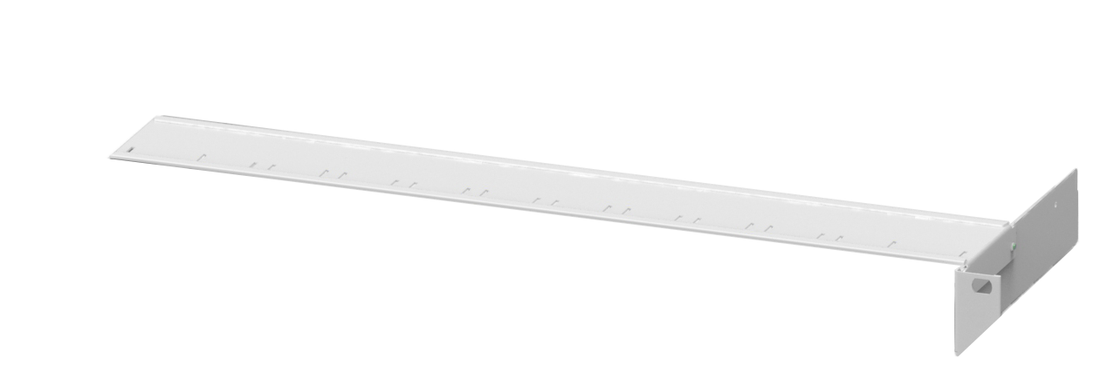
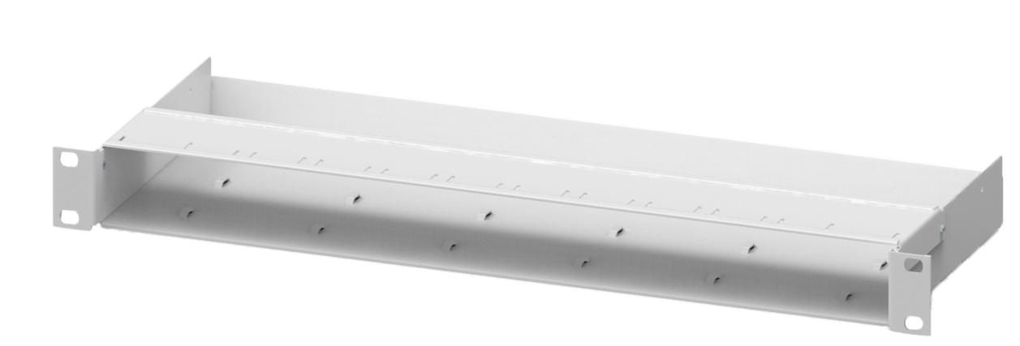
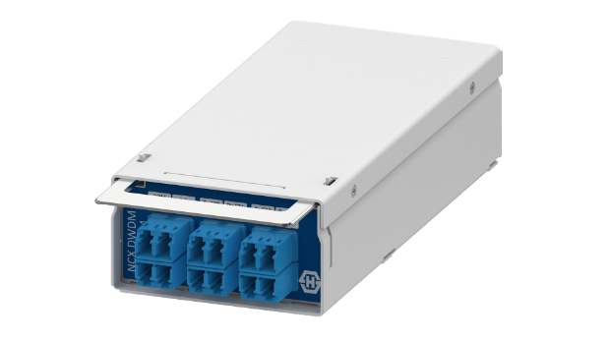
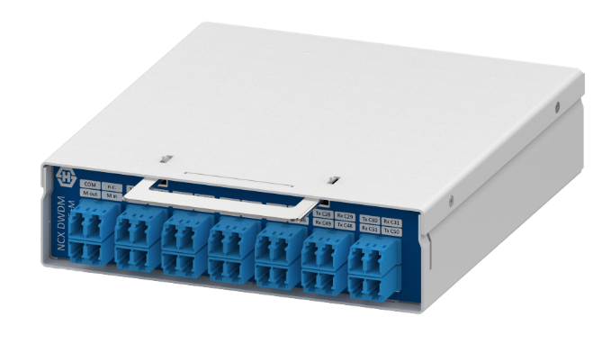
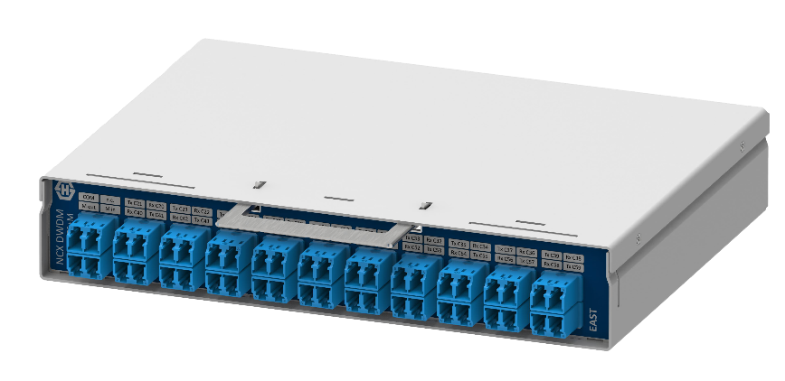
DWDM n*400G Coherent
N*400G Passive Optical Multiplexer
Option 1:
Use 200GHz spaced DWDM muxs
Option 2:
Use muxs capable of supporting 75Ghz passband
https://solutions.cubeoptics.com/network-cube-x

Slide 15
Many thanks steve.jones@hubersuhner.com +44 7900 881 729

