Slide 1
An Introduction to Networks in Kubernetes
James Wilkinson, 4th April 2023

Slide 2
What are Containers?
Application
Website files
Container
Runnable
Portable
Secure
Run from immutable images
Composed of layers
Libraries
Web server
Mini OS
Ubuntu

Slide 3
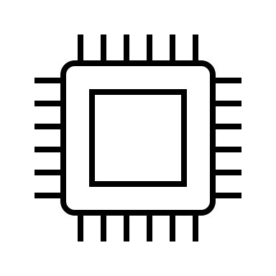
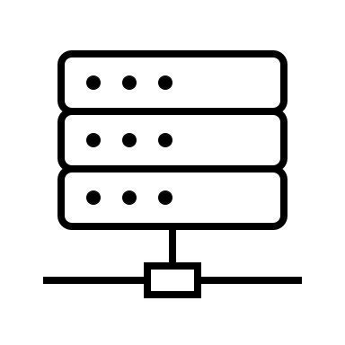
How are Containers Run?
Container
Container Runtime Interface
Resources (CPU, RAM, Disk, Network)

Slide 4
How are Containers Run?

Slide 5
How are Containers Run?

Slide 6
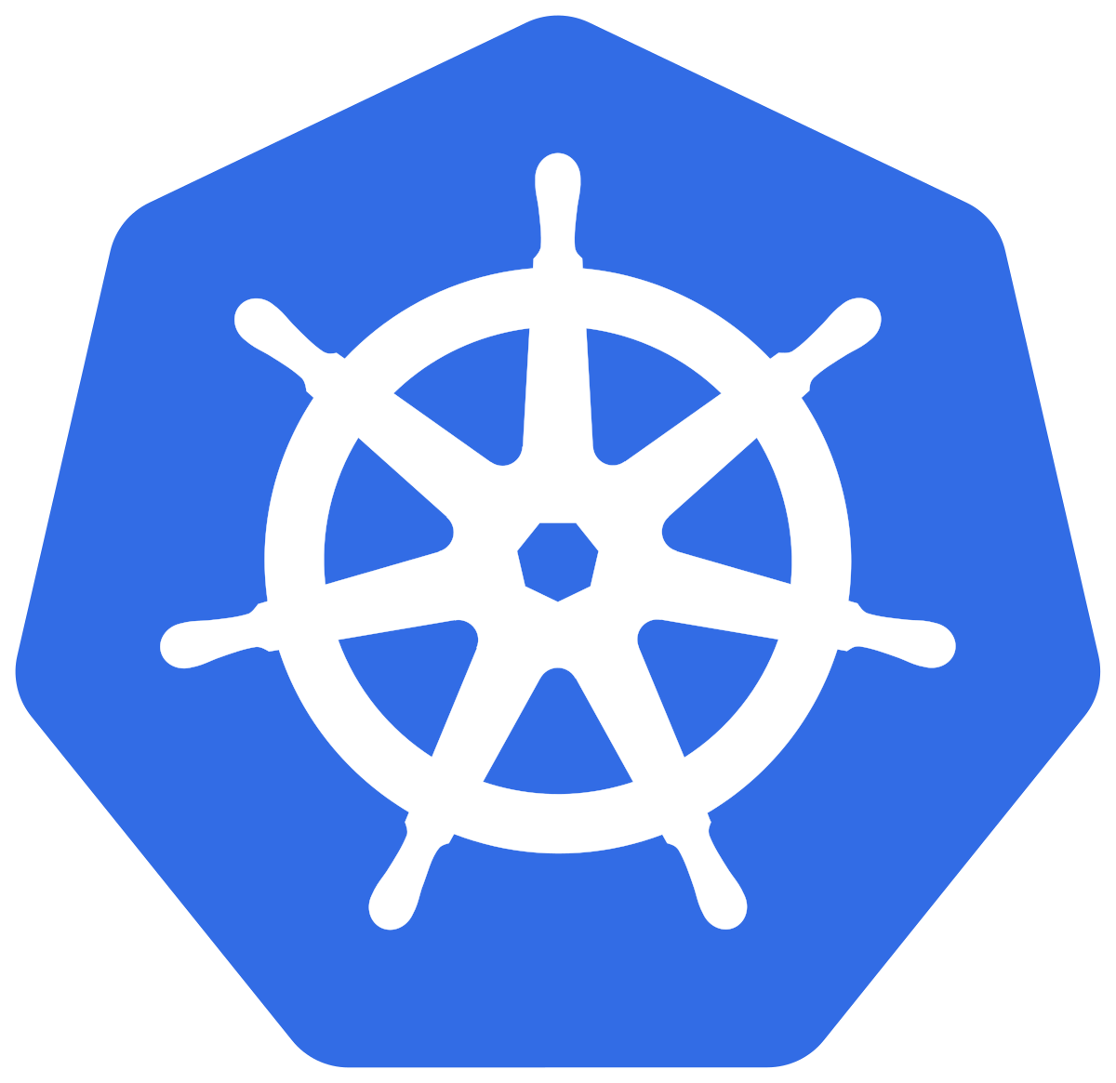
How are Containers Run?
Kubernetes

Slide 7
K8s in 8Ss
Scheduler
Simple
State machine
Stable
Sets
Secure
Services
Storage

Slide 8
Kubernetes Networking
Service: 10.0.0.0/24
Pod: 192.168.0.0/20
Physical: 172.16.0.0/24

Slide 9
Pod network
“Every Pod in a cluster gets its own unique cluster-wide IP address. ”
https://kubernetes.io/docs/concepts/workloads/pods/

Slide 10
Service network
Services are used to expose applications internally...
svc-foo 10.0.0.2
svc-foo 10.0.0.2
svc-foo 10.0.0.2
svc-foo 10.0.0.2
foo
foo
ClusterIP

Slide 11
Service network
…and externally
svc-foo 10.0.0.2
svc-foo 10.0.0.2
svc-foo 10.0.0.2
svc-foo 10.0.0.2
foo
foo
foo
172.16.0.5:30000
172.16.0.6:30000
172.16.0.7:30000
172.16.0.8:30000
NodePort

Slide 12
Access example – Inbound from customer
svc-foo 10.0.0.2
svc-foo 10.0.0.2
svc-foo 10.0.0.2
svc-foo 10.0.0.2
foo
foo
foo
172.16.0.5:30000
172.16.0.6:30000
172.16.0.7:30000
172.16.0.8:30000

Slide 13
Access example – App to database

Slide 14
Extensibility
CNIs (Container Network Interfaces)
BGP peering
Network Policies (including cross-cluster)
Encapsulation
Controllers
Manage external appliances e.g. Load Balancers, Firewalls
Gateway API under development

Slide 15
Q&A

