Slide 1
On the Temporal Behaviour of a Large-Scale Microservice Architecture
Giles Winchester
UKNOF51, 3rd-4th April 2023

Slide 2
Microservices
Architectural approach that composes an application as a collection of loosely coupled, fine-grained, services.
Basket
Checkout
Shipping
Shopfront
Catalogue
Stock

Slide 3
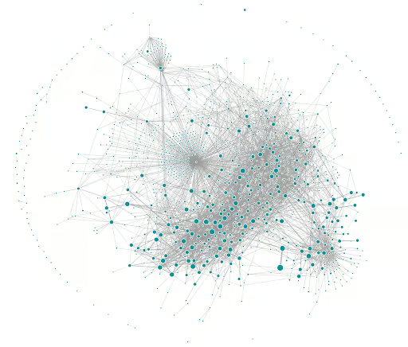
Microservice Complexity
Evolutionary architectures
Evolve to provide new functionality.
Can grow complex.
Hard to understand on a system-wide scale.
How complex is their behaviour?
[1] Gluck, Uber Blogs, 2020.

Slide 4
Microservice Dependencies
Static
Aggregate view of all possible dependencies.
Runtime
Who is actually communicating with who right now?
How variable are the system-wide dependencies of a large-scale microservice architecture at runtime?
Notes:
I’m probably going to say behaviour a lot in the next 10 minutes, but there are many ways to approach microservice “behaviour”. One way to characterize a microservice architecture and it’s behaviour is through the dependency structure of all the microservices. Here we can talk either about static dependency structure or the dependency structure at run-time, or more the actual calls being made between microservices as the architecture is in operation.

Slide 5
Alibaba Cluster Dataset
Microservices running in a single production cluster
~1,300 microservices and ~90,000 instances.
Running on ~13,000 bare-metal nodes.
Metrics collected over 12 hrs of operation.
Call spans between microservices from front-end user requests!
[1] github.com/alibaba/clusterdata

Slide 6
Method
1
Time Window
2
…
…
3
…
…
[1] Masuda and Holme, Sci Reports, 2019.

Slide 7
Similarity Between Snapshots
S1
S1
S2
S3
S2

Slide 8
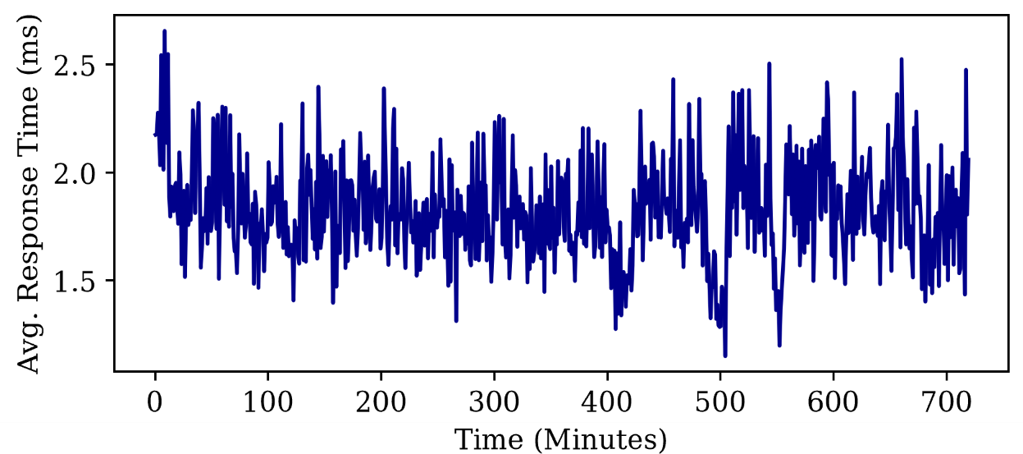
Functional Implications?

Slide 9
More in depth findings to be published with NOMS 2023 proceedings!
Thank you for listening!

