Slide 1
IPv4 Ecosystem Overview
February 2023

Slide 2
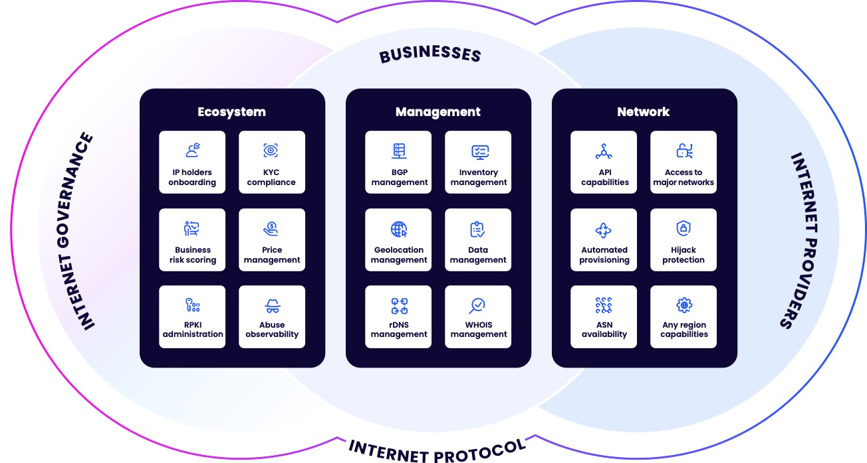
Philosophy
Develop a unified platform
connecting governance and
Internet providers.

Slide 3
How sustainable is IPv4?

Slide 4
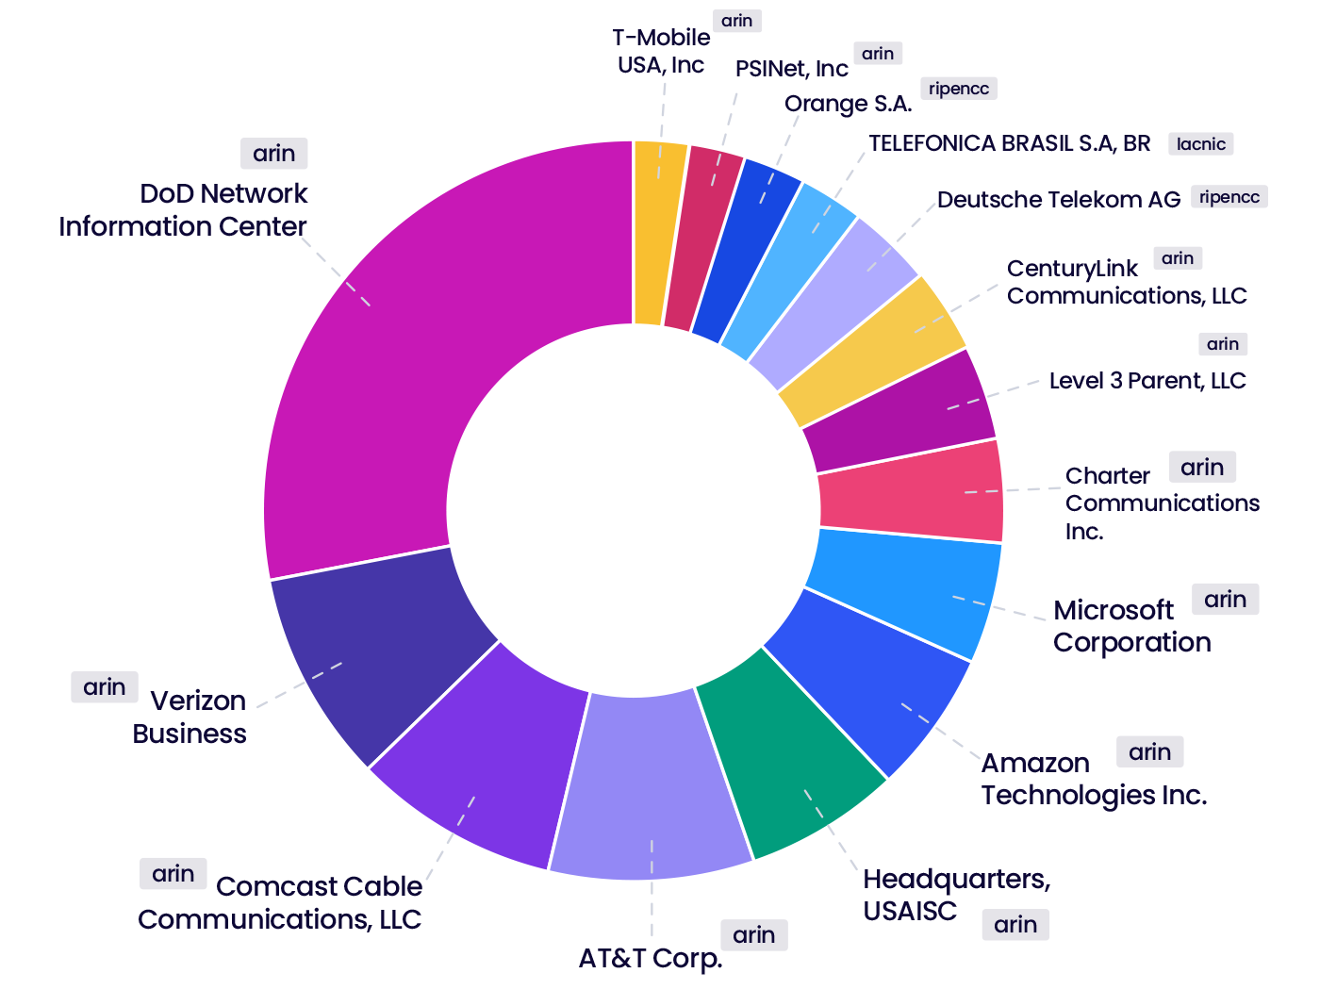
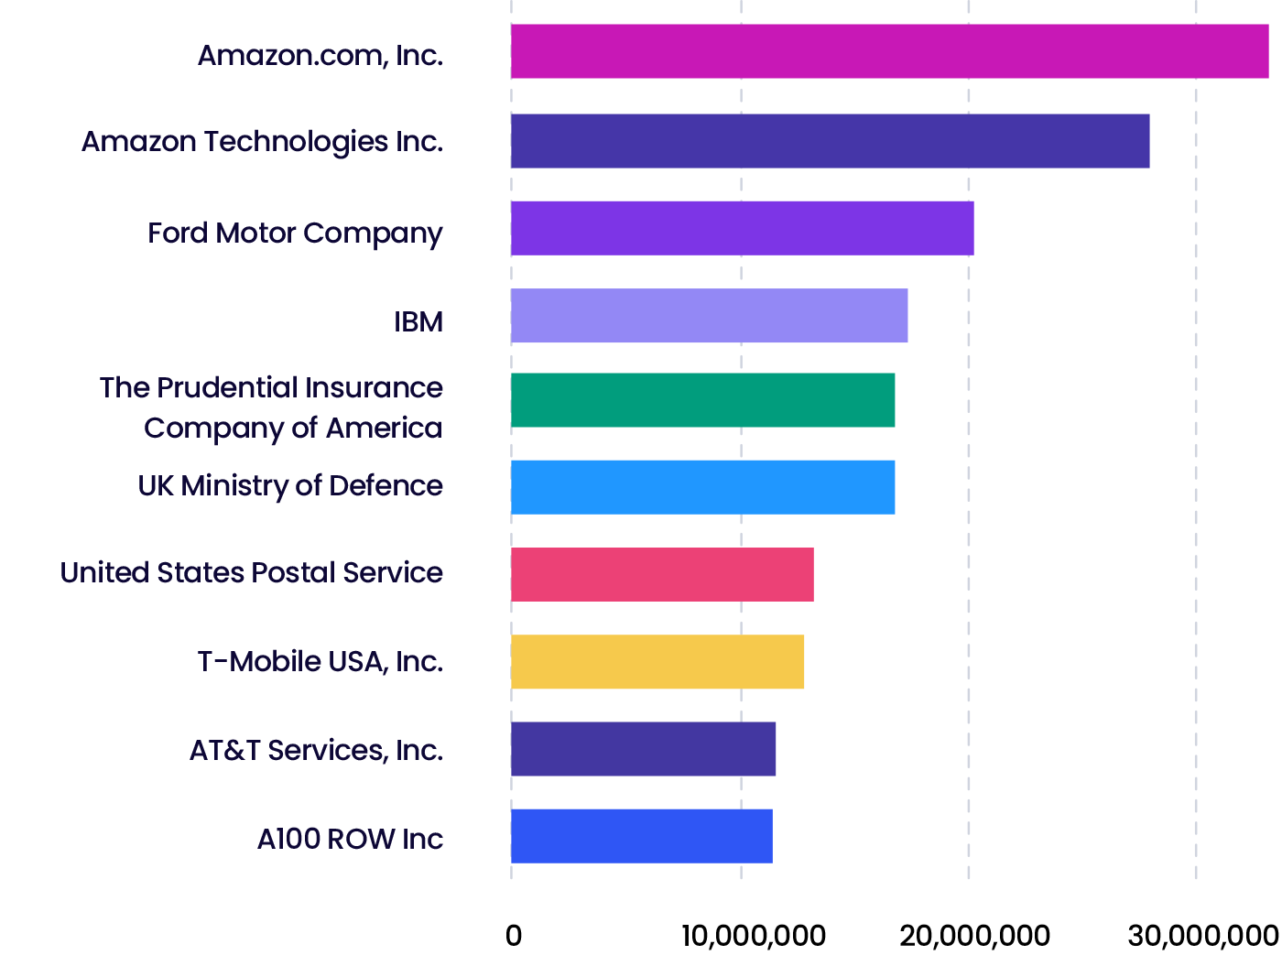
BGP Table
Largest holders of the unadvertised space
BGP biggest advertisers

Slide 5
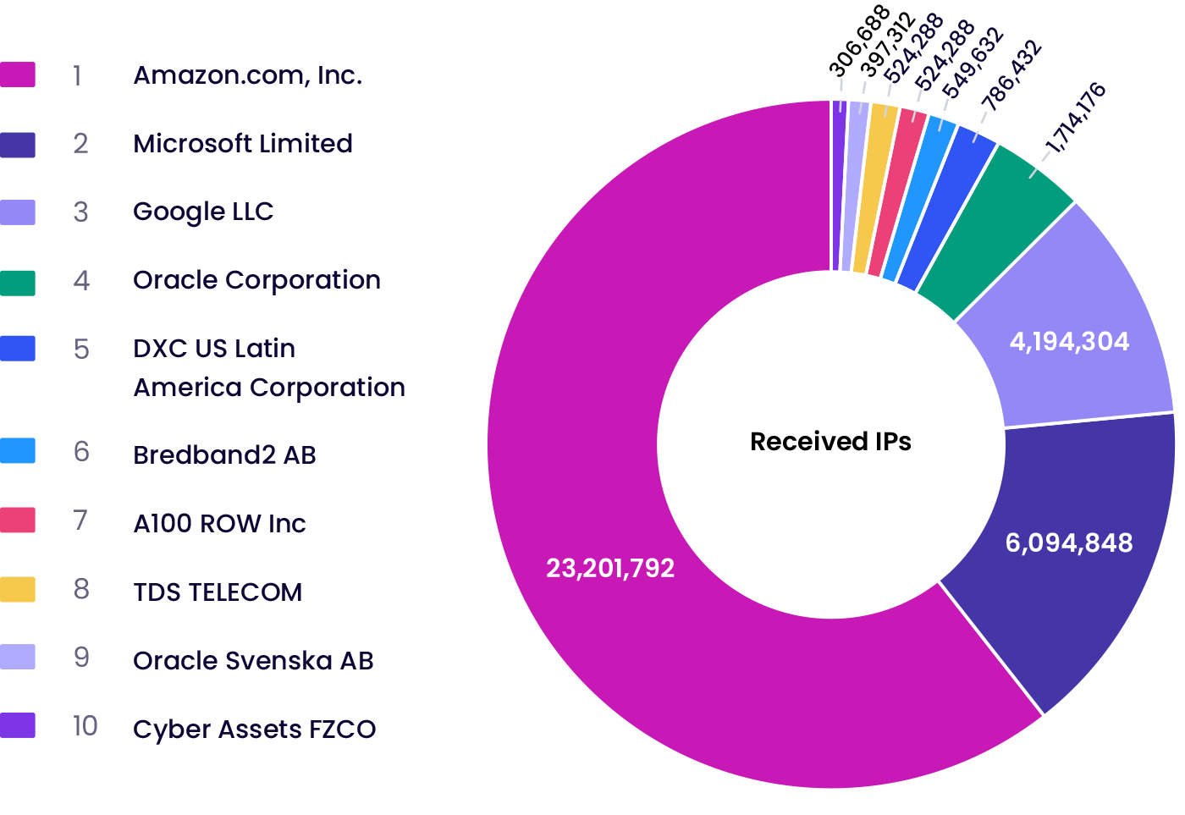
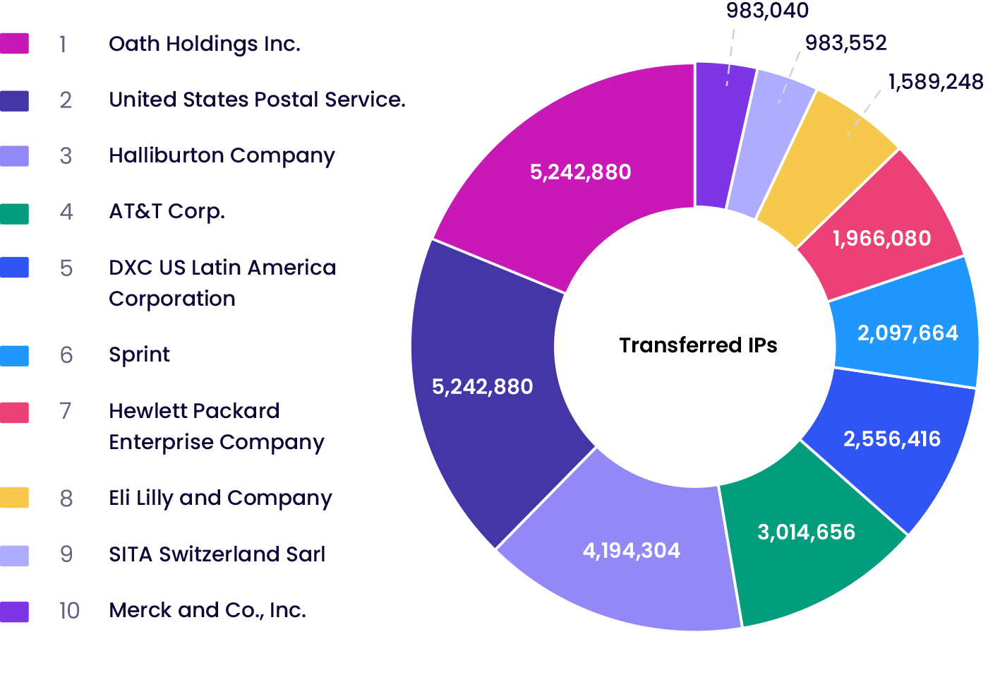
The Largest IPv4 Buyers vs. Sellers
Top 10 buyers
Top 10 sellers

Slide 6
28,57%
Not announced
(1,227,072,156 IPv4)
Total IPv4 pool
4,294,967,296
71,43%
Total IPv4 address space announced
(3,067,895,140 IPv4)

Slide 7
What are the alternatives?

Slide 8
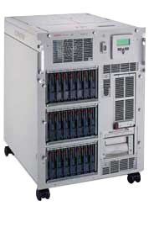



The cloud! Trust and evolution.
1995-2005
2006
2008
2022

Slide 9
Alternatives to IPv4 Acquisition
Risks
Benefits
Abuse observability
rDNS records validation
KYC process
ASN blocklists
Risky industries
IP hi-jacking
Instant provisioning
No CAPEX required
WHOIS accuracy
Addressing legacy space
RPKI adoption
More IPv4 in the market
Extra revenue
IPv4 Leasing

Slide 10
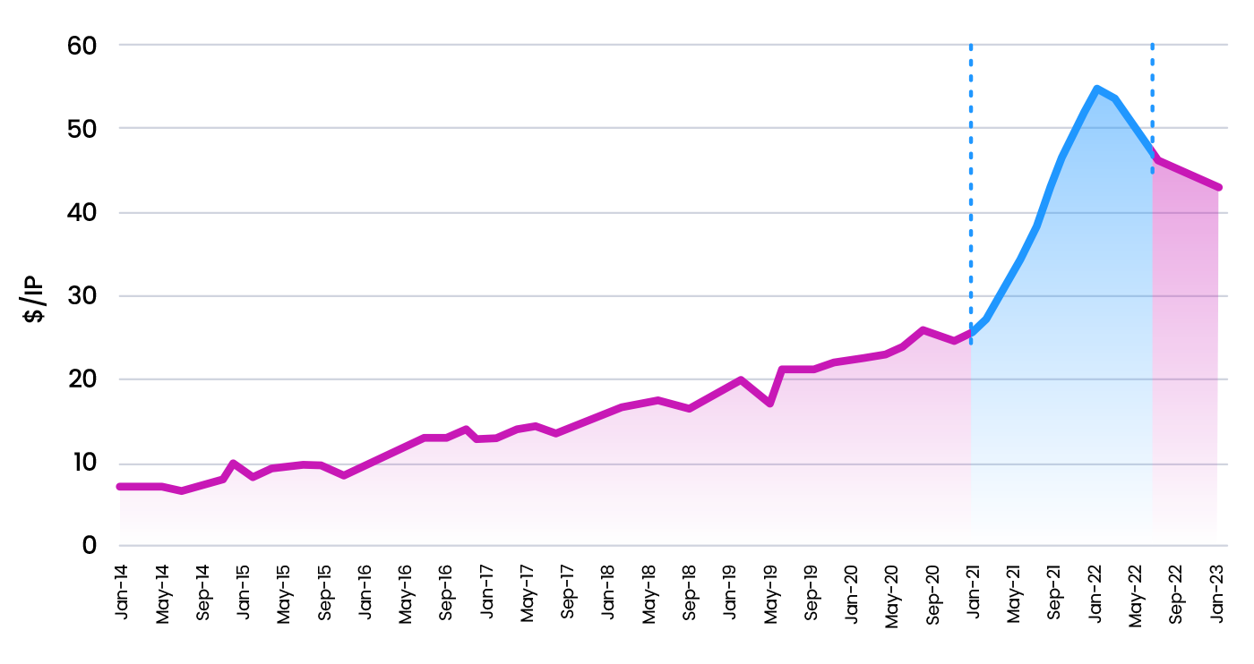
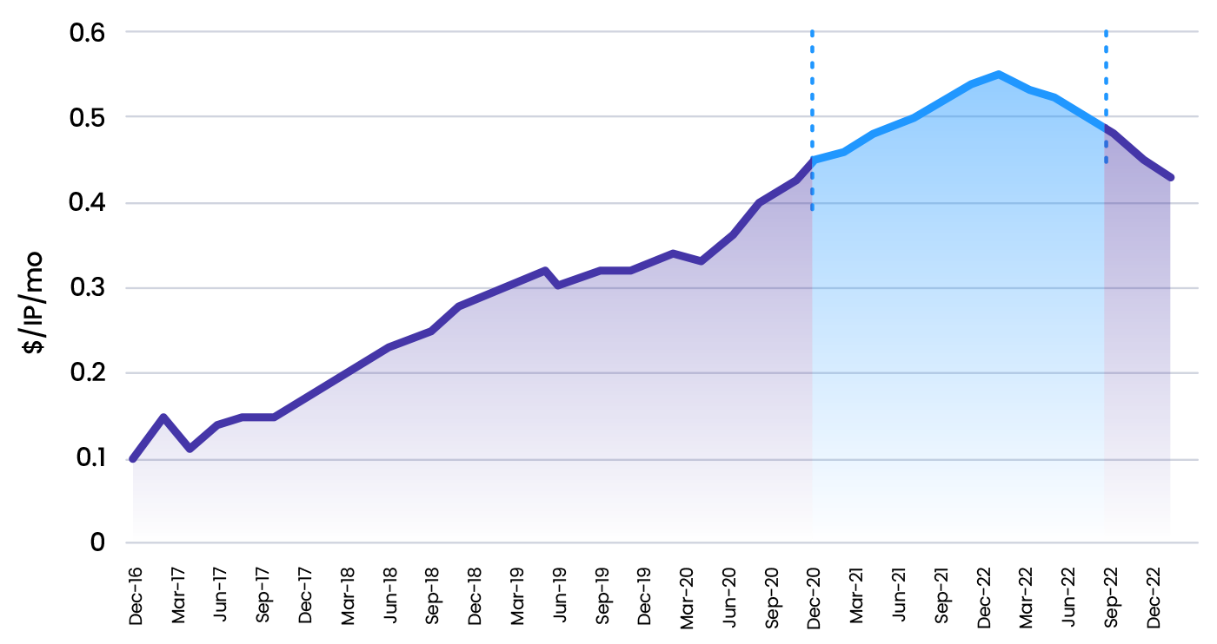
Prices for IPv4 Acquisition vs. Lease
COVID-19
COVID-19
IPv4 Acquisition
IPv4 Leasing

Slide 11
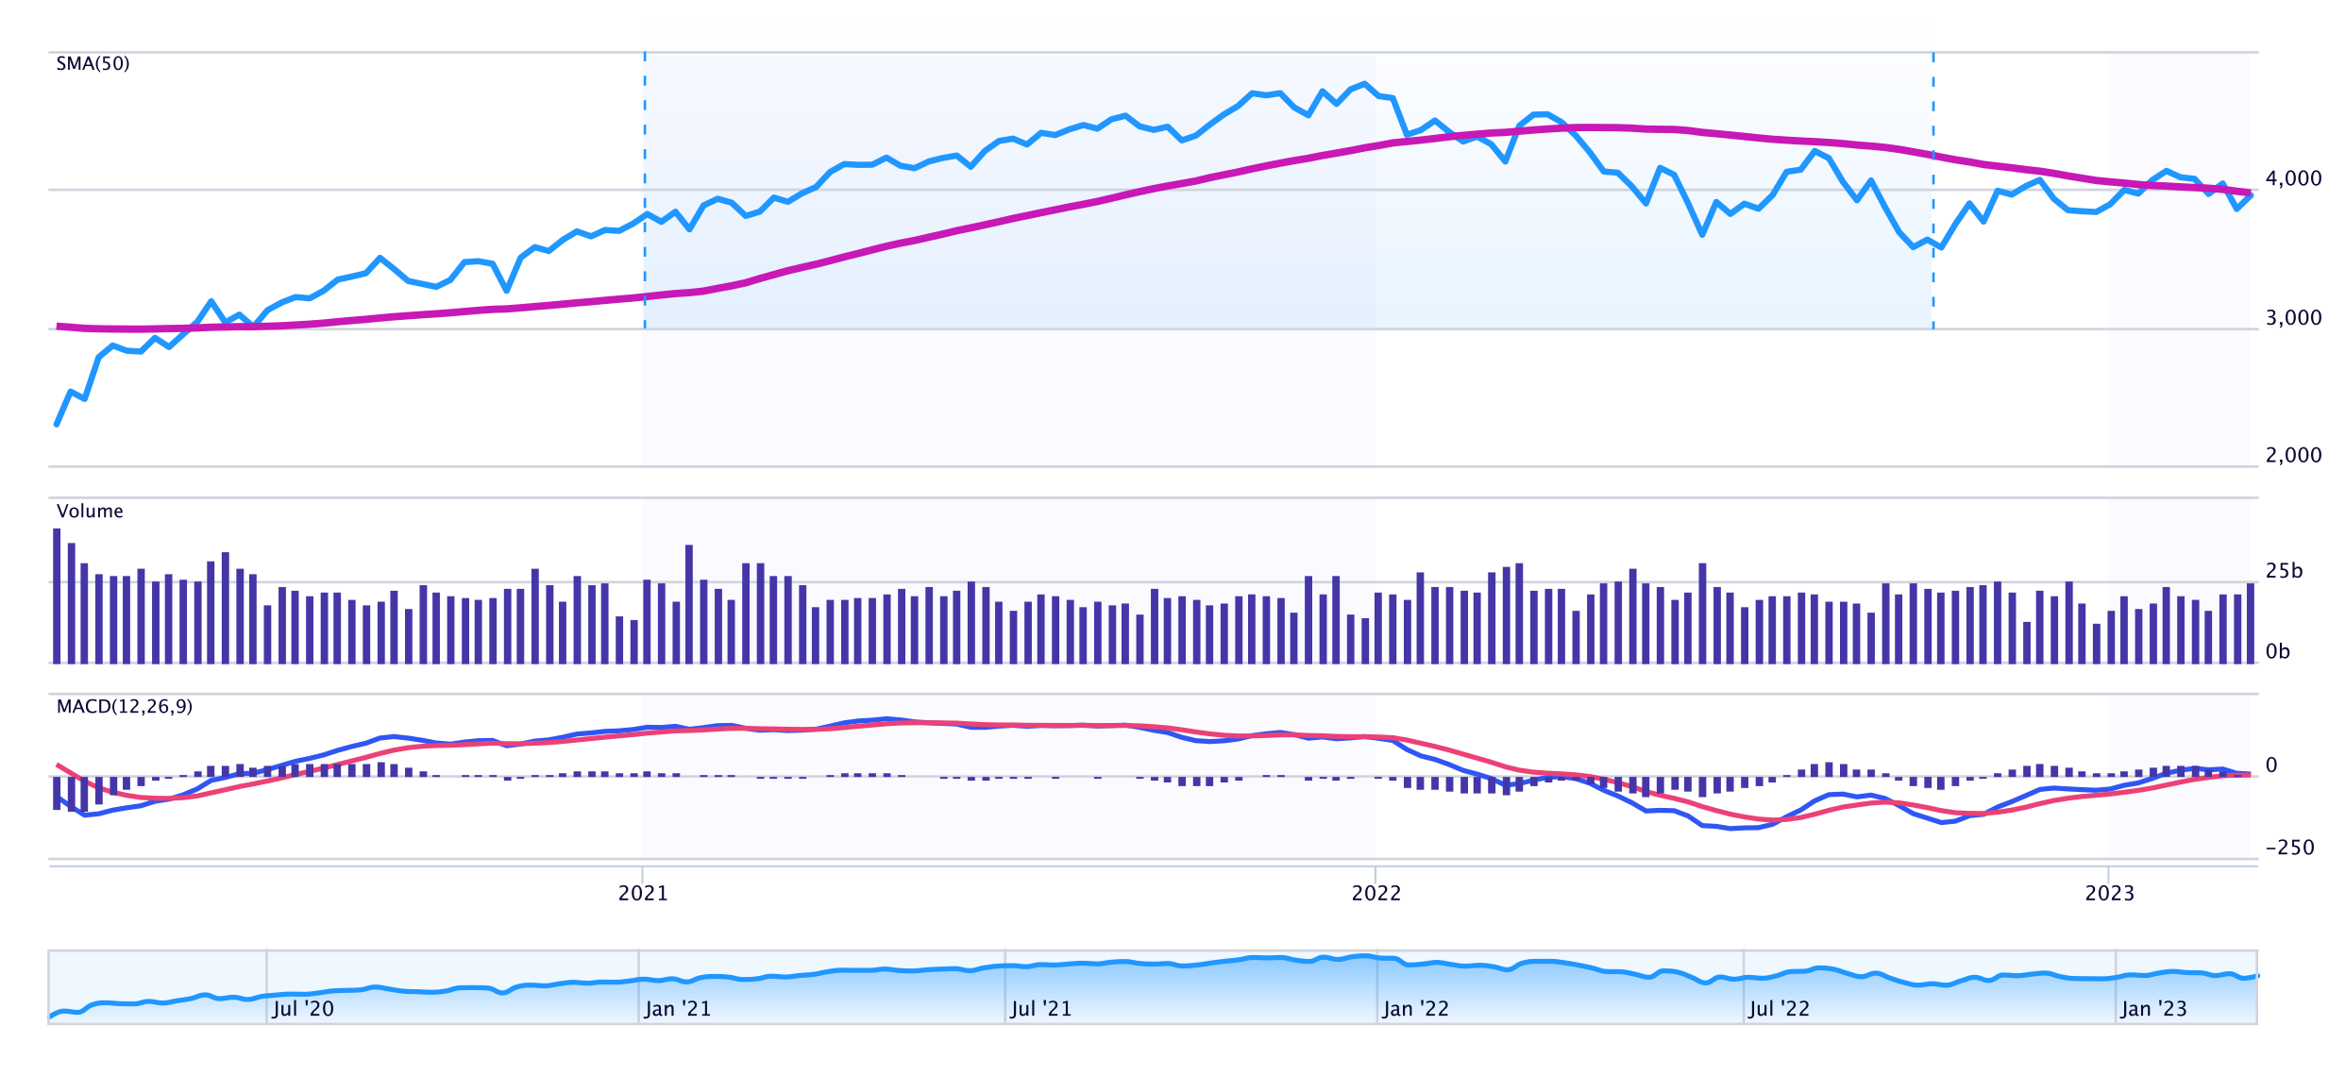
S&P 500 Index
COVID-19
https://www.marketwatch.com/investing/index/spx/charts?mod=mw_quote_advanced

Slide 12
How can the community impact the IPv4 ecosystem?

Slide 13
Management​
Network Operators
RPKI adoption
IPv4 & IPv6
Lack of Management Efficiency
WHOIS accuracy​
IPv6 adoption

Slide 14


RIRs Improvement
Justification
processes
RPKI
development
Sleeping
legacy space
More
technological
approach
FBI worried about IPv6 public traceability, says legislation may be needed.
Law enforcement agencies including the FBI and DEA are reportedly worried about the potential loss of tracking abilities that will come with the shift to IPv6.

Slide 15
IPv4
IPv6
Business risk assessment
LIR requirement
High IP prices
IP shortage
Lack of knowledge
MARKET OBSTACLES
Obstacles
Infrastructure constrains
Geolocation management
WHOIS management
Abuse handling capabilities
RPKI capabilities
DNS management
rDNS management
Automated provisioning
Data feed
MANAGEMENT OBSTACLES

Slide 16
What about IPv6?
I know a great IPv6 joke, but I don’t think you’re ready for it.

Slide 17



Vincentas Grinius
CEO / Co-Founder
vincentas@ipxo.com
www.ipxo.com

