Slide 1
UKNOF(51)
” Weaponizing Mobile Infrastructure”
Are Politically Motivated Cyberattacks
a Threat to Democracy?
Lead Security Architect/Researcher
Imran Saleem

Slide 2
AGENDA
1
Role of Cyber attacks in armed conflicts
2
The Missed Intel
3
Political shift can drive cyber-attacks
4
The Financial Impact
5
Work Ethics & Disclosure
6
Recommendations
1
1

Slide 3
Role of Cyber attacks in armed conflicts
Notes:
Todays talk is not only going to bring the intelligence captured from RU-Ukraine conflict, but also highlights events, where we may be probably missed out or we haven’t covered and spoken about it in public on the activities captured during US exit from AF.

Slide 4
Why Cyber Warfare plays a key role in Armed Conflicts?
Espionage : Monitoring other countries to steal state secrets.
Sabotage : Hostile governments or terrorists may steal information or destroy it.
D/DoS : Prevent users from accessing legitimate service.
Electrical Grid or ICS: Attacking the power grid allows attackers to disable critical systems.
Propaganda : Attempts to control the minds and thoughts of people living in or fighting for a target country
Economic Disruptions : Attacking financial institutions or manipulating the stocks.
Notes:
There is no clear set date of when cyber warfare began but Introduction of cyber dimension has fundamentally shifted the nature of the wartime in battlefield. so, you don’t have to have two tanks shooting at each other to call it war.
So, Cyber warfare allows new actors to participate despite their relative importance, it provides anonymity and therefore plausible deniability of wrongdoing
Additionally, cyber warfare allows states an alternative course of action, which is more convenient and cost-effective. Cyber warfare ultimately breaks down the traditional foundation of conflict.
It merely depends on the objective of cyberattack, but it can range from discuss the top attack types listed.

Slide 5
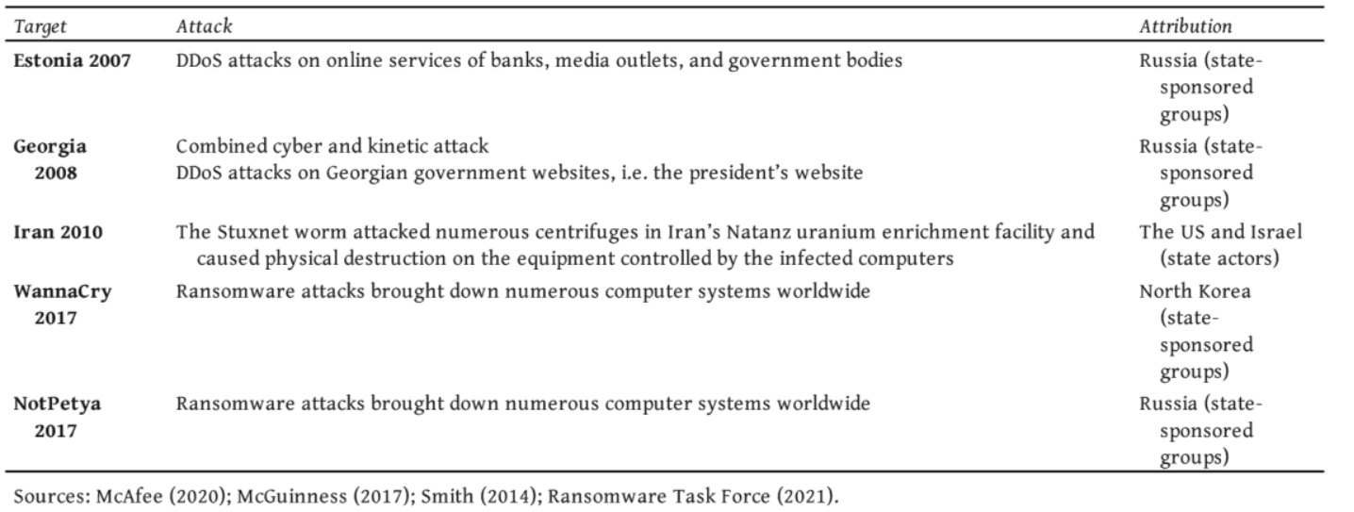
Historical Outlook to politically motivated Cyberattacks?
Nation state a phenomenon existed in past.
Notes:
There is no clear set date of when cyber warfare began but a key milestone was in Kosovo in 1999 . So, if we are to look at the historical outlook of politically driven cyber attacks, we will notice high number of the sophisticated attacks were conducted by Russian APT’s. So, the phenomenon of nation state attacks existed in the past.

Slide 6
“The MISSED Intel”
“U.S” withdrawal from “AF”
Notes:
Attacks executed were state sponsored.
Did we missed out an intelligence.?
Have we spoken about this intelligence in the public.

Slide 7
Timeline of U.S. Withdrawal from Afghanistan –Reflection
A geopolitical event leads to patterns captured on the global threat landscape which can provides useful insights on these developing situations.
Trump Strikes a Deal
Feb. 29, 2020 — U.S. and Taliban sign an agreement that sets the terms for a U.S. withdrawal from Afghanistan by May 1, 2021,
https://thediplomat.com/2021/04/the-us-exit-the-view-from-afghanistan/
Biden Follows Through
April 14 ,2021— Saying it is “time to end the forever war,” Biden announces that all troops will be removed from Afghanistan by Sept. 11.
https://www.factcheck.org/2021/08/timeline-of-u-s-withdrawal-from-afghanistan/
Notes:
So going back to the timelines of US withdrawal from AF, Do these political events have any reflection on the global signalling. We captured interesting facts around it.
Back in Feb 2020, trumps administration signed an agreement with Taliban for US withdrawal from AF by MAY 2021.
This was endorsed by Biden administration who took the charge in Jan 2021, the timelines were then moved from May to September 2021.

Slide 8
U.S. Withdrawal from Afghanistan - A Glimpse of Intelligence
Key Artifacts:
Afghanistan was never prime target based on historical investigations.
Malicious activities started to appear in Feb 2021 due to the political events and administrative changes closely aligns to April 2021
The threat actor behind these operation are nefariously known and potentially have links to Nation state.
Supported by a few other unresolved sources with the same origin.
These sources were clustered.
SS7 Attacks
No historical activity
Aug 2021
Sept 2020
Feb 2021

Slide 9
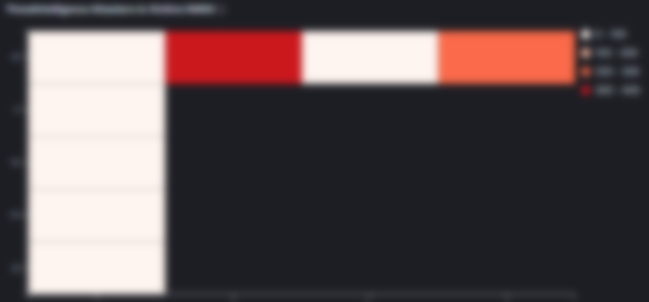
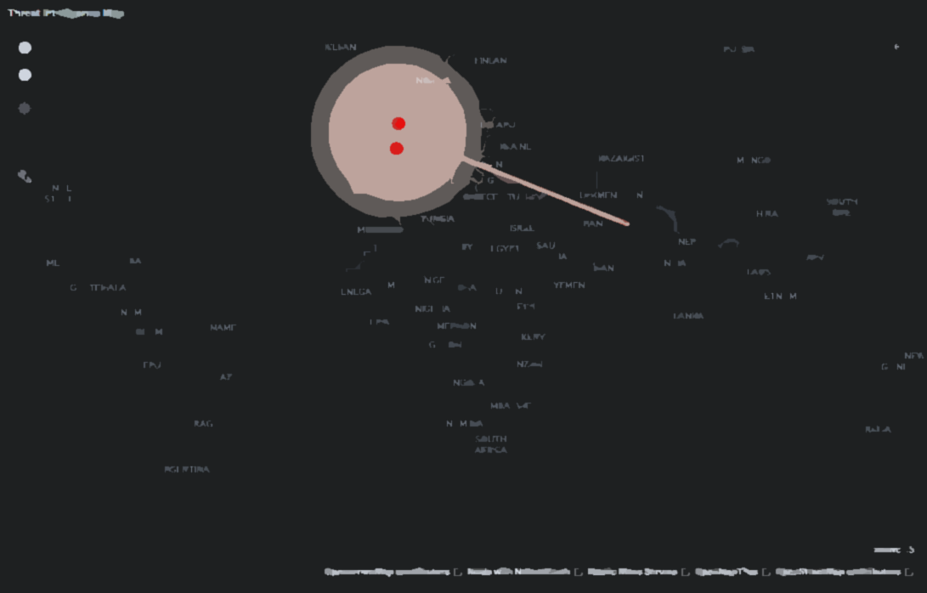
U.S. Withdrawal from Afghanistan – Motive & Targets
Targets
Prime targets : AF
Secondary targets : Roamers in AF (Few from NATO Countries)
Potential victim Organization could be:
News and Media
NGO’s
Government Institutions
SS7 Attacks
Motive
IMSI Gathering and Network discovery
Users Surveillance and tracking
Potential communication interception at radio level.
Threat Indicators
Bypass security controls (If any)
Notes:
Potential communication interception at radio level , gives an indication that the activity was supported by physical presence, which was a success. This provides evidences on the coordination and consistencies for these nation state actors.

Slide 10
Political shift in a Region can drive cyber-attacks!

Slide 11
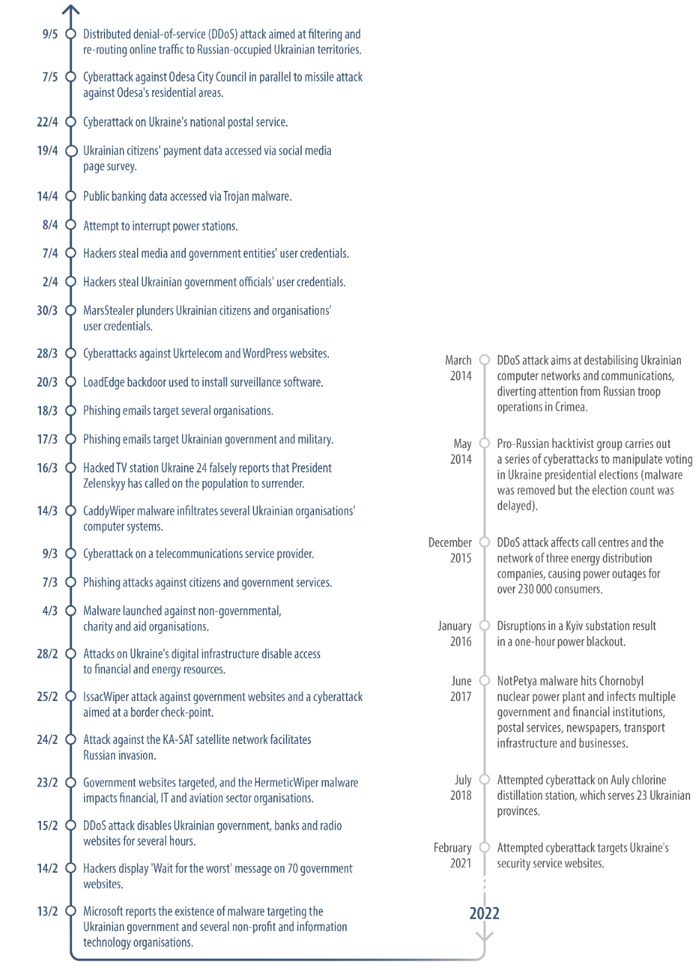
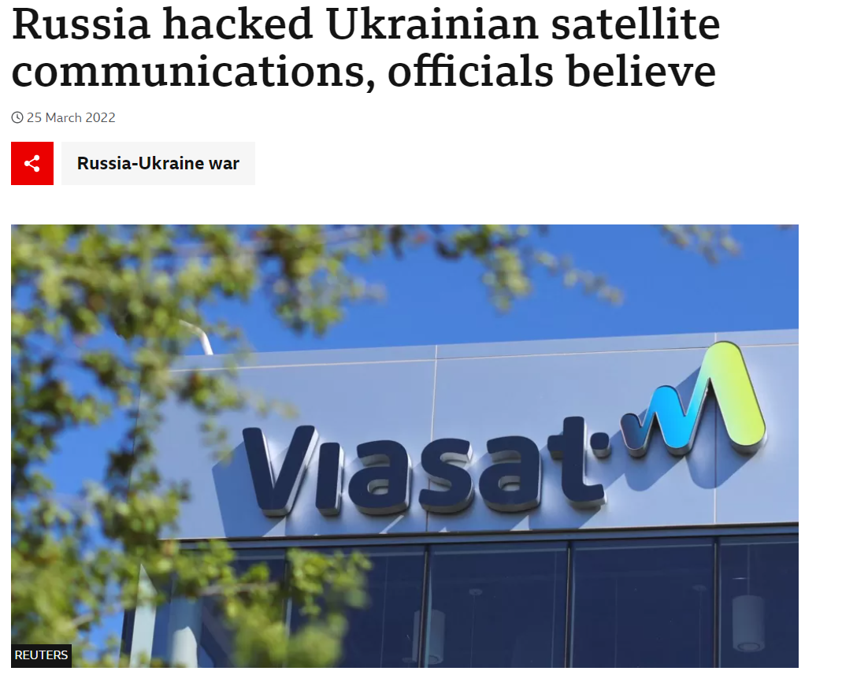
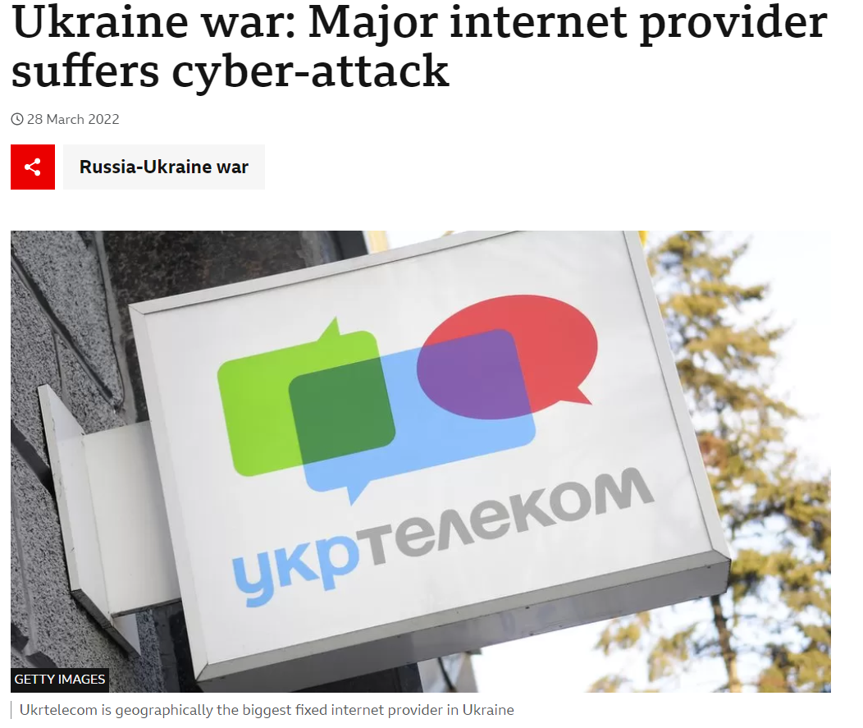
Is “UA” – “RU” conflict any different than “AF”.
Russia's war on Ukraine: Timeline of cyber-attacks (europa.eu)
Russia-linked cyberattacks on Ukraine
A timeline
Russia hacked Ukrainian satellite communications, officials believe - BBC News
Ukraine war: Major internet provider suffers cyber-attack - BBC News
Organized and coordinated.
Consistent and motivated.
Intel sharing is the key.
Does Telecom industry have a concrete intel sharing framework?
Notes:
AF conflict is no different from UA-RU, as a matter of fact, AF conflict has merely gone the same level of attention in media and public. This doesn’t means there were no attacks on the infrastructure and subscribers, the evidence of which has been provided.
For the UA-RU, the scale of cyberattacks were massive as seen and captured from the Europol fact timelines. At several instance, the telecom industry was targeted. From hacking Satellite, to BGP prefix re-routing to D/DOS on ISP.

Slide 12
Understanding Russian signalling Activities
In 2022, Russia sources intensified the activities by up to 150 times comparing to 2020/21 historical records.
SS7 Attacks
Low activity in 2020/21
High activity in 2022
These activities were supported by malicious threat indicators known to potentially bypass security controls.
Known techniques listed in the FS.11 few others not available in the guidelines.
Key fact “fuzzing executed targeting various networks.”

Slide 13
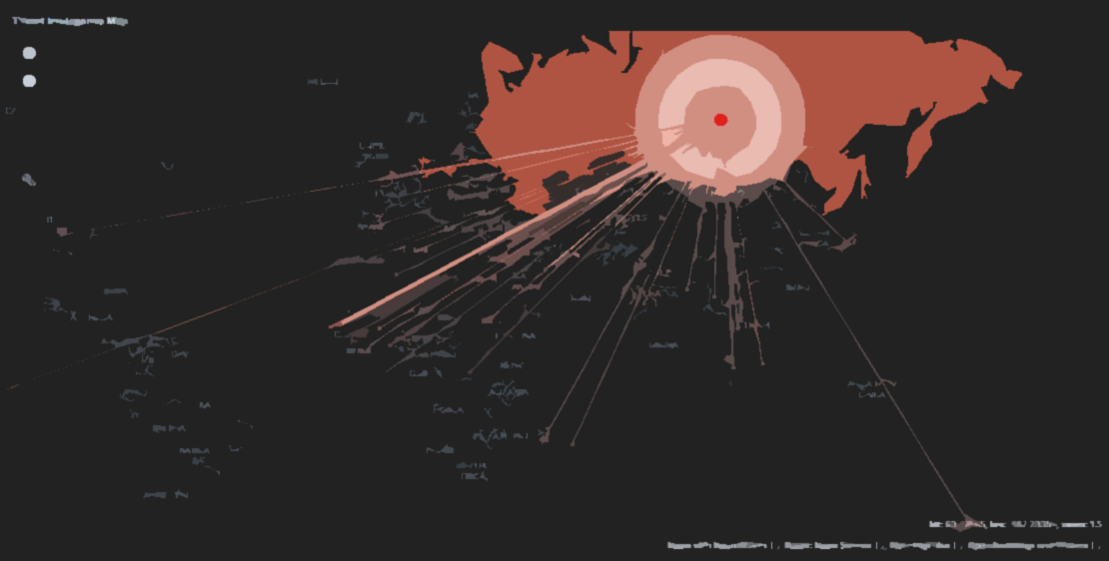
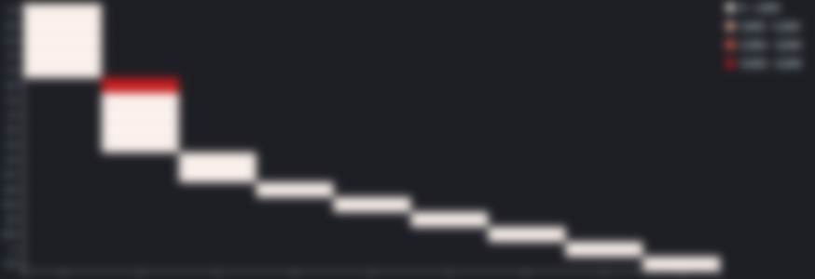
Understanding the “RU” backed State actors
SS7 Attacks
Key behavioural characteristics and threat landscape
Is Ukraine and NATO countries on the only target = NO
Attack Intensity = High
Coverage = Extreme
Current state = Active
Targeting inbound roamers in NATO countries
Clustered group
Zero-day exploit = Observed (CVD Submission)
Account takeover
Identity spoofing
Fuzzing
Roughly 60+ countries were targeted.

Slide 14
Are these “APT’s”, Government-backed attackers?
Russian attackers aggressively pursue wartime advantage in cyberspace using global signalling.
Threat Intelligence team has uncovered set of attacks targeted towards Ukrainian and NATO countries with following objectives.
Attacks Involved | Unresolved Russian Origins | Targeted Nations
Network Discovery | Mapping the network topologies through scanning | Ukraine NATO Countries Middle east Africa
Information gathering | IMSI extractions and profile extractions.
Location tracking | Performing surveillance on targeted victims.
Hostile registrations | Hostile location updates made to potentially intercept the comms.
Account takeover | Social media accounts taken over.
Fraud | Financial fraud observed several other cases.

Slide 15
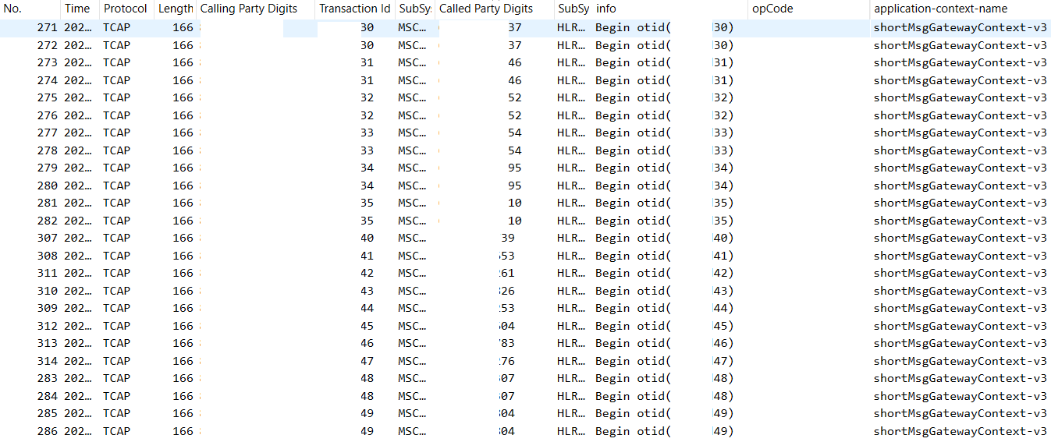
Russian Influence in global signalization – Recon and Targeted Scanning
Massive scale scan to discover and map networks.
Multiple networks and countries were scanned. Sequential network identifiers.
Sequential and
incremental session ID

Slide 16
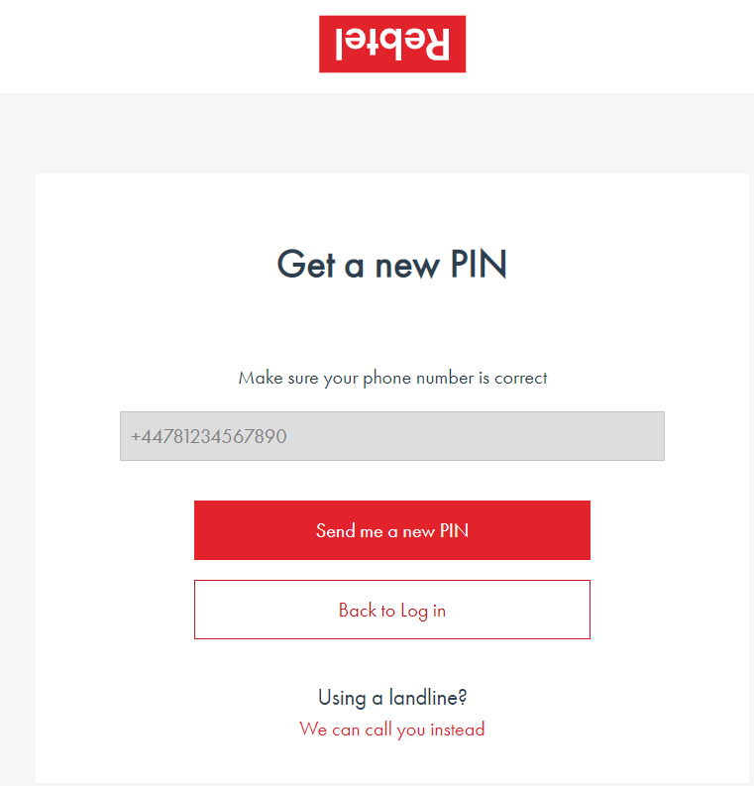
Russian Influence in global signalization – Identity Impersonation
Identity impersonation for social application through account takeover.
Hostile Registration
Home network shares
user profile to malicious source
2FA token access
Social Application account takeover
Input Required : Phone number
Not linked to email.

Slide 17
Russian Influence in global signalization – Identity Spoofing
How we back our statement that these are nation backed activities.
SCCP layer Spoofed Identity
Spoofed E.164 numbering plan doesn’t
belong to any of Operators that owns
these low layer identities
Low layer Spoofed Identity
Link Level analysis revealed traffic initiated via Russian operator
Low layer Spoofed Identity
Notes:
Engagement with Tier 1 operator helped us track clusters through fingerprinting of these odd sources. That led to sources which again where engaged in fuzzing activities.
This security event is self explanatory, where the SCCP identities were spoofed, MTP3 layer identities were spoofed, that pointed to traffic coming via physical links from Russian operator.

Slide 18
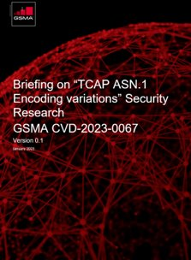
Russian Influence in global signalization – Zero-day exploits
Coordinated Vulnerability Disclosure
CVD submitted and under final review.
Plans to releases the briefing paper by Q1 2023.
Actions towards Mobile Operators
Mobile Operators are requested to reproduce this vulnerability in their labs once the briefing paper is published.
Notes:
Based on the investigation on various fuzzing attempts, our research team has made a vulnerability disclosure on the threat indicators that were used in various campaign originating from Russian origins.

Slide 19
“The FINANCIAL IMPACT”

Slide 20
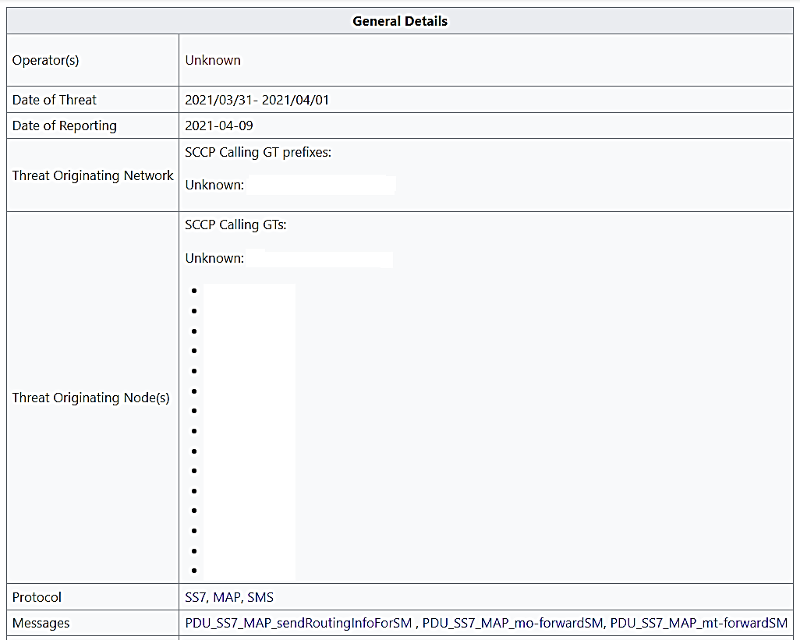
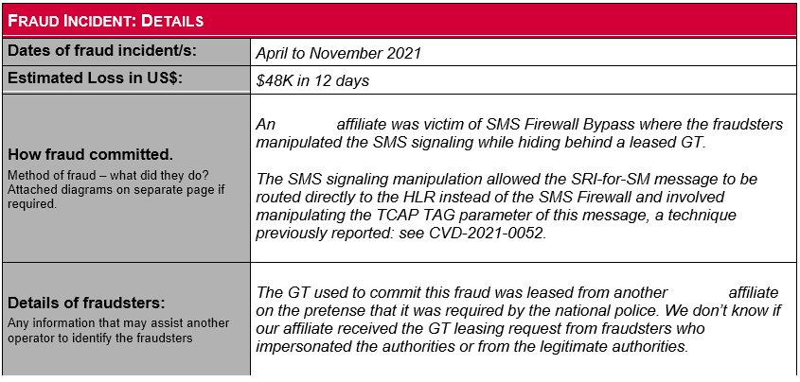
Financial loss towards operators for zero-day exploit!
The Mobileum Threat Intelligence team discovered a new vulnerability back in early April 2021
A global operator group reported a fraud incident between April and Nov 2021 that exploited that vulnerability
Overall financial impact of this zero-day is not fully known.
This can be due to factors like lack of visibility.
Lack of interest in reporting such incident towards GSMA.

Slide 21
Responsible Vulnerability DISCLOSURE
Coordinated Vulnerability Disclosure
Actions towards Mobile Operators
Mobile Operators were requested to reproduce this vulnerability in their labs to assess if controls in places are sufficient.
Operators should consider adapting to the global threat intelligence services.
https://www.gsma.com/security/gsma-mobile-security-research-acknowledgements/
Notes:
Actions towards Mobile Operator’s
Mobile Operators should reproduce this potential vulnerability in their environment and ensure the message with manipulated TCAP Tag Class is discarded by the SS7 firewall, STP or target network elements.
The edge firewall shall look at the full TCAP encoding within the TCAP layer, review against expected values and act accordingly: block the message or another relevant action
Mobile Operators should consider adapting to the threat intelligence services as part of having early warnings for potential malicious sources before inflicting greater impact toward Operator and its subscribers.
Coordinated Vulnerability Disclosure
A responsible vulnerability disclosure for this 0-day exploit was submitted to the GSMA CVD program who assigned a CVD number CVD-2021-0052 and after impact assessment, nature and severity placed the discovery under the “hall of fame” accessible at acknowledgment page.

Slide 22
“Work ETHICS & DISCLOSURE”

Slide 23
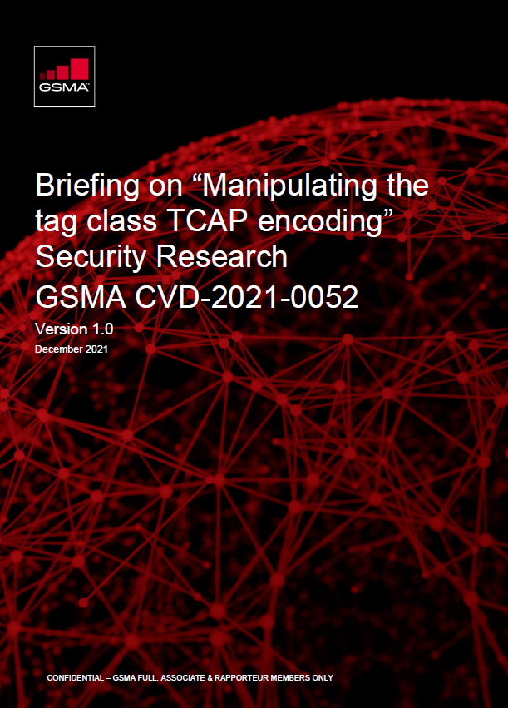
Work Ethics and Disclosure
Coordinated Vulnerability Disclosures
Share key intelligence gathered through security research back to the Industry.
Share details on zero day exploits that can avoid security breaches and financial losses.
Objective driven to secure services offered by operators.

Slide 24
Industry should learn from enterprise and build a telecom focus intel sharing framework. Like (STIX, TAXI)
Build and create culture of resilience in an organization.
Processes are key to the implementation of an effective cyber-safety strategy to handle cyber conflicts.
Security guidelines are not a measure of absolute security.
Operators to enable themselves with a mindset of Global Threat Intelligence
What further actions can be taken?

Slide 25
Thank you
Q & A

