Slide 1
Notes:
Mark

Slide 2
What is WDM?
Wave Division Multiplexing

Slide 3
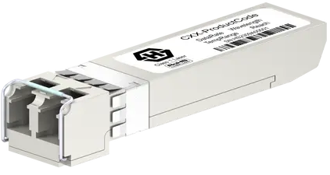
Point to point connections over Fibre
    Plug in a *transceiver into the switch/router - using a separate fibre for each connection
    *often referred to as ‘Grey’ transceivers – typically wideband 1310 or 1550
Location A
Location B
Optical Fibre
Optical Fibre
Optical Fibre
Optical Fibre
Great if you have lots of fibre

Slide 4


What if you don’t have enough fibre capacity?
You could dig & install more fibre ....
You could rent more fibre ....
Or what about combing more connections over one fibre?

Slide 5




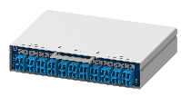

What if we could combine the Colours (lambdas)?
    If we combined (Mux) the matching colours onto a single fibre pair, we could put many connections on that fibre.
    We call that Multiplexing (combining) and DeMultiplexing (separating)
    Matching Colours (Lambdas) at each end
Location A
Location B
Mux/Demux
Optical Fibre
Mux/Demux

Slide 6
Types of WDM
Coarse Wavelength Division Multiplexing (CWDM) 18 channels – ITU-T G.694.2
Dense Wavelength Division Multiplexing (DWDM) more than 100 channels - ITU-T G.709
DWDM channels are located towards the end of the CWDM spectrum. Therefore you can combine CWDM and DWDM on the same link.
CWDM
18 Channels
Wavelength
1271
1291
1311
1331
1351
1371
1391
1411
1431
1451
1471
1491
1511
1531
1551
1571
1591
1611
DWDM
100+ Channels
C Band - 1528.77 nm to 1563.86 nm

Slide 7
What about PON?
You can run WDM in conjunction with PON, Incl OTDR port
ITU-T G.984.5 (05/2018) Recommendation

Slide 8
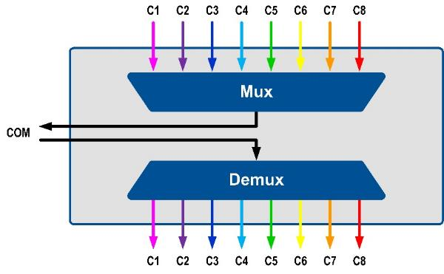
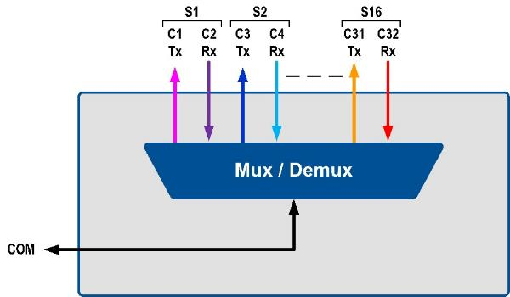
WDM Types Mux/DeMux
Dual fibre optical multiplexer/demultiplexer
Uses two separate fibre connections for transmission (TX) and reception (RX).
The number of wavelengths therefore is identical to the number of TX/RX channels.
Single fibre optical multiplexer/demultiplexer
Requires a single fibre for both transmission (TX) and reception (RX).
The number of required wavelengths therefore is double the number of TX/RX channels.

Slide 9
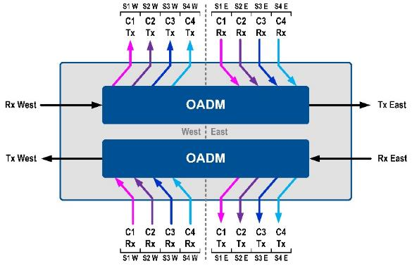
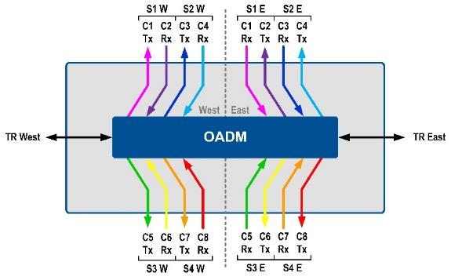
WDM Types OADM
Dual fibre optical add/drop multiplexer
East and West connection each uses a separate fibre for transmission (TX) and reception (RX).
The number of add/drop channels is identical to the number of wavelengths.
Single fibre optical add/drop multiplexer
East and West connections each only require a single fibre for TX and RX.
The number of add/drop channels therefore is double the number of wavelengths.

Slide 10

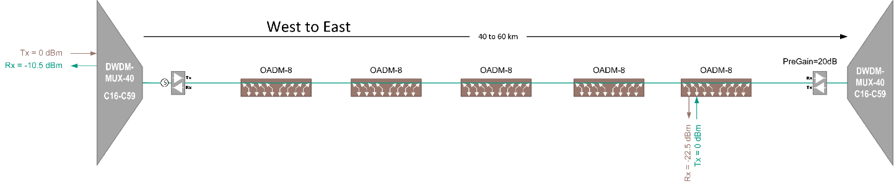
Project Example
Customer requirements
Metro access DWDM link
Reach 40 – 60 km
Up to 5 intermediate drop nodes with 8 redundant services
Monitoring channels at each node
Neutral Host
USA

Slide 11
Passive vs Active WDM
Active Transport System
    Conversion from client (“grey transceivers”) to line (“coloured transceivers”) signals by transponder cards
    Requires additional hardware, eg a chassis with redundant power and management card
    Often cards fixed to service type & speed
    Ideal if you need remote demarcation device
Passive Transport System
Agnostic to service type, eg 1G, 10G, 25G, 100G, 400G….
No conversion, coloured transceivers are plugged straight into terminal equipment
Fewer active elements => higher reliability, lower latency
Transceivers are managed by terminal equipment (Switch/Router etc.)
Passive WDM >80% power savings vs Active system

Slide 12
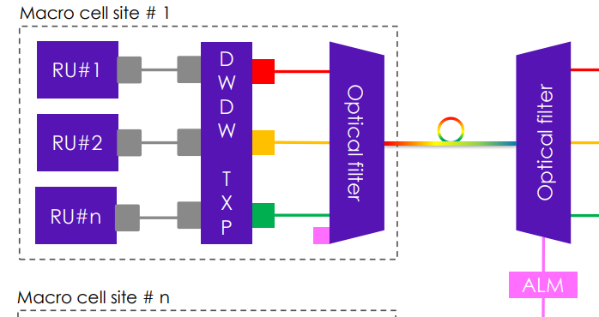
Source: xHaul Technology & Economics (macro-cell centric)
A Sutton

Slide 13


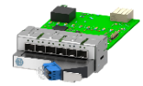
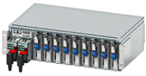



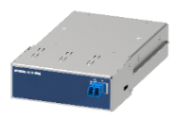
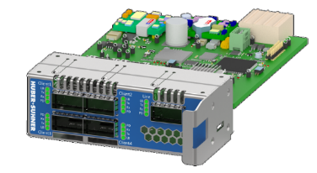

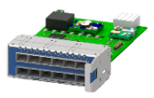
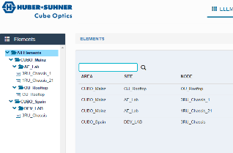
What about…..
Transponder
Muxponder
Amplification
Dispersion Compensation
Optical Protection
Power supplies
Management
Optical Protection
Transponding Mux
Enclosures
Dispersion Comp.
Muxponder
SDN/NetConf
CLI
Amplification
WebGUI
Transponder
EMS
Management
These are important if building an Optical Transport System, but not strictly WDM

Slide 14
Parts that are often included in WDM Systems
Transponder
      Transponds one wavelength (lambda) to another wavelength (lambda)
Muxponder
      Multiplexes more than 1 wavelength onto 1 wavelength, (eg 4 x 100G onto 1 x 400G)
Dispersion Compensation
      Cancelling/limiting the chromatic dispersion
Amplification
      Amplifies signal. Most Amp’s work around 1550, You can amplify at 1310
Optical Protection
      Automatic switch over to another fibre. Quicker than L2/3 re-route
You can choose:
Vendor lock-in
or
Open Line System

Slide 15
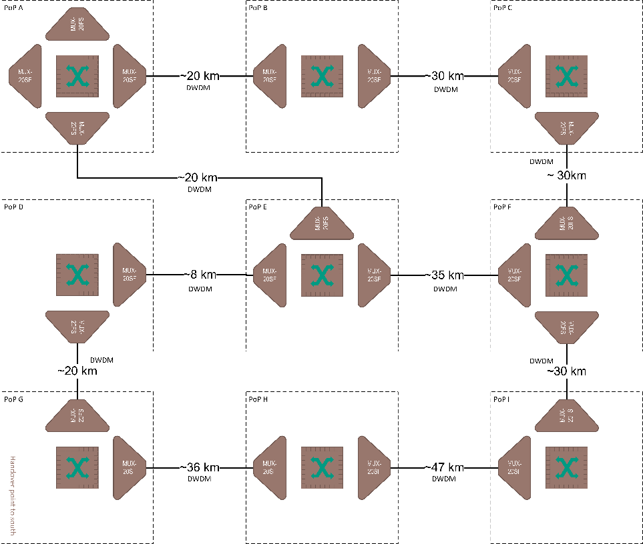

Project Example – ISP backhaul (PON network)
WDM Units
  Passive DWDM ‘Single Fibre’
Active Units
  EDFA modules
  Dispersion Compensation
  modules
ISP
United Kingdom

Slide 16
So how do you get higher speeds …100G, 400G etc?

Slide 17
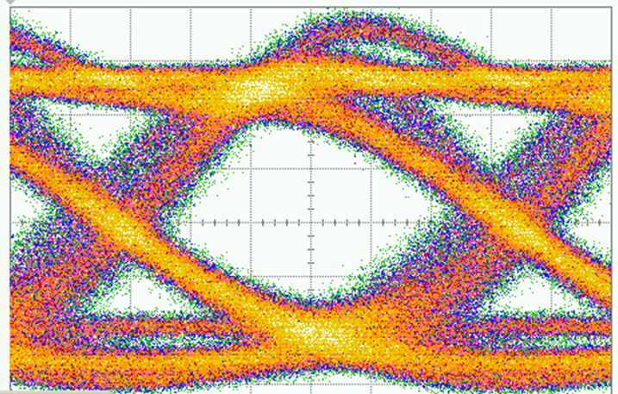
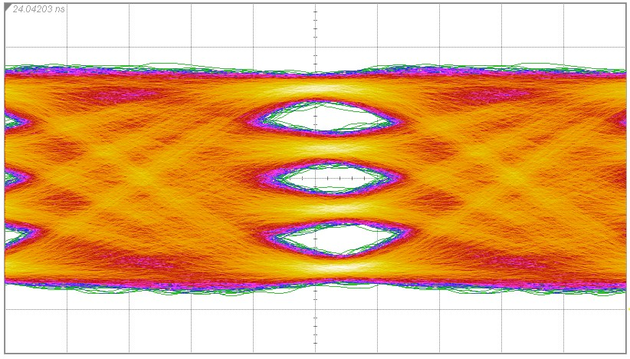
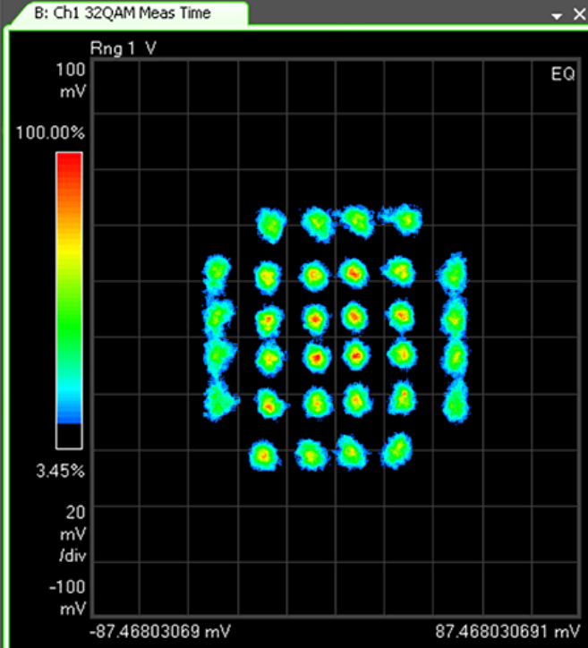
Modulation formats
Direct Detect: NRZ
Direct Detect: PAM4
Coherent: QAM
Uses two states 1 and 0 in amplitude.
Higher attenuation allowed compared to PAM4.
Base modulation for direct detect for up to 25G per lane.
Uses four states 00,01,10 and 11 in amplitude.
Allows double the data rate compared to NRZ with same baud rate.
Standard modulation for direct detect > 25G per lane.
Uses multiple states in amplitude and phase.
Allows higher data rate for similar baud rate than NRZ and PAM4
Coherent requires more complex modulation and demodulation than direct detect.

Slide 18
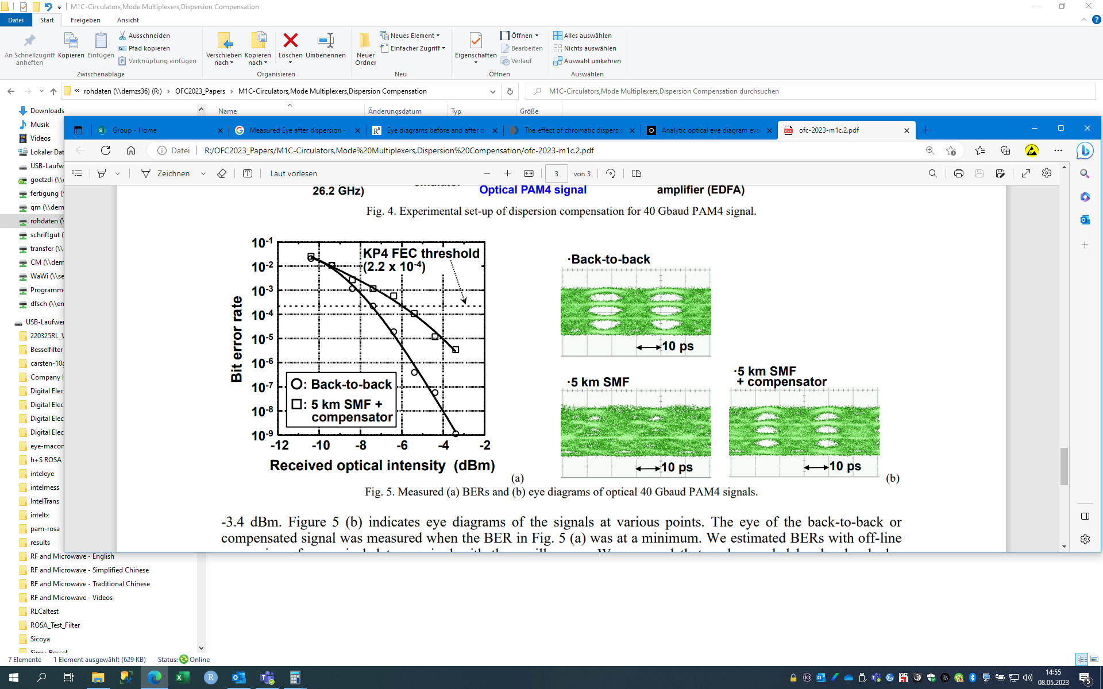
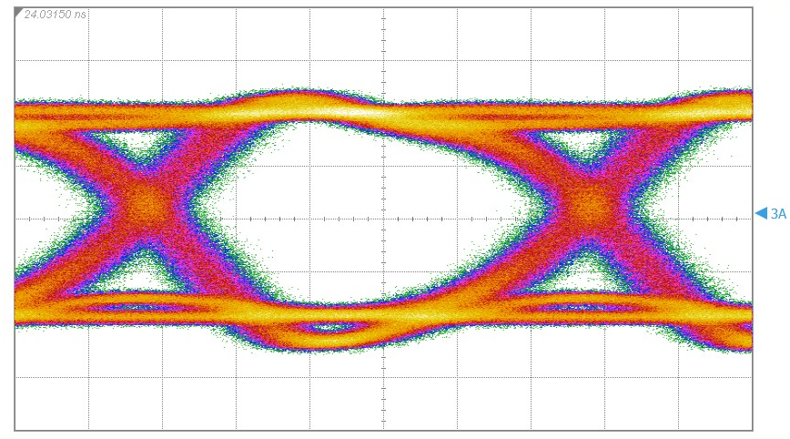
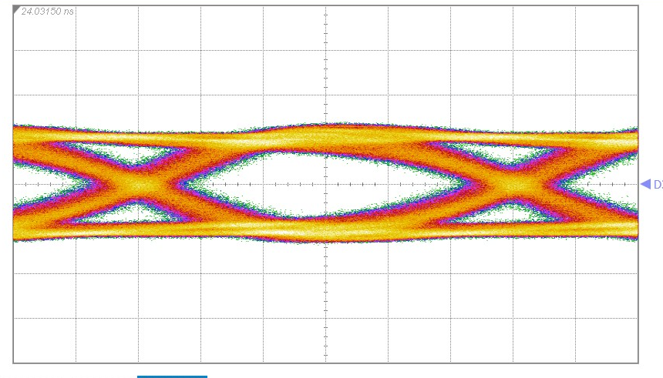
Dispersion & Attenuation
Dispersion on PAM4 signal
Attenuation 25G NRZ signal
-5dBm @ receiver
Dispersion causes Jitter on signal limiting reach.
PAM 4 signal is more sensitive to dispersion and attenuation than NRZ.
no dispersion
86 ps/nm dispersion
-10dBm @ receiver

Slide 19
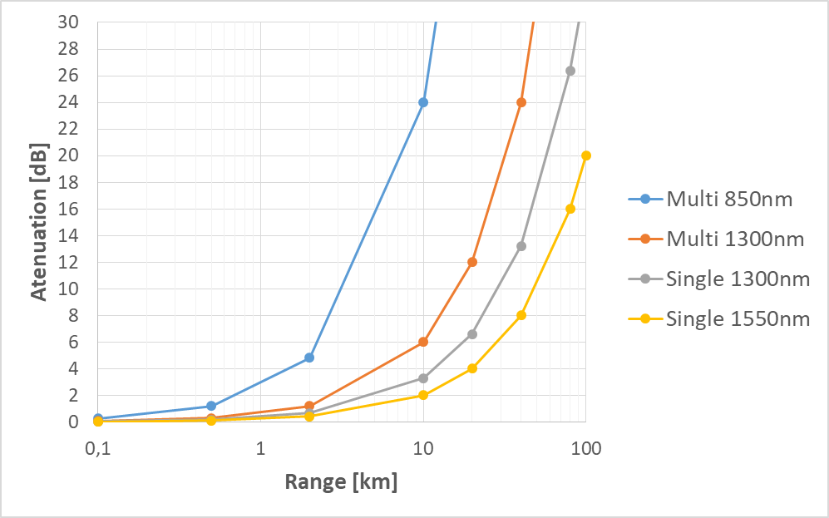
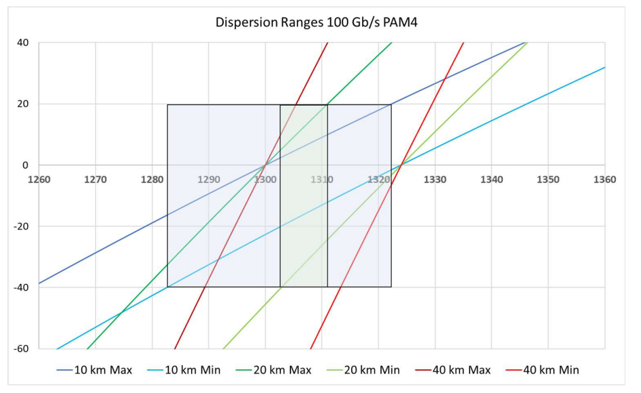
Dispersion & Attenuation for fibers
Attenuation for different fibers
Dispersion depending on reach
Lowest attenuation for single mode 1550nm.
Acceptable dispersion for 100Gb/s PAM 4 is -40 - +20ps/nm.
Dispersion is lowest in 1310nm range
Dispersion is limiting possible wavelength area
for direct detect.

Slide 20
Conclusions
Deploying WDM is much cheaper & quicker than installing new fibre
An active WDM system can make sense in certain circumstances, eg demarcation point
A passive WDM system can make sense in certain circumstances, eg agnostic to data rate, services that run over it
Decide if you want a vendor tie-in (everything from one vendor) or Open Line Systems
Transceivers/Transponders define the speed – not WDM
      All vendors use the same ITU WDM grids

Slide 21
Many thanks steve.jones@hubersuhner.com
+44 7900 881 729

Slide 22
Backup slides

Slide 23
Direct Detect vs. Coherent Receiver
Direct Detect Receiver
P_{In}
Vpd
Out+
Out+
Data outputs
PD
I_{PD}
TIA
CDR
Out-
Out-
clock
Coherent Receiver
Digital Signal Processor (DSP)
P_{polx}
Hybrid
coupler
0°
I_{xI}
90°
I_{xQ}
Chromatic Dispersion Compensation
Out+
P_{In}
Frequency Offset Compensation
Decoding….
Polarization Demultiplexing
Carrier Phase recovery
Laser
Balanced
detectors
Out-
P_{poly}
Hybrid
coupler
0°
I_{yI}
Polarization splitter
90°
I_{yQ}

Slide 24
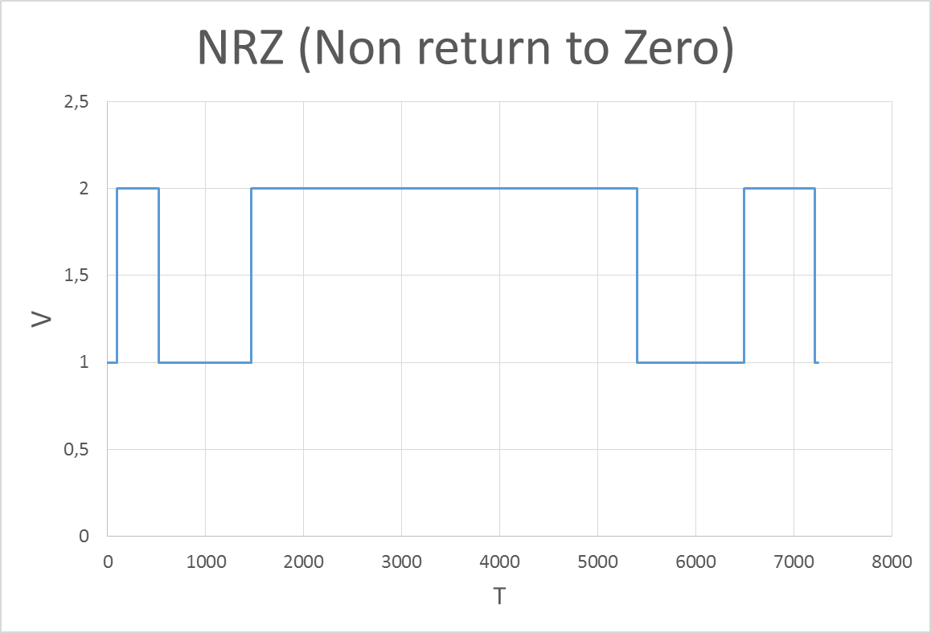
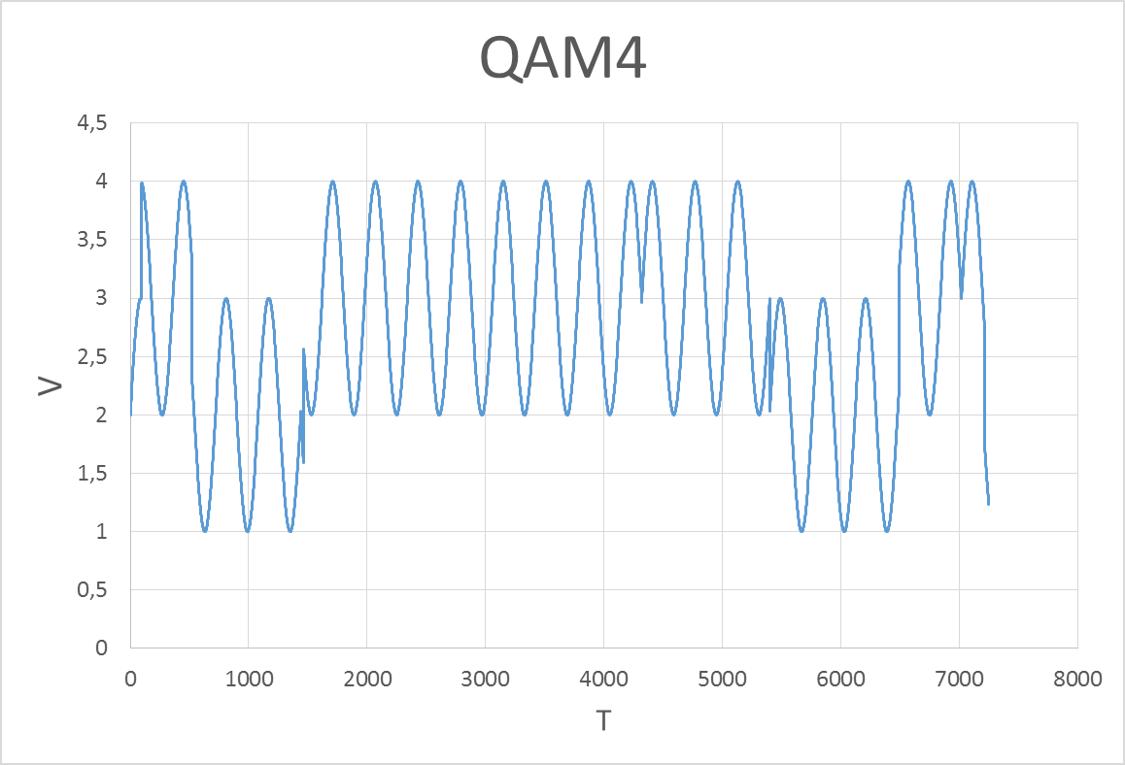
Coherent or Incoherent – Outline & Basics
    Direct Detect
    Simple modulation (Amplitude NRZ / On-off keying to Pulse Amplitude PAM4)
    Hence simpler (lower cost) electronics
    Sensitive to dispersion effects
    Coherent
    Advanced modulation (QPSK, 8QAM,.. 64QAM to PM-QPSK), Amplitude, Phase and Polarization (12x capacity / lambda)
    Hence requiring high-end (higher cost) additional analogue electronics (additional laser oscillators, DSP chips etc)
    Compensates dispersion effects
Dispersion effects grow with data rate and distance
The higher the bit rate &/ distance, the more DD is replaced by Coherent

Slide 25
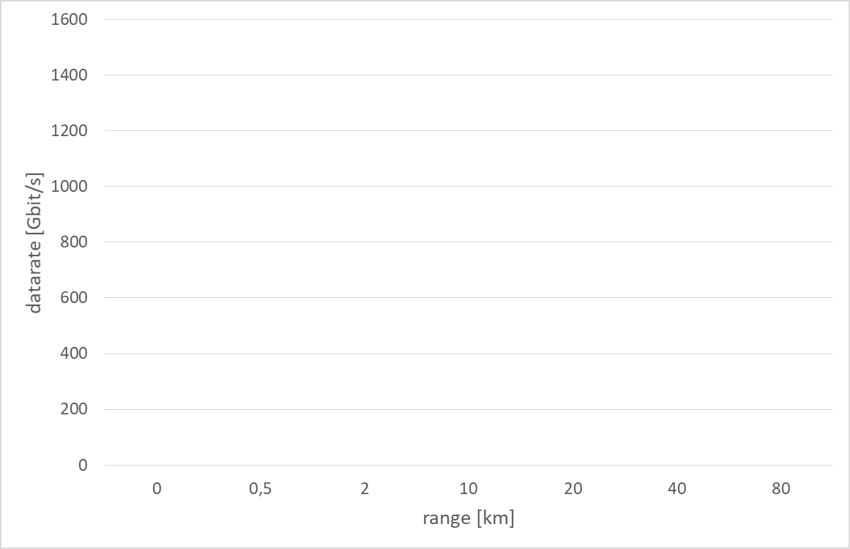
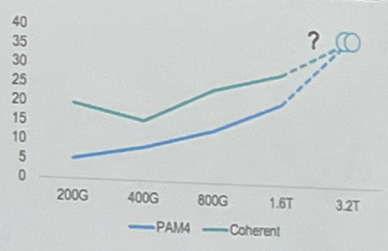
Coherent vs Direct Detect Summary
For higher reach and data rate, direct detect is getting more and more complex increasing price and power consumption.
  DSP is required for equalization.
  Dispersion needs to be compensated.
For higher data rate spectral efficiency is getting more important.
Also coherent is significant improving price and power consumption due to integration and smaller IC structures.
For transition area also other parameters are important for choice of available transceivers like available wavelengths, switches…
Coherent
Transition
area
Direct detect
Power consumption Im-DD transceiver
projection

