Slide 1







Welcome to High Tide Group
www.hightidegroup.net

Slide 2

Festival Wi-Fi
Since COVID people have moved heavily to contactless payment
For contactless to work, a connection to the internet is required.
Village 4G masts are design for about 1000 people, not 10,000

Slide 3
Who is High Tide
Technology company based in the North East of England.
Multi Nations Mergers, Acquisitions and Divestments
Enterprise Network design, assessment and support
Internet Service provider providing bespoke internet connectivity
Critical National Infrastructure services

Slide 4
The Background
DeerShed is a local family friendly Music festival that attracts close to 10,000 people each year.
We have been asked to provide WIFI over the whole site for the following services.
  Tickets
  Bars
  Vendors
  Phone in the Welfare tent for contacting parents of lost children
  “WIFI MUST WORK – We have gone Cashless”

Slide 5
The Background
Backbone – Planned
Backbone – Actual
Client Access
Network Overview
The Timeline

Slide 6
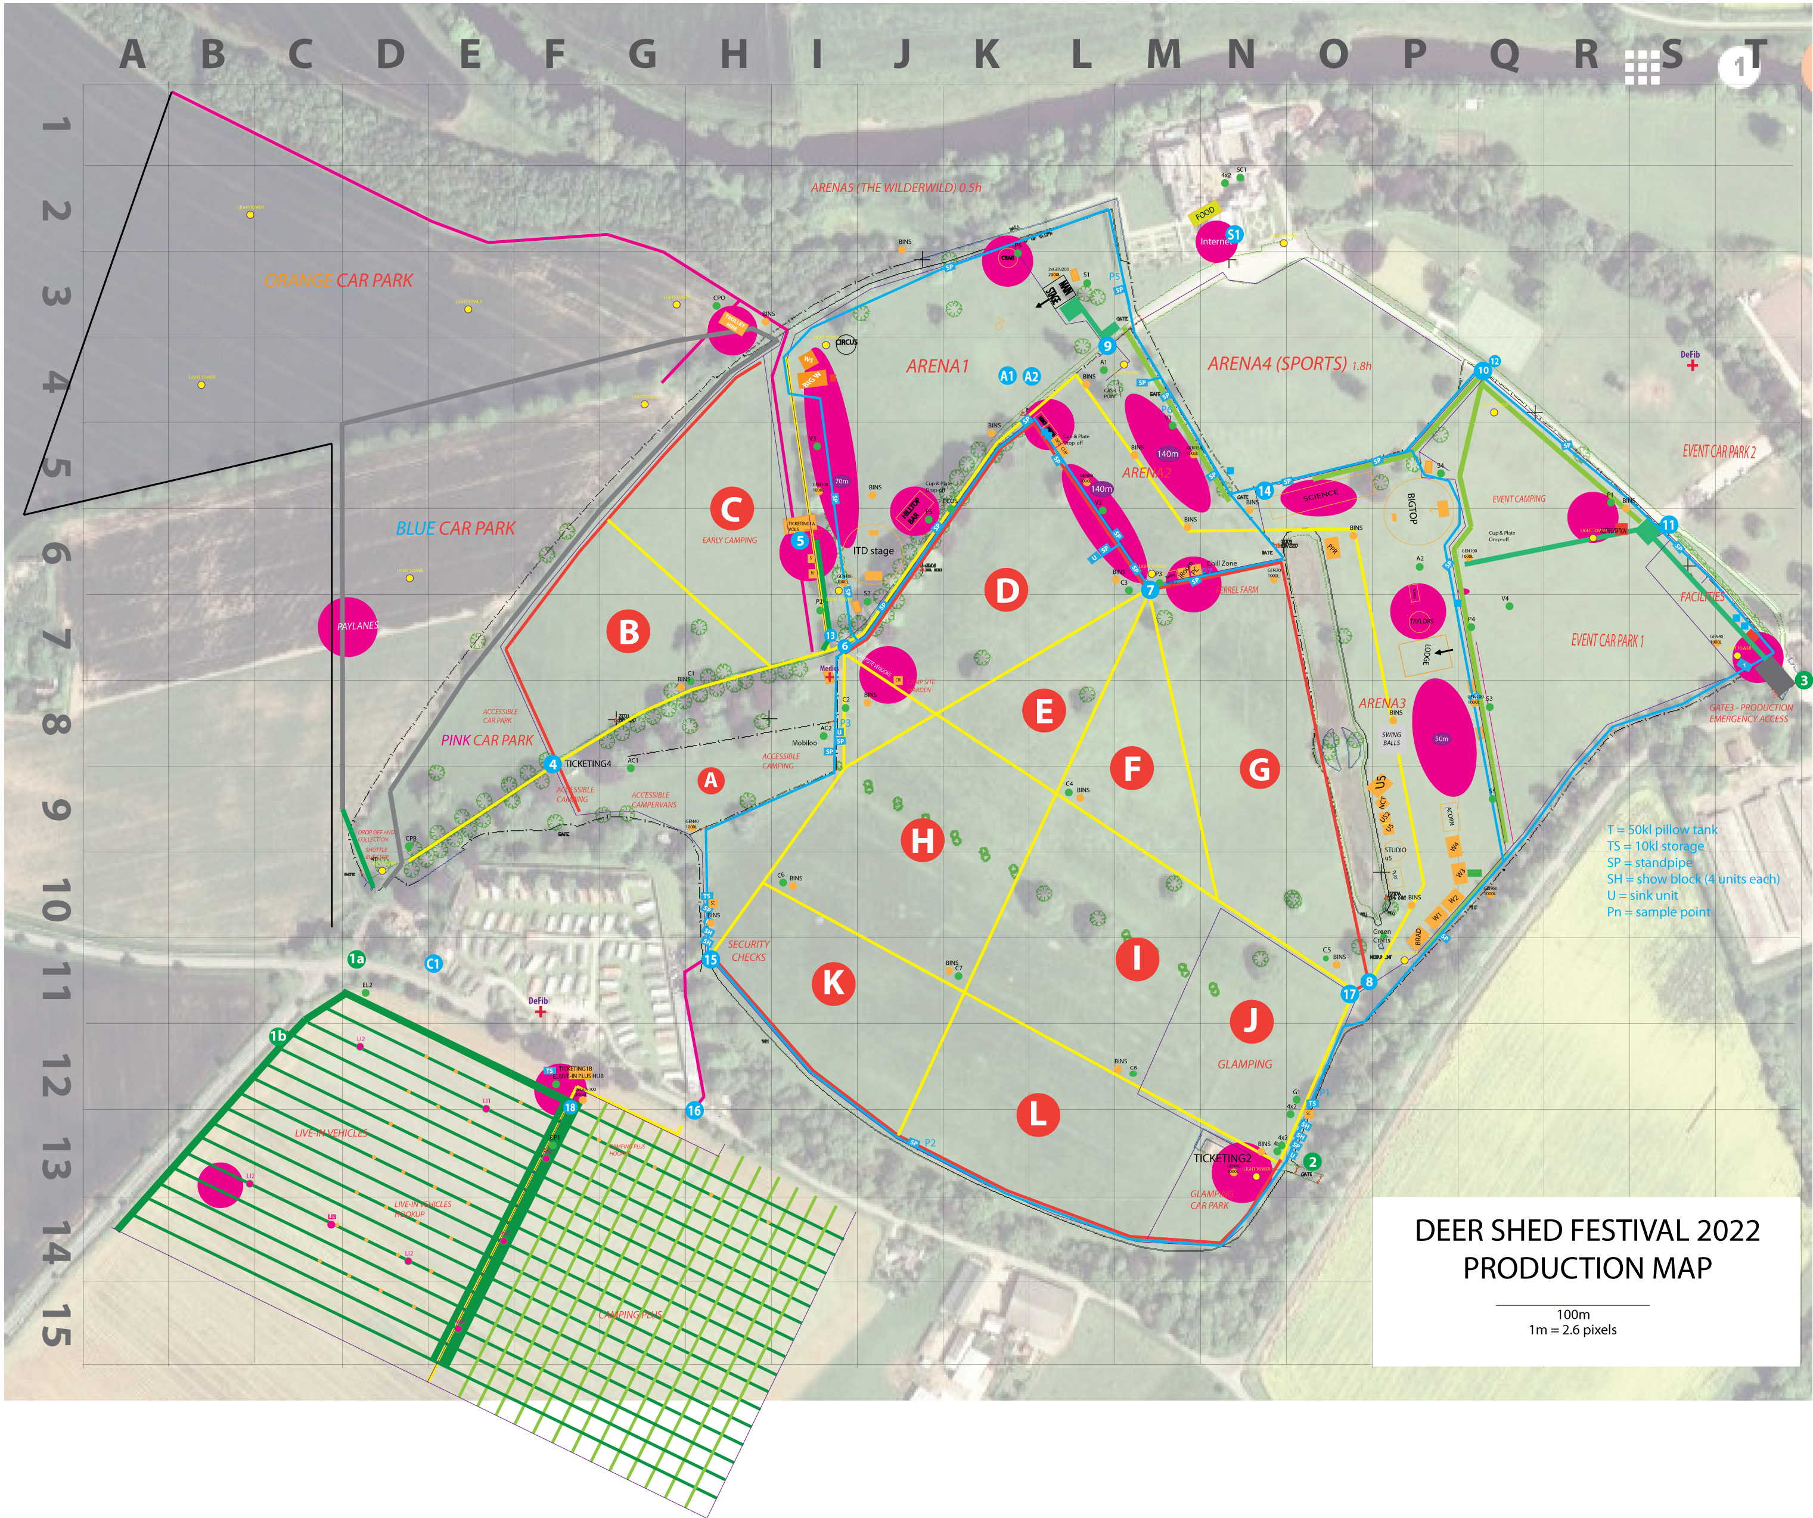
Site Overview

Slide 7
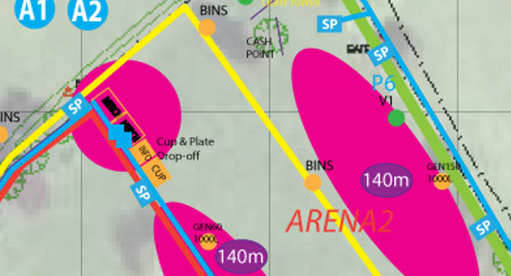
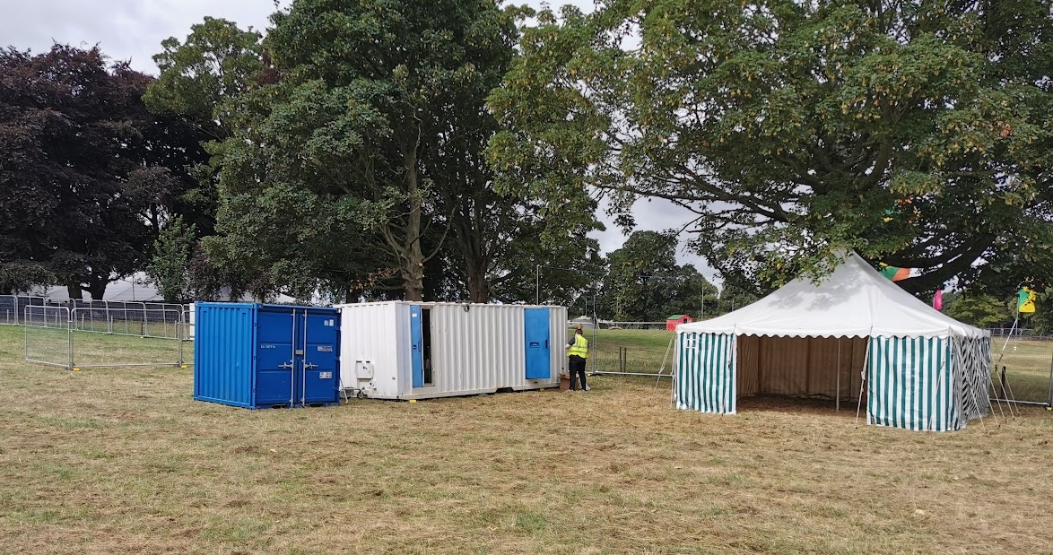
Head Office

Slide 8
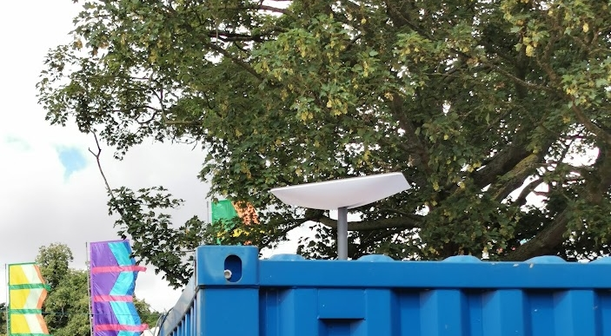
Get Temporary Connected to the outside world

Slide 9
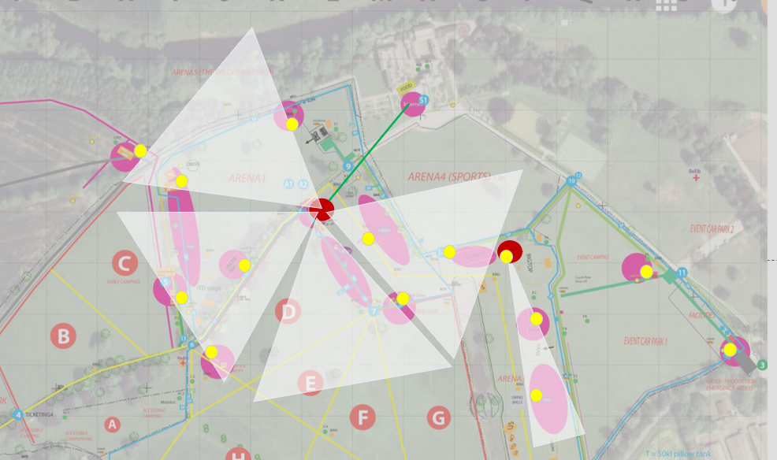
WIFI Setup (Backbone) – Planned
Backbone
4 X Ubiquity sectional antenna
22 X Ubiquity Point to MultiPoint links (back to the sectional antenna with one exception)
Link back to School for internet access

Slide 10
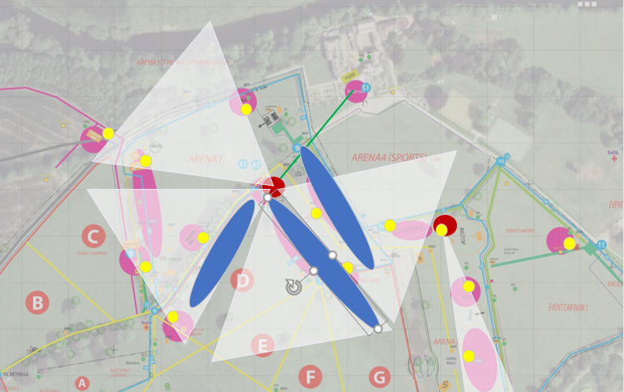
Wi-Fi Setup (Backbone) – Actual
The festival had increased the sizes of the vendor areas, but forgot to tell us.

Slide 11
Wi-Fi Setup (Client Access)
The festival had increased the sizes of the vendor areas, but forgot to tell us.

Slide 12
Network Overview
L2TP back to London (Bypass School Firewall issues. This however saved our bacon later)
VLAN for different SSID so we can Priorities traffic. BAR and Staff has priority as this is what the festival makes the money (Shhh, Don’t tell the vendors)

Slide 13
Client Authentication
Last year we downloaded over 2TB of data from Netflix. (I am not aware of Netflix being a Epos vendor)
This year each vendor was issued with a username and password. This enabled us to limit the number of devices a vendor connects
This also allows us to track bandwidth hogs

Slide 14
Inflight changes
One of the Vendors (A class vendor I was informed by management) was rated based on the number of app installs at the festival. The lack of 4G was causing them major issues.
Utilizing a mashed access point and a hotspot portal we where able to provide them with codes to allow people to connect for a short period of them to download the

Slide 15
Inflight changes
One of the acts utilized an interactive app people needed to download before walking through a forest. They did not plan for a highly congested 4G and asked if they could give out there WIFI code.
Another Hotspot with 15 min tokens was used.

Slide 16
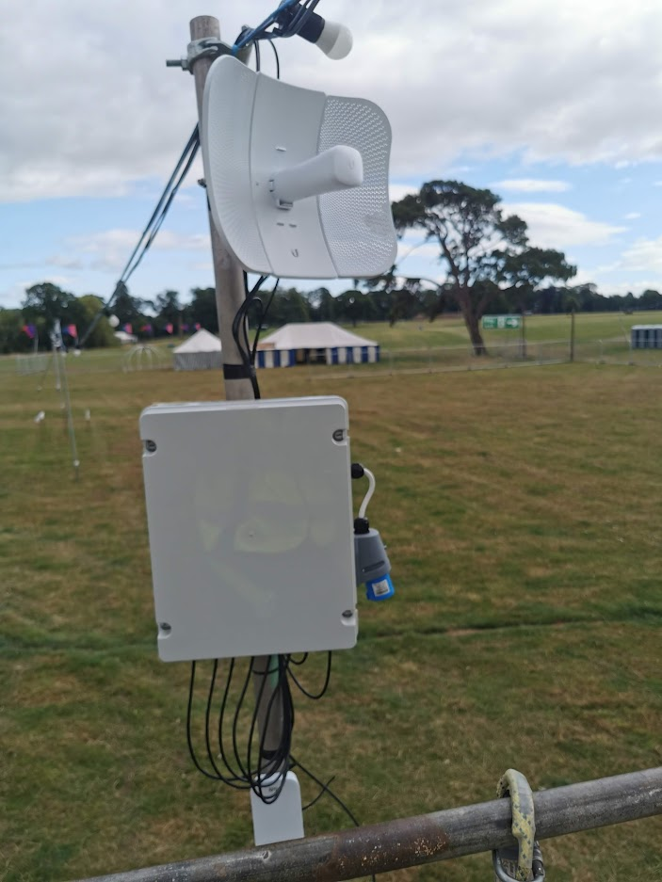
Planned Timeline
Monday – Setup
Tuesday – Setup
Wednesday – Setup
Thursday – Turn up and test
Friday 8AM – Doors open
Friday 12:00 Bands start
Saturday 7:00 till 24:00
Sunday 7:00 till 14:00
Monday – Strip down

Slide 17
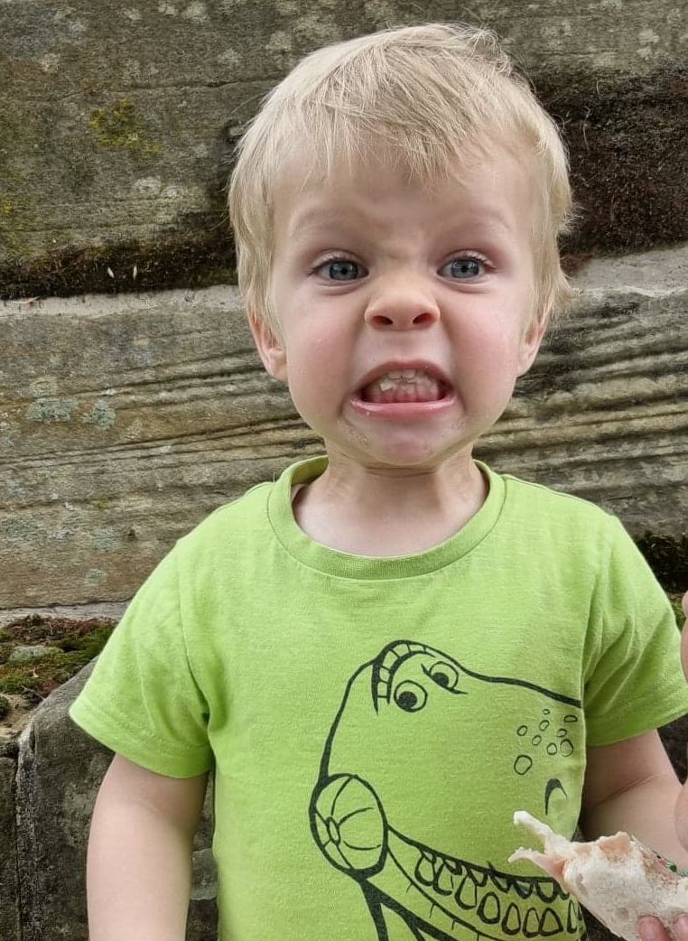
Actual Timeline
Monday – Setup
Tuesday – Setup
Wednesday – Setup
Thursday – NO POWER
Friday 8AM – Doors open. 8:15 Power on, but not stable. Issues with radio so only ticketing on. We also had a Diesel leak in the WIFI Cabin
Friday 12:00 Bands start – Demands for Bars and Vendors, but still power issues and radio issues.
WIFI Team and Electrical Team are NOT friends
Saturday 7:00 till 24:00
Sunday 7:00 till 14:00
Monday – Strip down
STRESS

Slide 18
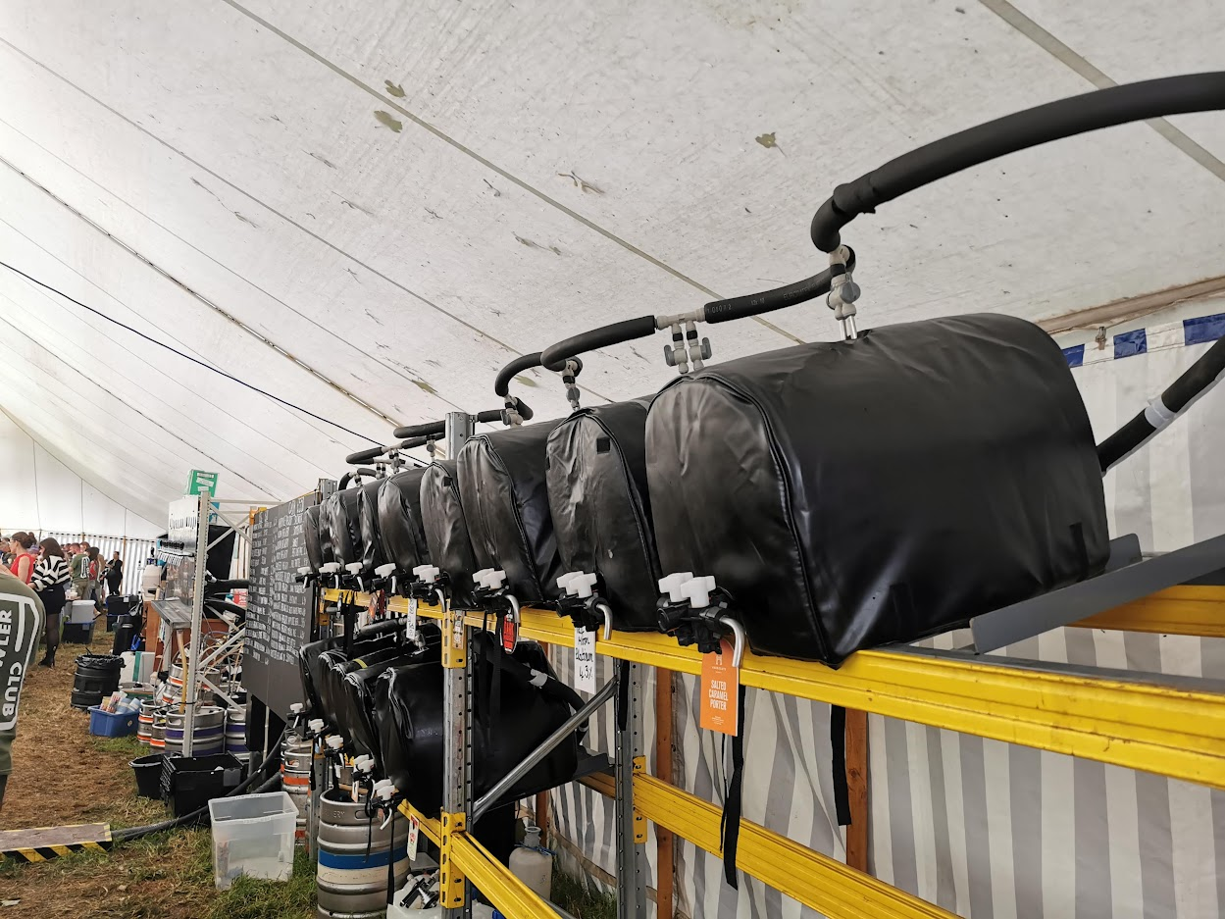
The Fun Begins
Random Generators around site keep tripping but Electrical team don’t know which ones
WIFI Team call the Electrical team to complain, we are able to tell them which generator is off as we have lost part of the network
WIFI team and Electrical Team are now friends.
BAR WIFI Stable, FREE DRINKS ☺

Slide 19
The Fun Begins
Friday at 16:00 JCB has a fight with the internet cable. We failover to Starlink (NO L2TP)
Starlink breaks out in Ireland. Some of the payment systems stop working.
We bring up the L2TP, all fixed.
We run on the Starlink for the rest of the festival
We placed some traffic prioritization for Vendors and Bars and restricted Netflix and Apple.
We suffer an outage on starlink, only to find a child standing in front of it (Move it onto the top of the cabin)

Slide 20
What we take from this
Keep the network simple
Take spare kit for unplanned changes
Mesh can be your friend to provide quick and simple expansions to sections of the network
Segment traffic if possible, to allow prioritization if needed
Always have a backup link
Some Card readers may not have been on WIFI for a long time and decide to do firmware updates
Allot of card readers are still 2.4 ☹

Slide 21
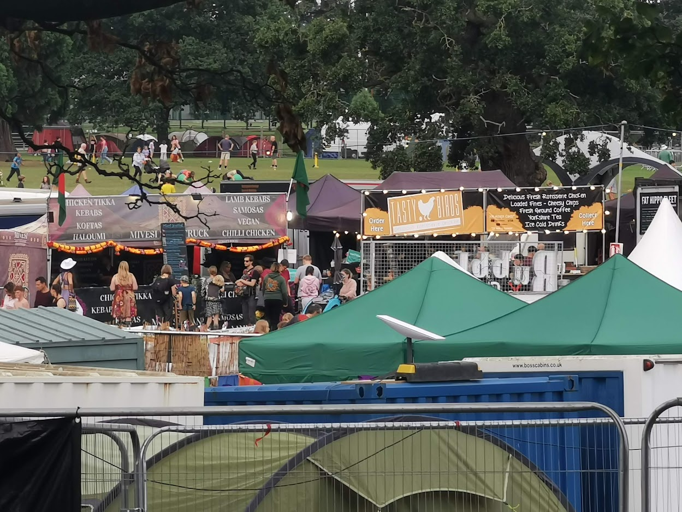
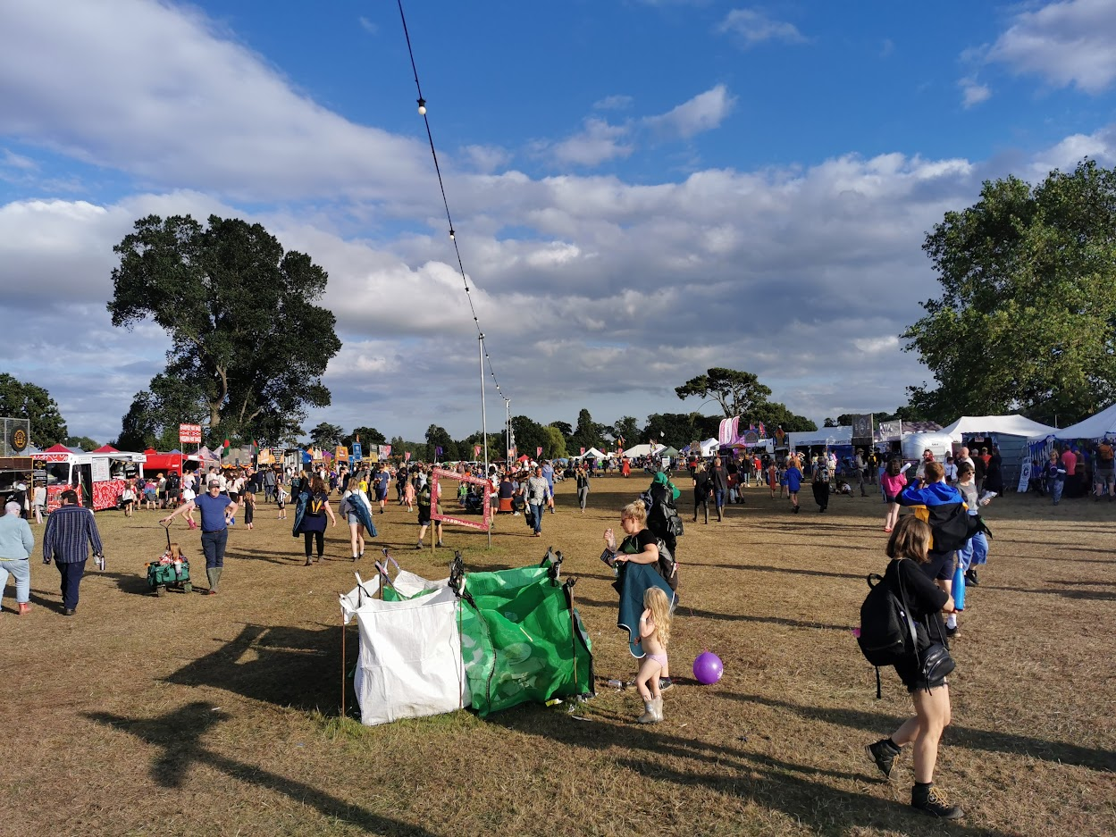
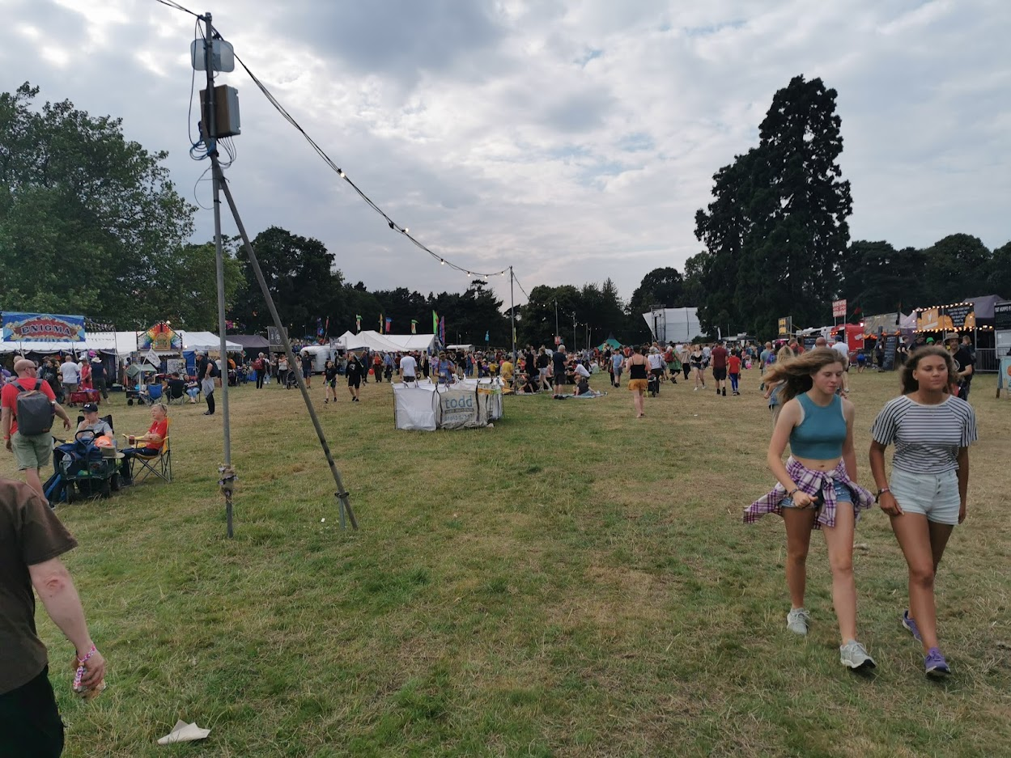
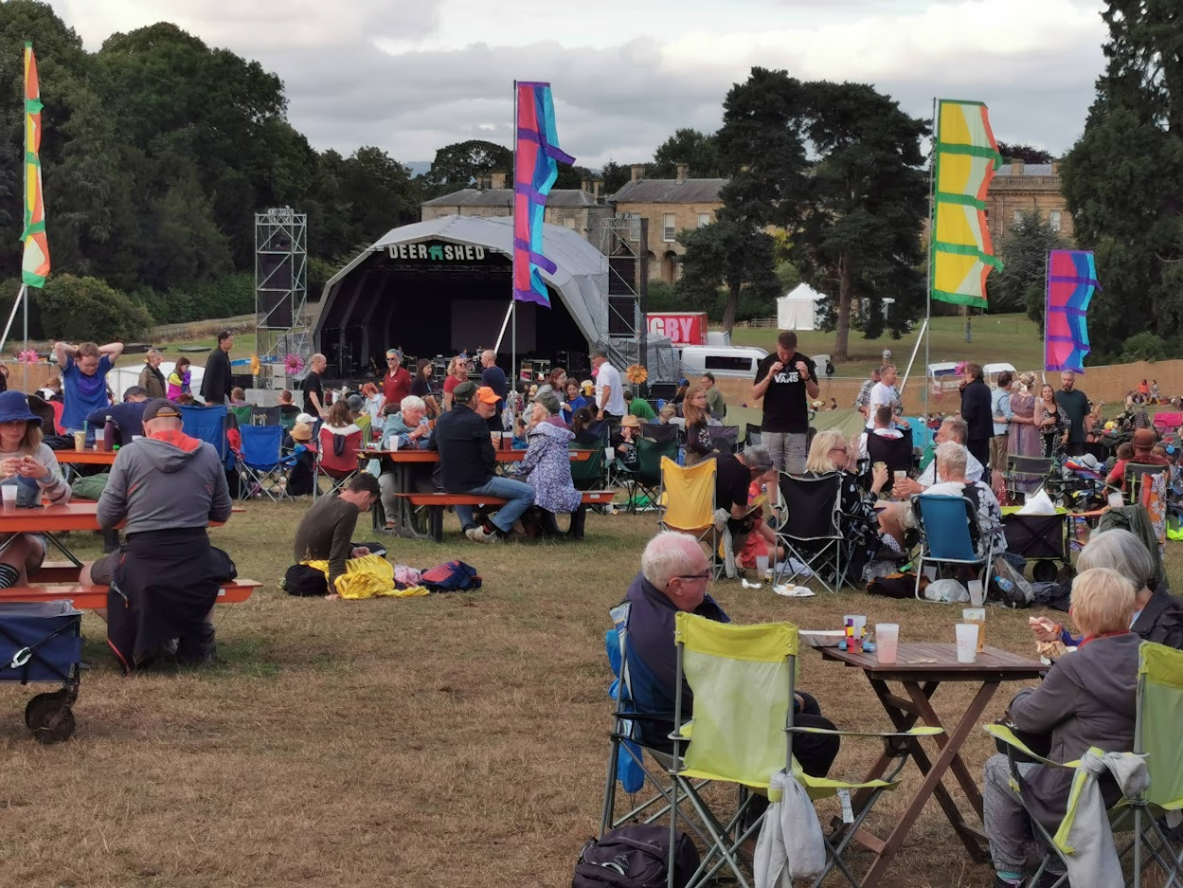
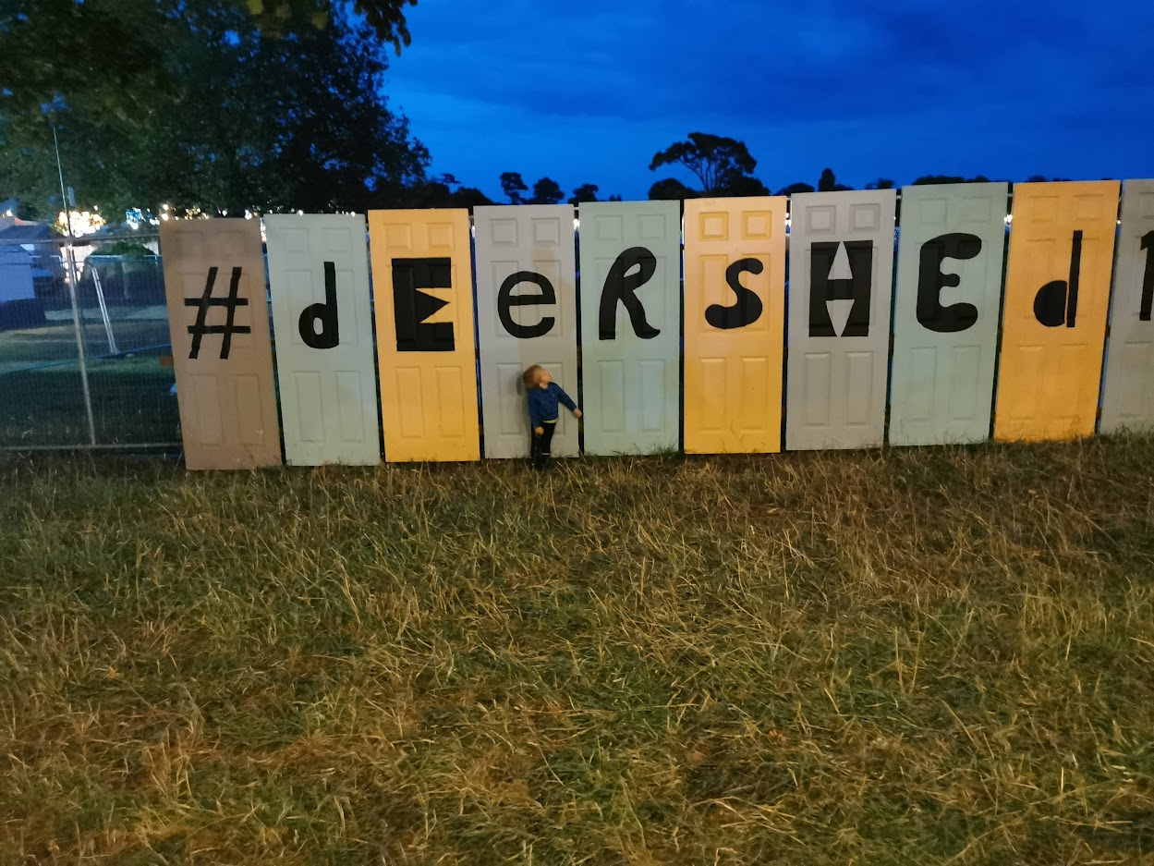
Some of the Family Fun

Slide 22
