Slide 1
Getting Started with Network Source of Truth and Data-Driven Network Automation with Nautobot
Learn Why Data is The Key to Unlocking Successful Enterprise Network Automation
Gabor Hadrevi - Senior Sales Engineer

Slide 2
Do you believe?

Slide 4
Agenda
Introductions
Current State of Network Management & Automation
Introduction of Source of Truth (Intent vs. Reality)
Data - Driven Network Automation
Nautobot Overview
Q&A
Notes:
Some of the things we're going to be talking about today is:
what is the current state of network automation
How do we manage the differences between intended versus reality when it comes to a network source of truth
How can we leverage the data to actually do a data-driven approach within Network automation
then we'll be diving into what nautobot is how does it come into the Paradigm
and then dive into some really great demos

Slide 5
Introductions
Gabor Hadrevi
Senior Sales Engineer EMEA
Network to Code
gabor.hadrevi@networktocode.com
Notes:
introductions,

Slide 6
Current & Possible State of Network Management

Slide 7
The Current State of Network Management
Most organizations are leveraging tools, processes & technologies developed 20+ Years ago
Legacy Management Characteristics
Engineering hours are spent on monotonous tasks
Slow response times & excessive backlogs
High operating costs
Excessive downtime
Limited scalability
Inflexibility & limited innovation
Efficiency of Network Operations
Departmental Power Tools
Personal Scripts
All Manual CLI
Maturity of Enterprise Automation Frameworks
Notes:
Where we see the state of the industry today and where we can start to move forward in our journey with Network Automation and all the key components that come as part of that.
Traditionally we see if you start here in the the bottom left corner of our grid there.
We have all manual CLI type driven methodologies for managing an environment
As it scales become more complex and more difficult to manage.
people start to:
write scripts, batch shell , python script, some sort of power tools on individuals laptops.
- As we become more in control of our network and the more we automate the more Efficient the network Operations become.

Slide 8
What’s Possible with Automation Leveraging a Single Source of Truth
Adopting a new strategy unlocks new potential
NetDevOps Management Characteristics
Engineering hours spent pursuing business initiatives
Quick response times, some fully automated
Moderated operating costs
Less frequent and shorter outages
Highly scalable
Highly flexible & innovative
Highly Automated &
Resilient Infrastructure
Self-Service ITSM,
with Deep Integration
Efficiency of Network Operations
Extensible Enterprise Automation Architecture
Shared Enterprise
Source of Truth
Departmental Power Tools
Personal Scripts
All Manual CLI
Maturity of Enterprise Automation Frameworks
Notes:
As for that Efficiency of Network Operations the first things you'll discover is that we need a Source of Truth.
Then of course as we continue further down the journey along these components :
Automation Architecture
platform for Self-service integrated
then finally into a Highly Automated resilient infrastructure
So today we're going to focus on that Source of Truth piece.
This is the key fundamental component that if you want to be able to proceed down this journey you have to have true Network Automation.
Because you cannot drive Automation and you cannot drive change through automation if you don't have a Source of Truth.

Slide 9
Where to start?
Data Unlocks Network Automation’s Highest Potential
Highly Automated &
Resilient Infrastructure
Self-Service ITSM,
with Deep Integration
Efficiency of Network Operations
Extensible Enterprise Automation Architecture
Shared Enterprise
Source of Truth
Departmental Power Tools
Personal Scripts
All Manual CLI
Maturity of Enterprise Automation Frameworks
Notes:
So the question is where do we start?
As I mentioned , the absolutely key component is the source of Truth
If we don't have that, we cannot really move forward and this is where we start to see the the power of data.
Now in the traditional world we think of data generally speaking as, documentation.
We don't necessarily think of it as the way that we drive change, and what ends up happening is that we are really not maintaining our Sources of Truth.
So the really the notion here is that we stop thinking of data as documentation.
We change the data first, and then change flows into the environment, and this is a really different way of thinking for most Network environments.
Therefore we don't think of data as documentation, we think of data as the way we drive change.
And this is really the paradigm shift that's required to unlock the potential of network Automation and managing a network through this type of methodology.

Slide 10
Introduction to Source of Truth (Intent vs. Reality)

Slide 11
Understanding Source of Truth
Source of Truth is all about intentions and planning.
It is about the expected state.
Source of Truth data drives parts, labor, and configurability.
VS
Notes:
The source of Truth it really is all about intent.
That is we express our intent into the Source of Truth, and that is what is the trusted and accurate State for the environment.
This is also a different way of thinking, particularly for Network Engineers, right.
We generally think:
if I want to know the trusted and accurate state of the network, I go look at the network itself.
And that is the traditional way that we manage Network environments.
Now as we start to think about using Source of truth, it's important that we flip that mentality.
That is we expect that the authoritative state of the network, should be expressed in our Source of Truth, and then reflected into the environment.
Whenever we try the other way around:
that is we treat the environment as the authoritative State and we try to reflect that back into our so called Source of Truth, that doesn't end up working.
We are unable to maintain an accurate State between those two things, and it is inevitable that the environment will not match the source of Truth.
Whereas if we go the other direction: - that is source of Truth is our intent and we deploy that into the environment, that will allow us to actually have these two things match.

Slide 12
Understanding Network Configuration Data (cont’d)
interface Ethernet1
description connects to WAP–HQ-Bldg-5–Floor-3–Closet-1
switchport mode access
switch access vlan 5
Network
Design
interface Ethernet1
description connects to WAP–HQ-Bldg-5–Floor-3–Closet-1
switchport mode access
switch access vlan 5
Data Point | Value
Interface | Ethernet1
Description | connects to WAP…
Mode | access
VLAN | 5
Designs should drive configuration
Is that the correct configuration?
Data
Notes:
12.a (BUILD FULL SLIDE 3- clicks)
Here is an example of just thinking about looking at some configuration of the switch.
On the right is that the expected state of the environment, and we can see all of these pieces of data that are here in this configuration.
And if you start to think about the difference between my intent:
that is:
the specifics of the Syntax for the vendor
and the specific configuration commands versus the data.
So the data here highlighted in Orange,
and then our configuration syntax more of the way that we're actually managing the environment : is expressed in black.
What we are changing is the data piece on the right: the pieces in Orange here. And that's where we typically see most change occurring in an environment.
So this also is a key component to how we're driving change from that source of Truth.

Slide 13
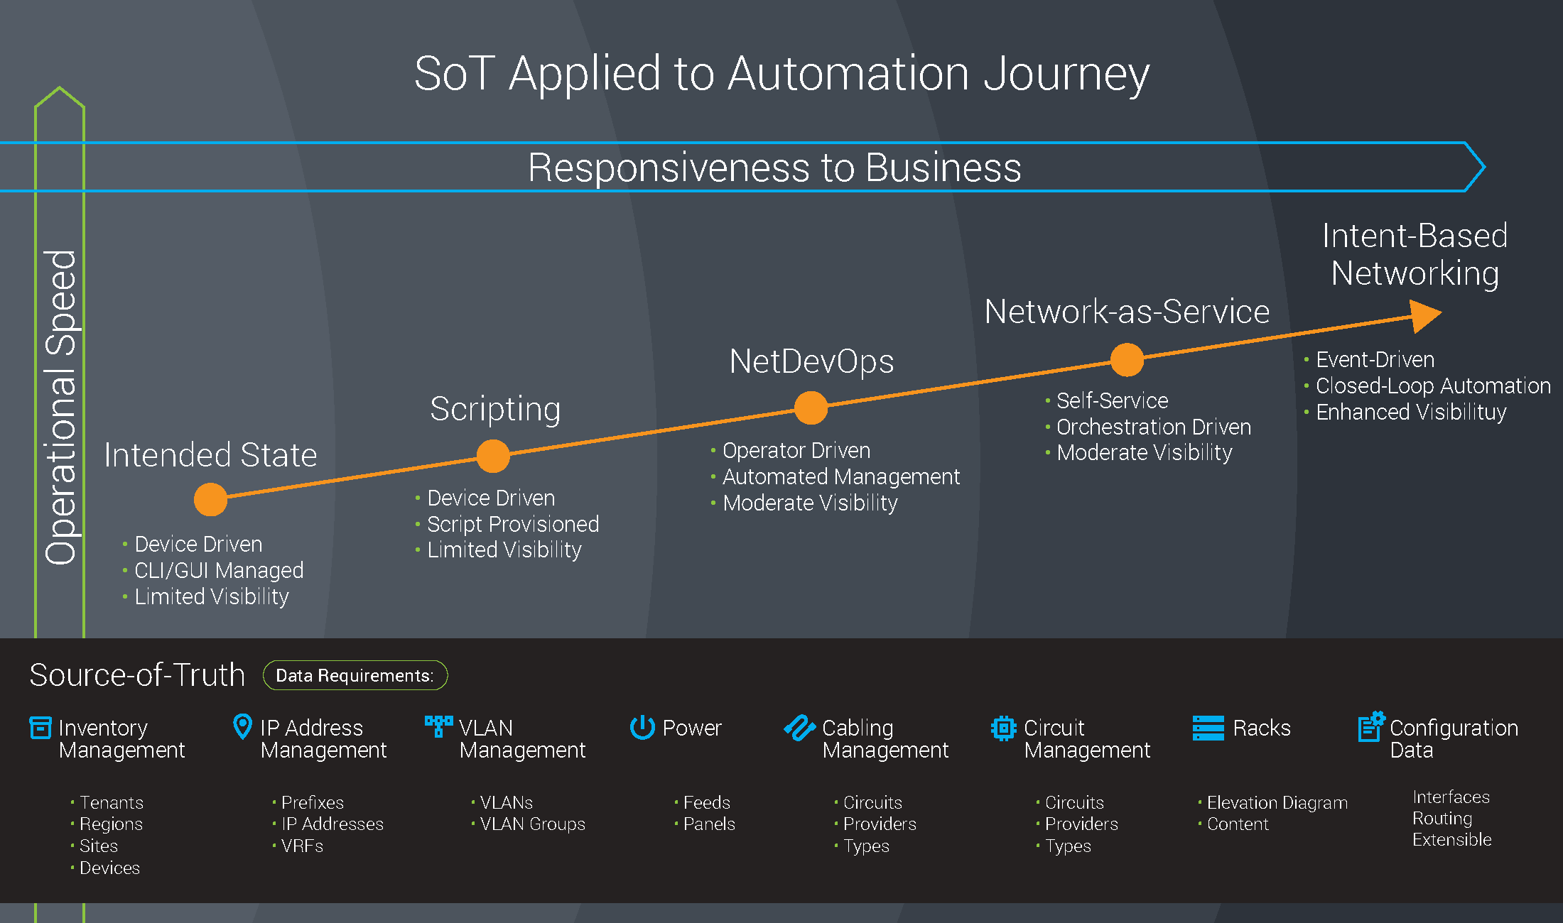
Source of Truth is the Foundation
Enables data-driven network automation
De-couples CLI syntax and API calls from data
Enables vendor-agnostic network automation
Allows architects and engineers to focus on network designs
Provide traceability and history of the Source of Truth
More data, more insights.
Notes:
Source of Truth being the foundation
This is how we are able to express our intended State, and go down that journey of moving from CLI driven, to a data-driven network automation type environment.
We're really trying to make that decoupling: between what is expressed in the CLI, and what it is that we're actually trying to Achieve.
What is the design or the intent that we're expressing into that CLI.
The key being here is that we're trying to decouple these things. That traditionally we have kind of really merged these Concepts.
We think of the CLI and our intent as the same thing and they're really not.
The CLI is just a method by which we achieve our intent.

Slide 14
Intent vs. Reality
vs.
Intent - the desired state of the network.
Reality - the discovered state of the network.
CMDB
Discovery
Note: The Nautobot SSoT framework can be used to synchronize data from any tool (intended and reality) into Nautobot based on use case and desired outcomes.
Notes:
The desired state of the network versus the intended state.
Some examples of the way we might Express that intent is the Desired state.
Nautobot or other tools
Versus what we have out there in the Real world and this is the discovered state of the network.
Through using various ITSM tools.
So there's really these two different pieces right there's:
one to go and confirm what we have out there in the real world
versus what our intended state
So we need to keep in mind, that these are two different things, as sometimes we do tend to mix these Concepts and we want to make sure we understand these are really
different.

Slide 15
Nautobot Overview
Notes:
so diving into not about quick overview

Slide 16
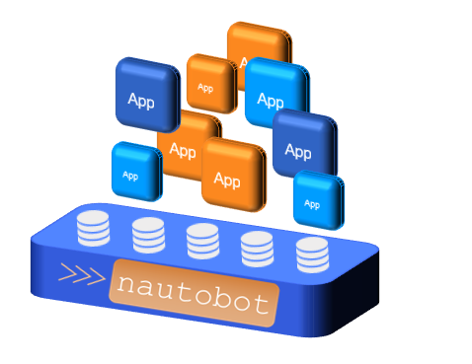
About Nautobot
Source of Truth and Network Automation Platform
Open source community project created in 2021
Apache 2 License
Sponsored by Network to Code
Purpose-built to drive network automation
Notes:
NAUTOBOT is a
Source of Truth & Network automation platform.
and that's really a key component:
That it is not just about the Source of Truth, it's about how do we actually use that source of Truth , to drive the change and integrate tools into the environment.
Nautobot as an open source Community project, that started in 2021 sponsored by Network to code, and it's real purpose is to drive Network Automation and network ecosystem.

Slide 17
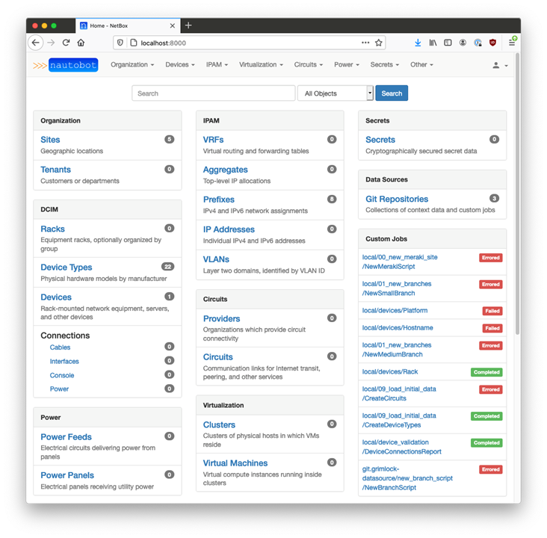
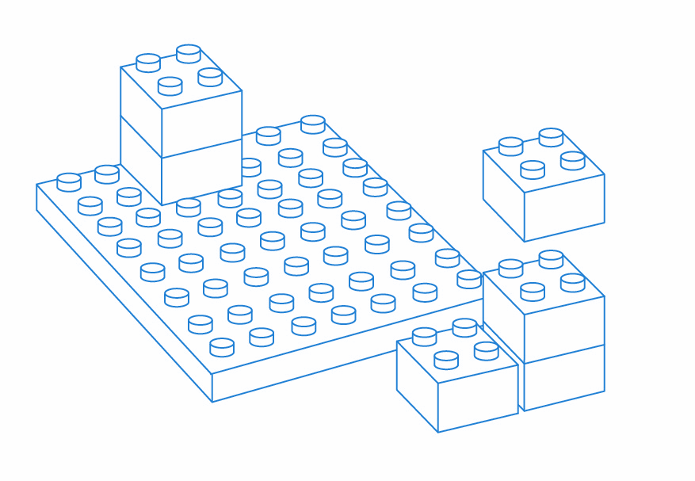
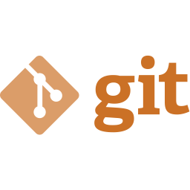
Nautobot Use Cases
Network Source of Truth
Network Automation Platform
Devices
IP Addresses
VLANs
ASN
…
Custom
Use Open Source Apps
Build Custom Apps
Save 70% development time using the platform
User-Defined Relationships
Custom Fields
Data Validation
Git as a Data Source
Powered by APIs and NetDevOps extensibility & integrations
Extensible Plugin System
Notes:
Some specific use cases we might see with the platform on the Source of Truth component:
modeling the environment so that it displays:
our devices , our IP addresses , our vlans
You would see this information using traditional tools :
- CMDB (Config Mgmt Database) - e.g. ServiceNow
- IPAM - (IP Address Mgmt) E.g. Infoblox
and a DCIM (data Centre Infrastructure Mgmt) - E.g. Device42.
The aim is that we have a Single Source of Truth, that are capable of modeling all of those different components in one place.
So things like:
user-defined relationships
custom Fields
data validation
using Git as a repository as a data source
Nautobot is giving you flexibility to take the framework and make sure that it can be representative of your environment.
Because every environment is just a little bit different, and this is a common problem with Sources of Truth:
Its that they're often not flexible enough to be able to adapt to how you do Business.
And then the key component on top of the automation platform - the open source apps
These are available as part of the nautobot Community, As well as the capability to build them yourself.
<<< Skip if over 15minutes:>>>
(All available to you:
- to launch your code , - to run your scripts, - to run your power tools
giving you a place to consolidate them in your environment
And of course fully supporting:
Rest API
GraphQL endpoints
Webhooks
Git integration
and further applications and plugins that can be developed on.

Slide 18
Intent-Based Networking with Nautobot
Creating a closed-loop automation system
Nautobot focuses on the intended & desired state
Nautobot unifies disparate data sources creating a Single Source of Truth
Nautobot exposes all intended state data and systems through its REST and GraphQL
Nautobot Apps are used to tailor designs and build integrations with external systems
External systems are still often used for orchestration, execution, and telemetry
Notes:
Nautobot focuses on the intended & desired state
unifies disparate data sources creating a Single Source of Truth
exposes all intended state data and systems through its REST and GraphQL
Apps are used to tailor designs and build integrations with external systems
External systems are still often used for orchestration, execution, and telemetry

Slide 19
Diving Deeper
Nautobot Overview
Notes:
going a little bit deeper here as we start to kind of explore nautobot

Slide 20
Extensibility Features Summary
Tailor Nautobot to your network design requirements
Status
Config Contexts
Tags
Config Contexts JSON Schemas
Dynamic Groups
Jobs
Secrets
Computed Fields
Git as a Data Source
Extensibility
Custom Fields
Relationships
Custom Links
Export Templates
Custom Models, UI & APIs
Notes:
28. How can you tailor Nautobot to Your Network design requirements?
Some things you might think about from an extensibility perspective. Ways we might use nautobot in some of the key Concepts.
Things like being able to :
set status on a device:
is this a cold spare on the Shelf
maybe it's a we're doing a major renovation and we need to be pre-planning devices
We can we can use those statuses to indicate that.
Then there are Tags, really powerful very flexible, the ability to use tags across the database as well
Things like Dynamic groups really flexible concept here that we have as well in the platform, allowing you to group things based on a higher level abstraction, rather than necessarily having to specify.
Some of the other highlights here Config Context we'll take a look at these things as well here in the demo in a minute.
Computed Fields , custom Fields all giving you a lot of flexibility in the way that we can use and extend the platform.

Slide 21
How is the SoT Populated?
Nautobot provides several methods to get you up and running quickly
Data Synchronization & Normalization
Network Importer
Data Aggregation
Automated collection
SoT Database
Onboarding App
Manual Population
Notes:
22.
Moving on to:
How do we get data in, now that we have deployed nautobot?
We get our data models so that it's reflective of our environment, but now there's nothing there, so we have to start from somewhere.
And if at all possible we want to avoid manual entry of data.
So we have several methods by which we can we can get data into an nautobot. Starting from data synchronization and normalization this is, you could think of it as data aggregation.
Pulling or pushing data from external tools, relative to nautobot so whether it's:
Infoblox,
maybe Arista Cloud Vision
servicenow cmdb
device 42
IP fabric, any number of this list can go on and on. Any number of tools here that we can push or pull data from nautobot.
And then of course maybe we have don't have any existing data that we're willing to trust, then we can always go out and automate the collection from the existing Network.
Now we would recommend that this be a something that we limit to a one-time step or at least during the initial phases of deployment of the source of truth.
That is going back to that earlier idea that:
- we are attempting to change the way we think
We don't want to be going and pulling the environment on a regular basis and importing that into our intent , into our source of Truth.
But again really key concept being that we should start to change the way we think about this, that this should be minimized and eventually retired.
The goal being here that we are eventually having our data in the source of truth, and that's expressed into the network, not the other way around.
Worst case scenario: if you need, we can do manual population. We do have an Onboarding App that helps make that as easy as possible.

Slide 22
Nautobot Data Validation & Integrity
Nautobot supports two main ways of enforcing data validation and integrity.
Data Validation Core API
User defined Jobs
These features go beyond the natural validation of the core network data model.
Validation Provider
Jobs
Data Validation Core
Notes:
24.
Some ways that we can help maintain that and enforce that data validation and Integrity.
We have both the idea of:
data validation engine,
as well as user-defined jobs that can be used to validate the data both before and after a change, as well as as data it entered.
And this is really what we're looking at here as far as how can we ensure we have good data integrity?

Slide 23
Integrating & Using Nautobot
Notes:
Integrations and using nautobot

Slide 24
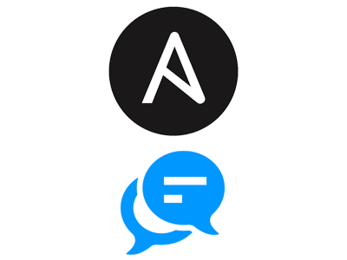
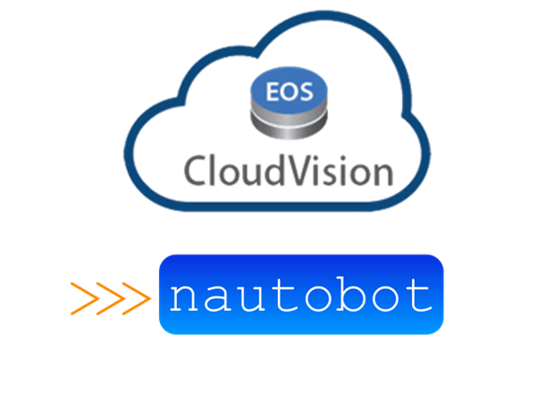
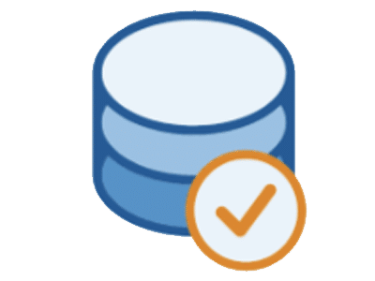
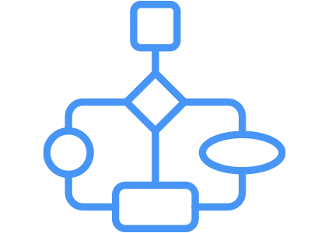
Nautobot’s Growing App Ecosystem - Over 25 Apps to Date
Ansible ChatOps
Arista CloudVision ChatOps
Arista CloudVision SSoT
IP Fabric ChatOps
Capacity Metrics
Perform common Ansible AWX/Tower operations using ChatOps
Perform common IPF operations using ChatOps
Expose key data in Nautobot as Prometheus endpoints
Perform common CloudVision operations using ChatOps
Synchronize data between Nautobot and CloudVision
July 15, 2021 - 1.1.0
August 3, 2021 - 1.1.0
August 3, 2021 - 1.1.0
December 15, 2021 - 1.1.0
February 24, 2021 - 1.0.0
Circuit Maintenance
Golden Configuration
Data Validation
Device Onboarding
Grafana ChatOps
Dynamically manage circuit maintenance notifications in Nautobot
Automate backups, generate configs, and perform configuration compliance
Add validation rules to ensure corporate standards and proper data hygiene
Simplifies onboarding and re-onboarding devices into Nautobot
Retrieve any Grafana panel directly from Chat
May 7, 2021 - 1.1.0
February 24, 2021 - 1.1.0
August 3, 2021 - 1.1.0
February 24, 2021 - 1.1.0
October 27, 2021 - 1.0.0
Device Lifecycle Management
Meraki ChatOps
Nautobot ChatOps
Cisco ACI ChatOps
Welcome Wizard
Perform common Meraki operations using ChatOps
Perform common Nautobot operations using ChatOps
Perform common ACI operations using ChatOps
UI wizard that simplifies getting started with Nautobot
Track EOL, software versions, and contract data in Nautobot
November 8, 2021 - 1.1.0
September 29, 2021 - 1.1.0
February 24, 2021 - 1.0.0
December 2, 2021 - 1.1.0
July 30, 2021 - 1.0.0
Version Control
Single Source of Truth
IP Fabric Single Source of Truth
Infoblox Single Source of Truth
ServiceNow SSoT
Add Git concepts such as branch, merge, and PR directly into Nautobot
Pluggable framework that enables 3rd party data synchronization with Nautobot
Synchronize data between Nautobot and Infoblox
Synchronize data between Nautobot and IP Fabric
Synchronize data between Nautobot and Infoblox
December 7, 2021 - 1.2.0
December 7, 2021 - 1.2.0
January 3, 2022 - 1.2.0
January 20, 2022 - 1.2.0
January 20, 2022 - 1.0.0
Partner Integrations | Standalone Solutions | Custom Development
Nautobot as a platform compliments any network automation strategy.
networktocode.com/nautobot/nautobot-apps/
Notes:
https://www.networktocode.com/nautobot/apps/
32.
And just you know give you a little overview here.
We have currently over 25 apps available in the project, that are out there.
Some of our most popular things like the:
circuit maintenance app
golden configuration
device life cycle
The onboarding Tool
data validation
all really highly popular tools that provide a lot of power right out of the box in many cases once we have that data populated.

Slide 25
Nautobot - Q&A
Nautobot’s Growing App Ecosystem

Slide 26
Contact details:

