Slide 1
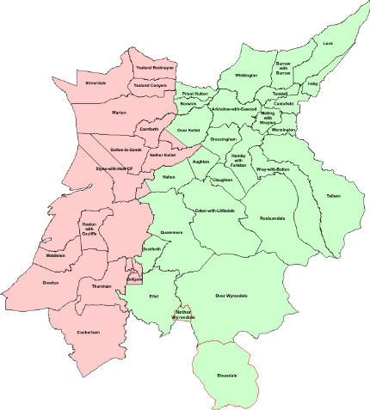
Broadband for the last 5%
Barry Forde
B.Forde@b4rn.org.uk
www.b4rn.org .uk

Slide 2
Lancaster District
Area = 576Km²
Population = 139,700
Pop Density = 243/Km²
Properties = 60,761
Prop Density = 105/Km²

Slide 3
B4RN Coverage Area
Area bounded by M6 on the west, Cumbria to the north and NYCC to the east
B4RN area = 425Km²
Properties = 3520
Prop Density = ~8/Km²
For comparison
Gt Manchester area = 1156Km²
Properties = 213529
Prop Density = ~184/Km²

Slide 4
Coverage area
2013-2014/5
425Km²
21 full parishes
5 partial
3539 properties
No timescale

Slide 5
The Trigger
Few BT exchanges
Virtually all lines are EO
Only three PCP cabinets in whole area
Line lengths out to >12Km
Even dial up problematic and making a call often impossible if its rained recently!
Current ADSL provision mainly <512Kbs
Very few above 2Mbs

Slide 6
The ambition
Deliver at least EU DA 2020 targets
50% to have 100Mbs or better
and B4RN to be in that 50% ☺
Rest to have floor of 30Mbs (leave that to urban areas ☹)
Coverage to be 100% of properties in area
No exclusions due to line lengths, copper quality etc.
If you are in one of the 21 B4RN parishes then you WILL get full speed service
Future proofed
1Gbs and upwards without new infrastructure
Affordable
£150 connections fee, £30/month for service?

Slide 7
Decision time!
Fibre based
How else can we achieve at least 1Gbs symmetrical to at least 10Km ranges reliably? (G657d/G657a mixed)
FTTH
PtP delivery not GPON - (want symmetrical)
2 fibres per property – 1000BaseBX on one, other spare
Blown fibre technology
Narrow bore (16/12mm) HDPE duct, 500mm deep
Cross county routes with landowners giving us free wayleaves!
Get farmers and landowners to dig in the duct

Slide 8
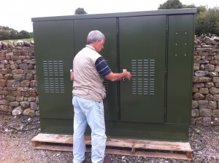
Design
Mapped all properties in all the parishes
Selected locations for village nodes
Each serves one or more parishes
Min property count 136, max count 530
Keep max line length <=10Km where possible
16 nodes needed
Planned cross country routes radiating out from each node to optimally pass all properties in the parish.
Trunk routes = 278Km of duct
Spurs to properties = 242Km

Slide 9
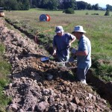
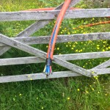
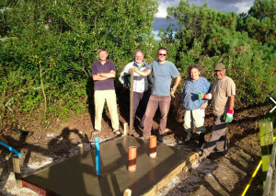
Construction

Slide 10
Active kit
Hubs
Need fibre SFP based switches with layer 3
Need 10GbE ports for backhaul
Need low initial CAPEX
Pizza stacking boxes fit the bill
But forces us outside of telco market place into the enterprise/business one.
Not many around, using Netgear M5300-28GF3
24x1GbE SFP ports + 2x10GbE SFP+ ports
Stackable 8 deep to give 192 ports.

Slide 11
Costs
Duct and fibre
520Km
£2.440M for materials (need cash to buy)
£1.121M for labour (but can be sweat equity)
Cost per metre = £6.86
Village nodes and active equipment
£250K
Total Project cost =£3.811M @ 100%
Where do we get it?

Slide 12
Broadband for the Rural North Ltd
Mutual/Coop, Not for profit
Industrial and Provident Society Act 1965
Community Benefit Society
Similar to coop but answerable to community rather than our shareholders, more like a charity in some ways
One member one vote, not related to number of shares member holds
Free cash flow to be returned into the community

Slide 13
Why?
If landowners are to give free wayleaves
Must be certain it’s a community project not standard commercial one
If any money is to be made then it’s the community who benefits not remote investors
If farmers and landowners going to dig it too
Must be certain its for the communities benefit
Be prepared to accept shares in lieu of cash for the work done

Slide 14
Funding
Opened shares issue in Dec 2011
Eligible for EIS tax relief (30%)
Investors of £1500 or more get free connection and 12 months free service
Buy shares for cash or effort (sweat equity) such as digging trenches and installing ducts.
1m dug = £1.50 of shares
1000m dug = £1500 of shares = free connection and 12 months service
~£1M of shares subscribed mix of cash/sweat
Bid for £900K from RCBF, still not got anything but fingers X
Now negotiating commercial loans to fill gap.

Slide 15
Financial Targets - 1
Need 300 customers to cover OPEX
Assumes all labour is freely donated by volunteers
At 535 customers can service loans too
Then we start taking on staff and reducing load on unpaid volunteers.
At 1200 customers we are fully staffed (6-7 posts)
Then free cash goes into sinking fund to allow investors to withdraw shares

Slide 16
Financial Targets - 2
Coverage/properties passed is ~3500
Business plan calls for 50% take up by the end of Year 1 a route is completed = 1750
Increasing to 80% take up by end of year 4.
Based on 6.5% interest on loans and 5% divi on shares can payback investment by about year 12.
Then have free cashflow between £500K and £1M
As a community benefit society this has to go back to the community not flow to share holders

Slide 17
Backhaul/External
Must match external bandwidth to internal
1Gbs per property
But of course no one can use this!
Need ? External to cope
Go with dark fibre to peering centre
Telecity Manchester is our nearest
Peer at Manchester (EDGE-IX, IX-Manchester)
IP transit from layer 1 provider
Need to be able to add capacity without large incremental costs for managed bandwidth
Must utilise dark fibre with our own DWDM
Then can add 10Gbs channels as needed with just CAPEX

Slide 18
Core and External links
2 Core 10GbE switching nodes, north and south of area
Each village node gets 2 diversely routed 10Gbs fibre links one to each core node
Core nodes also connected with private dark fibre
Leased single Dark Fibre from GEO between Quernmore and Telecity, 128Km
Smartoptics DWDM installed with EDFAs supporting 32 wavelengths (16 bi/di ch)
Created node in Kilburn house with Juniper MX240 in full redundant mode
Registered with RIPE and allocated AS: 58273
Established peering
Many thanks to TNP Ltd who have handled all the BGP4 stuff for us on the MX240 at Manchester as well as OSPF configurations etc.

Slide 19
Quernmore
Abbeystead
Arkholme
Dolphinholme
Wray
Capernwray
10 Gbps diverse routed links
North
South
32 x 10Gbps lambdas
Telecity
Manchester

Slide 20
Status
20 routes now completed.
150Km of duct operational
787 properties passed
462 properties either live or about to become live.
Average % takeup across 20 routes is 57%
Worst is 45%, best is 95%
On target for 1500 passed and 750 connected by early summer.

Slide 21
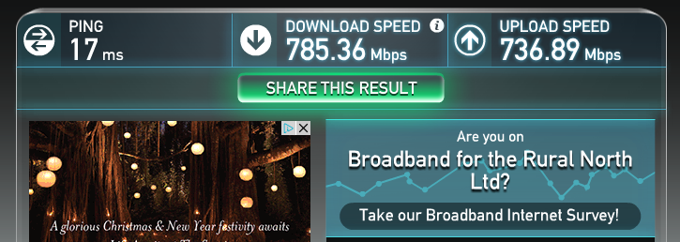
Lessons Learnt
Access circuit runs at 1Gbs, but not end kit
We have to explain that putting a bicycle on a motorway will not make it run at 70MPH!
Streaming video over wifi -?

Slide 22
Next?
Broadband ok
Streaming video ok, (15Mbs for 4K)
VoIP ok
Cellular ?
Need to deploy femtocells but operators wont support multi operator kit
Ability to teleport septic tank contents away via fibre would be welcomed by community
Still working on this one……..

Slide 23
Barry Forde
B.Forde@b4rn.org.uk
www.b4rn.org .uk

